Slide 1


26 JUNE 2024
All the things I wish
(native) Solidity would let me do

Slide 2
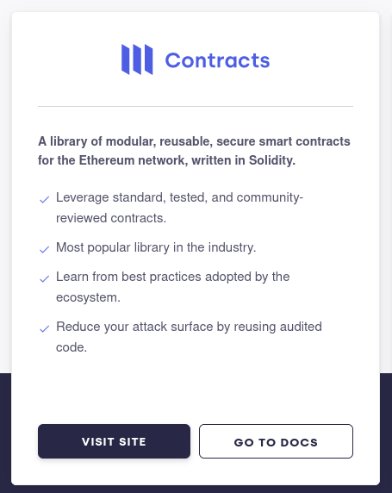
Contracts
@openzeppelin/contracts@5.5.0
@openzeppelin/contracts-upgradeable@5.5.0

Slide 3
Designed and implemented:
By solidity developers

Slide 4
Designed and implemented:
By solidity developers
For solidity developers

Slide 5
Designed and implemented:
By solidity developers
For solidity developers
In solidity

Slide 6
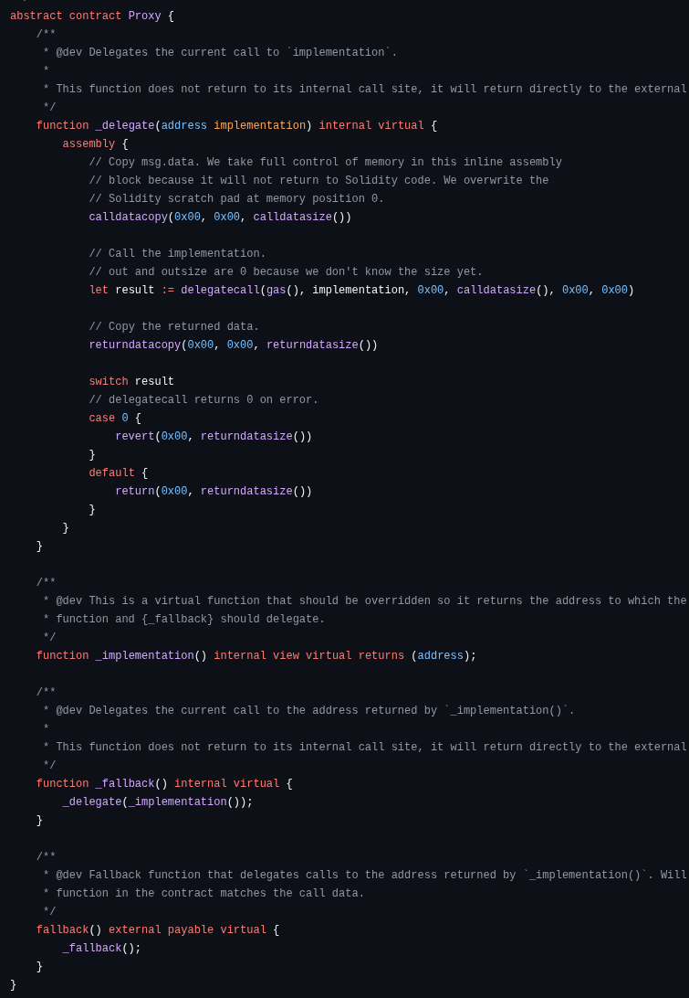
Our code is not 100% native solidity.
@openzeppelin/contracts uses ~400 assembly blocks.
These blocks allow us to leverage features of the EVM that are not (easily/cheaply) available in native solidity !
These blocks reduce the readability/auditability of the code, negatively impacting security.

Slide 7
Where do we use assembly?

Slide 8
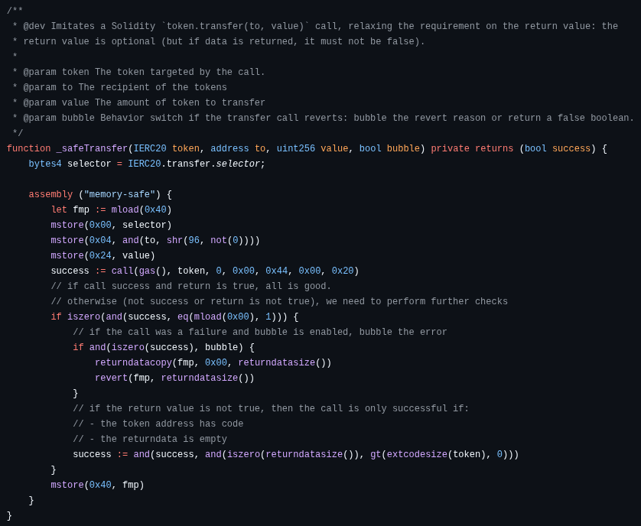
Low level calls
Basic call will bubble any revert,
Try-catch reverts if the target has no code
Low level calls “address.call(...)” require encoding the parameters, and expand the memory with results
When gas costs are critical, branches must be minimized and memory allocation must be avoided, YUL is king.

Slide 9
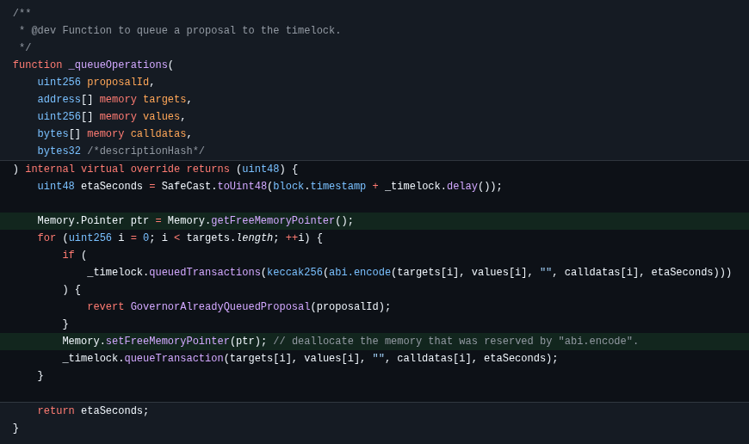
Deallocating memory
Solidity as a tendency to allocate (reserve) memory, by moving the FMP (free memory pointer).
Memory is never deallocated/cleared.
Memory expansion is expensive. Doing any king of “abi.encode” in a loop can ruin your day if you don’t deallocate stuff you don’t need.

Slide 10
Bubbling reverts
Basic calls don’t support arbitrary calldata
Low level calls provide the returndata as a “bytes memory” object
There is no native way to revert with a raw bytes reason without encapsulation in an “Error(bytes)”
Proxies require bubbling the revert in YUL.

Slide 11
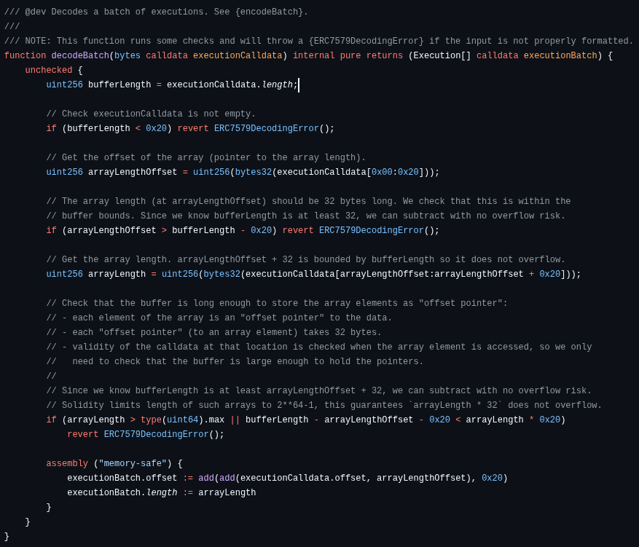
Decode calldata
A calldata object is represented using a pointer with two components (offset and length)
It would be great to be able to do an “abi.decode” that takes calldata input, and returns calldata outputs.
Mostly possible to do in solidity. Still require some YUL to create the “calldata pointer”.

Slide 12
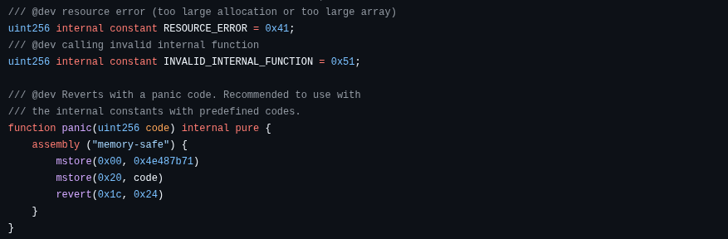
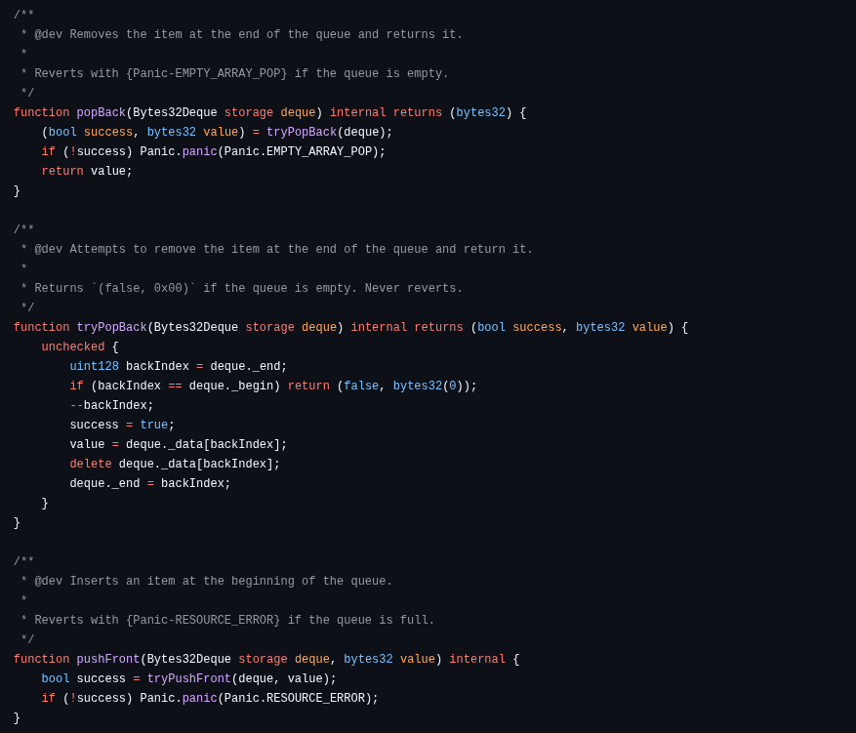
Emit panic code
Panic codes are great!
They are “universal custom error” for common/frequent errors (overflow, division by zero, array out-of-bound).
There is no native way to trigger them, which we may want to do when implementing math operations or data structures.

Slide 13
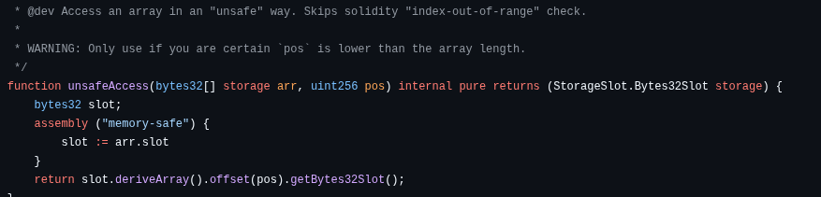
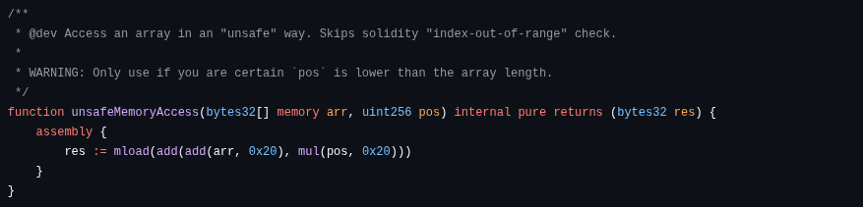
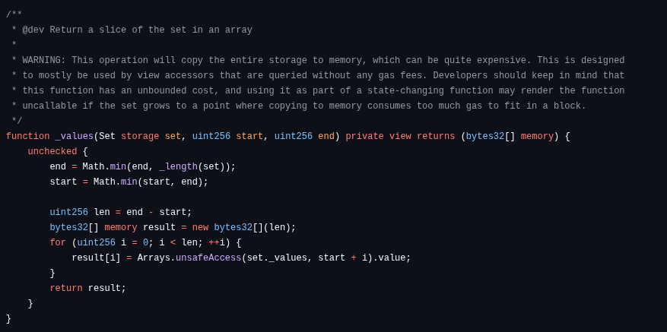
Unchecked accesses
When accessing an array element, solidity will check that the index is within bounds. That check includes a read (possibly from storage) and a branch.
In some cases we know the index is in bound.
There is no way to skip the check in order to save gas. “unchecked” does not remove this check.

Slide 14
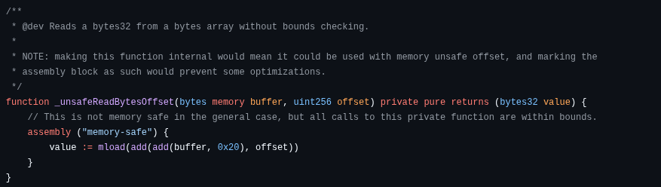
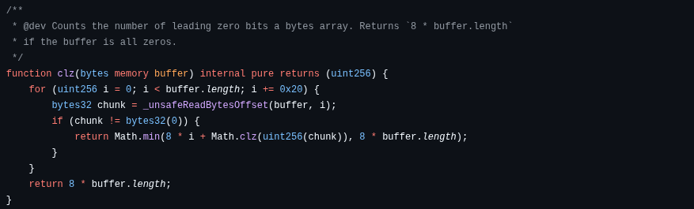
Chunks of bytes
Solidity allows you to access “bytes” and “string” object byte by byte (from memory or storage).
Accessing more than one byte is supported when reading from calldata
If you want to read more than one byte at a time, you need to do it in YUL.

Slide 15
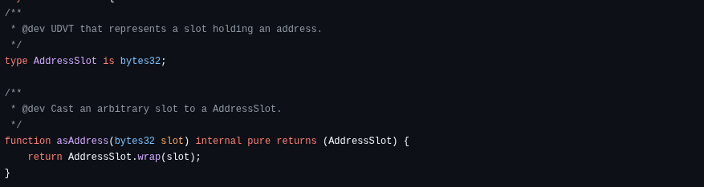
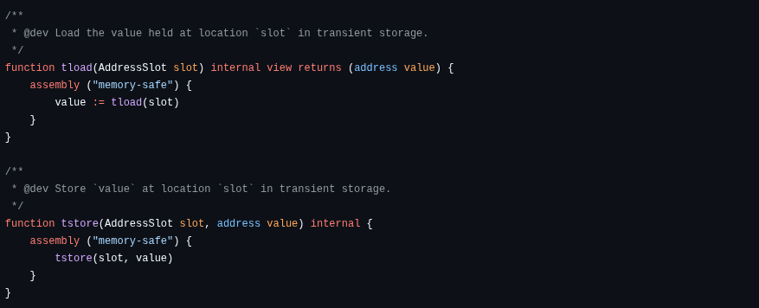
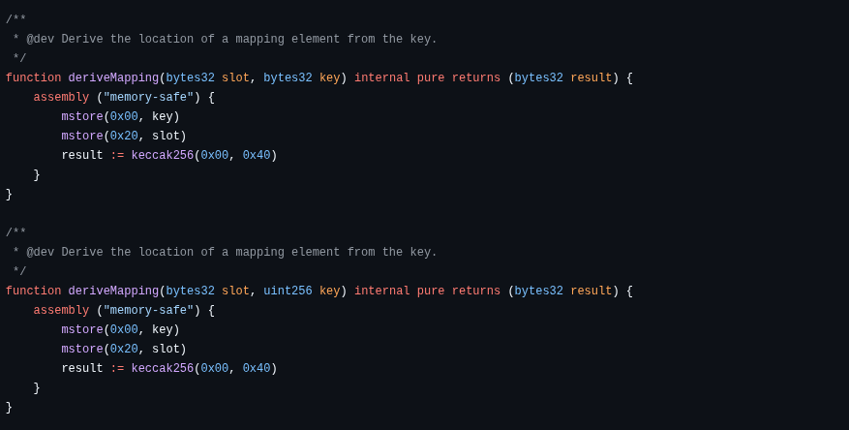
Transient structures
Since version 0.8.28, solidity supports value type transient state variable.
Non-value types (including mappings, strings, …) are NOT supported. Application such as Uniswap v4 rely on these.
Combining our SlotDerivation and TransientSlot libraries, we can implement transient mappings or array.

Slide 16

How hard would it be?
“Trivial”
“Easy”
Hard!
Panic codes
Bubble reverts
Transient structures
Calldata decode
Unchecked accesses
Chunks of bytes
Deallocate memory
Low level calls

Slide 17
Can solidity core help?
If OZ can do some of these in YUL, the solidity code “standard library” should be able to solve some of these.

Slide 18
Q&A

