Slide 1


18 NOV 2025
Solar Invictus
A new Solidity compiler

Slide 2
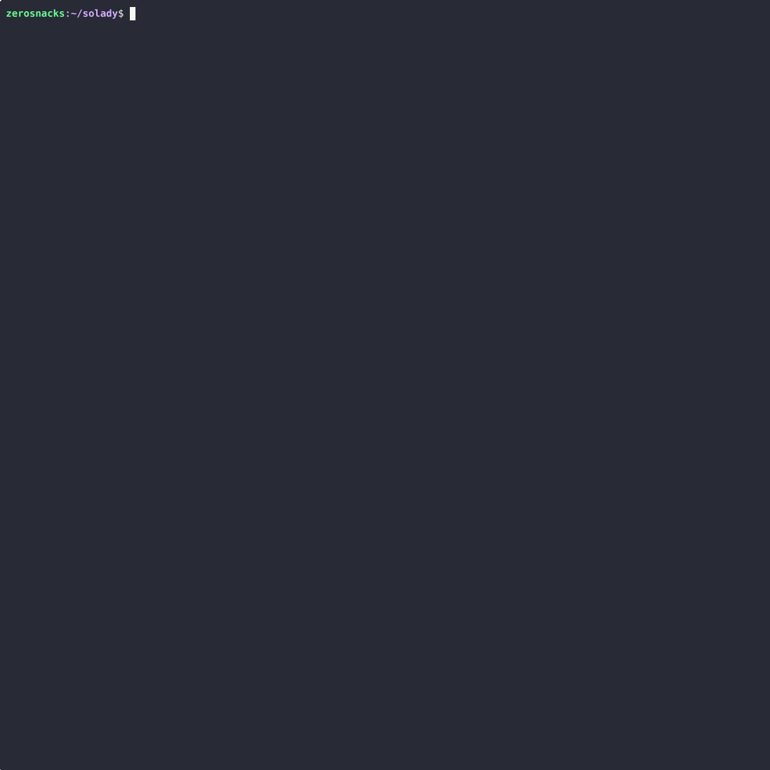

FOUNDRY
Foundry 100x’d devex
Notes:
How my journey started: slow and bad devex in the (somewhat) early days of.
Foundry came out, 100x improvement in devex compareÒd to writing slow javascript tests with hardhat
Was already learning Rust and decided to start contributing to OSS, got hired 2022 and been working since on the Paradigm OSS stack

Slide 3
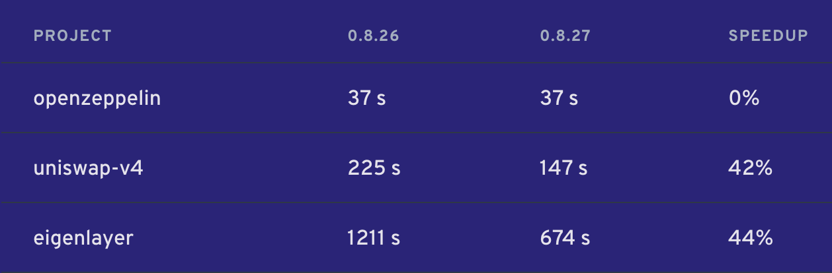

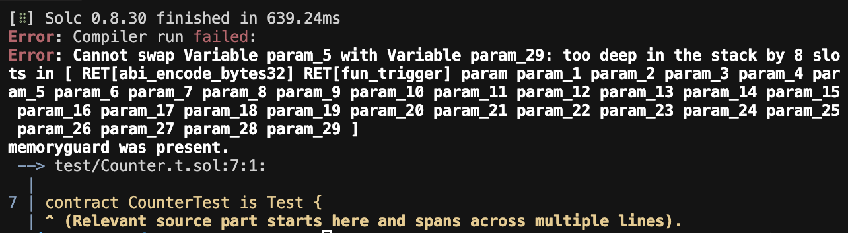
SECTION NAME
But…
Limitations of the Solidity compiler soon surfaced,
as developers started writing larger and more complex
projects using only Solidity
Notes:
Foundry was a 100x improvement, but
over time this exposedweaknesses in solc
mainly slow compile times due to more and more Solidity code being written, more complex projects requiring even more complex test suites

Slide 4
FOUNDRY
Workarounds
Smarter caching
Recompile as little as possible
Request minimum from the compiler
Dynamic linking
Notes:
However this can only get you so much, in the end you still need to compile the whole project at least once,
and changing a file still needs to go through the whole compiler pipeline to produce bytecode

Slide 5
FOUNDRY
Highlight:
dynamic test linking
up to 131x
Eliminates redundant compilation by pre-processing test contracts during the initial build
Faster building and testing

Slide 6
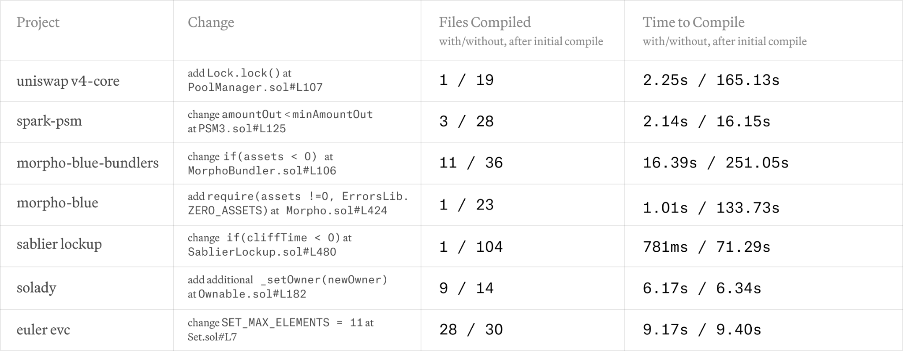
FOUNDRY

Slide 7
SOLAR
Solar
https://www.paradigm.xyz/2024/11/solar

Slide 8
SOLAR
Written from the ground up with performance in mind
Multiple IRs
Data Oriented Design
Multi-threaded-friendly structure
Possibility for incremental compilation

Slide 9
SOLAR
Ergonomic design
Single entry point (Compiler)
Multiple diagnostic formats
Multiple backends (soon)
Focus on modularity, extensibility, library usage

Slide 10
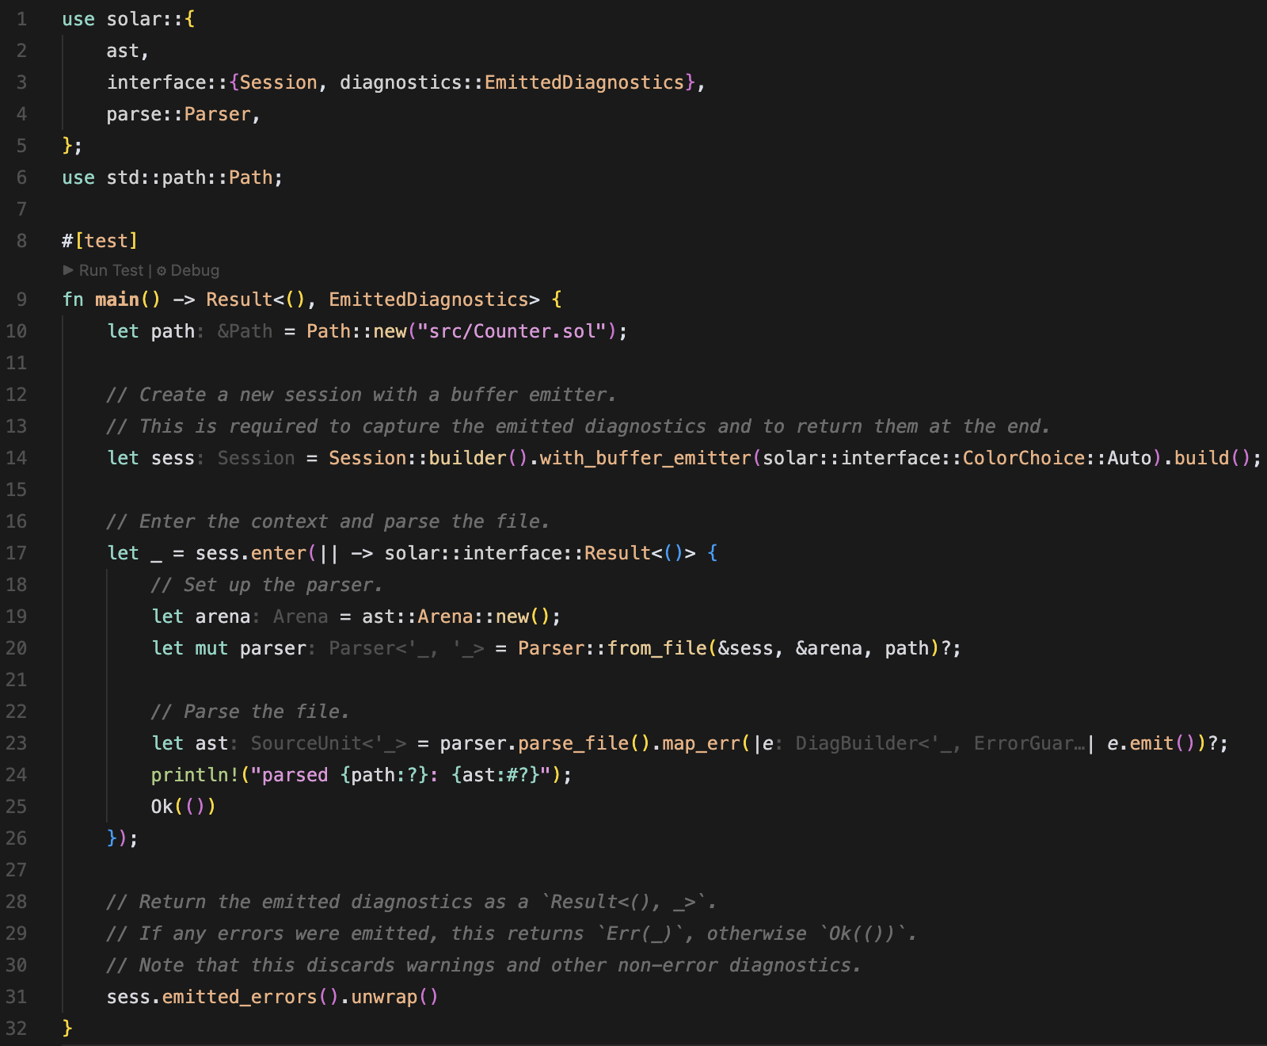
SOLAR

Slide 11
SOLAR
5x-10x parsing
Faster at single-threaded parsing; multithreaded parsing
Early benchmark results
50x ABI
Faster at emitting ABI information
??x bytecode
Faster and better bytecode than Solc (SOON)

Slide 12
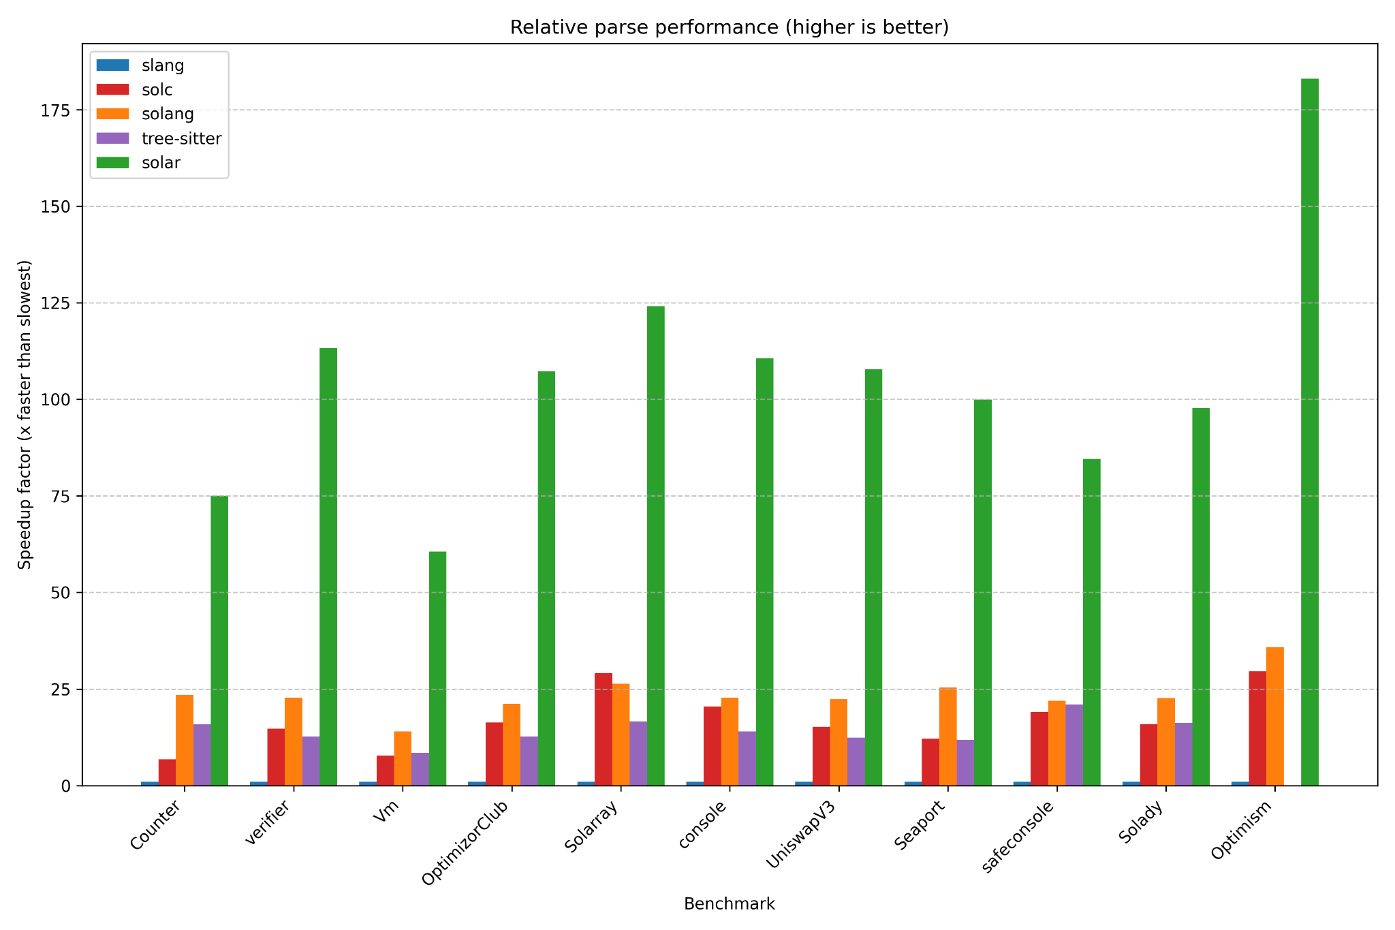
SOLAR

Slide 13
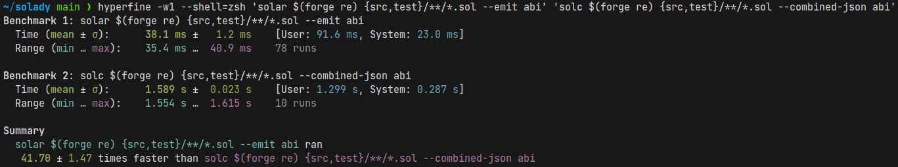
SOLAR

Slide 14
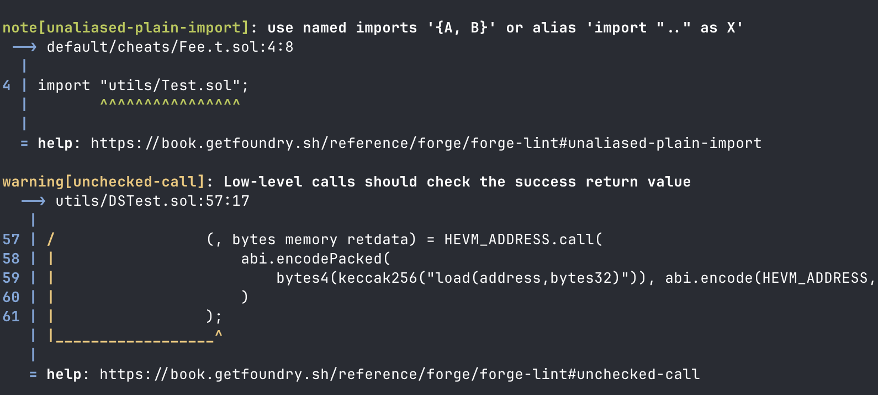
SOLAR
Forge Lint
Powerful static analysis built-in to Forge,
powered by Solar

Slide 15
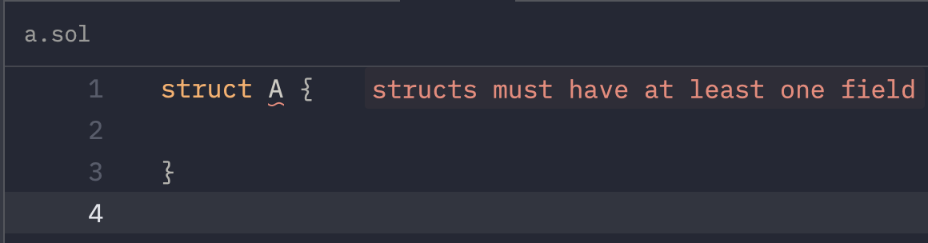
SOLAR
Solar LSP (soon)
Powering Foundry IDE extensions (soon)
Diagnostics, code actions, go to definition, etc.

Slide 16
Q&A

