Slide 1
ethdebug/format bringing modern debugging to ethereum
g. nicholas d’andrea // @gnidan
argot collective

Slide 2
debugging is hard because compilers must be smart
Especially on smart contract platforms, where bad performance costs money.
Compilers must have good optimizers, but optimizers obfuscate intent.
Debugging optimized code requires guessing from a world of multiple possibilities.

Slide 3
ethdebug makes good debugging less expensive (also possible :)
The format presents EVM code from the lens of ambiguous machine instructions.
Compilers output accurate contextual information about each instruction with various levels of precision (based on what optimization permits)
Debuggers evaluate execution and disambiguate based on observation of runtime.

Slide 4
fledgling ecosystem support

Slide 5
implementation progress
Solidity implementation is in progress, minimal experimental output since 0.8.29 (via feature flag).
Things are looking quite positive on the debugger side: Tenderly, Simbolik, and Walnut are all working on support.
Walnut is also building frameworks for evaluating compilers’ ethdebug-compliance and looking at backwards compatibility solutions for older solc.

Slide 6
design approach

Slide 7
ethdebug/format is reference-implementation forward
Debugging is hard. Debugging is still hard even with good debugging data and compiler support.
To help make implementation easier, we are implementing this format while designing it.
We’ve made a couple libraries to show debugger-side support for ethdebug, and have built a “toy compiler” for a fictional language to produce ethdebug data end-to-end.

Slide 8
Of course, reference implementations also help validate the format itself

Slide 9
demos

Slide 10
Example ethdebug program (static)

Slide 11


Slide 12
BUG demo (Minimal.bug)

Slide 13
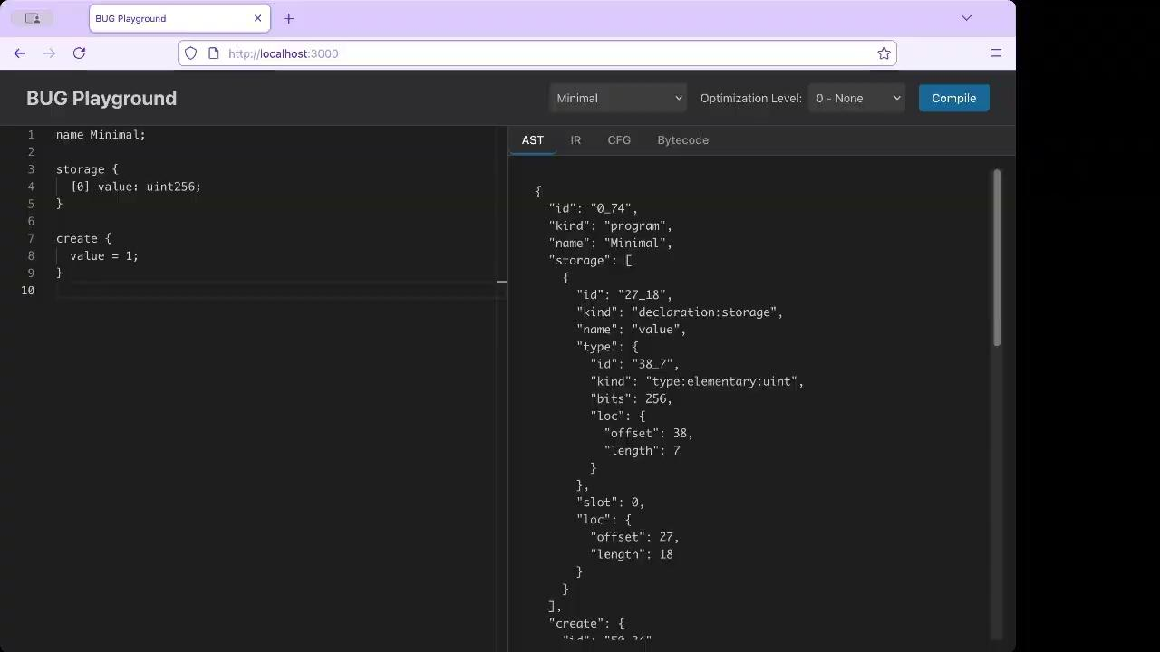

Slide 14
Common subexpression elimination
(Optimizer off demo)

Slide 15
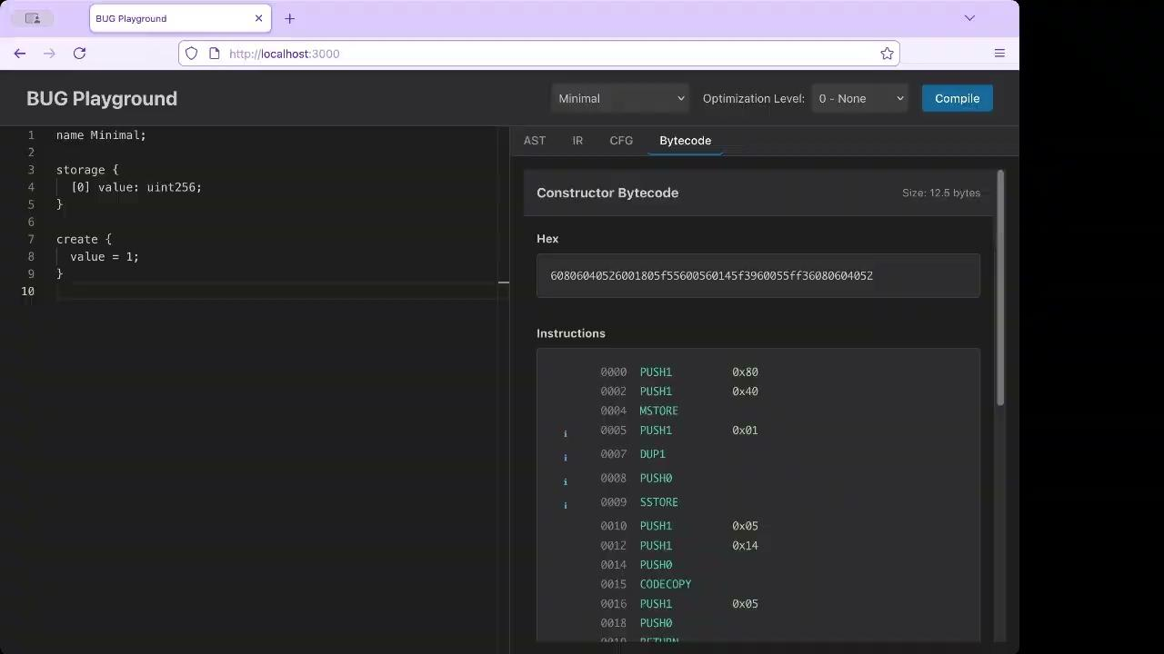

Slide 16
Common subexpression elimination
(Optimizer enabled)

Slide 17
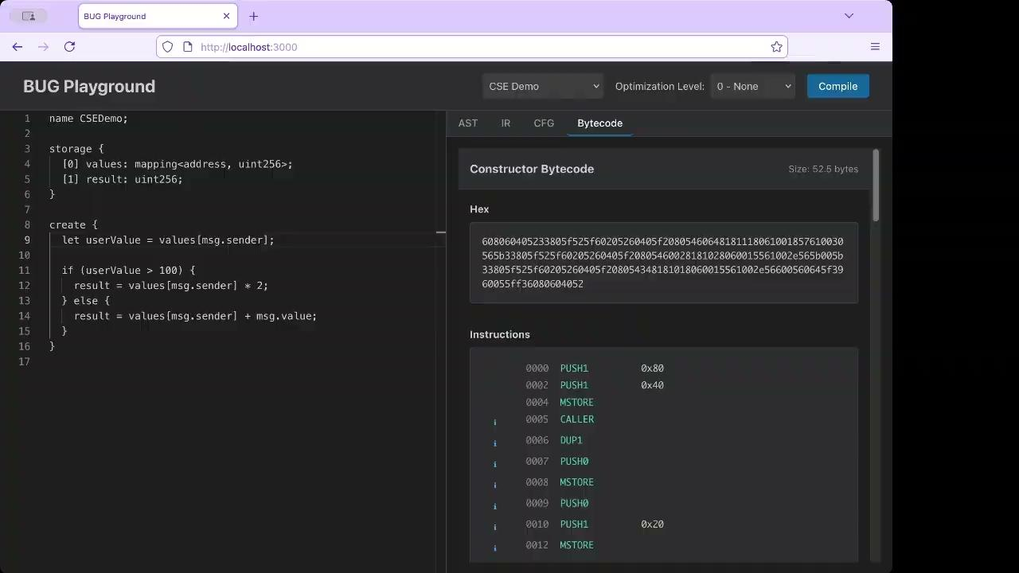

Slide 18
closing remarks

Slide 19
ethdebug/format is finally not just theoretical
Every year, I present on a “hypothetical” ethdebug format.
This year, thanks to the community, things are becoming much more concrete.
Please stay tuned for much more soon! 🙏

Slide 20
thank you!
more information:
https://ethdebug.github.io/format
https://github.com/ethdebug/format
https://github.com/ethdebug/bugc
(shoutout to https://github.com/walnuthq for github.com/walnuthq/ethdebug-stats and more)

