Slide 1
An Automatic Software Quality Measurement System

Slide 2
Overview of Project
Gain an insight into the world of software quality assurance.
A tool that measures the quality of object oriented designs expressed in UML.

Slide 3
Tasks Undertaken
Researching Software Quality in General
Researching Quality of OO Designs
  What structures affect the quality of OO Designs?
Choosing a metrics suite
Methodology for extracting metric information from UML
Implementing a tool to measure the quality of systems designed with UML

Slide 4
Why measure the quality of designs?
$100
Requirements
$500
Max
Design
$1000
Min
Coding
$3000
Testing
$5000
Acceptance Test
$8200
Operation
0
50
100
Source: Software Education Associates Ltd

Slide 5
Why measure the quality of designs?
Origins of Defects
Code
Other
10%
7%
28%
Design
55%
Requirements
Source: Software Education Associates Ltd

Slide 6
What makes a good OO Design?
No clear definition exists
Quality is a subjective and ambiguous concept
Conflicts and contradictions can occur when asking for a ‘good quality’ design

Slide 7
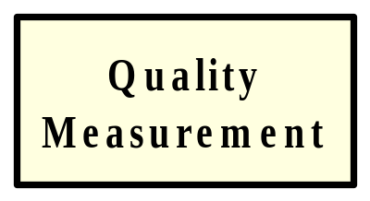
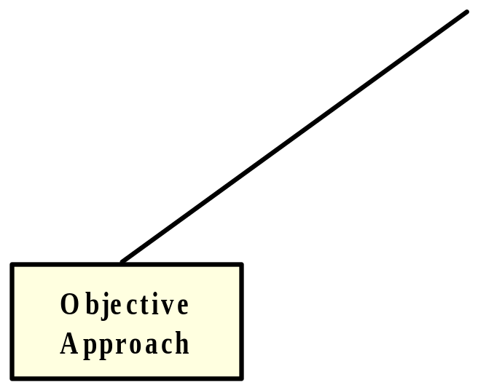
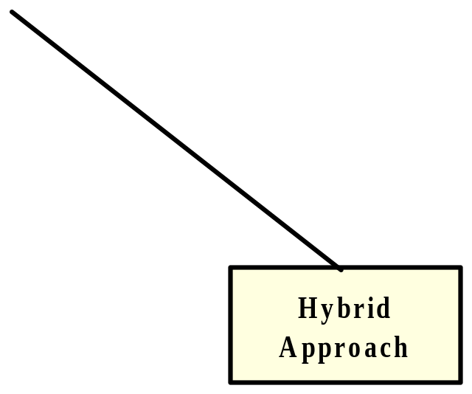
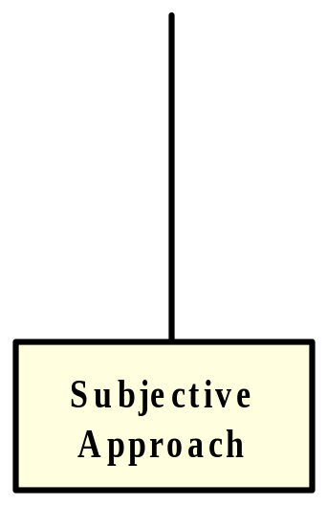
Approaches to Measuring Quality

Slide 8
Measurable Structures in OO Designs
Class
  Template from which objects are created
  The way in which classes are designed affects the overall understandability and maintainability of a system
  Reusability could also be affected

Slide 9
Measurable Structures in OO Designs
Message
  A request that one object makes to another object
  It is important to study message flows between classes in a system
  More complex message flows make for less understandable and maintainable systems

Slide 10
Measurable Structures in OO Designs
Cohesion
  The degree to which methods are related to one another and work together to provide well-bounded behavior
  High degree of cohesion indicates self-contained classes increasing efficiency
  Self-contained classes are easily reused

Slide 11
Measurable Structures in OO Designs
Coupling
  The strength of association from one entity to another
  Indicates level of efficiency (strong coupling complicates a system making it inefficient)
  Indicates level of maintainability (changes in one class won’t have a lot of ripple effect if coupling is low)
  Indicates level of reuse (classes with low coupling are easily reused)

Slide 12
Measurable Structures in OO Designs
Inheritance
  Mechanism whereby object acquires characteristics from one or more other objects
  Can by analyzed from the ‘depth’ or ‘breadth’ perspective
  Affects reusability and complexity of a system

Slide 13
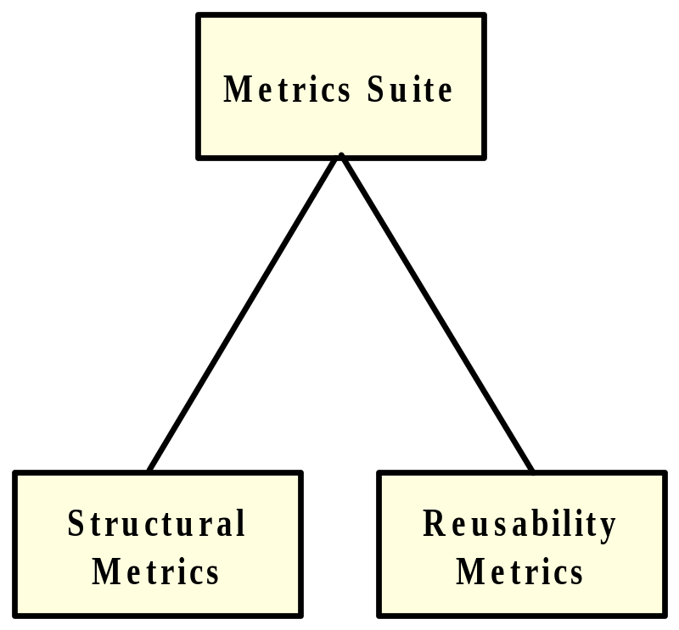
Choice of Metrics
Suite of 14 metrics
Measure each of the above structures
Separated into two groups: Structural Metrics and Reusability Metrics

Slide 14
Structural Metrics
Weighted Methods per Class (WMC)
Depth of Inheritance Tree (DIT)
Number of Children (NOC)
Coupling Between Objects (CBO)
Response for a Class (RFC)
Lack of Cohesion of Methods (LCOM)

Slide 15
Reusability Metrics
Developed by Price and Demurijan in 1997
Combine subjective and objective techniques
8 coupling-based metrics

Slide 16
Overview of the Price/Demurijan Method
Allowing designer to design system
Collecting Subjective Information from Designer
Use objective metrics on subjective data to obtain reusability readings

Slide 17
Collecting Subjective Data
General and Specific Classes
Related / Unrelated Hierarchies

Slide 18
Types of Coupling
8 Types of Coupling can Occur
Reuse Metrics are basically counts of these different types of coupling
Each type of coupling is judged to have a positive, negative or neutral influence on the reusability of a system

Slide 19
Enumeration of Coupling Types
CC1 = G→G (among related hierarchies)
CC2 = G→G (among unrelated hierarchies)
CC3 = G→S (among related hierarchies)
CC4 = G→S (among unrelated hierarchies)
CC5 = S→G (among related hierarchies)
CC6 = S→G (among unrelated hierarchies)
CC7 = S→S (among related hierarchies)
CC8 = S→S (among unrelated hierarchies)

Slide 20
Methodology
For each metric, a methodology was developed for extracting information from UML diagrams
4 UML diagrams are utilized in total:
  Class Diagrams
  Activity Diagrams
  Sequence Diagrams
  Collaboration Diagrams
2 Light-weight extensions were defined for UML in the form of stereo-types.

Slide 21
Design and Implementation of the Tool

Slide 22
Features provided by the Tool
Plugs into an existing UML editor
Collection of extra data for Metrics
Function Points calculation
Function Points-based productivity estimates
Calculation of Metrics
Provides help on specific metrics and their use

Slide 23
Features provided by the Tool (Cont)
Maintains a repository of results on different projects
Provides graphs for easier interpretation of Metric Results
Detailed help system describing how graphs could be interpreted.

Slide 24
Design Decisions
The architecture of the system should make it easier for new metrics to be added at a later stage if needed
Both quality-related data and the metrics repository will be saved in XML format.

Slide 25
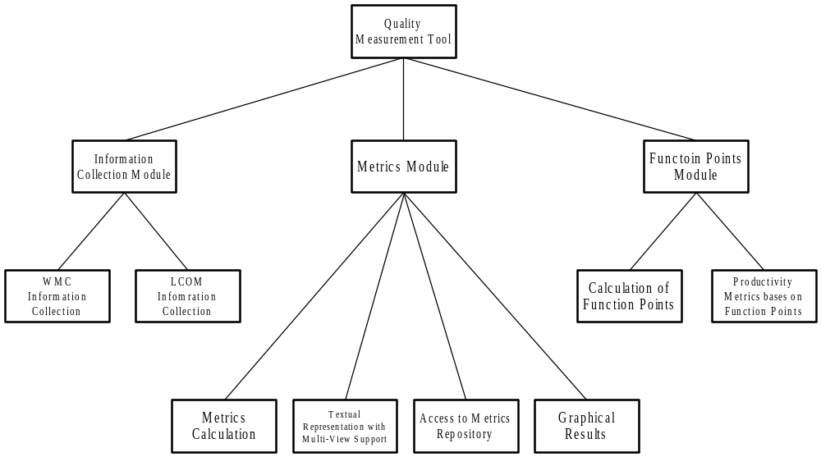
An Quick Overview of System Modules

Slide 26
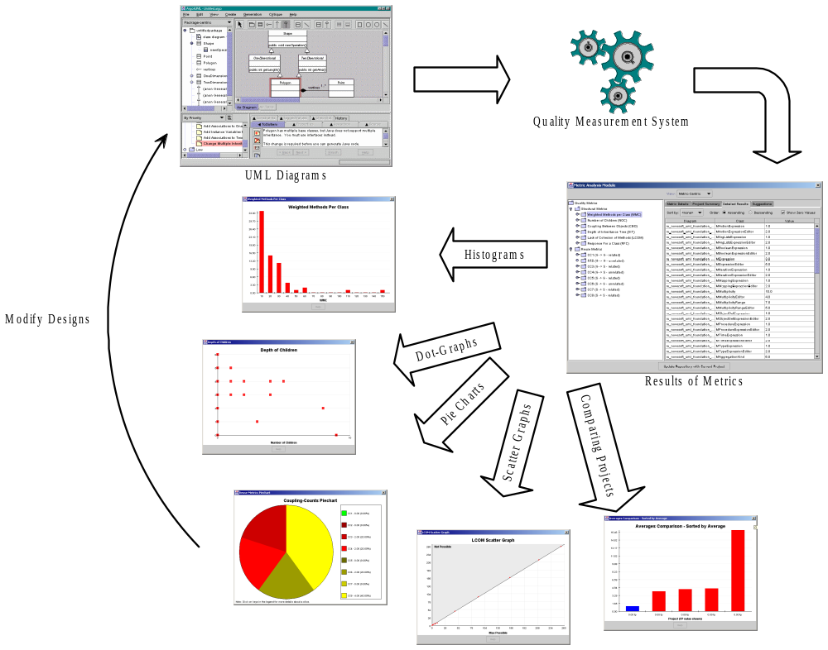

Slide 27
Program Demonstration

