Slide 1
Electricity Grid Congestion Manager
Project owner: Kristjan Eljand (Eesti Energia)
Team P20
Artem Grukhal, Bohdan Romashchenko, Jatan Shrestha

Slide 2
Problem
Rise of popularity of electric vehicles (EVs) causes additional electricity consumption and hence, load on electricity grids.
To avoid huge investments in improving the grids, a smart EV charging system could be developed.

Slide 3
Tasks
Prepare the datasets for analysis.
Develop a prediction model that forecasts the grid load in specific location based on EV charging statistics.
Develop a model for smart charging – a model that divides the electricity consumption of EVs such that the limits of the grid won’t be exceeded and all of the EV owners receive the similar experience.
Develop a graphical user interface (GUI) with following functionality:
Selecting a time of day (hour) and location as an input and shows grid load forecast.
Showing the optimized charging schedule if there is a threat of grid congestion.

Slide 4
Data
Provided data is separated into multiple files:
Chargers’ locations
Grids’ locations and max power
Grids’ baseload for each hour of the day
EVs’ descriptions
EVs’ home locations
EVs’ charging/moving history
Developed datasets:
Grid-chargers based on haversine distance
Grid loads for each hour of the day (base, max, actual)
Charger statistics for each hour of the day (car model, charge need)

Slide 5
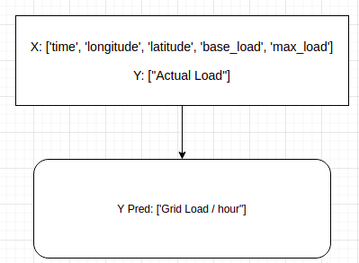
Predicting grid load
With such set of features only Ensemble Learning models make sense
GradientBoostingRegressor: Accuracy 96.46%
RandomForestRegressor: Accuracy: 94.74%
X : [time, latitude, longitude, base load, max load]
Y : actual load

Slide 6
Smart charging
Get all the chargers that load some certain overloaded grid
Predict the charge need on each one of them
Decrease the output until the conditions are satisfied

Slide 7
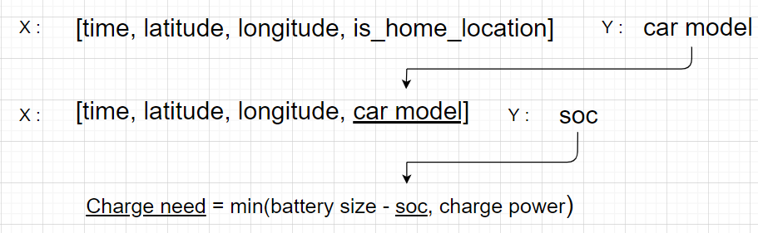
Predicting charge need
Classify car model connected to the charger
Predict its state of charge (accuracy is higher than predicting charge need directly)
Calculate charge need

Slide 8
Predicting charge need
Ensemble Methods- Random forests, Gradient Boosting, Histogram-based Gradient Boosting
Accuracy of both models within 70-80%, final charge need accuracy is about 60-70%
Definitely can be improved with more data

Slide 9
Smart charging algorithm
total = sum of charge predictions
decrease_rate = 0.1
if base_load >= max_load:
set all outputs to 0
return
while base_load + total > max_load:
for each charger (c) in chargers:
c[optimized] = c[need] * (1.0 - decrease_rate)
total = sum of optimized charges
decrease_rate += 0.1
If base load is higher than max load, output on the chargers is set to 0 kW
Otherwise, decrease the output of the chargers by the same percentage until estimated load is higher than max load of the grid.

Slide 10
Lessons
Having enough data is quite important for good performance
Data Preprocessing & Analysis could be the hardest part

Slide 11
DEMO TIME

Slide 12
Links
Github repo
Colab

Slide 13

Thank You

