Slide 1
Argus Authorization Service
Security Training
Valery Tschopp (SWITCH)
Argus PT

Slide 2
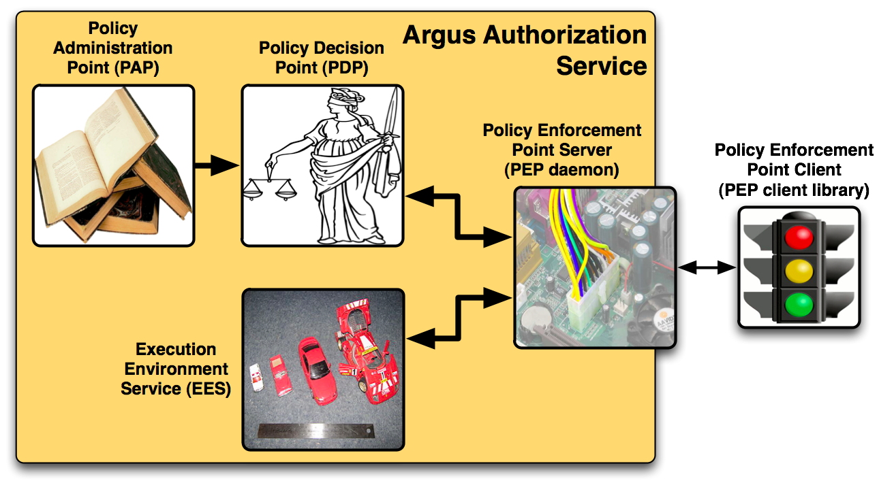
Argus Authorization Service
Renders authorization decisions based on XACML policies:
  Can user X perform action Y on resource Z ?
  Ban user by DN, FQAN, issuing CA, … !
PAP: manages and publishes the authorization policies
PDP: evaluates the authorization requests
EES: resolves the user execution environment e.g. UID, GID, pool account, …
PEP daemon: processes the PEP thin client requests
17/09/2010
Security Training, EGI Technical Forum 2010, Amsterdam

Slide 3
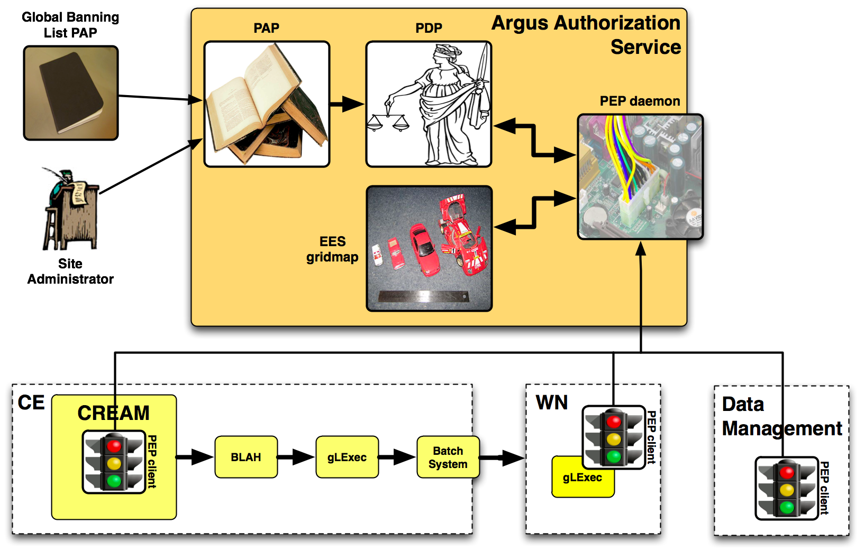
Argus Deployment
Argus as a site service to manage consistent authorization policy based decisions
17/09/2010
Security Training, EGI Technical Forum 2010, Amsterdam

Slide 4
Argus Operation
Open ports (firewall):
  PAP: 8150 (pap-admin, policies publishing)
  PEP daemon: 8154 (PEP client connections)
Log and audit files:
  /opt/argus/(pap|pdp|pepd)/logs
Init scripts:
  /etc/init.d/pap-standalone {start|stop|status}
  /etc/init.d/pdp {start|stop|status|reloadpolicy}
  /etc/init.d/pepd {start|stop|status|clearcache}
Nagios plugins available to monitor the PAP, PDP and PEP daemon
17/09/2010
Security Training, EGI Technical Forum 2010, Amsterdam

Slide 5
Authorization Decisions
Argus is designed to answer the question:
  Can user X perform action Y on resource Z?
Permit Decisions
  Allow to authorize users to perform an action on a resource
Deny Decisions
  Allow to ban users
Both can be express with XACML policies
17/09/2010
Security Training, EGI Technical Forum 2010, Amsterdam

Slide 6
XACML Policy
<xacml:PolicySet xmlns:xacml="urn:oasis:names:tc:xacml:2.0:policy:schema:os" PolicyCombiningAlgId="urn:oasis:names:tc:xacml:1.0:policy-combining-algorithm:first-applicable" PolicySetId="9784d9ce-16a9-41b9-9d26-b81a97f93616" Version="1">
<xacml:Target>
<xacml:Resources>
<xacml:Resource>
<xacml:ResourceMatch MatchId="urn:oasis:names:tc:xacml:1.0:function:string-regexp-match">
<xacml:AttributeValue DataType="http://www.w3.org/2001/XMLSchema#string">.*</xacml:AttributeValue>
<xacml:ResourceAttributeDesignator AttributeId="urn:oasis:names:tc:xacml:1.0:resource:resource-id" DataType="http://www.w3.org/2001/XMLSchema#string" MustBePresent="false"/>
</xacml:ResourceMatch>
</xacml:Resource>
</xacml:Resources>
</xacml:Target>
<xacml:PolicyIdReference>public_2d8346b8-5cd2-44ad-9ad1-0eff5d8a6ef1</xacml:PolicyIdReference>
</xacml:PolicySet>
<xacml:Policy xmlns:xacml="urn:oasis:names:tc:xacml:2.0:policy:schema:os" PolicyId="public_2d8346b8-5cd2-44ad-9ad1-0eff5d8a6ef1" RuleCombiningAlgId="urn:oasis:names:tc:xacml:1.0:rule-combining-algorithm:first-applicable" Version="1">
<xacml:Target>
<xacml:Actions>
<xacml:Action>
<xacml:ActionMatch MatchId="urn:oasis:names:tc:xacml:1.0:function:string-regexp-match">
<xacml:AttributeValue DataType="http://www.w3.org/2001/XMLSchema#string">.*</xacml:AttributeValue>
<xacml:ActionAttributeDesignator AttributeId="urn:oasis:names:tc:xacml:1.0:action:action-id" DataType="http://www.w3.org/2001/XMLSchema#string" MustBePresent="false"/>
</xacml:ActionMatch>
</xacml:Action>
</xacml:Actions>
</xacml:Target>
<xacml:Rule Effect="Deny" RuleId="43c15124-6635-47ee-b13c-53f672d0de77">
...
17/09/2010
Security Training, EGI Technical Forum 2010, Amsterdam

Slide 7
XACML Policy (cont.)
Problem?
  Not easy to understand
  Not easy to read or write
Solution
  Hide the XACML language complexity
  Introduce a Simplified Policy Language (SPL)
  Provide tools to manage the policies
    pap-admin to create, edit, delete permit/deny policy rules
17/09/2010
Security Training, EGI Technical Forum 2010, Amsterdam

Slide 8
Simplified Policy Language (SPL)
Permit Atlas users (FQAN) to execute a job on a worker node (WN):
  resource "http://grid.switch.ch/wn" {
  action "http://glite.org/xacml/action/execute" {
  rule permit { fqan="/atlas" }
  }
  }
Ban a particular user by DN:
  resource ".*" {
  action ".*" {
  rule deny {
  subject="/C=CH/O=SWITCH/CN=Valery Tschopp" }
  }
  }
17/09/2010
Security Training, EGI Technical Forum 2010, Amsterdam

Slide 9
pap-admin Command Line Tool
List active policies:
  pap-admin list-policies
Import policies, in SPL format, from a file:
  pap-admin add-policies-from-file my-policies.spl
Easily ban/un-ban VOs, users:
  pap-admin ban vo testVO
  pap-admin un-ban vo testVO
Add a generic policy:
  pap-admin add-policy --resource "ce_1" --action ".*" permit
  pfqan="/testVO/Role=pilot"
17/09/2010
Security Training, EGI Technical Forum 2010, Amsterdam

Slide 10
Documentations & Contact
Argus Documentation:
  https://twiki.cern.ch/twiki/bin/view/EGEE/AuthorizationFramework
Simplified Policy Language:
  https://twiki.cern.ch/twiki/bin/view/EGEE/SimplifiedPolicyLanguage
PAP admin CLI:
  https://twiki.cern.ch/twiki/bin/view/EGEE/AuthZPAPCLI
Contact: argus-support@cern.ch
17/09/2010
Security Training, EGI Technical Forum 2010, Amsterdam

Slide 11
Questions?
17/09/2010
Security Training, EGI Technical Forum 2010, Amsterdam

