Slide 1


Argus
The EMI Authorization Service
Valery Tschopp (SWITCH)
Argus Product Team

Slide 2
Outline
Argus Authorization Service
Service Deployment
Authorization Policies
Simplified Policy Language
pap-admin Tool
Pilot Jobs Authorization
Argus 1.3 EMI-1 Release
Conclusions
12/04/2011
Argus Authorization Service, EGI User Forum 2011, Vilnius

Slide 3
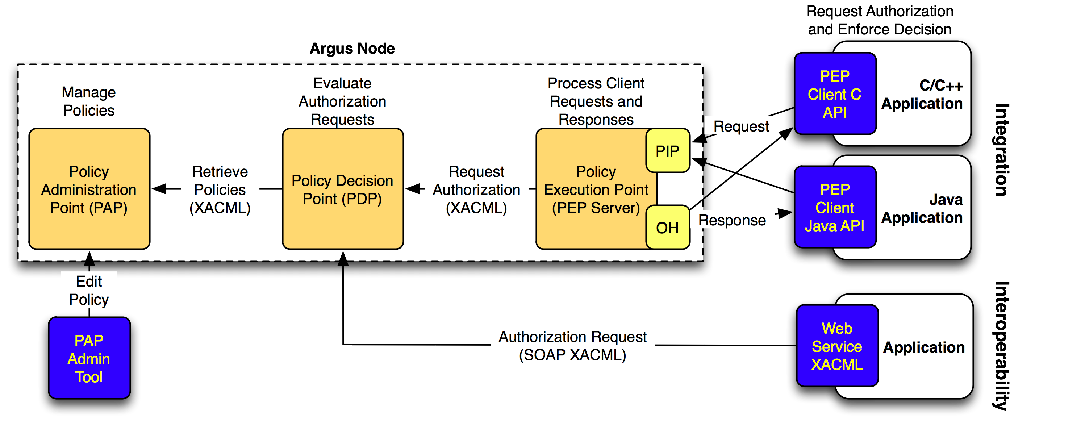
Argus Authorization Service
Renders consistent authorization decisions based on XACML policies
  Can user X perform action Y on resource Z?
  Ban user by DN, FQAN, issuing CA, … !
12/04/2011
Argus Authorization Service, EGI User Forum 2011, Vilnius

Slide 4
Argus Authorization Service (cont.)
Argus PAP: Policy Administration Point
  Provides site administrators with the tools for authoring policies (pap-admin)
  Stores and manages authored XACML policies
  Provides managed authorization policies to other authorization service components (other PAPs or PDP)
12/04/2011
Argus Authorization Service, EGI User Forum 2011, Vilnius

Slide 5
Argus Authorization Service (cont.)
Argus PDP: Policy Decision Point
  Policy evaluation engine
  Receives authorization requests from the PEP
  Evaluates the authorization requests against the XACML policies retrieved from the PAP
  Renders the authorization decision
12/04/2011
Argus Authorization Service, EGI User Forum 2011, Vilnius

Slide 6
Argus Authorization Service (cont.)
Argus PEP: Policy Execution Point
  Client/Server architecture
  Lightweight PEP client libraries (C and Java)
  PEP Server receives the authorization requests from the PEP clients
  Applies additional filters to the requests (PIP)
  Asks the PDP to render an authorization decision
  Applies the obligation handler (OH) to determine the user mapping
12/04/2011
Argus Authorization Service, EGI User Forum 2011, Vilnius

Slide 7
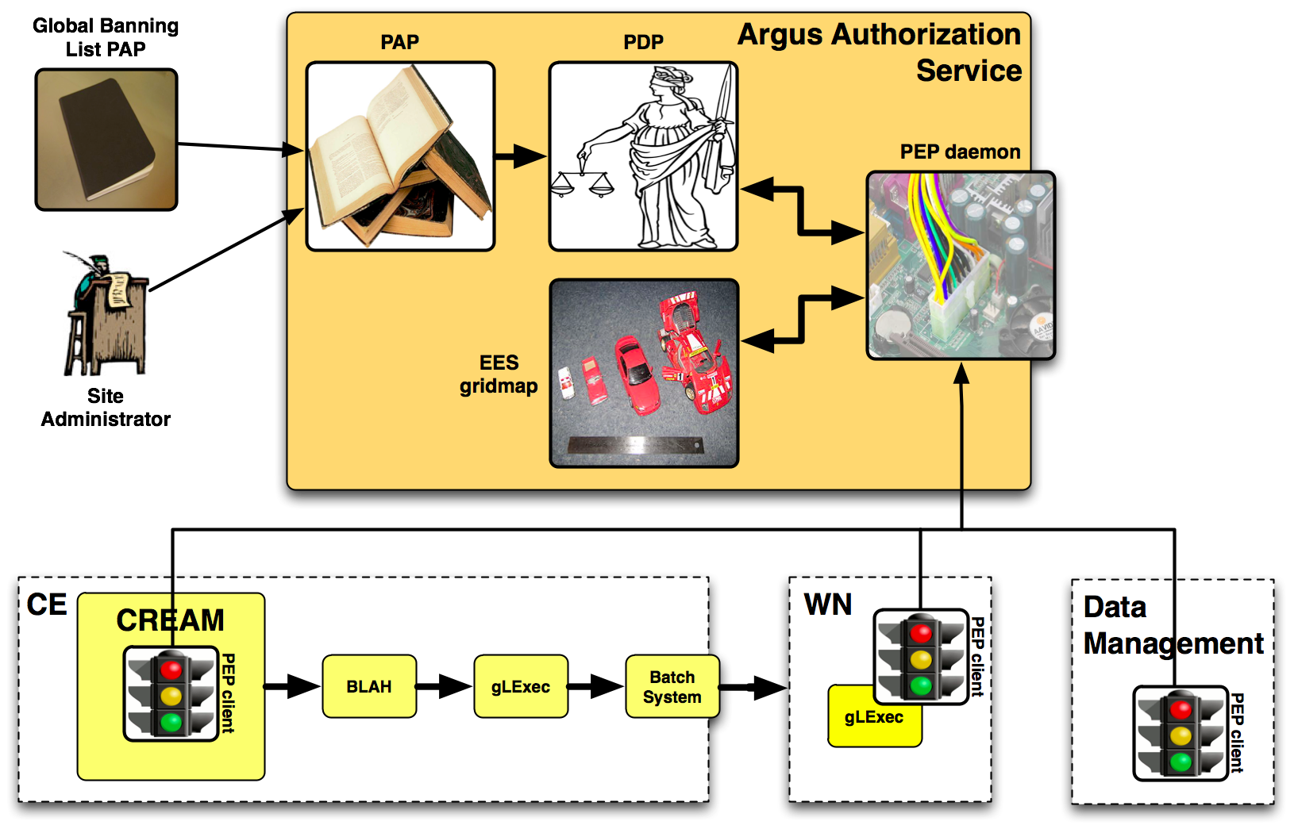
Service Deployment
Argus as a service to manage consistent authorization policy based decisions
12/04/2011
Argus Authorization Service, EGI User Forum 2011, Vilnius

Slide 8
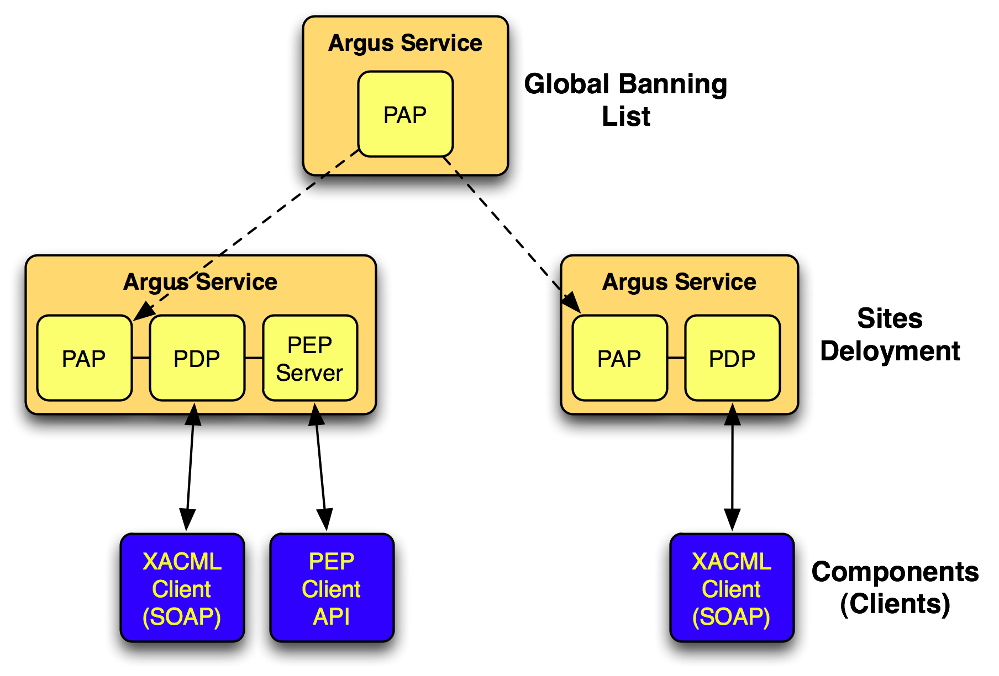
Service Deployment (cont.)
Hierarchical distribution of policies
12/04/2011
Argus Authorization Service, EGI User Forum 2011, Vilnius

Slide 9
Service Deployment (cont.)
Global banning list (EGI, NGI, …)
Local site authorization policies
Experiment specific policies
12/04/2011
Argus Authorization Service, EGI User Forum 2011, Vilnius

Slide 10
Argus Service Operations
Open ports (firewall):
  PAP: 8150 (pap-admin, policies distribution)
  PEP Server: 8154 (PEP client connections)
Log and audit files:
  /var/log/argus/(pap|pdp|pepd)
Init scripts:
  /etc/init.d/argus-pap {start|stop|status}
  /etc/init.d/argus-pdp {start|stop|status|reloadpolicy}
  /etc/init.d/argus-pepd {start|stop|status|clearcache}
Nagios plugins available to monitor the service
12/04/2011
Argus Authorization Service, EGI User Forum 2011, Vilnius

Slide 11
Authorization Policies
Argus is designed to answer the questions:
  Can user X perform action Y on resource Z?
  Is user X banned?
PERMIT decision
  Allow to authorize users to perform an action on a resource
DENY decision
  Allow to ban users
Both can be expressed with XACML policies
12/04/2011
Argus Authorization Service, EGI User Forum 2011, Vilnius

Slide 12
Authorization Policies (cont.)
XACML policies !?!
<xacml:PolicySet xmlns:xacml="urn:oasis:names:tc:xacml:2.0:policy:schema:os”PolicyCombiningAlgId="urn:oasis:names:tc:xacml:1.0:policy-combining-algorithm:first-applicable" PolicySetId="9784d9ce-16a9-41b9-9d26-b81a97f93616" Version="1">
<xacml:Target>
<xacml:Resources>
<xacml:Resource>
<xacml:ResourceMatch MatchId="urn:oasis:names:tc:xacml:1.0:function:string-regexp-match">
<xacml:AttributeValue DataType="http://www.w3.org/2001/XMLSchema#string">.*</xacml:AttributeValue>
<xacml:ResourceAttributeDesignator AttributeId="urn:oasis:names:tc:xacml:1.0:resource:resource-id" DataType="http://www.w3.org/2001/XMLSchema#string" MustBePresent="false"/>
</xacml:ResourceMatch>
</xacml:Resource>
</xacml:Resources>
</xacml:Target>
<xacml:PolicyIdReference>public_2d8346b8-5cd2-44ad-9ad1-0eff5d8a6ef1</xacml:PolicyIdReference>
</xacml:PolicySet>
<xacml:Policy xmlns:xacml="urn:oasis:names:tc:xacml:2.0:policy:schema:os” PolicyId="public_2d8346b8-5cd2-44ad-9ad1-0eff5d8a6ef1”
RuleCombiningAlgId="urn:oasis:names:tc:xacml:1.0:rule-combining-algorithm:first-applicable" Version="1">
<xacml:Target>
<xacml:Actions>
<xacml:Action>
<xacml:ActionMatch MatchId="urn:oasis:names:tc:xacml:1.0:function:string-regexp-match">
<xacml:AttributeValue DataType="http://www.w3.org/2001/XMLSchema#string">.*</xacml:AttributeValue>
<xacml:ActionAttributeDesignator AttributeId="urn:oasis:names:tc:xacml:1.0:action:action-id" DataType="http://www.w3.org/2001/XMLSchema#string" MustBePresent="false"/>
</xacml:ActionMatch>
</xacml:Action>
</xacml:Actions>
</xacml:Target>
<xacml:Rule Effect="Deny" RuleId="43c15124-6635-47ee-b13c-53f672d0de77">
...
12/04/2011
Argus Authorization Service, EGI User Forum 2011, Vilnius

Slide 13
Authorization Policies (cont.)
Problem?
  XACML not easy to read and/or understand
  XACML not easy to write, prone to error
Solution
  Hide the XACML language complexity
  Introduce a Simplified Policy Language (SPL)
  Provide administrators with simple tool to manage the policies
    pap-admin to create, edit, delete permit/deny policy rules
12/04/2011
Argus Authorization Service, EGI User Forum 2011, Vilnius

Slide 14
Simplified Policy Language
Ban a particular user by DN
  resource ".*" {
  action ".*" {
  rule deny {
  subject="/C=CH/O=SWITCH/CN=Valery Tschopp" }
  }
  }
Permit ATLAS users (FQAN) to execute a job on a worker node (WN)
  resource "http://grid.switch.ch/wn" {
  action "http://glite.org/xacml/action/execute" {
  rule permit { fqan="/atlas" }
  }
  }
12/04/2011
Argus Authorization Service, EGI User Forum 2011, Vilnius

Slide 15
pap-admin Tool
Administrator’s tool to manage the PAP
  Policies management
  PAP server management
  PAP authorization management
Simple way to ban user
Simple way to create, edit and delete authorization policies
12/04/2011
Argus Authorization Service, EGI User Forum 2011, Vilnius

Slide 16
pap-admin Tool (cont.)
Create authorization policies
  Permit a user by distinguished name (DN)
$ pap-admin add-policy
--resource “http://grid.switch.ch/wn”
--action “http://glite.org/xacml/action/execute”
permit subject="CN=Valery Tschopp,O=SWITCH,C=ch”
  Permit users by primary FQAN
$ pap-admin ap
--resource “http://grid.switch.ch/wn”
--action “http://glite.org/xacml/action/execute”
permit pfqan=”/atlas”
  Ban a user for any action and resource
$ pap-admin ban subject "CN=John Doe,O=ACME,C=org”
12/04/2011
Argus Authorization Service, EGI User Forum 2011, Vilnius

Slide 17
pap-admin Tool (cont.)
Listing existing authorization policies
$ pap-admin lp
Enter the passphrase for the private key /home/tschopp/.globus/userkey.pem:
default (local):
resource ”.*" {
action ”.*" {
rule deny { subject="CN=John Doe,O=ACME,C=org” }
}
}
resource ”http://grid.switch.ch/atlas-cluster" {
obligation "http://glite.org/xacml/obligation/local-environment-map" { }
action ”http://glite.org/xacml/action/execute" {
rule permit { pfqan="/atlas" }
rule permit {
subject="CN=Valery Tschopp,O=SWITCH,C=ch”
}
}
}
…
12/04/2011
Argus Authorization Service, EGI User Forum 2011, Vilnius

Slide 18
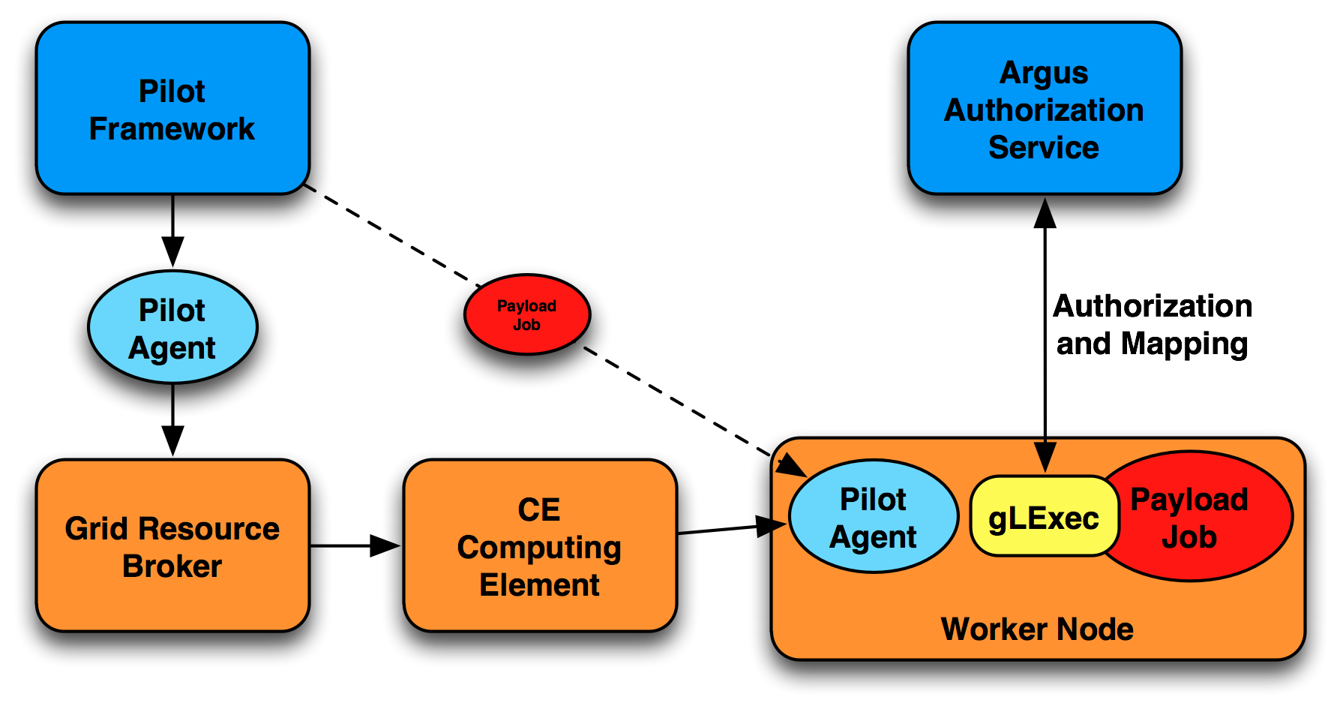
Pilot Jobs Authorization
Payload is downloaded on the WN
gLExec runs it under the end-user identity
12/04/2011
Argus Authorization Service, EGI User Forum 2011, Vilnius

Slide 19
Pilot Job Authorization (cont.)
Pilot Job Policy
resource ”http://grid.switch.ch/wn" {
obligation "http://glite.org/xacml/obligation/local-environment-map" { }
action ”http://glite.org/xacml/action/execute" {
rule permit {
pfqan="/atlas/Role=pilot"
}
rule permit {
fqan=”/atlas/analysis”
}
}
}
12/04/2011
Argus Authorization Service, EGI User Forum 2011, Vilnius

Slide 20
Argus 1.3 EMI-1 Release
Argus 1.3
  Compatible with gLite 3.2 Argus PEP client libraries (C and Java)
  Support for LFC/DPM banning engine
  Bug fixes
Will be released for EMI-1 (end April)
Is it a problem for gLite 3.2 site ?
  Install the Argus 1.3 EMI-1 service (standalone)
  Keep the existing gLite 3.2 applications
12/04/2011
Argus Authorization Service, EGI User Forum 2011, Vilnius

Slide 21
Conclusions
Global banning list policies
Site specific authorization policies
Experiment specific authorization policies
Consistent authorization decisions across the whole middleware stack (CE, WN, …)
Pilot Jobs authorization and mapping
Simple tool to manage authorization
12/04/2011
Argus Authorization Service, EGI User Forum 2011, Vilnius

Slide 22
Documentation
General documentation
https://twiki.cern.ch/twiki/bin/view/EGEE/AuthorizationFramework
Service Reference Card
https://twiki.cern.ch/twiki/bin/view/EMI/ArgusSRC
PAP admin CLIhttps://twiki.cern.ch/twiki/bin/view/EGEE/AuthZPAPCLI
Simplified Policy Language https://twiki.cern.ch/twiki/bin/view/EGEE/SimplifiedPolicyLanguage
12/04/2011
Argus Authorization Service, EGI User Forum 2011, Vilnius

Slide 23
Support
GGUS Tickets (ARGUS Support Unit)
  https://gus.fzk.de
Support mailing list (e-group):
  argus-support@cern.ch
12/04/2011
Argus Authorization Service, EGI User Forum 2011, Vilnius

Slide 24
Thank you
EMI is partially funded by the European Commission under Grant Agreement INFSO-RI-261611
12/04/2011
Argus Authorization Service, EGI User Forum 2011, Vilnius

