Slide 1


Argus
EMI Authorization Integration
Valery Tschopp (SWITCH)
Argus Product Team

Slide 2
Outline
Argus Authorization Service
Common XACML Authorization Profile
EMI Authorization Integration
Service Deployment
Argus Releases
Conclusions
31/05/2011
Argus, EMI All Hands Meeting 2011, Lund

Slide 3
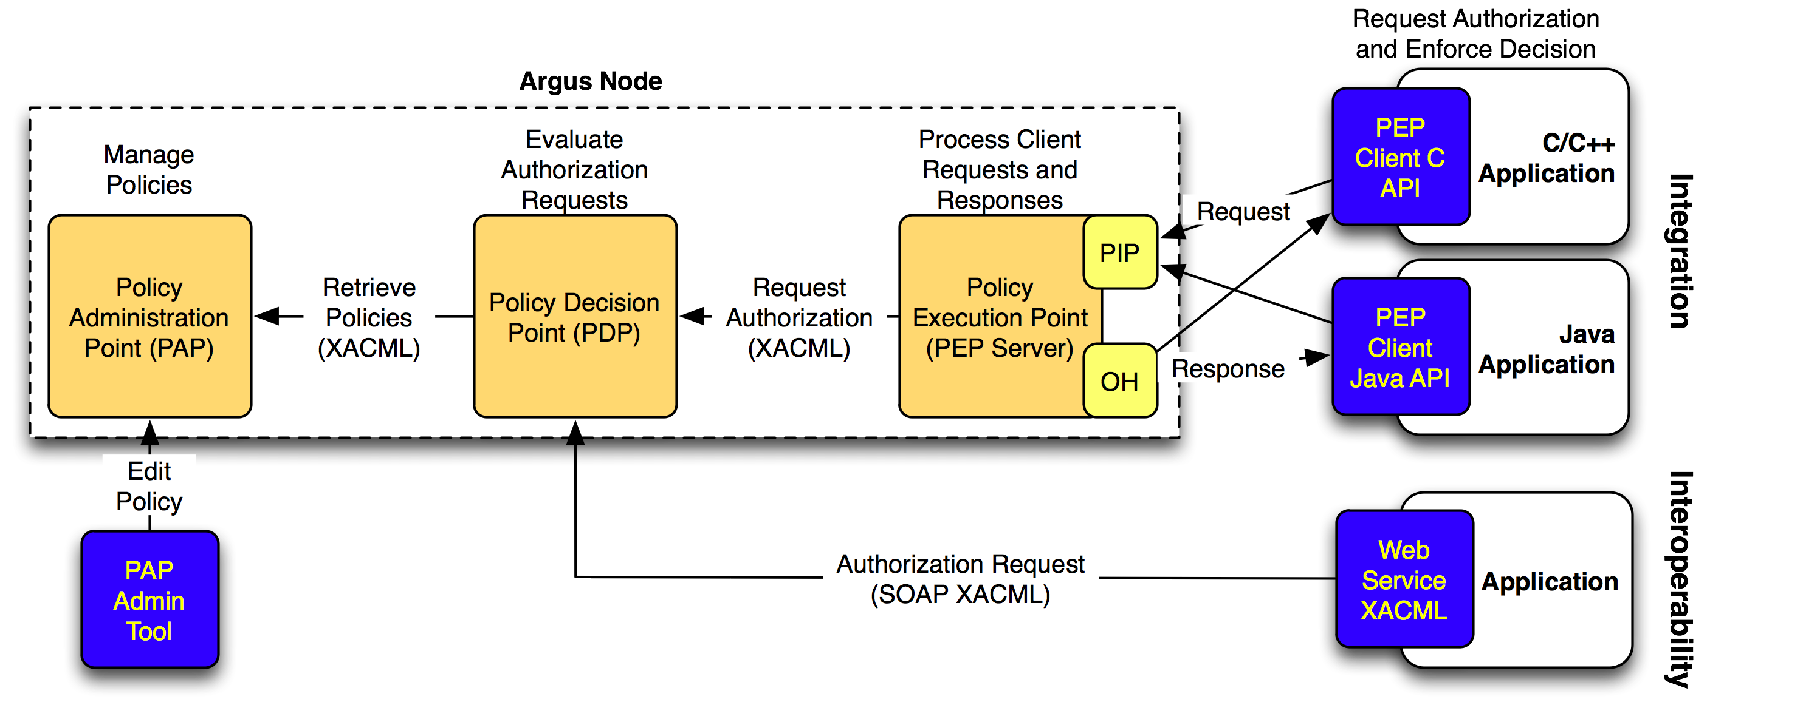
Argus Authorization Service
Renders consistent authorization decisions based on XACML policies
  Can user X perform action Y on resource Z?
  Ban user by DN, FQAN, issuing CA, … !
31/05/2011
Argus, EMI All Hands Meeting 2011, Lund

Slide 4
Argus Authorization Service (cont.)
Argus PAP: Policy Administration Point
  Provides site administrators with the tools for authoring policies
  Stores and manages authored XACML policies
  Provides managed authorization policies to other authorization service components (other PAPs or PDP)
pap-admin tool
  Simple Policy Language
31/05/2011
Argus, EMI All Hands Meeting 2011, Lund

Slide 5
Argus Authorization Service (cont.)
Argus PDP: Policy Decision Point
  XACML policies evaluation engine
  Receives authorization decision requests from the PEP Server or other components (UNICORE PDP, …)
  Evaluates the authorization decision requests against the XACML policies retrieved from the PAP
  Renders the authorization decision
31/05/2011
Argus, EMI All Hands Meeting 2011, Lund

Slide 6
Argus Authorization Service (cont.)
Argus PEP: Policy Enforcement Point
  Client/Server architecture
  Lightweight PEP client API libraries (C and Java)
  PEP Server receives the authorization decision requests from the PEP clients
  Applies additional filters to the requests (PIP)
  Asks the PDP to render an authorization decision
  Applies the obligation handler (OH) to determine the user mapping
  Sends authorization decision (with obligations) back to the PEP clients
31/05/2011
Argus, EMI All Hands Meeting 2011, Lund

Slide 7
Common XACML Authorization Profile
EMI common authorization profile
  Define a common set of XACML authorization attributes
  Homogenous and consistent authorization decisions across the EMI middleware
  Profile released, but still need to be implemented for
    UNICORE PDP integration in XACML
    ARC SecHandler integration with PEP client API
https://twiki.cern.ch/twiki/bin/view/EMI/EmiJra1T4XACML
31/05/2011
Argus, EMI All Hands Meeting 2011, Lund

Slide 8
EMI Authorization Integration
EMI-1 release authorization status
  Computing Element (CE):
    CREAM CE integrated with Argus
  Worker Node (WN):
    gLExec with LCMAPS PEP plugin for pilot jobs
  Storage Element (SE):
    DPM/LFC banning engine
    dCache authorization plugin (available in EMI-1, not enabled by default)
31/05/2011
Argus, EMI All Hands Meeting 2011, Lund

Slide 9
EMI Authorization Integration (cont.)
Future work (EMI Year 2)
  Implement the common XACML authorization profile
    Argus update to support new profile
      Extend the simple policy language
      Define the new XACML attributes
    UNICORE PDP integration in XACML
    ARC SecHandler integration with PEP client API
  Storage Element (SE)
    StoRM authorization (banning)
  EMI Execution Service (ES) integration???
31/05/2011
Argus, EMI All Hands Meeting 2011, Lund

Slide 10
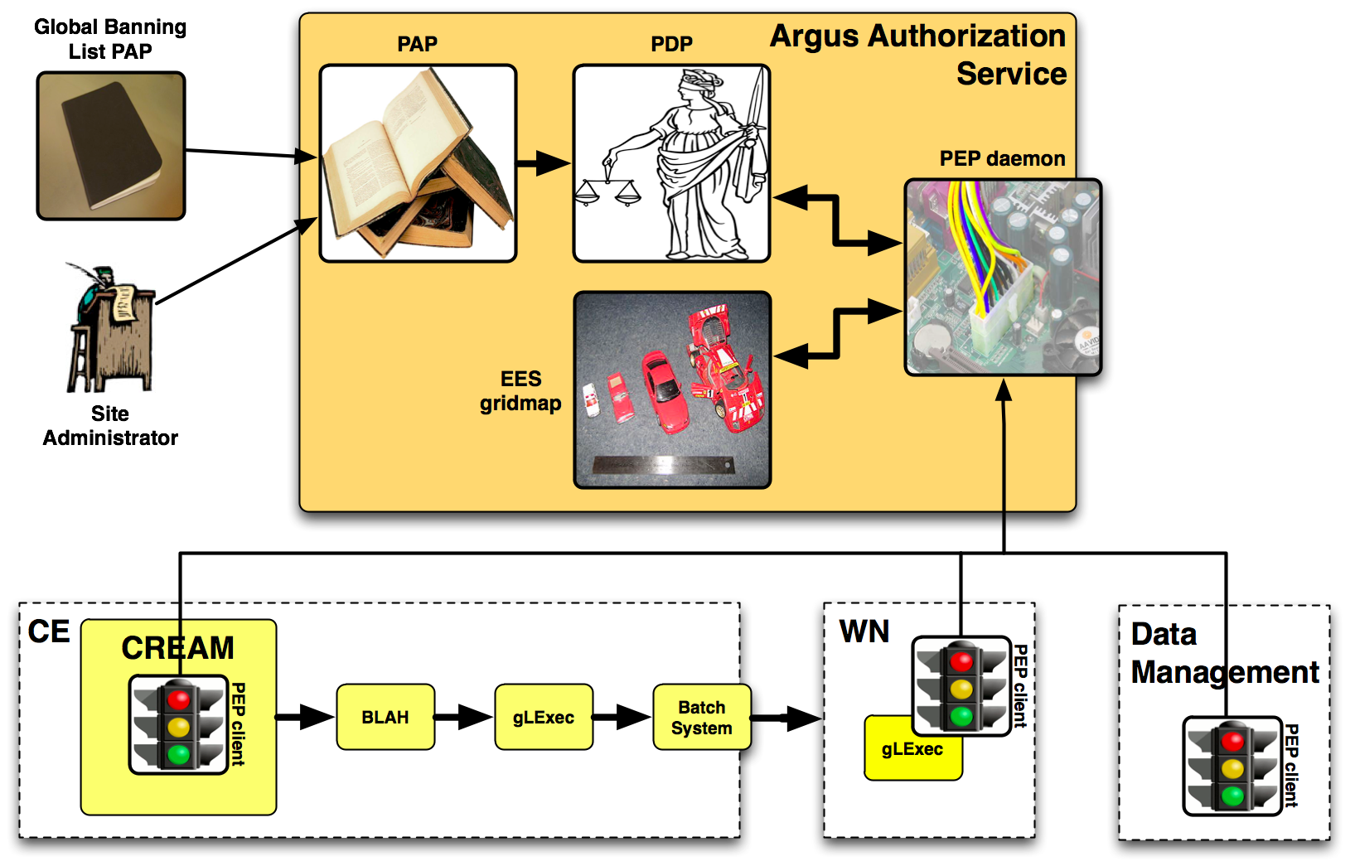
Service Deployment
Argus as a service to manage consistent authorization policy based decisions
31/05/2011
Argus, EMI All Hands Meeting 2011, Lund

Slide 11
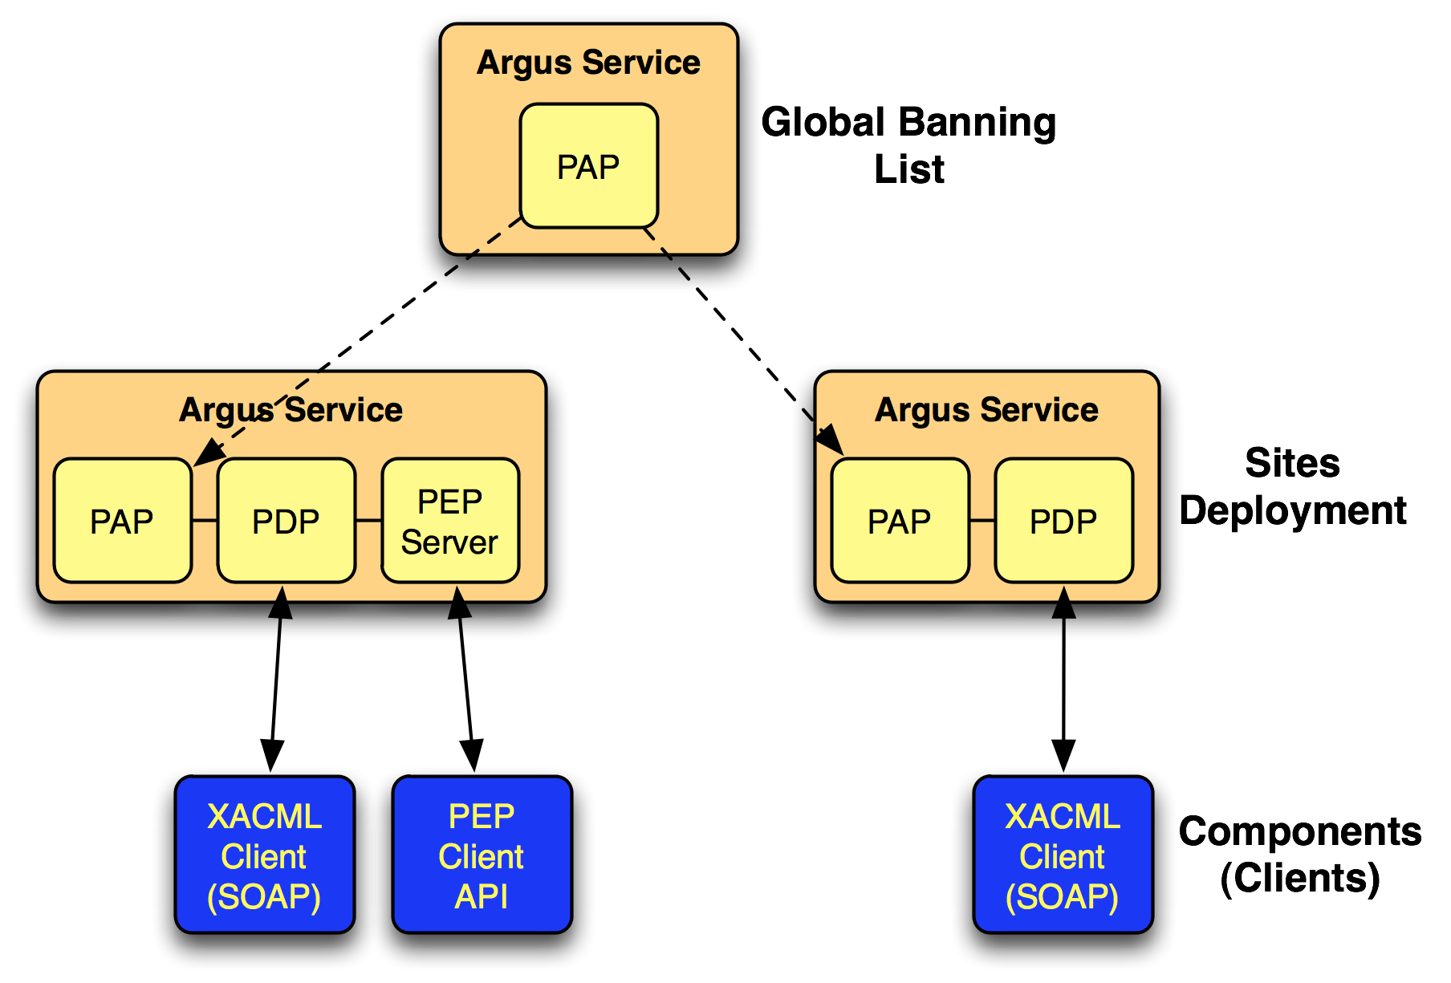
Service Deployment (cont.)
Hierarchical distribution of policies
31/05/2011
Argus, EMI All Hands Meeting 2011, Lund

Slide 12
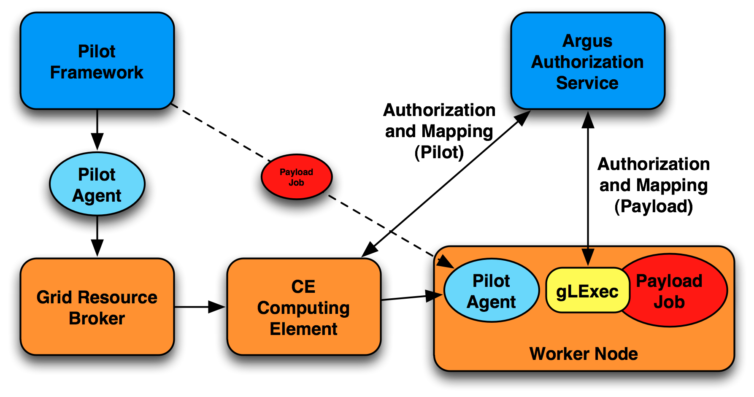
Pilot Jobs Authorization
Payload is downloaded on the WN
gLExec runs it under the end-user identity
31/05/2011
Argus, EMI All Hands Meeting 2011, Lund

Slide 13
Argus Releases
Argus 1.3 (EMI-1 release)
  Back-compatible with gLite 3.2 Argus PEP client API libraries (C and Java)
  Support for LFC/DPM banning engine
  Bug fixes
Next Argus release (EMI Year 2)
  Implement the EMI Common XACML Authorization Profile
  Integration with UNICORE and ARC
31/05/2011
Argus, EMI All Hands Meeting 2011, Lund

Slide 14
Conclusions
Common XACML Authorization Profile
EMI authorization integration ongoing
Consistent authorization decisions across the whole EMI middleware stack (CE, WN, SE, UNICORE, ARC, …)
Global banning list easy to manage and distribute
31/05/2011
Argus, EMI All Hands Meeting 2011, Lund

Slide 15
Argus Support
GGUS Tickets (ARGUS Support Unit)
  https://ggus.eu
Support mailing list (e-group):
  argus-support@cern.ch
General documentation
https://twiki.cern.ch/twiki/bin/view/EGEE/AuthorizationFramework
31/05/2011
Argus, EMI All Hands Meeting 2011, Lund

Slide 16
Thank you
EMI is partially funded by the European Commission under Grant Agreement INFSO-RI-261611
31/05/2011
Argus, EMI All Hands Meeting 2011, Lund

