Slide 1
Real Estate EDA
For the area King County (WA)

Slide 2

Agenda
Introduction
Exploratory data analysis
Results
Key Takeaways
Outlook
Notes:
What could you expect in the next couple of minutes
Smooth transition

Slide 3





























Introduction
What have the following companies in common?

Slide 4
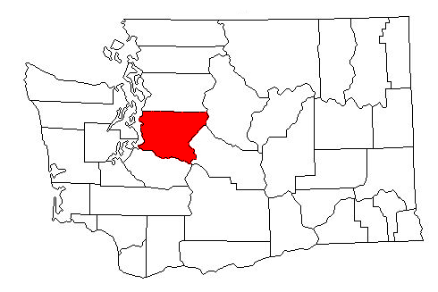

Introduction
They are all based in the King County (WA)
Area 2,307 sq mi (5,980 km²)
Population (estimate 2019) 2,252,782
35 cities, 4 towns and 14 ghost towns
Notes:
For better classification a few facts about King County

Slide 5

Introduction
Benefits
Better understand of the real estate market in general.
Indicators for low and high property prices
Insights into the process of data analysis.
The dataset
21,597 successfully sold properties
21 features each
Dated between spring 2014 and spring 2015
Prices from 78,000 up to 7,700,000 USD
From bungalows up to 3 floor mansions
}
= 453,537 feature characteristics
Notes:
collected
You will get a better understanding of the real estate market in King County.
Learn about

Slide 6

Exploratory data analysis
Bad news
Missing feature characteristics
¾ bathrooms and ½ floors
Incorrect data
Little data for some features
Partially missing description
Good news
Numerous helpful information
No duplicates
Formating mostly accurate
Notes:
address
Missing feature characteristics (i.e. 3,842 yr_renovated)
For example entries where the suqare footage of the living is bigger than the square footage of the lot (and the property is not about two or more floors)
There are only 744 entries for renovation year (3.842 items missing and 17.011 with value 0.0)

Slide 7
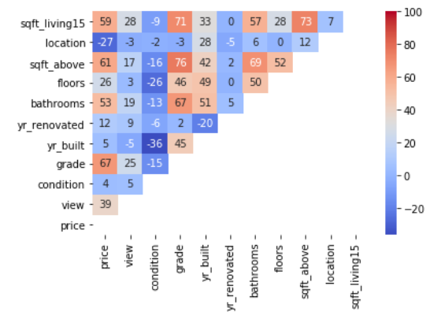
Exploratory data analysis
Correlation between the variables

Slide 8
Exploratory data analysis / Results
Grouping the data
Houses with 2,5 floors were more expensive
Most houses are graded between 7 and 9
Houses with up to eight bathrooms
The condition of the house has a smaller
impact than grade
Most of the houses was tagged with no view and no waterfront

Slide 9


Exploratory data analysis
(Multiple) Linear Regression
Notes:
Quality measure
R-Squared = Explained variance of the model / Total variance of the target variable
How similar a regression line is to the data it’s fitted to. If it’s a 0, the model predicts none of the variance
N is the number of points in your data sample. K is the number of independent regressors, i.e. the number of variables in your model, excluding the constant

Slide 10

Results
Best Adj. R² variables
Quad with best adj. R²
Triplet with 2nd best adj. R²
Grade +
yr renovated +
location +
sqft_living
Grade +
Location + sqft
living
Lat +
Sqft
living
Grade
Sqft
living
65.4%
70.4 %
73.8 %
49.5 %
49.3 %

Slide 11
Key Takeaways
Do not consider the condition as a key indicator for your choice
Houses graded 7 and 8 has the
best value for price
The amount of bedrooms had only
a small impact on the grading
Houses with more than one bathrooms will increase the grading signifcantly
Houses with a view cost at least twice as much as without view
Houses with a waterview will at least triple the price
Notes:
High SD of grouped contion indicate the variable as a bad predictor

Slide 12









Outlook
Stronger focus on
outlier handling
Visualising
graph relations
What should be
tackled in a deeper analysis?
Influence of the
year of construction
Implemention of a
map feature
Calculation of distance to
bigger cities, water, airports, etc.

Slide 13

Liked the presentation? Visit my GIT and take a look at the EDA in the juypter notebook.

