Slide 1
Quantum Fisher Information as a Thermal and Dynamical Probe in Frustrated spin system

Slide 2

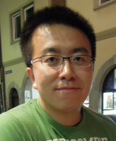
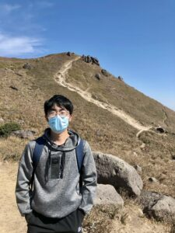

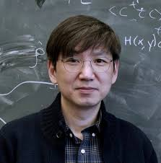

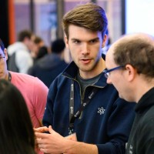
Cooperators
Zi Yang Meng University of Hongkong Professor
Menghan Song University of Hongkong Ph.D. Candidate
Yong Baek Kim University of Toronto Professor
Zhengbang Zhou University of Toronto Ph.D. Candidate
Felix Desrochers Harvard University Postdoctoral Fellow

Slide 3
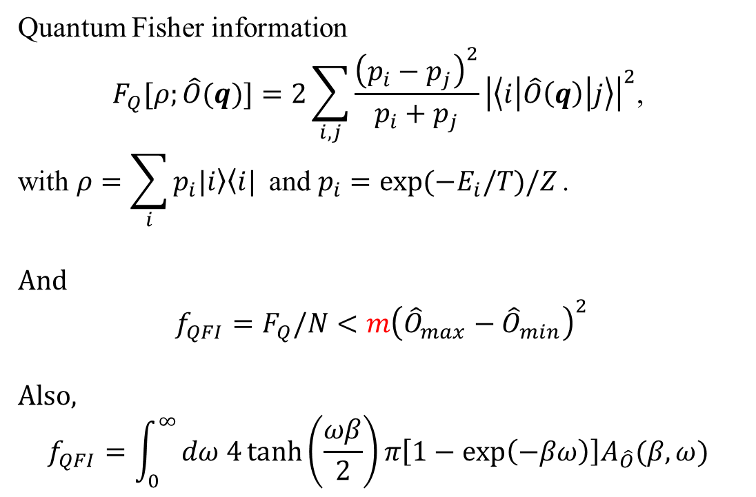

Entanglement depth
The $k$-producibility state $\left|ψ\right\rangle =⨂_{i=0}^{M}{|ψ_{i}⟩}$
Entanglement depth $m$ means $m≥k_{i}, ∀ i$
Quantum Fisher information
$$F_{Q}[ρ;\hat{O}(q)]=2\sum_{i,j}{\frac{{\left(p_{i}−p_{j}\right)}^{2}}{p_{i}+p_{j}}}{\left|\left\langle i | \hat{O}\left(q\right) | j\right\rangle \right|}^{2}\text{, }$$
$$\text{with} ρ=\sum_{i}{p_{i}\left.|i\right\rangle \left\langle i\right.|} \text{and} p_{i}=\exp{(−E_{i}/T)/Z}\text{.}$$
And
$$f_{QFI}=F_{Q}/N<m{\left({\hat{O}}_{max}−{\hat{O}}_{min}\right)}^{2}$$
Also,
$$f_{QFI}=\int_{0}^{∞}{dω 4\tanh\left(\frac{ωβ}{2}\right)π\left[1−\exp\left(−βω\right)\right]A_{\hat{O}}(β,ω) }$$
$\left|ψ\right\rangle = ({\left|↑\right\rangle }_{0}+{\left|↓\right\rangle }_{0})⨂ ({\left|↑\right\rangle }_{1}+{\left|↓\right\rangle }_{1})$ $⨂ ({\left|↑\right\rangle }_{1}+{\left|↓\right\rangle }_{1})⨂$...
$\left|ψ\right\rangle = ({\left|↑↓\right\rangle }_{01}−{\left|↓↑\right\rangle }_{01})⨂ ({\left|↑↓\right\rangle }_{23}−{\left|↓↑\right\rangle }_{23})⨂$...
$$\left|ψ\right\rangle =(\left|↑↑↑↑…\right\rangle +\left|↓↓↓↓…\right\rangle )$$
$$\left|ψ\right\rangle = ({\left|↑↓\right\rangle }_{01}−{\left|↓↑\right\rangle }_{01})⨂ (\left|↑↑↑↑…\right\rangle +\left|↓↓↓↓…\right\rangle )$$
Philipp Hauke, et al., Nature Phys 12, 778–782 (2016)
Luca Pezzé, et al., Phys. Rev. Lett. 102, 100401 (2009)
Notes:
typo

Slide 4
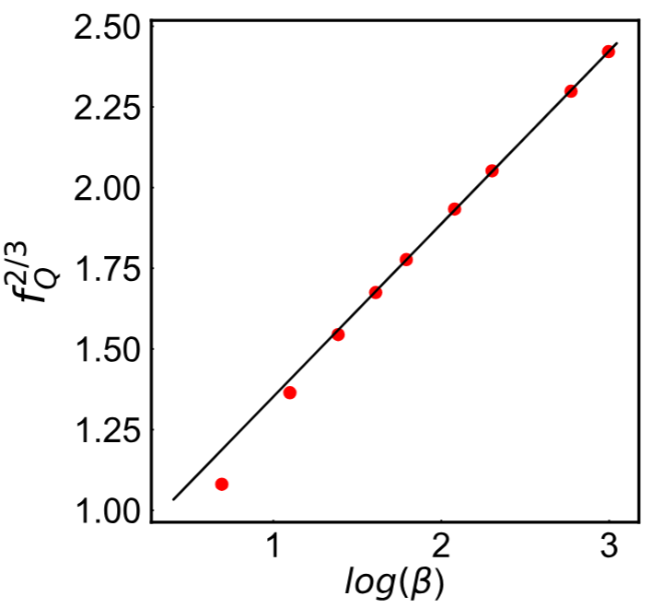
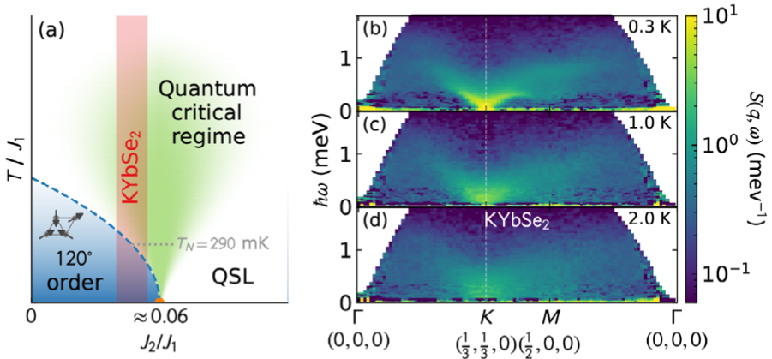
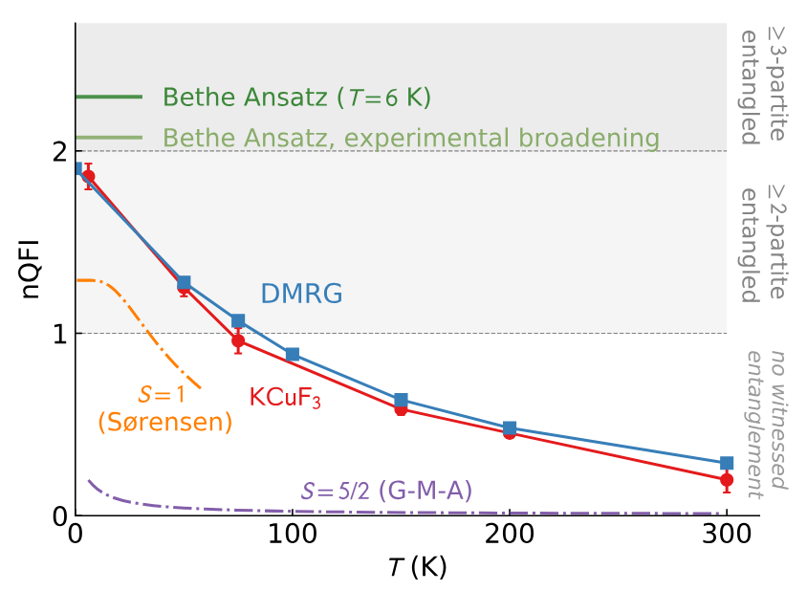
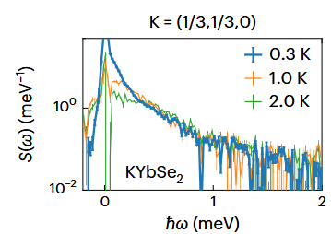
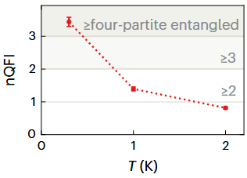
Quantum Fisher Information
Heisenberg spin chain
V. Menon, et al., Phys. Rev. B 107, 054422 (2023)
A. Scheie, et al., Phys. Rev. B .103, 224434 (2021)
Triangle Lattice
A. O. Scheie, et al., Nat. Phys. 20, 74–81 (2024)

Slide 5
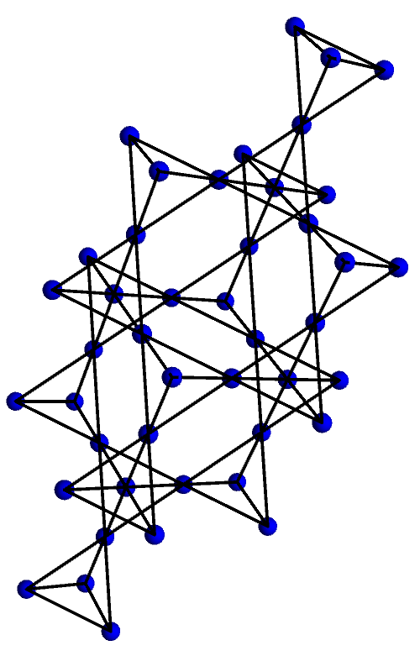
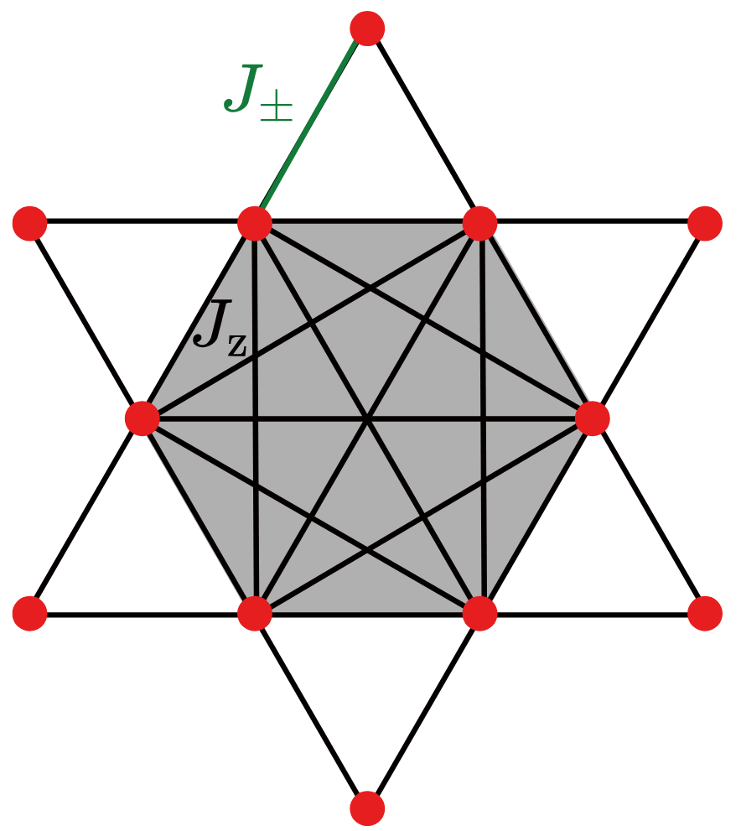
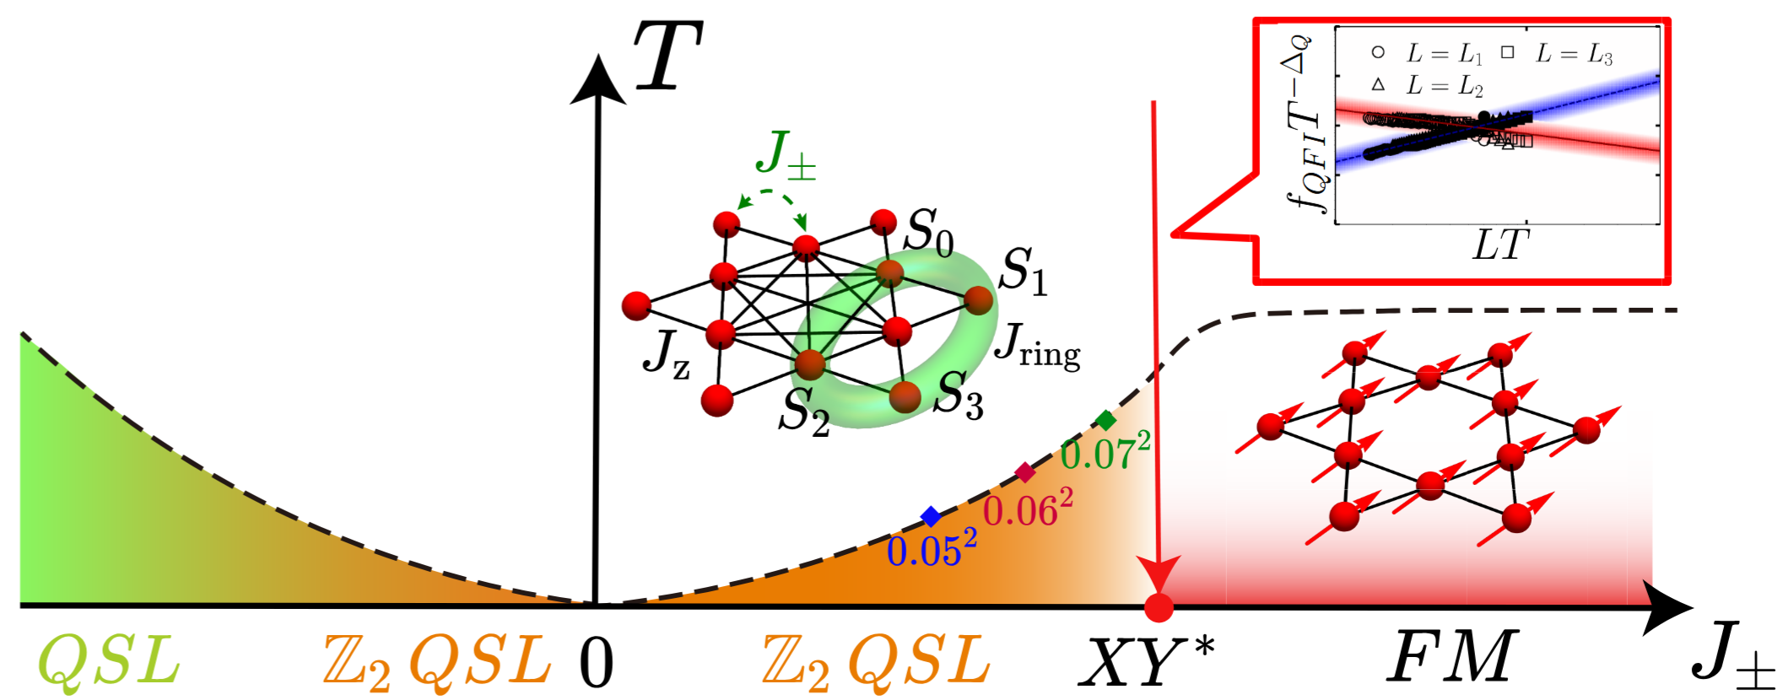
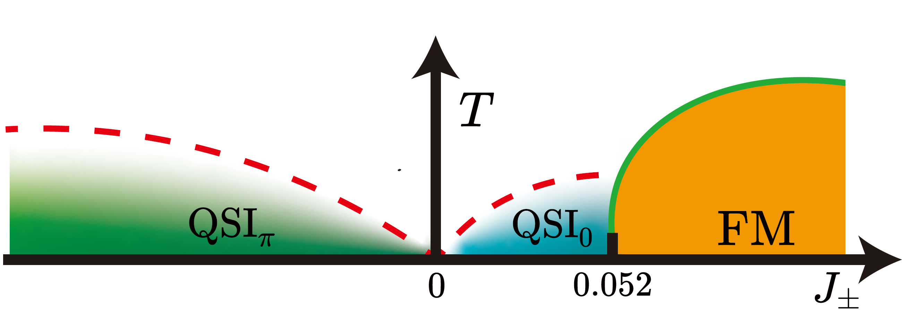
Outlook
1, Pyrochlore lattice Nat Commun 17, 7975 (2026)
2, Balents-Fisher-Girvin (BFG) model arXiv:2603.19951 (2026)

Slide 6
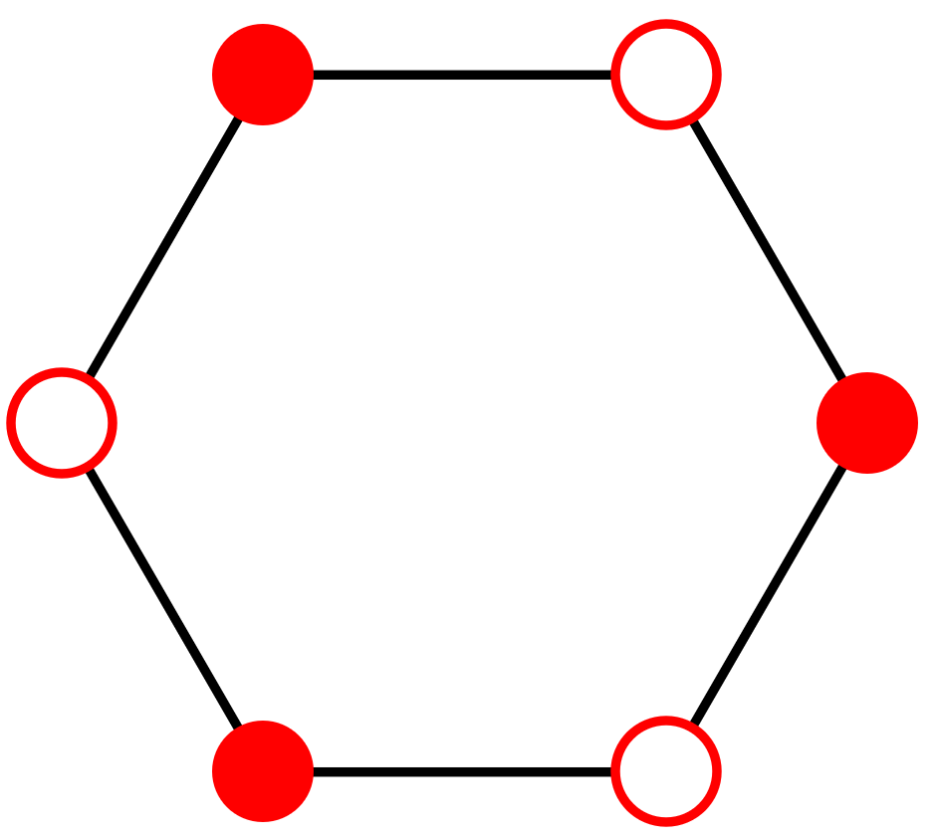
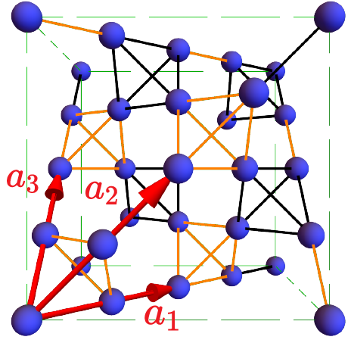
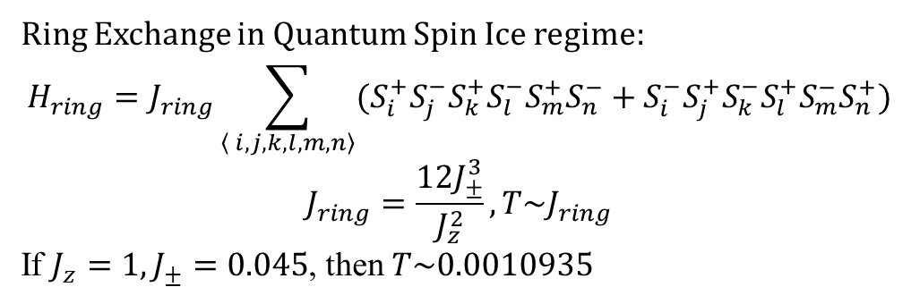


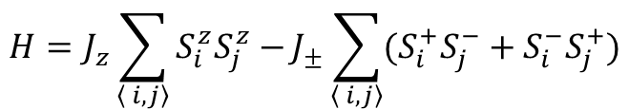
Pyrochlore lattice
$$H=J_{z}\sum_{\left\langle i, j\right\rangle }{S_{i}^{z}S_{j}^{z}−}J_{±}\sum_{\left\langle i, j\right\rangle }{(S_{i}^{+}S_{j}^{−}+S_{i}^{−}S_{j}^{+})}$$
Ring Exchange in $Quantum$ Spin Ice regime:
$$H_{ring}=J_{ring}\sum_{\left\langle i, j,k,l,m,n\right\rangle }{(S_{i}^{+}S_{j}^{−}S_{k}^{+}S_{l}^{−}S_{m}^{+}S_{n}^{−}+S_{i}^{−}S_{j}^{+}S_{k}^{−}S_{l}^{+}S_{m}^{−}S_{n}^{+})}$$
$$J_{ring}=\frac{12J_{±}^{3}}{J_{z}^{2}},T\sim J_{ring}$$
If $J_{z}=1, J_{±}=0.045$, then $T\sim 0.0010935$
Sign problem: Exact diagonalization
Gauge mean-field theory calculation
Sign problem free: SSE-QMC
$$\left| \right\rangle +\left| \right\rangle$$
$$\left| \right\rangle −\left| \right\rangle$$
Leon Balents, et al., Phys. Rev. B 69, 064404 (2004)
Johannes Reuther, et al., Phys. Rev. B .111, 134442 (2025)

Slide 7
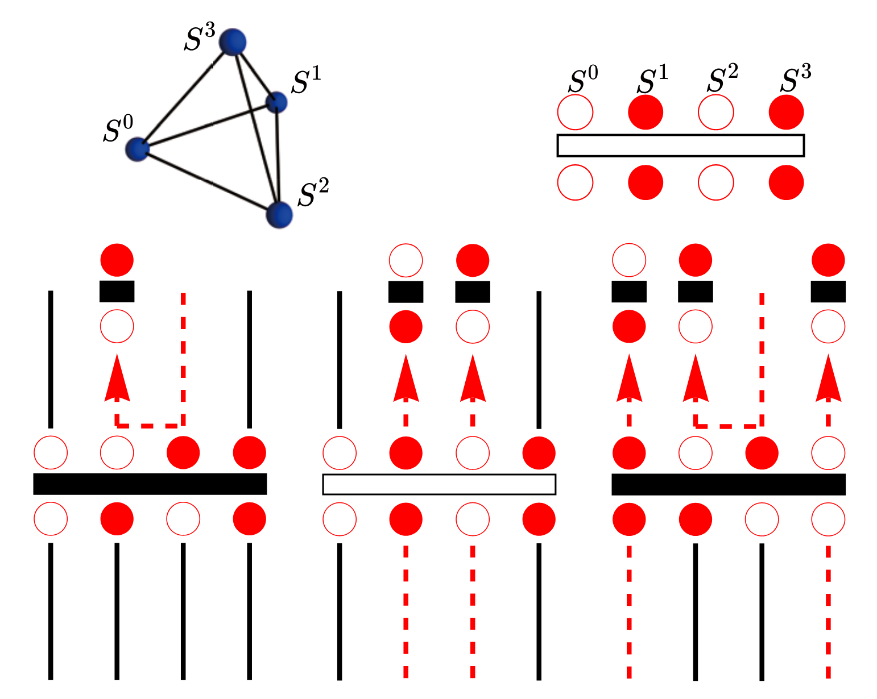







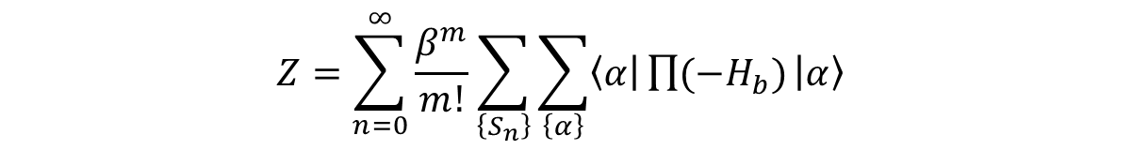


Method ($J_{±}>0$)
$$Z=\sum_{n=0}^{∞}{\frac{β^{m}}{m!}}\sum_{\left\{S_{n}\right\}}{\sum_{\left\{α\right\}}{\left\langle α | \prod{{(−H}_{b})} | α\right\rangle }}$$
Directed loop (DL) update:
1 pair of $S^{+}S^{−}$
$$C_{1}$$
$$C_{2}$$
evolution
$S^{−}$
$S^{+}$
Multi-directed loop (MDL) update:
3 pairs of $S^{+}S^{−}$
$$C_{1}$$
$$C_{3}$$
evolution
Thermal annealing process: $β=1/T$ from$1$ to $1500$ with $δβ=1$

Slide 8
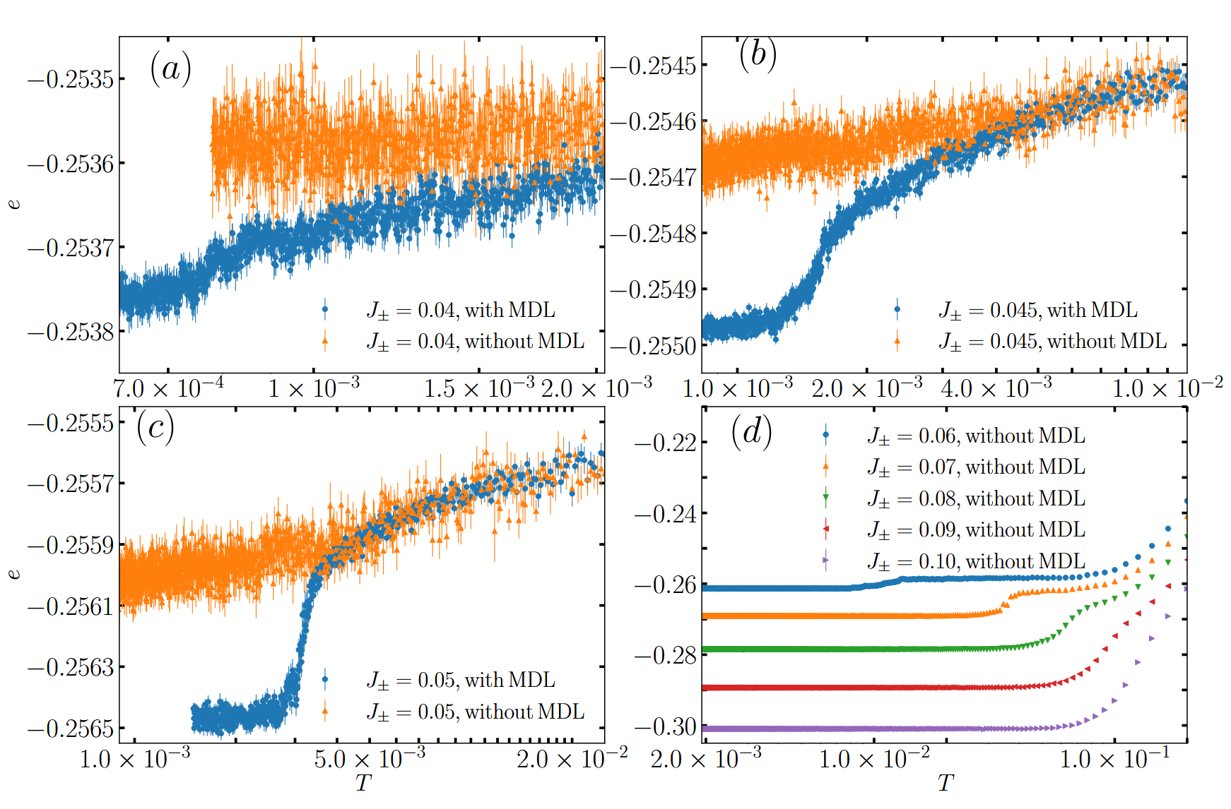
Method ($J_{±}>0$)

Slide 9
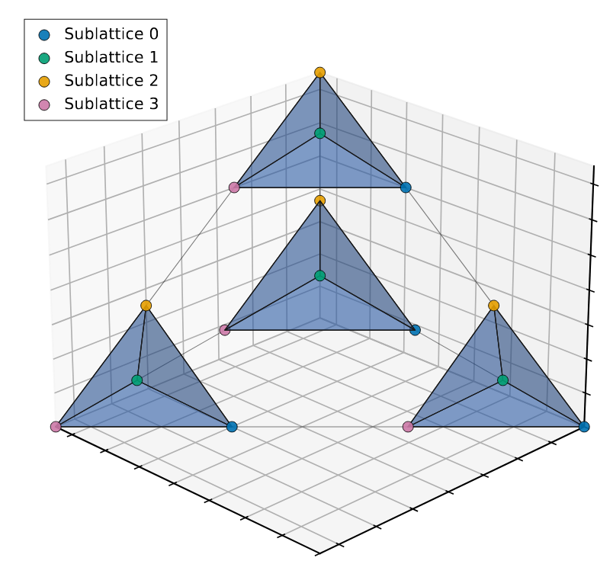

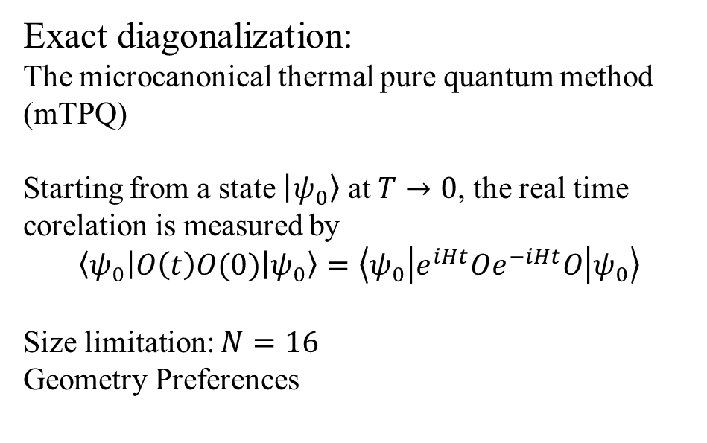
Method ($J_{±}<0$)
Exact diagonalization:
The microcanonical thermal pure quantum method (mTPQ)
Starting from a state $\left|ψ_{0}\right\rangle$ at $T→0$, the real time corelation is measured by
$$\left\langle ψ_{0} | O\left(t\right)O(0) | ψ_{0}\right\rangle =\left\langle ψ_{0} | e^{iHt}Oe^{−iHt}O | ψ_{0}\right\rangle$$
Size limitation: $N=16$
Geometry Preferences
Akira Shimizu, et al., Phys. Rev. Lett. 108, 240401 (2012)
Akira Shimizu, et al., Phys. Rev. Lett. 111, 010401 (2013)

Slide 10
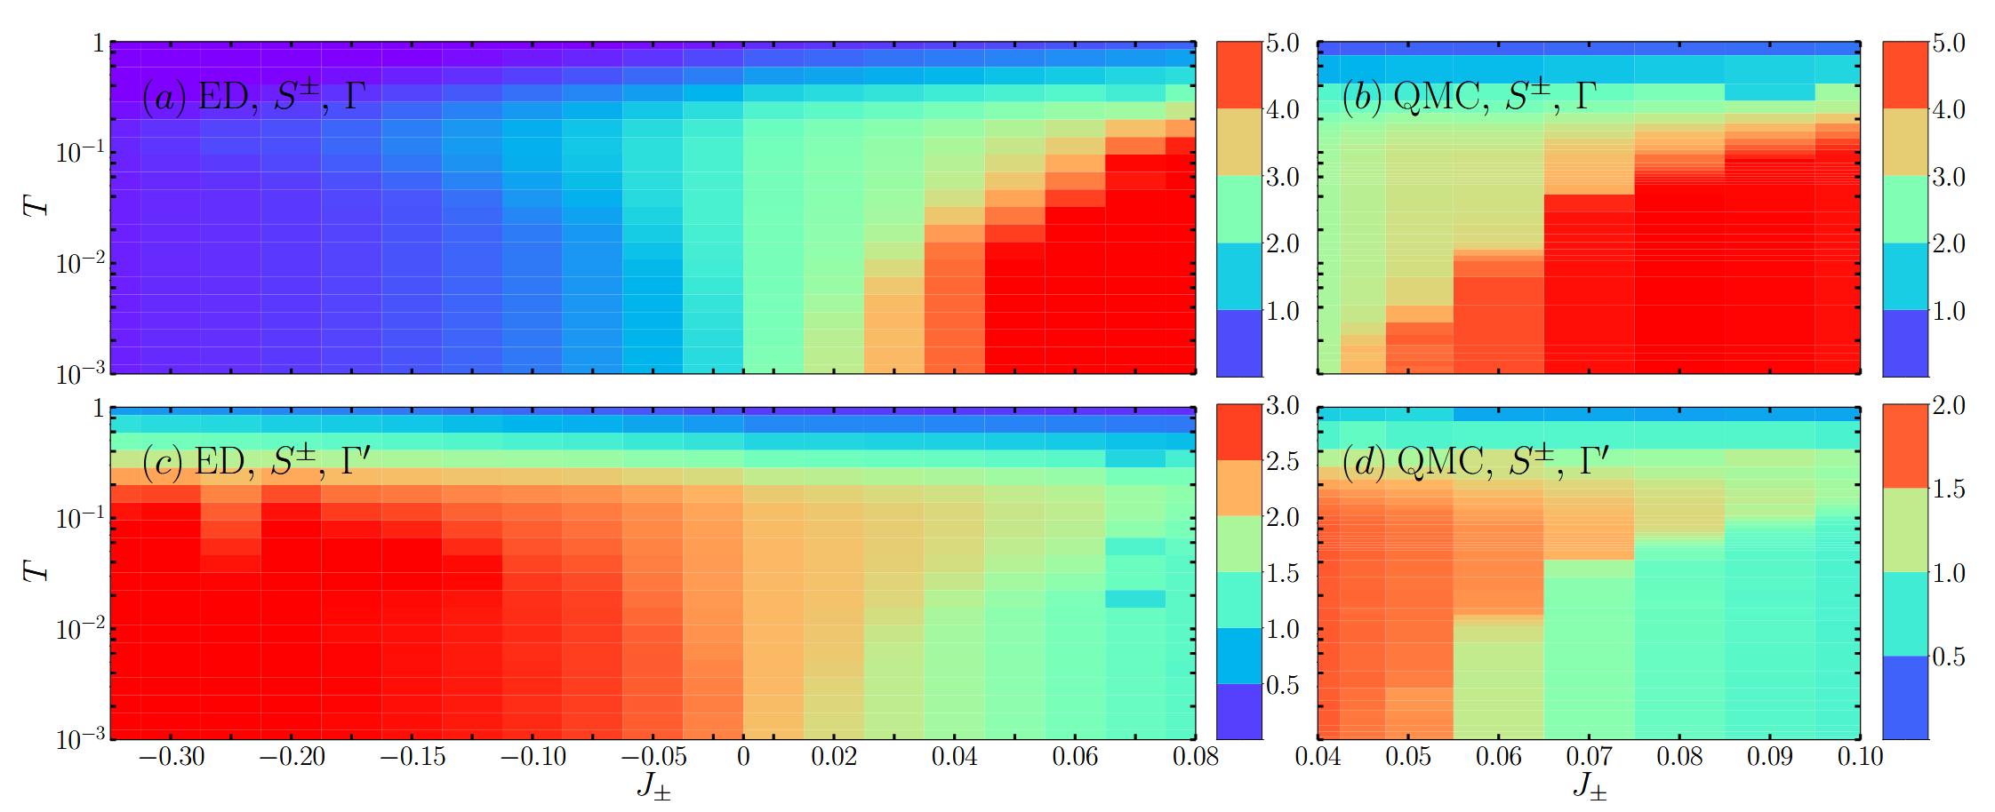



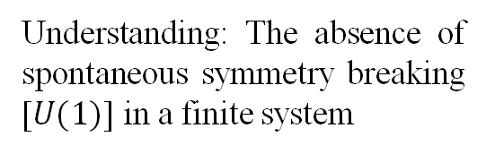
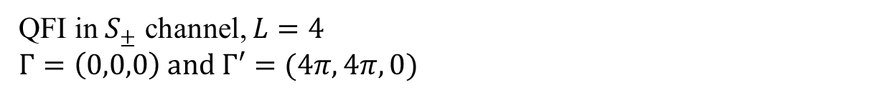
Results
QFI in $S_{±}$ channel, $L=4$
$Γ=\left(0,0,0\right) and Γ′=(4π,4π,0)$
Understanding: The absence of spontaneous symmetry breaking [$U(1)$] in a finite system
$${QSI}_{0}$$
$$FM$$
$${QSI}_{π}$$
Notes:
u1

Slide 11
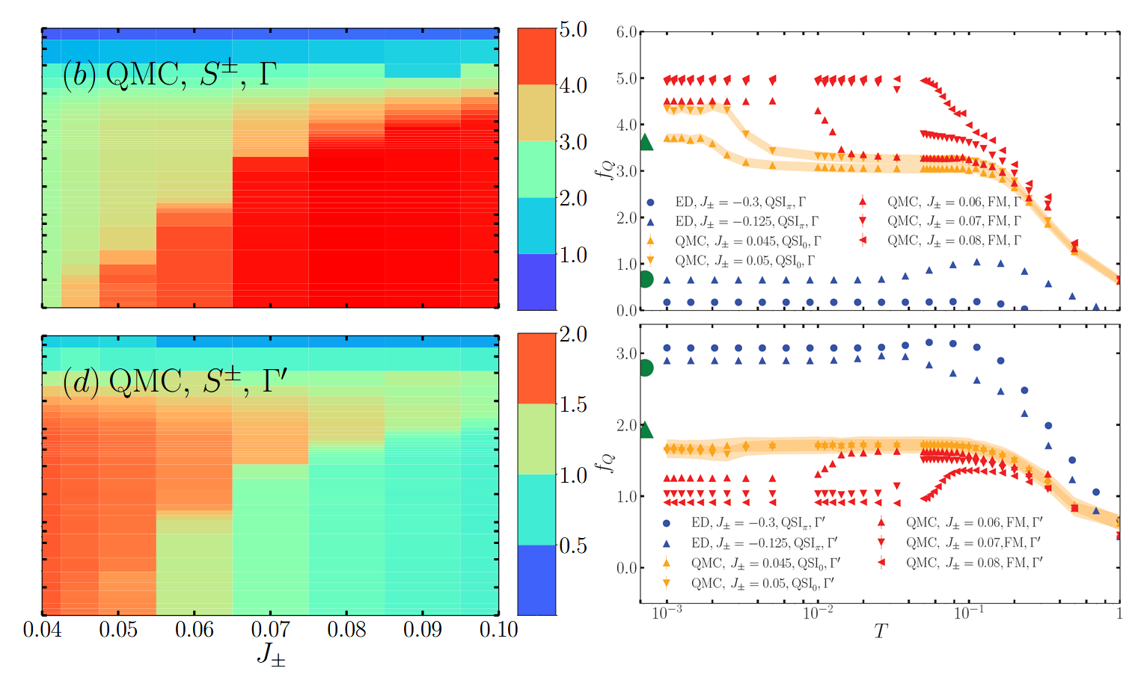
Results

Slide 12
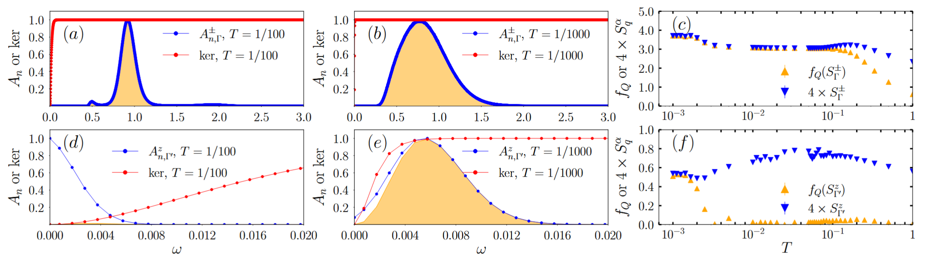
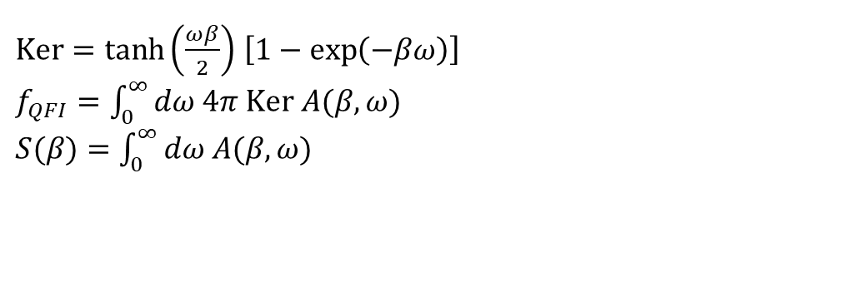
Results
$Ker=\tanh\left(\frac{ωβ}{2}\right)$ $\left[1−\exp\left(−βω\right)\right]$
$f_{QFI}=$ $\int_{0}^{∞}{dω 4π Ker A(β,ω) }$
$S(β)=$ $\int_{0}^{∞}{dω A(β,ω) }$

Slide 13
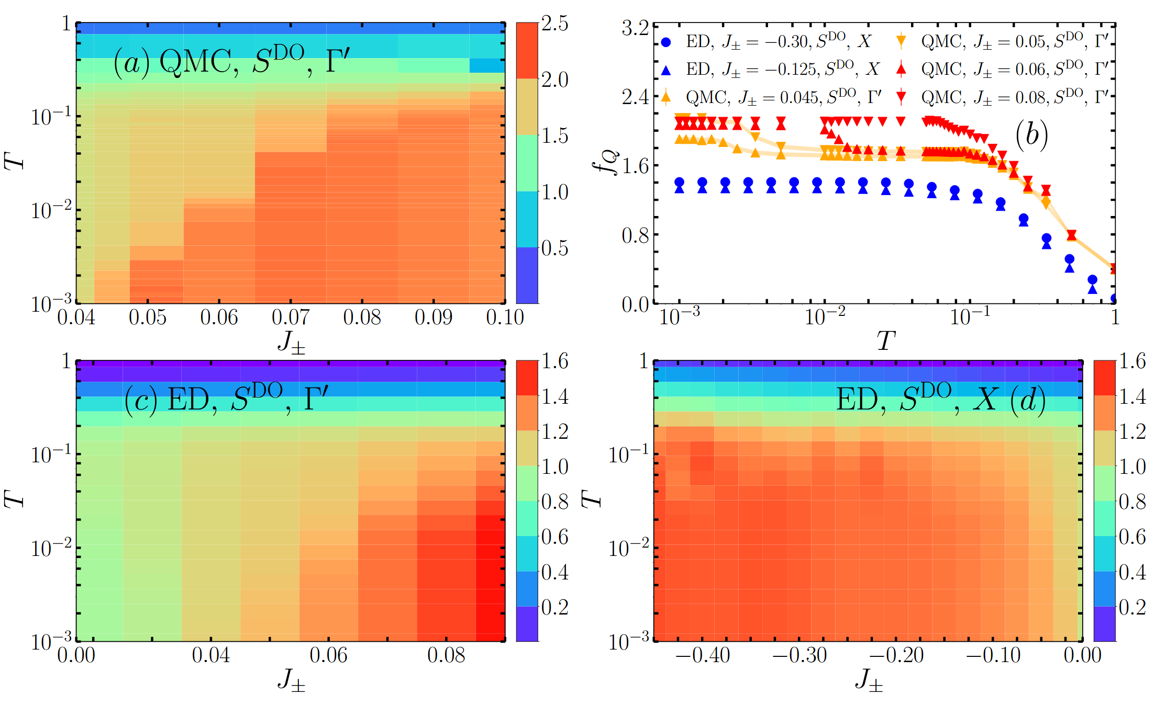
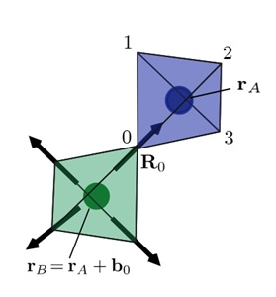
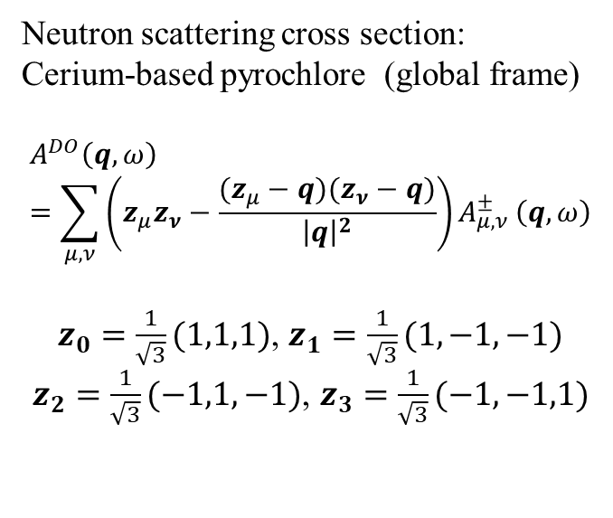
Results
Neutron scattering cross section:
Cerium-based pyrochlore (global frame)
$$A^{DO}\left(q,ω\right)=\sum_{μ,ν}{\left(z_{μ}z_{ν}−\frac{(z_{μ}−q)(z_{ν}−q)}{{\left|q\right|}^{2}}\right)A_{μ,ν}^{±}}\left(q,ω\right)$$
$z_{0}=\frac{1}{\sqrt{3}}(1,1,1)$, $z_{1}=\frac{1}{\sqrt{3}}(1,−1,−1)$
$z_{2}=\frac{1}{\sqrt{3}}(−1,1,−1)$, $z_{3}=\frac{1}{\sqrt{3}}(−1,−1,1)$

Slide 14
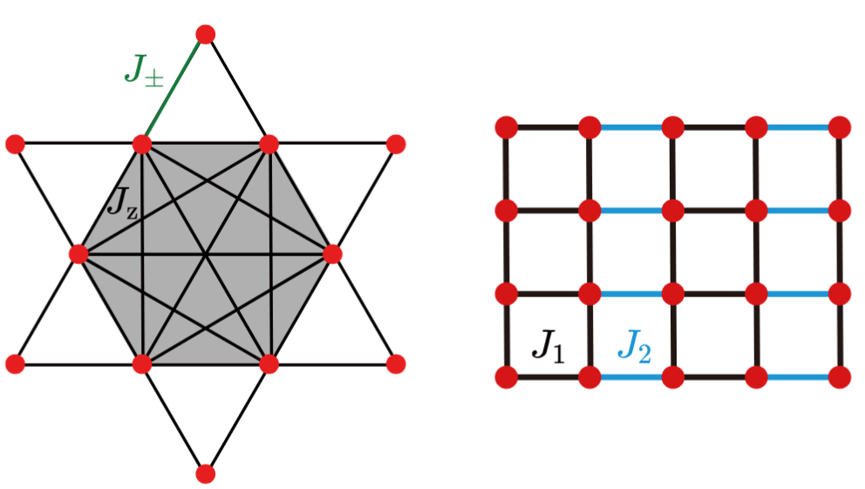

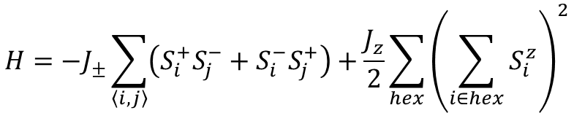
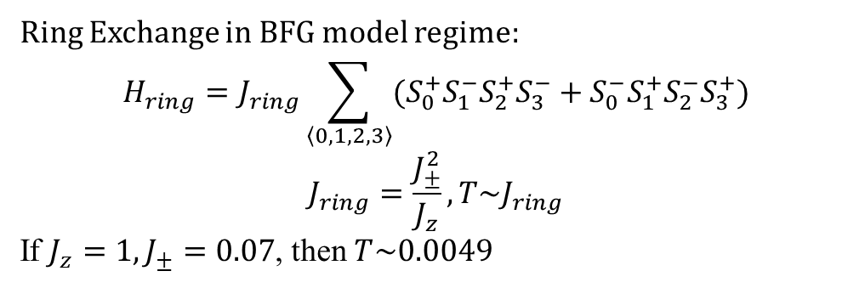
Balents-Fisher-Girvin (BFG) model
$$H=−J_{±}\sum_{\left\langle i, j\right\rangle }{\left(S_{i}^{+}S_{j}^{−}+S_{i}^{−}S_{j}^{+}\right)}+\frac{J_{z}}{2}\sum_{hex}{{\left(\sum_{i∈hex}{S_{i}^{z}}\right)}^{2}}$$
Ring Exchange in BFG model regime:
$$H_{ring}=J_{ring}\sum_{\left\langle 0,1,2,3\right\rangle }{(S_{0}^{+}S_{1}^{−}S_{2}^{+}S_{3}^{−}+S_{0}^{−}S_{1}^{+}S_{2}^{−}S_{3}^{+})}$$
$$J_{ring}=\frac{J_{±}^{2}}{J_{z}},T\sim J_{ring}$$
If $J_{z}=1, J_{±}=0.07$, then $T\sim 0.0049$
Leon Balents, et al., Phys. Rev. B 65, 224412 (2002)
$$0.07076$$

Slide 15
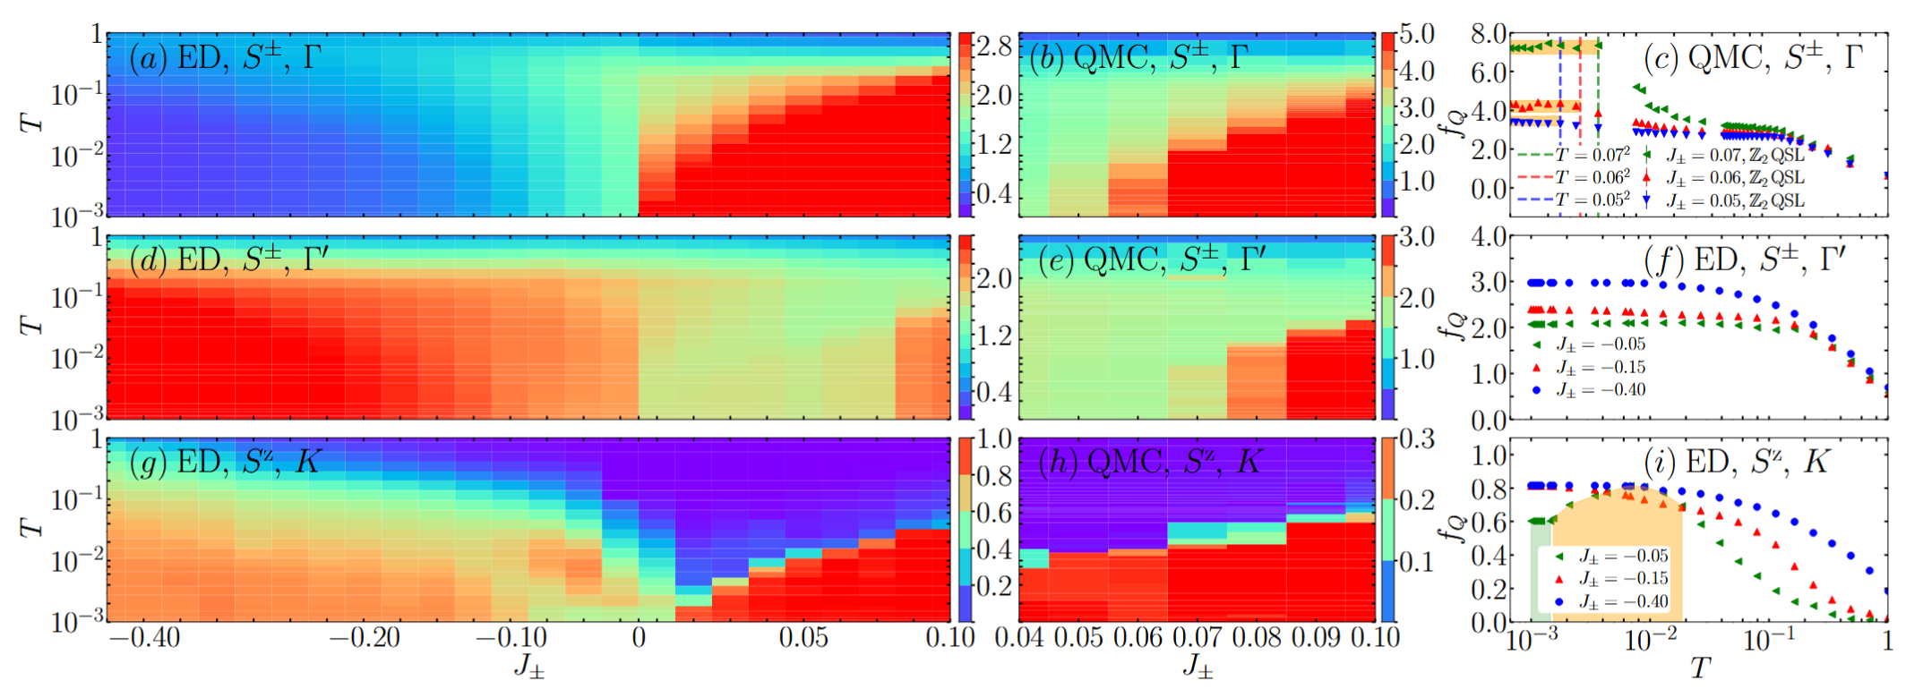
Results

Slide 16
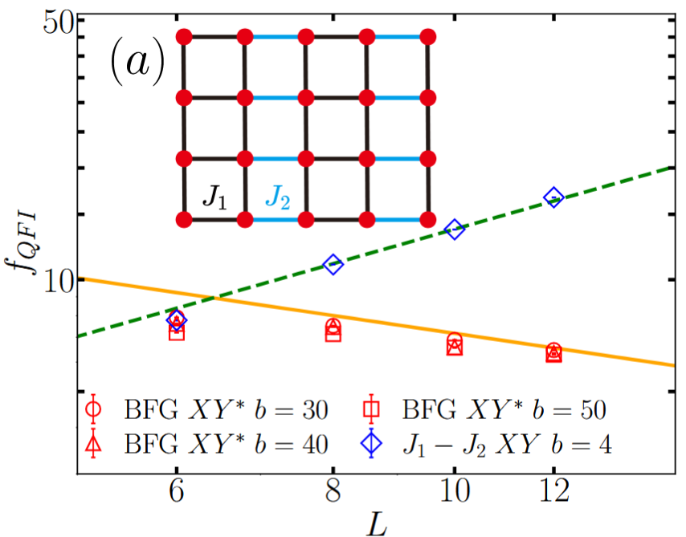
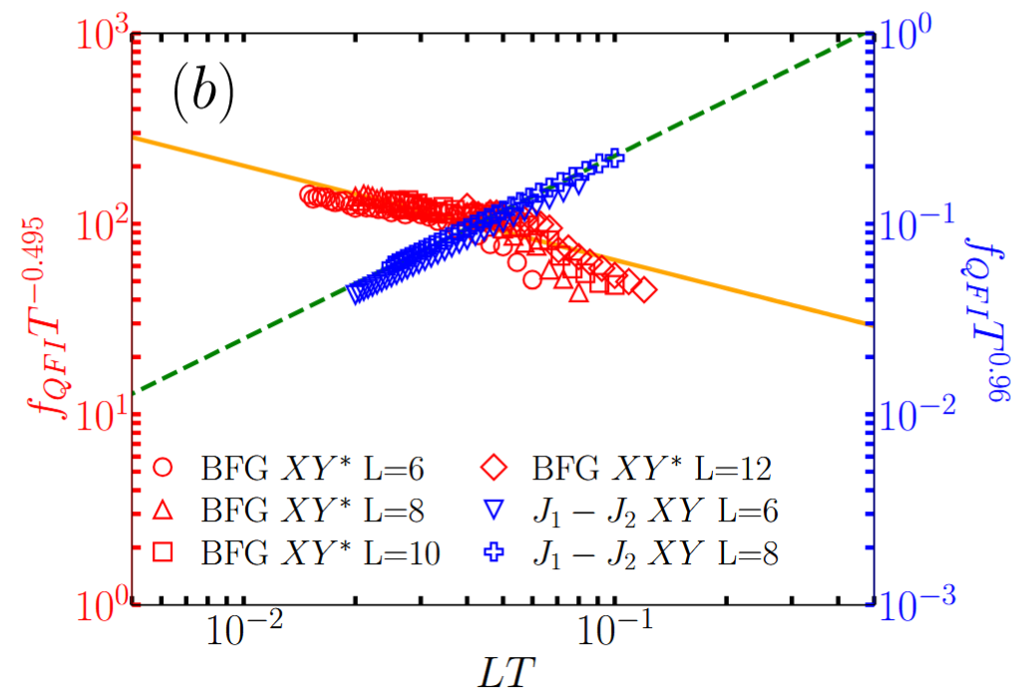
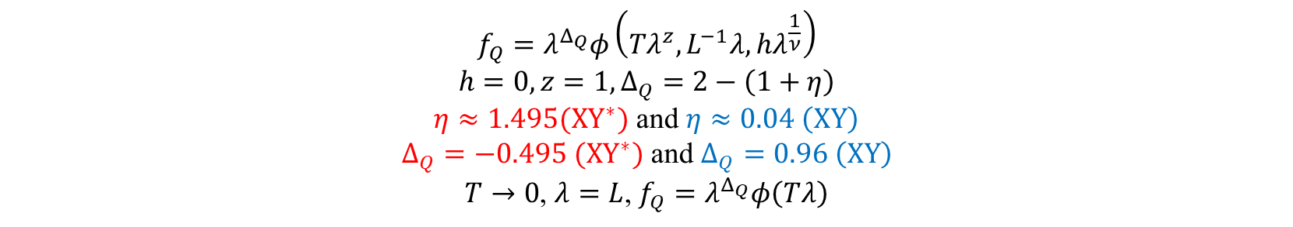
Sacling behavior of QFI
$$f_{Q}=λ^{Δ_{Q}}φ\left(Tλ^{z},L^{−1}λ,hλ^{\frac{1}{ν}}\right)$$
$$h=0, z=1,Δ_{Q}=2−\left(1+η\right)$$
$η≈1.495(XY^{∗})$ and $η≈0.04 \left(XY\right)$
$Δ_{Q}=−0.495 (XY^{∗})$ and $Δ_{Q}=0.96 \left(XY\right)$
$T→0$, $λ=L$, $f_{Q}=λ^{Δ_{Q}}φ\left(Tλ\right)$
$$f_{Q}=L^{Δ_{Q}}φ\left(1/b\right)$$
$$f_{Q}T^{Δ_{Q}}={(TL)}^{Δ_{Q}}φ\left(TL\right)$$
Philipp Hauke, et al., Nature Phys 12, 778–782 (2016)

Slide 17
Results

Slide 18
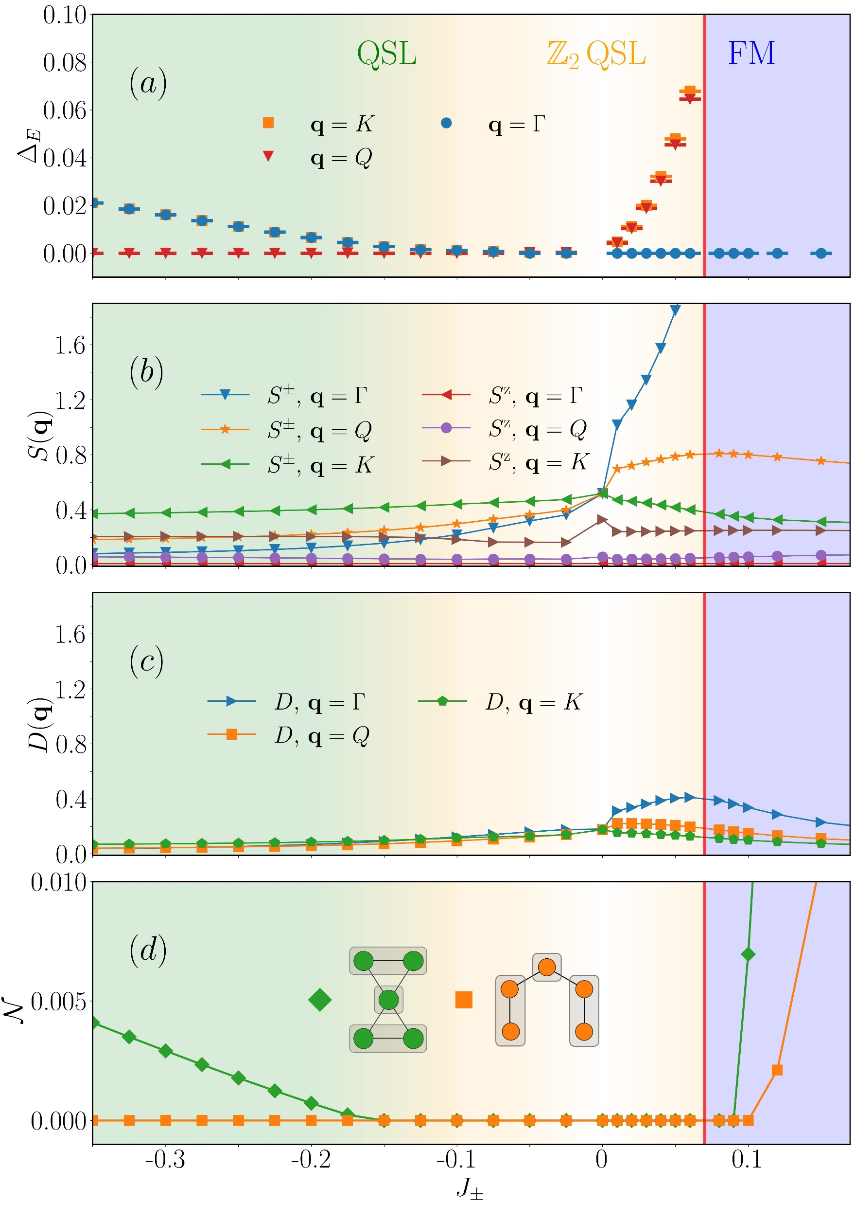
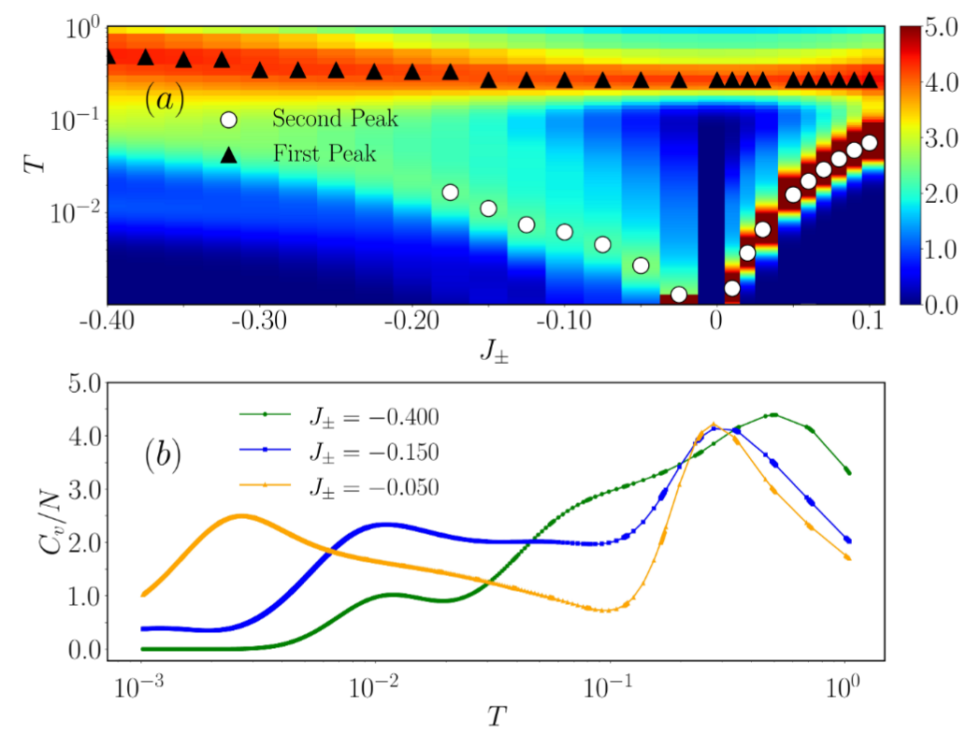
Observation
Ground state change
No Spin order
No dimer order
Entangle structure change
Liuke Lyu, et al., arXiv:2505.18124 (2025)
Menghan Song, et al., arXiv:2509.09983 (2025)

Slide 19

Thank you. arXiv:2510.14813 (2025) arXiv:2603.19951 (2026)

Slide 20
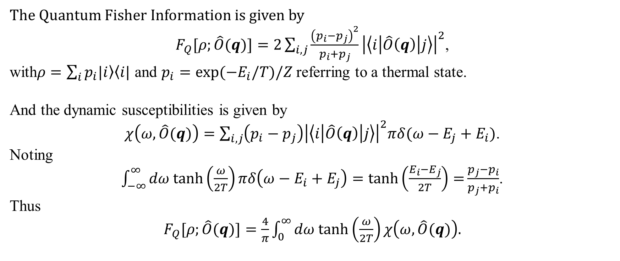
Quantum Fisher Information
The Quantum Fisher Information is given by
$F_{Q}[ρ;\hat{O}(q)]=2\sum_{i,j}{\frac{{\left(p_{i}−p_{j}\right)}^{2}}{p_{i}+p_{j}}}{\left|\left\langle i | \hat{O}\left(q\right) | j\right\rangle \right|}^{2}$,
with$ρ=\sum_{i}{p_{i}\left.|i\right\rangle \left\langle i\right.|}$ and $p_{i}=\exp{(−E_{i}/T)/Z}$referring to a thermal state.
And the dynamic susceptibilities is given by
$χ\left(ω,\hat{O}(q)\right)=\sum_{i,j}{\left(p_{i}−p_{j}\right){\left|\left\langle i | \hat{O}\left(q\right) | j\right\rangle \right|}^{2}πδ(ω−E_{j}+E_{i})}$.
Noting
$\int_{−∞}^{∞}{dω tanh\left(\frac{ω}{2T}\right)πδ\left(ω−E_{i}+E_{j}\right)=tanh\left(\frac{E_{i}−E_{j}}{2T}\right)=}\frac{p_{j}−p_{i}}{p_{j}+p_{i}}$.
Thus
$F_{Q}[ρ;\hat{O}(q)]=$ $\frac{4}{π}\int_{0}^{∞}{dω tanh\left(\frac{ω}{2T}\right)}χ\left(ω,\hat{O}(q)\right).$
Philipp Hauke, et al., Nature Phys 12, 778–782 (2016)

Slide 21
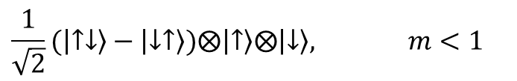
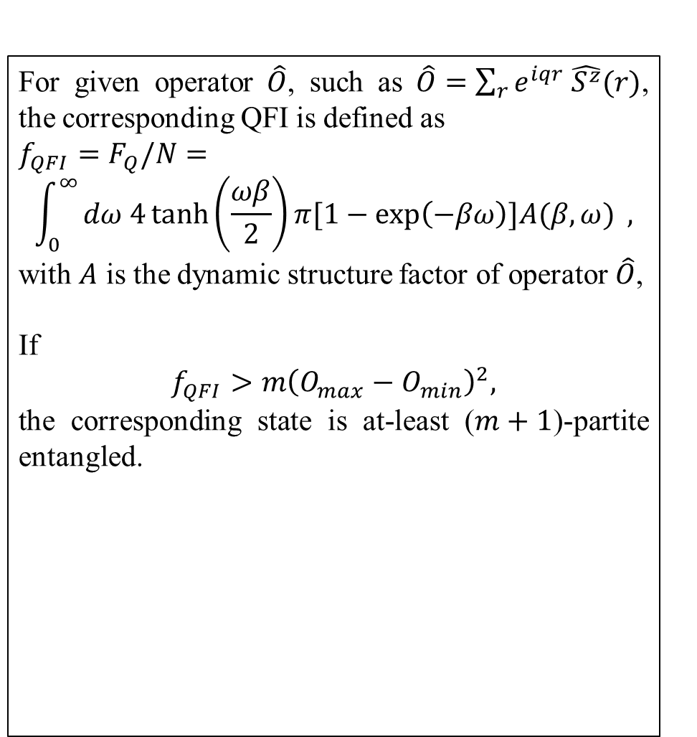
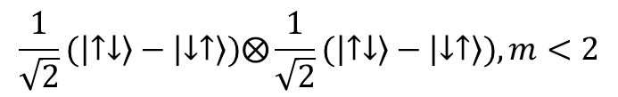
Quantum Fisher Information
For given operator $\hat{O}$, such as $\hat{O}=\sum_{r}{e^{iqr} \hat{S^{z}}(r)}$, the corresponding QFI is defined as
$f_{QFI}=$ $F_{Q}/N=$
$$\int_{0}^{∞}{dω 4\tanh\left(\frac{ωβ}{2}\right)π[1−\exp\left(−βω\right)]A(β,ω) },$$
with $A$ is the dynamic structure factor of operator $\hat{O}$,
If
$$f_{QFI}>m{\left(O_{max}−O_{min}\right)}^{2},$$
the corresponding state is at-least ($m+1$)-partite entangled.
Heisenberg spin chain
V. Menon, et al., Phys. Rev. B 107, 054422 (2023)
A. Scheie, et al., Phys. Rev. B .103, 224434 (2021)
$$\frac{1}{\sqrt{2}}(\left|↑↓\right\rangle −\left|↓↑\right\rangle )⨂\frac{1}{\sqrt{2}}(\left|↑↓\right\rangle −\left|↓↑\right\rangle ), m<2$$
$$\frac{1}{\sqrt{2}}(\left|↑↓\right\rangle −\left|↓↑\right\rangle )⨂\left|↑\right\rangle ⨂\left|↓\right\rangle , m<1$$
Triangle Lattice
A. O. Scheie, et al., Nat. Phys. 20, 74–81 (2024)
Philipp Hauke, et al., Nature Phys 12, 778–782 (2016)
Luca Pezzé, et al., Phys. Rev. Lett. 102, 100401 (2009)

Slide 22

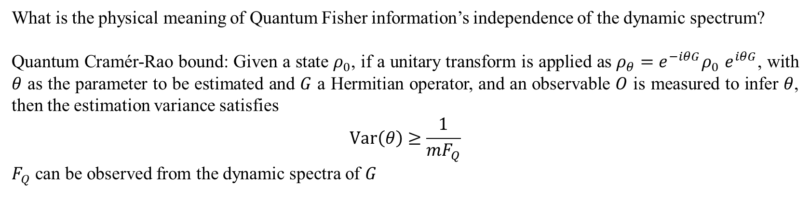
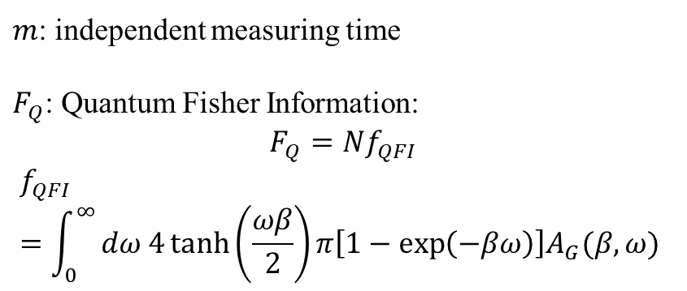

Q&A QFI
What is the physical meaning of Quantum Fisher information’s independence of the dynamic spectrum?
Quantum Cramér-Rao bound: Given a state $ρ_{0}$, if a unitary transform is applied as $ρ_{θ}=e^{−iθG}ρ_{0}$ $e^{iθG}$, with $θ$ as the parameter to be estimated and $G$ a Hermitian operator, and an observable $O$ is measured to infer $θ$, then the estimation variance satisfies
$$Var\left(θ\right)≥\frac{1}{{mF}_{Q}}$$
$F_{Q}$ can be observed from the dynamic spectra of $G$
$m$: independent measuring time
$F_{Q}$: Quantum Fisher Information:
$$F_{Q}=Nf_{QFI}$$
$$f_{QFI}=\int_{0}^{∞}{dω 4\tanh\left(\frac{ωβ}{2}\right)π\left[1−\exp\left(−βω\right)\right]A_{G}(β,ω) }$$
$ρ_{0}$
$$ρ_{θ}$$

Slide 23
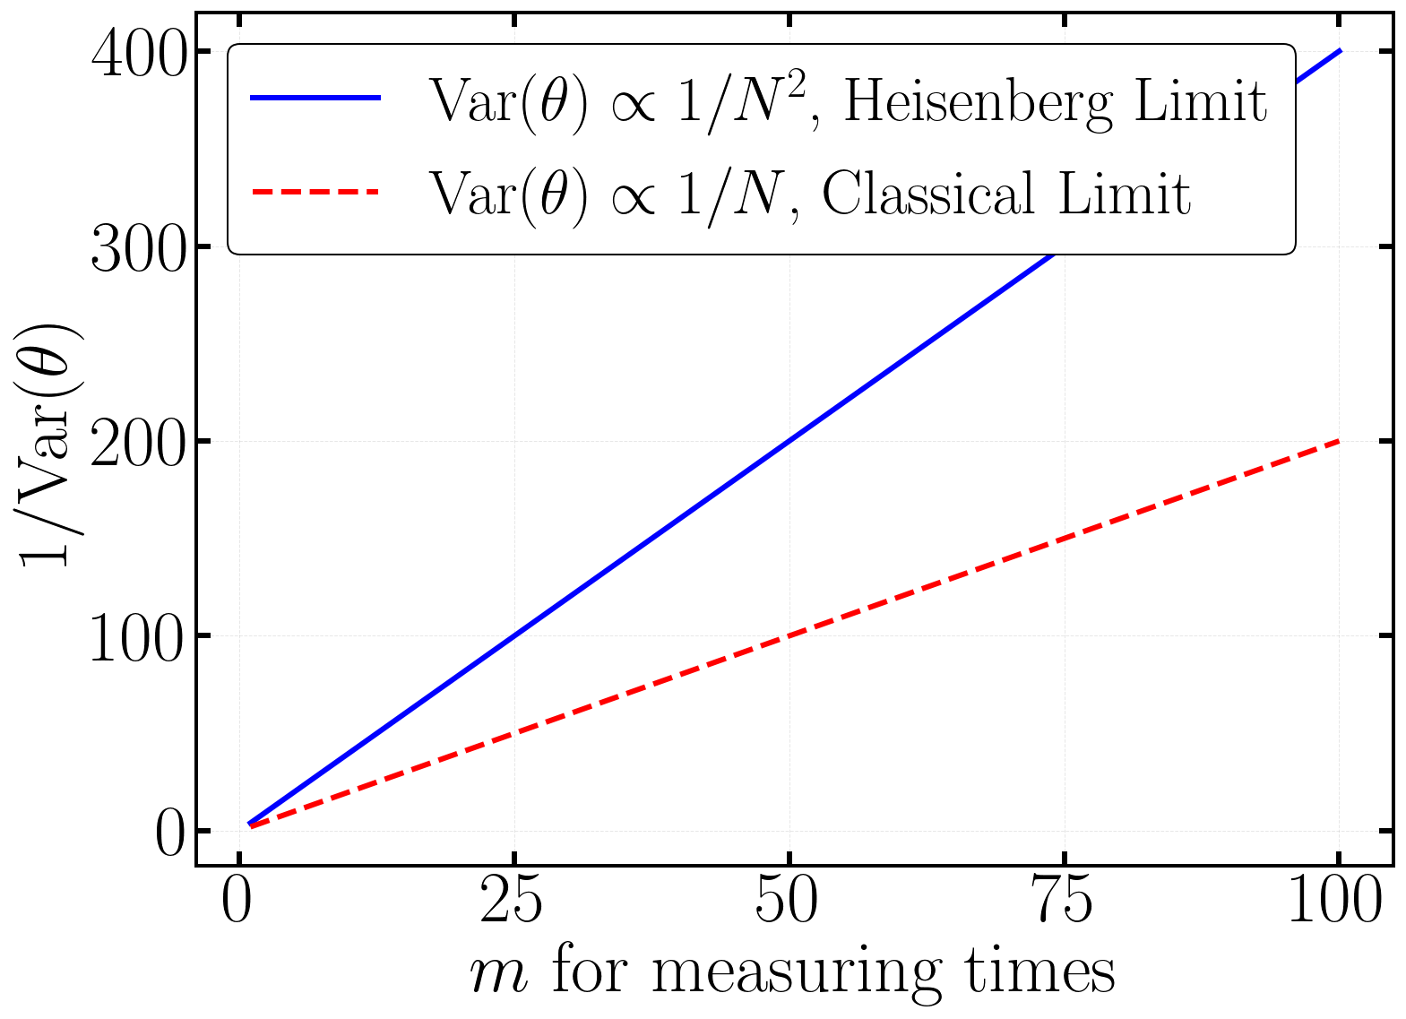
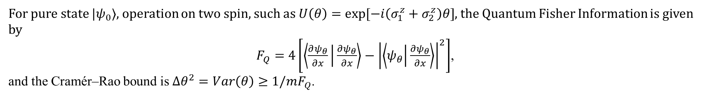


Quantum Fisher Information
Q&A QFI
For pure state $|ψ_{0}⟩$, operation on two spin, such as $U\left(θ\right)=exp⁡[−i\left(σ_{1}^{z}+σ_{2}^{z}\right)θ]$, the Quantum Fisher Information is given by
$F_{Q}=4\left[\left\langle \frac{∂ψ_{θ}}{∂x} | \frac{∂ψ_{θ}}{∂x}\right\rangle −{\left|\left\langle ψ_{θ} | \frac{∂ψ_{θ}}{∂x}\right\rangle \right|}^{2}\right]$,
and the Cramér–Rao bound is $Δθ^{2}=Var\left(θ\right)≥1/mF_{Q}$.
Heisenberg limit: Best entangled
$\frac{1}{\sqrt{2}}(\left|↑↓\right\rangle −\left|↓↑\right\rangle )$,
$$F_{Q}=4$$
$$Δθ∝\sqrt{\frac{1}{F_{Q}}}=\frac{1}{N}$$
Classical limit: Standard quantum
$$\frac{1}{2}(\left|↑\right\rangle +\left|↓\right\rangle )⊗(\left|↑\right\rangle +\left|↓\right\rangle )\text{,}$$
$$F_{Q}=2$$
$$Δθ∝\sqrt{\frac{1}{F_{Q}}}=\frac{1}{\sqrt{N}}$$
Notes:
Not Good

Slide 24


Q&A QFI Lower bound
For $A^{z}\left(q,ω\right)$, ${\left(O_{max}−O_{min}\right)}^{2}={\left(\frac{1}{2}−\left(−\frac{1}{2}\right)\right)}^{2}=1$, therefore
$$f_{QFI, A^{z}}<m$$
For $A^{±}\left(q,ω\right)$= $A^{x}\left(q,ω\right)+A^{y}\left(q,ω\right)$, ${\left(O_{max}−O_{min}\right)}^{2}={2\left(\frac{1}{2}−\left(−\frac{1}{2}\right)\right)}^{2}=2$, therefore
$$f_{QFI, A^{±}}<\frac{m}{2}$$
For $A^{DO}\left(q,ω\right)$= $A^{NSF}\left(q,ω\right)+A^{SF}\left(q,ω\right)$, where (SF/NSF) means spin-flip/non-spin-flip channel with respect to the neutron polarization vector $p$. For $A^{NSF/SF}\left(q,ω\right)$,
${\left(O_{max}−O_{min}\right)}^{2}=\frac{1}{4}\sum_{μ}{{\left|Π_{\left(N\right)SF}^{μ}\right|}^{2}}$,
where
$$Π_{NSF}^{μ}=pz_{μ},{ Π}_{SF}^{μ}=vz_{μ},pv=0$$
Thus
$$f_{QFI, A^{(N)SF}}<m Tr\left[\sum_{μ}{p^{T}z_{μ}^{T}z_{μ}p}\right]=\frac{m}{3}$$
$f_{QFI,A^{DO}}<$ $\frac{2m}{3}$

Slide 25



Q&A QFI in other channel and position
$$L=4$$
$Γ′=(4π,4π,0)$ and $X=\left(0,0,2π\right)$

Slide 26

Understanding
Understanding (1): The absence of spontaneous symmetry breaking [$U(1)$] in a finite system
Understanding (2): Operator chosen
QFI in $S_{±}$ channel, $L=4$
$Γ=\left(0,0,0\right) and Γ′=(4π,4π,0)$
$${QSI}_{0}$$
$$FM$$
$${QSI}_{π}$$
Notes:
u1

Slide 27


Q&A ED and GMFT

