Slide 1
Project for GSI
B&S PHARMA
Made by:
Olavo Simao Marques Silva
Miguel Angelo Barraca Moura
Alberto Rubio Hurtado
Raúl Ojeda Robles

Slide 2
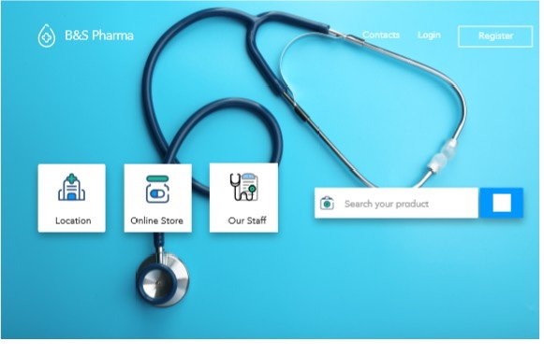
ANALYSIS
● Mockup 1 of main page:

Slide 3
Here we have the main page with a permanent and adaptive bar on top, with the contacts, login and register links. On the left we have the company’s logo.
In the middle we have links to the location, online store and Our Staff where the user can read about the staff.
At last we have a search bar, allowing the user to search for any product they desire. It will link to the online store

Slide 4
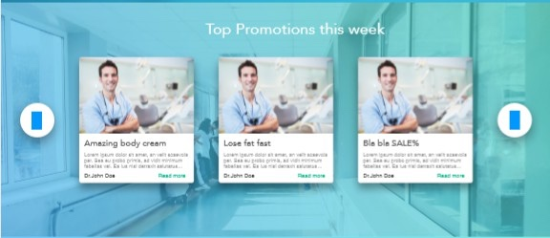
ANALYSIS
● Mockup 2 of main page:

Slide 5
Here we have 3 banners with promos that will be updated weekly.
On the mockup they are filled with Loren ipsum just for visual purposes.

Slide 6
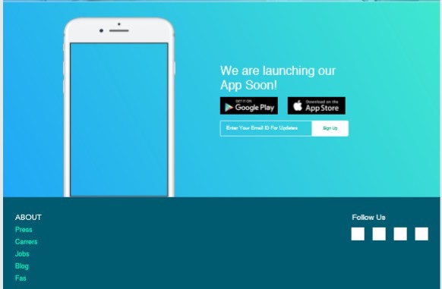
ANALYSIS
● Mockup 3 of main page:

Slide 7
This is situated at the bottom of the screen. It has links to the press, carreers/Jobs, offering possible jobs at our company, Blog, where users can comment ant discuss products and FAQ’s with frequently asked pictures.
There is also an add to a future app that could be developed.

