Slide 1
Project for GSI
B&S PHARMA
Made by:
Olavo Simao Marques Silva
Miguel Angelo Barraca Moura
Alberto Rubio Hurtado
Raúl Ojeda Robles

Slide 2
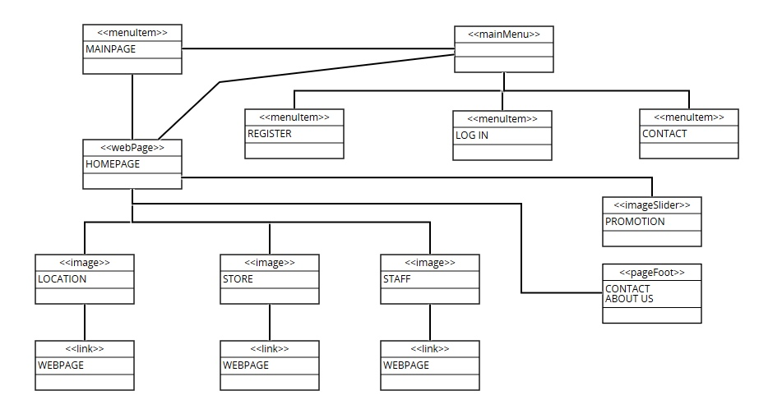
ANALYSIS
● The class diagram has been done based on the information
requirements and user interface requirements included in
the REM file.

