Slide 1
Project for GSI
B&S PHARMA
Made by:
Olavo Simao Marques Silva
Miguel Angelo Barraca Moura
Alberto Rubio Hurtado
Raúl Ojeda Robles

Slide 2
DESIGN
The implementation was done in Wordpress, using a simple theme which allowed us to pop a bar on top, as described in the mockups, as well as a big banner with the links to our location, online store and staff.
The search bar was also done alongside the promos section, although with a different design. The presented Wordpress is subject to modifications until the end of the semester.

Slide 3
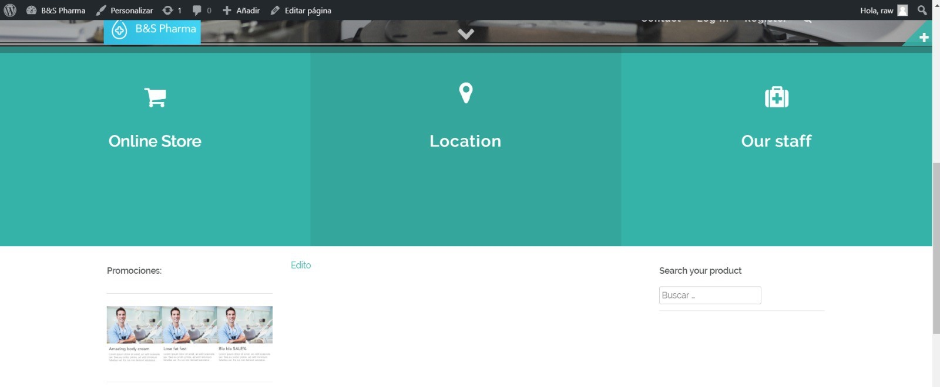
IMPLEMENTATION
● Implementation made by Wordpress.

Slide 4
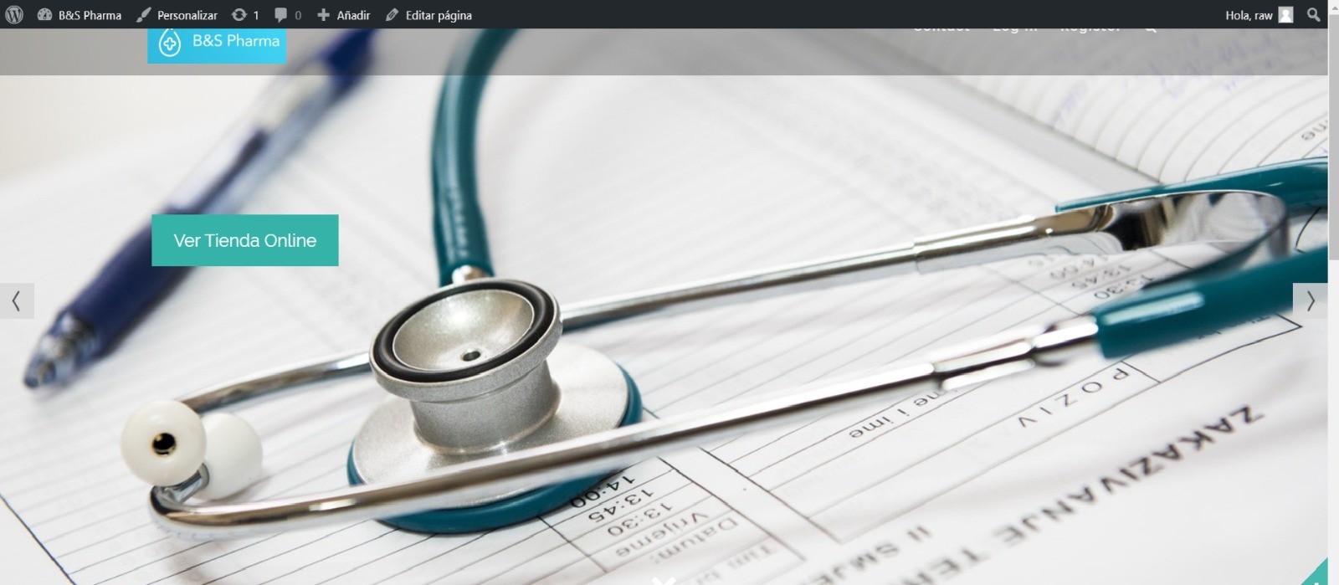
IMPLEMENTATION
● Implementation made by Wordpress.

