Slide 1
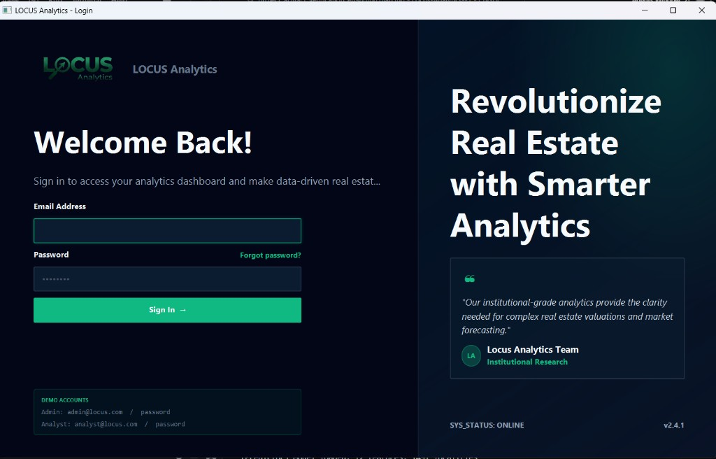
LOCUS Analytics
Institutional Real-Estate Intelligence Platform
Project Presentation
• FAST-NUCES SDA Project
• Team: Fasih 24i-5017 | Arham 24i-0640 | Ayaan 24i-0663
• Data-driven property intelligence for Pakistan
Login / Brand Experience

Slide 2
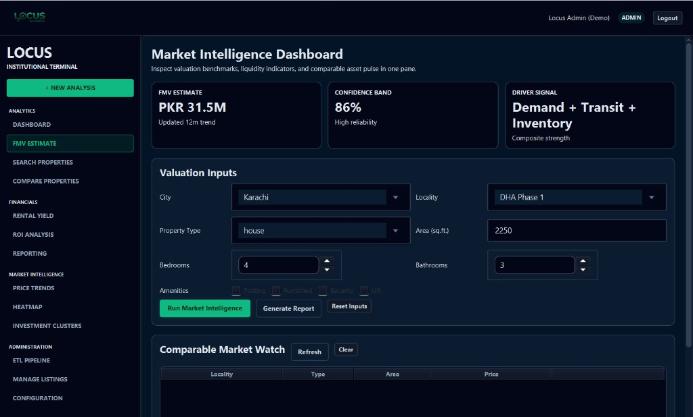
Project Idea
What problem are we solving?
Core Idea
• Replace fragmented manual analysis with one integrated platform.
• Enable reliable FMV, ROI, rental yield, and market insight workflows.
• Support both analyst operations and admin data governance.
FMV Workflow

Slide 3
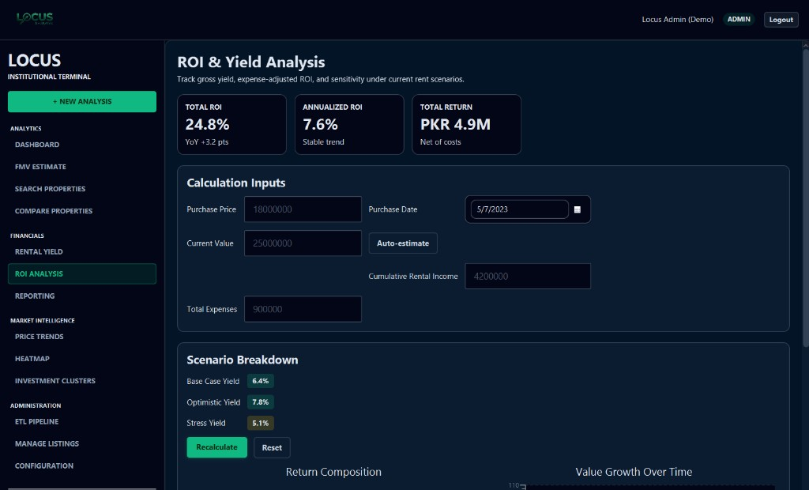
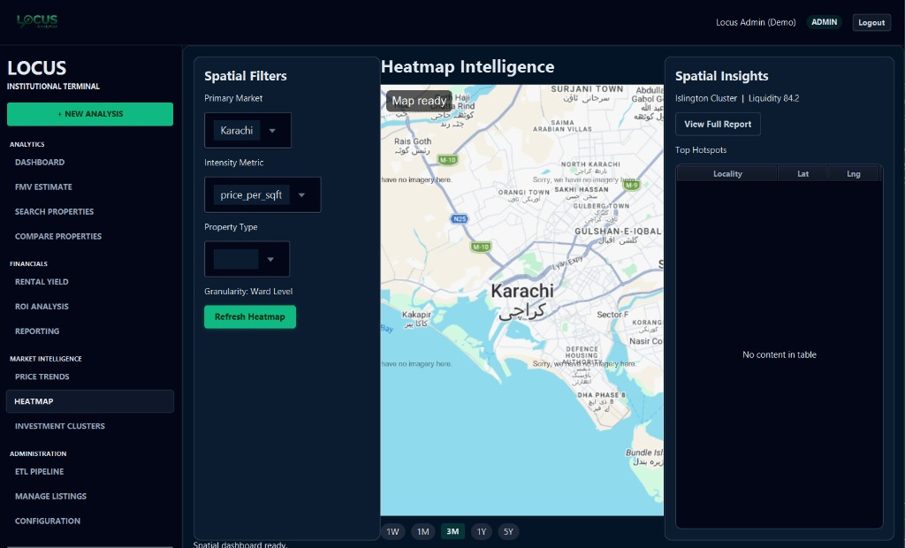
System Overview
Architecture and product flow
Overview
• JavaFX Desktop UI with role-based access (Analyst/Admin).
• Layered architecture: UI -> Services -> DAOs -> PostgreSQL.
• Python ETL + ML pipeline integrated with reporting workflows.
• Client-facing PDF valuation report generation.
ROI & Yield Analysis
Heatmap Intelligence

Slide 4
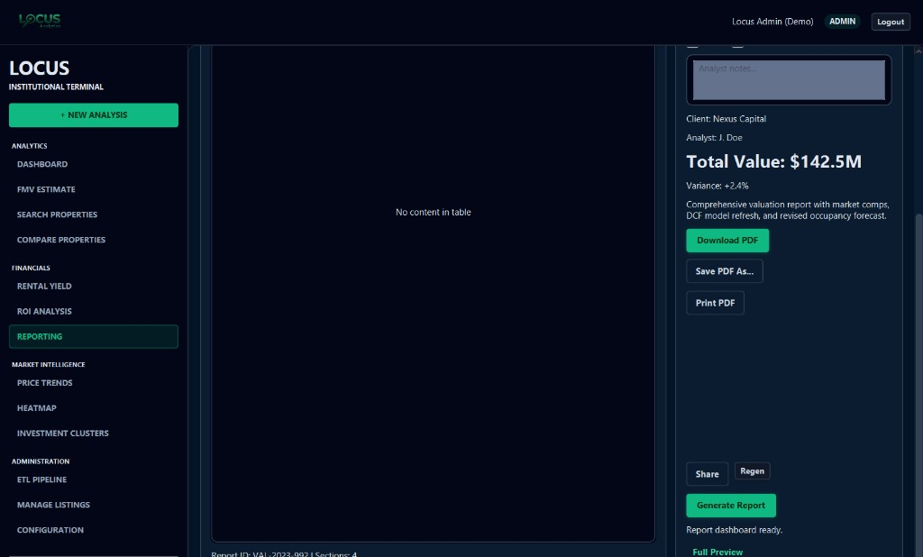
Implemented Use-Cases
Analyst workflows (UC-1 to UC-9)
Analyst Use-Cases
UC-1 FMV Estimation
UC-2 Rental Yield
UC-3 ROI Analysis
UC-4 Search Properties
UC-5 Compare Properties
UC-6 Price Trends
UC-7 Heatmap
UC-8 PDF Report Generation
UC-9 Investment Clusters
Reporting Module

Slide 5
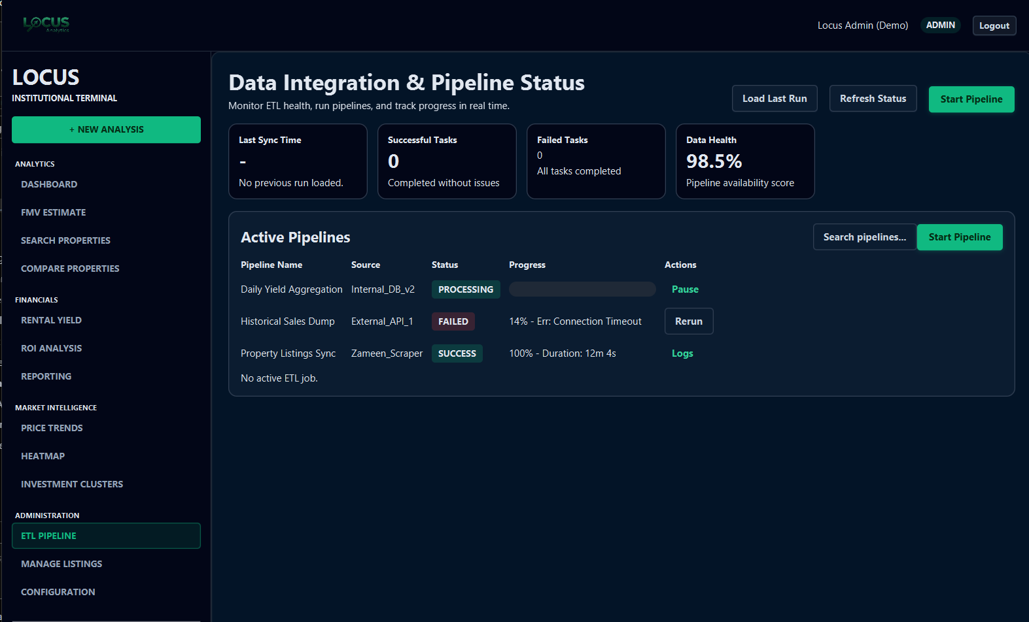
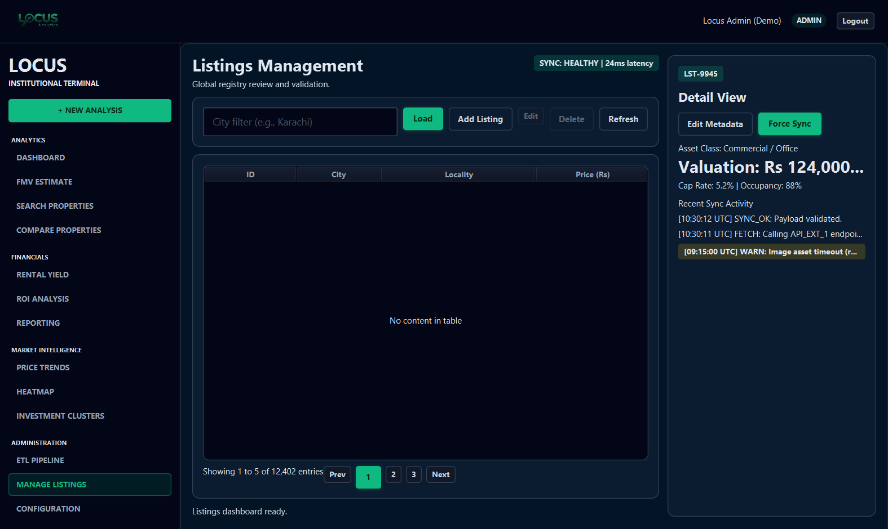
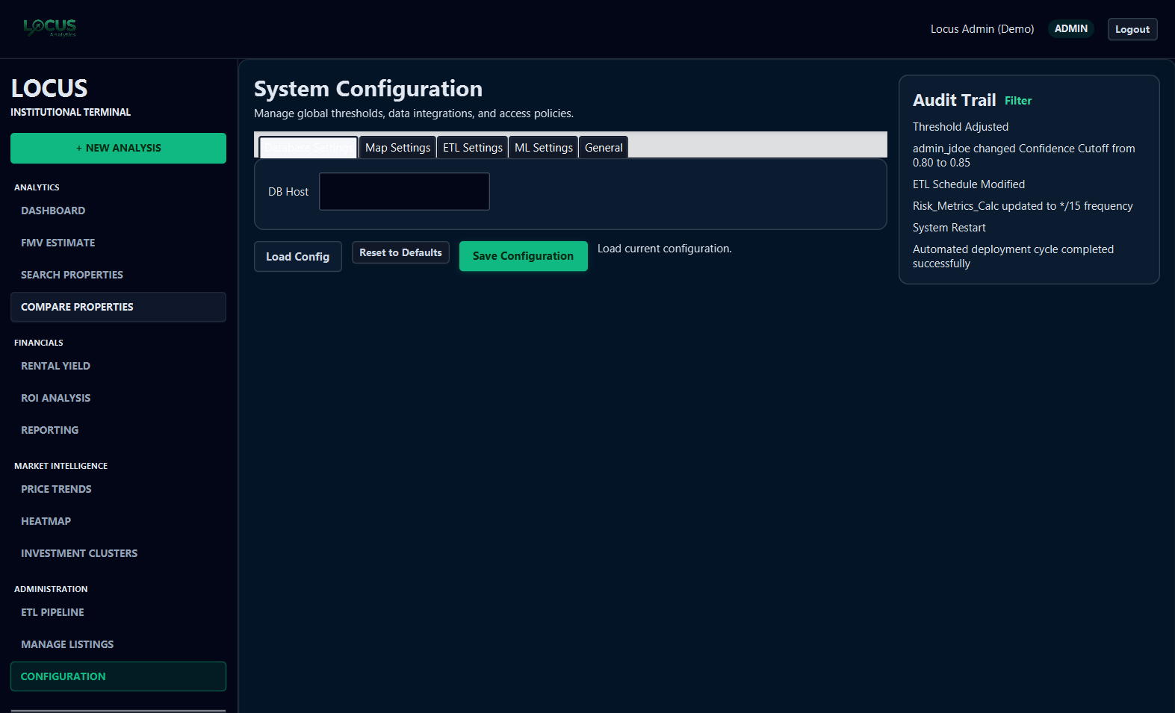
Implemented Use-Cases
Administrator workflows (UC-10 to UC-12)
Admin Use-Cases
• UC-10 Run ETL Pipeline
• UC-11 Manage Property Listings
• UC-12 Manage System Configuration
• Admin role can also perform analyst workflows.
Listings
ETL Screen
Configuration

Slide 6
Project Value
Why this matters
Delivered Impact
• One platform for valuation, market intelligence, and operational control.
• Decision support through transparent analytics workflows.
• Scalable architecture for future extensions (cities, features, channels).
Thank you

