Slide 1
TEAM 25
Day 1 PNL
107,674
Arham Aamir · Ali Sher · Sepehr Nassertork · Dev Arun
Notes:
DEV (0:10)
Hi, we're Team 25. I'm Dev, and this is Ali, Arham and Sepehr. Our whole approach fits in one sentence: no position without a measured pattern.

Slide 2
Pattern recognition is key
Strong pattern → full size
TOFFEE · LANTERNS · 10 vouchers · PINK · BLUE · GOLDEN · AMETHYST
Probable pattern → a sized bet
LYCHEE seems pulled back to ~7,436, so we bet half of what the backtest wanted
No pattern → tiny caps
TELLURIUM · JELLY · PEANUT_BUTTER · fruits · basket · WHITE · BLACK: earn the spread, hold almost nothing
Blue: trends. Orange: snaps back. Grey: no memory. Vouchers and pearls have other patterns (next slides).
Notes:
DEV (0:35)
There are 26 products. For each one we first asked: is there a pattern we can measure?
This chart is one test: does a 100-tick move predict the next one? LANTERNS trends, TOFFEE and AMETHYST snap back, and most products have no memory.
Then we sized each bet by how sure we were: full size for strong patterns, a deliberately sized bet on LYCHEE, whose pattern is probable but not proven, and tiny caps where there's no pattern. That made 409,590 on UTEFA's site. Ali will start with the core products.

Slide 3
Part 1: Core products with one recipe
Fair value
Take
Make
1
2
3
our estimate of the true price
any quote clearly through it
join the best bid and ask, or skew away from our position
Product | Pattern | Fair value | Execution | Cap / limit | Profit
TOFFEE_CAKE | snaps back to 5,000 | very slow EMA from 5,000 | take + skew | 50 / 50 | 65,395
PAPER_LANTERNS | trends persist | EMA + 0.75 × last 100-tick move | take + join | 50 / 50 | 55,466
AMETHYST | fixed at 10,000 | 10,000 | take + join | 50 / 50 | 1,613
TELLURIUM | random, big jumps | none | join only | 6 / 40 | 14,266
JELLY, PEANUT_BUTTER | random walks | EMA (50 / 20 ticks) | skew only | 3 / 50 | 1,466
Part I total |  |  |  |  | 138,206
Cap: the most we'll hold. A cap far below the exchange limit means there's no edge, so we hold little and just earn the spread.
Notes:
ALI (0:25)
All six core products use the same recipe: estimate a fair value, take any quote clearly through it, and quote with the rest.
What changes is the fair value and the cap. TOFFEE and LANTERNS have strong patterns, get the full 50, and make 87% of Part I. With no pattern, we hold at most 6 or 3 and just earn the spread.

Slide 4
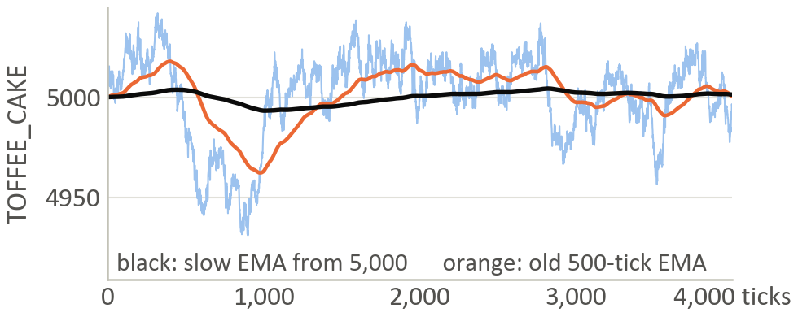
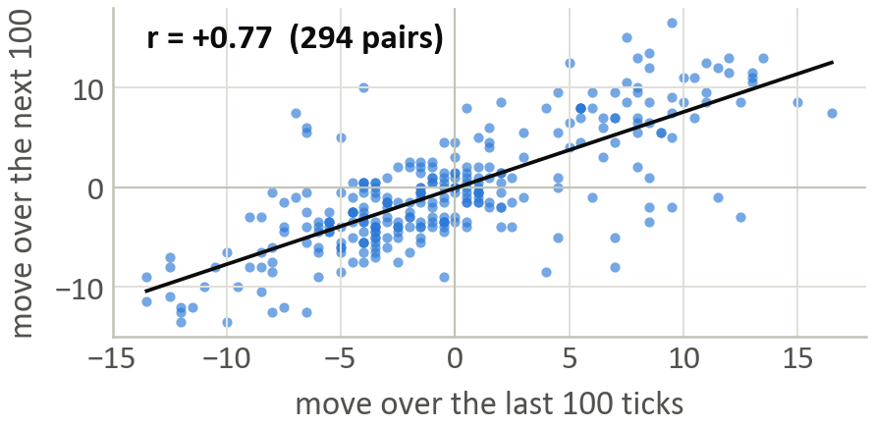
TOFFEE snaps back and LANTERNS keeps trending
TOFFEE_CAKE · mean reversion
PAPER_LANTERNS · momentum
Light blue: price. It keeps returning to ~5,000. Our first 500-tick average (orange) just chased it.
Each dot: two back-to-back 100-tick moves. A rise is usually followed by another rise.
Fair: slow average that starts at 5,000 → 65.4K
Fair: average + 0.75 × the last 100-tick move → 55.5K
Trade-off: hard-coded 5,000 made 67K, but lost up to 7.3K a day when the level moved 25
Robust: every weight from 0.5 to 1.0 made 45–55K
Part I total: 138.2K, up from 60.0K in our first version
Notes:
ALI (0:40)
TOFFEE keeps coming back to about 5,000. Our first version's 500-tick average just chased the price. Now we use a very slow average that starts at 5,000: 65K.
The trade-off: hard-coding 5,000 made slightly more, 67K, but if the level shifts by 25 it loses up to 7K a day. So we chose the version that adapts.
LANTERNS is the opposite. Each dot is two back-to-back 100-tick moves, and a rise is usually followed by another rise: correlation 0.77. So fair value adds three-quarters of the recent move: 55K, and every nearby setting made 45 to 55K.

Slide 5
Challenge 1: with 3 days every tweak looks good
A change ships only if it wins every test
3 days
6 half-days
3-way rotation
nearby settings
stress days
mirrored days
wrong-world days
Caught: re-tuned voucher settings looked better on the tuning days but lost 11.4K on the hidden days. We kept the old ones.
Rotation: tune on 2 days, test on the hidden 3rd, three times. Orange ≈ blue means the gains are real, not fitted.
Notes:
ALI (0:40)
Our first challenge: with only three days of data, almost any tweak makes the backtest go up.
So a change only goes in if it beats the old version on every test: each day, each half-day, tuning on two days and testing on the hidden third, nearby settings, and stress days with the pattern shifted, mirrored or removed.
The chart shows it worked: the gain on the hidden day, in orange, matches the tuned gain in blue.
And it caught real overfitting: re-tuned voucher settings lost 11K on the hidden days, so we kept the originals. Arham will cover the options.

Slide 6
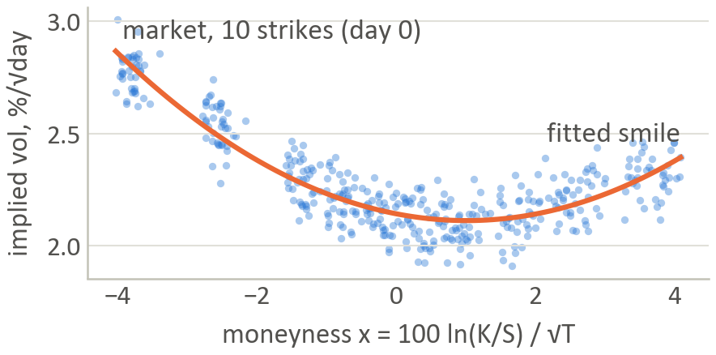
Part 2: Ten vouchers use the help of smile
1 · One smile fits all ten strikes
2 · Price every strike with Black–Scholes
1
Black–Scholes backwards on each price → implied vol
C = S·Φ(d₁) − K·Φ(d₂)
2
Fit one smile through all 10 strikes
σ(x) = a + b·x + c·x², x = 100·ln(K/S) / √T
3
Fair price = Black–Scholes at the smile's vol
4
Trade the gap: sell 3.5 above fair, buy 3.5 below
Implied vol vs moneyness, day 0. A strike misses the smile by only ~0.09 vol points.
197K
62K vs 49K
82 → 40
from the 10 vouchers: our biggest source
a day: one smile vs pricing each strike alone
hidden LYCHEE exposure, halved by shading prices (~1K). Hedging: 14–55K
Notes:
ARHAM (0:40)
The ten vouchers are call options on LYCHEE. For each strike we run Black–Scholes backwards on its price to get an implied volatility. All ten land on one smooth smile, on the left, so every tick we fit a parabola through them.
A strike's fair price is Black–Scholes at the smile's volatility. When a strike is 3.5 coins above fair we sell, 3.5 below we buy. That's 197K, our biggest source, and one shared smile beats pricing each strike alone: 62K versus 49K a day.
Hedging the LYCHEE risk would cost 14 to 55K, so we shade our prices instead, which halves it for about 1K.

Slide 7
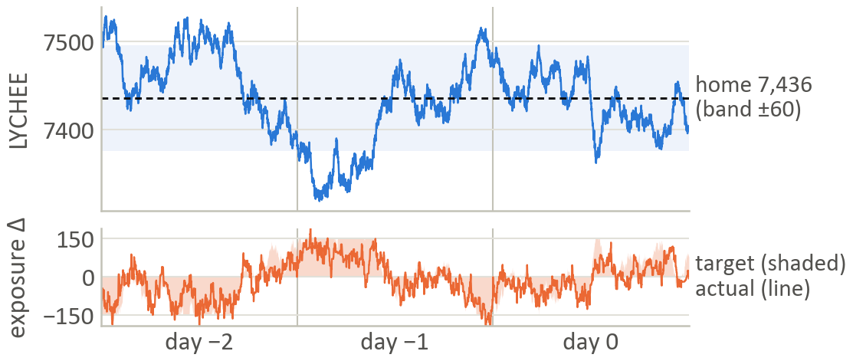
LYCHEE's leash isn't proven so we bet half
Top: LYCHEE kept returning to ~7,436 (band ±60). Bottom: our exposure target (shaded) and actual (line).
150, not 300
−2.80
+10–13K / −10–16K
300 scored best in the backtest. We halved it
ADF test (5% bar: −2.86). 1 in 10 random walks look this leashed
a day if the leash holds / if LYCHEE runs away instead
Notes:
ARHAM (0:35)
LYCHEE looks random tick by tick, but over hours it kept returning to about 7,436, on the left. The ADF test gives −2.80, just short of the −2.86 bar: probable, not proven.
So we sized it as a bet. On the right: the further LYCHEE is from home, the more exposure we take against it, up to 150, through the vouchers we already trade. The backtest wanted 300; we chose half. At 150 we gain 10 to 13K a day if the leash holds, and lose 10 to 16K if it doesn't.

Slide 8
Challenge 2: the site said 192K, we said 415K
1
Uploaded each part alone: only the LYCHEE part broke (212K here, −12K there)
2
Its one unverified input: a trade-flow signal read from other traders' trades
3
Turned it off: 409,590 on both, to the coin. It had been worth just 5.6K
Lesson: never depend on an input you can't verify, and cap every adjustment.
Notes:
ARHAM (0:35)
Our second challenge came the night before the deadline: UTEFA's site showed 192K for our bot, while our backtester said 415K.
We uploaded each part on its own. Core and pearls matched, but the LYCHEE part made 212K here and lost 12K there.
Its one unverified input was a trade-flow signal built from other traders' trades. We turned it off, and both said 409,590, to the coin. It had been worth just 5.6K.
The lesson: never depend on an input you can't verify. Sepehr will cover the pearls.

Slide 9
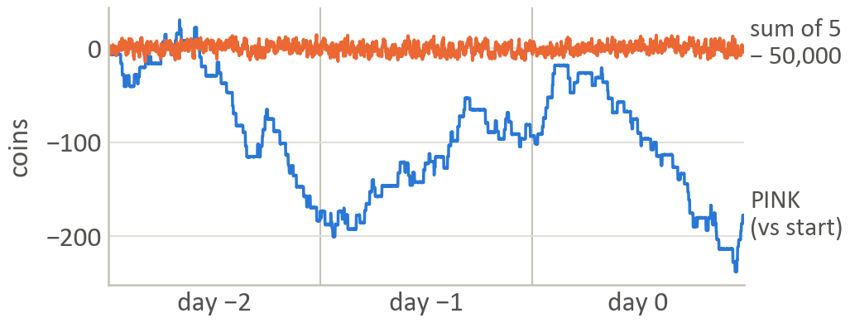
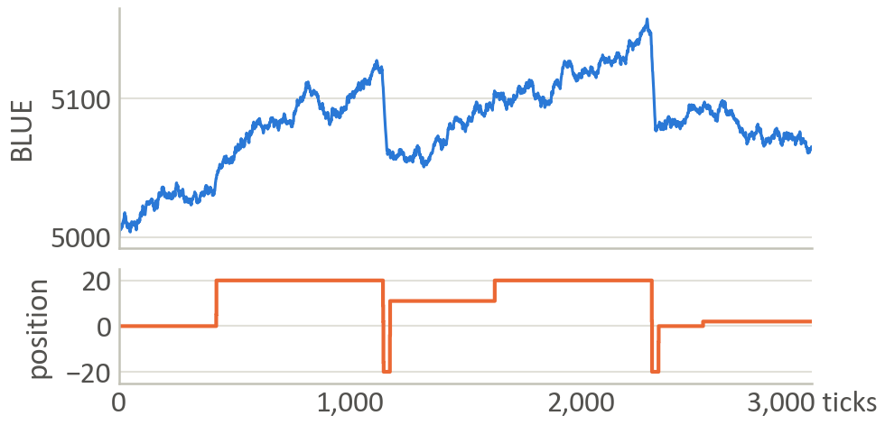
Part 3: PINK closes the 50,000 sum and BLUE saws
PINK · fair = 50,000 − the other four
BLUE · hold the creep, ride the drop
PINK wanders 200+ coins (blue). The five pearls' sum − 50,000 stays within a few coins (orange).
Top: BLUE creeps up, then drops ~45 in under 50 ticks. Bottom: our position.
27.1K. Only PINK closes the gap. The same idea on the other pearls lost 10–30K each.
27.7K. Trade-off: a slower drop detector. 5K less in the backtest, but it loses 2K (not 18–23K) on days with no sawtooth.
Part III total: 64.9K (GOLDEN's step levels 4.9K, WHITE + BLACK 5.1K)
Notes:
SEPEHR (0:40)
The five pearls always sum to 50,000, even though each one moves a lot. Only PINK closes that gap, so its fair value is 50,000 minus the other four: 27K. The same idea lost 10 to 30K on each of the other pearls, so we didn't use it there.
BLUE has a sawtooth: it creeps up slowly, then drops about 45 coins in under 50 ticks. We hold the creep and ride the drop: 28K.
The trade-off is the drop detector. A faster one made 5K more in the backtest, but on days without the sawtooth it loses 18 to 23K, against 2K for ours.

Slide 10
Challenge 3: our first pearl bot's 7K was luck
82% luck
e.g. +3,295 on WHITE in one day, from being short while it fell 460
Fix: split every pearl's profit this way. Build a strategy around any patterns: BLUE's saw, PINK's sum, and GOLDEN's steps. No pattern? Small inventory cap?
7.0K → 64.9K
We split each product's profit into what the quotes earned and what came from holding a position while the price moved.
pearls, positive on all 6 half-days
Notes:
SEPEHR (0:35)
Our third challenge was profit that was really luck. Our first pearl bot made 7,000, and it looked fine.
When we split its profit into what our quotes earned and what came from holding while the price moved, 82% was luck. For example, 3,300 on WHITE in one day, just from happening to be short while it fell 460.
So we split every product this way and built only on real patterns. Pearls went from 7K to 65K, positive on all six half-days. Dev will wrap up.

Slide 11
Steady every day, and we know the worst case
 | Day −2 | Day −1 | Day 0
Profit | 130.4K | 140.6K | 138.5K
Largest drop | 6.3K | 6.9K | 3.4K
Sharpe-style | 5.8 | 6.4 | 6.6
If we're wrong
LYCHEE has no leash: −10 to −16K that day
BLUE's sawtooth vanishes: about −2K
any other pearl pattern vanishes: at most 2–4K
No position without a measured pattern, and every bet sized to the evidence.
Notes:
DEV (0:30)
The result is steady: 130 to 141K on each day, the largest drop under 7K, and a Sharpe-style ratio around 6.
And we know our downside: if LYCHEE has no leash we lose 10 to 16K that day; if BLUE's sawtooth disappears, about 2K.
No position without a measured pattern, and every bet sized to the evidence. Thank you, we're happy to take questions.

Slide 12
Thank you.
TEAM 25
Arham Aamir · Ali Sher · Sepehr Nassertork · Dev Arun
Notes:
Q&A (3:00). Answer in 1–3 sentences, then stop. Whoever owns the part answers; Dev takes big-picture questions. Backup slides start at 13: type the number and press Enter in slideshow mode to jump.

Slide 13
Backup · profit by product (3 training days)
Product | Day −2 | Day −1 | Day 0 | Total
TOFFEE_CAKE | 22,277 | 21,382 | 21,736 | 65,395
PAPER_LANTERNS | 19,153 | 18,159 | 18,154 | 55,466
TELLURIUM | 1,274 | 5,680 | 7,313 | 14,266
AMETHYST | 527 | 608 | 478 | 1,612
PEANUT_BUTTER | −346 | 1,710 | −3 | 1,362
JELLY | −488 | 178 | 415 | 104
VOUCHER_7400 | 12,780 | 15,391 | 9,910 | 38,082
VOUCHER_7500 | 11,096 | 13,399 | 7,486 | 31,981
VOUCHER_7300 | 12,353 | 7,605 | 7,435 | 27,393
VOUCHER_7600 | 10,524 | 8,916 | 6,738 | 26,178
VOUCHER_7000 | 5,895 | 3,361 | 16,902 | 26,158
VOUCHER_7750 | 5,716 | 8,737 | 4,511 | 18,964
VOUCHER_7200 | −1,277 | 4,024 | 7,811 | 10,558
Product | Day −2 | Day −1 | Day 0 | Total
VOUCHER_7900 | 5,213 | 1,460 | 1,951 | 8,624
VOUCHER_6800 | 3,371 | 1,852 | 2,366 | 7,589
VOUCHER_8100 | 780 | 450 | 306 | 1,536
LYCHEE | 4,021 | 2,681 | 2,316 | 9,018
MANGOSTEEN | 122 | −62 | 426 | 485
GRANADILLA | 30 | 78 | 8 | 115
DRAGONFRUIT | 44 | 150 | −122 | 72
FRUIT_BASKET | −148 | 638 | −707 | −218
BLUE_PEARLS | 6,133 | 10,664 | 10,950 | 27,747
PINK_PEARLS | 10,192 | 8,165 | 8,741 | 27,098
GOLDEN_PEARLS | 125 | 1,998 | 2,762 | 4,886
WHITE_PEARLS | 773 | 3,432 | 265 | 4,470
BLACK_PEARLS | 288 | −38 | 400 | 650
Totals: Part I 138,206 · Part II 206,534 · Part III 64,850 · all 409,590 (site-verified)

Slide 14
Backup · trade-offs we made (1 of 2)
Decision | We chose | Why
LYCHEE lean size | 150 (not 300, the backtest's favourite) | The leash isn't proven (ADF −2.80). A wrong-way day costs 10–16K at 150; 150 → 200 adds 1.7K on good days but costs 2.5K on bad ones
TOFFEE fair value | Slow average from 5,000 (not hard-coded) | Hard-coded lost up to 7.3K/day when the level shifted 25. The slow average won all 24 test days
BLUE drop detector | 10 ticks, trigger 12 (not 5 ticks, trigger 8) | The faster one made +5K in-sample but loses 18–23K on days without the sawtooth, against 2K for ours
Voucher LYCHEE risk | Shade prices (not delta-hedge) | Halves exposure (82 → 40) for ~1K; hedging costs 14–55K. The shade is capped at 5 coins
Basket arbitrage | Rejected; cap 1 | The basket-vs-fruits gap drifts by hundreds (t = −1.6). Limits cap any hedge at ~13 baskets
Trade-flow signal | Off (was +5.6K locally) | It reads an input the site fills differently; it broke the voucher book there

Slide 15
Backup · trade-offs we made (2 of 2)
Decision | We chose | Why
Voucher parameters | Keep the original settings | Re-tuning lost 11.4K on the hidden days: overfitting
PINK sum target | Slow average from 50,000 | Hard-coded 50,000 failed 3 of 6 shifted-sum stress days
Random walks | Caps 1–6 | No edge means holding is luck. TELLURIUM at cap 40 swung −20K to +25K a day
Voucher fair value | One smile across all strikes | ~62K/day vs ~49K/day using each strike's own average vol
How to fade LYCHEE | Through the vouchers | Trading LYCHEE itself: crossing its spread ate the edge (median −7K/day)
Libraries | Plain Python | We couldn't confirm numpy/pandas on the server, and a crash would zero everything

Slide 16
Backup · ideas we tested and dropped
Idea (where it came from) | What we found
Basket vs fruits arbitrage (Prosperity 2/3) | The gap drifts −779 → +900 → −200 and doesn't revert
"Wall-mid" taking (Prosperity 2/3) | Our books have no deep wall. Taking loses 1–4 per unit
Following specific counterparties | Buyer and seller names are always blank
Deep out-of-the-money "bid 0" trick | VOUCHER_8100 trades at 2–44, never 0–1
JELLY / PEANUT_BUTTER pair trade | Correlated (+0.71), but the spread's half-life is 336–2,108 ticks and unstable
Per-strike vol offset on top of the smile | Within noise: 1 in 8 variants would pass by luck
Cubic smile, vega-weighted or leave-one-out fit | No better, or slightly worse
PINK's sum fair value on the other pearls | Loses 10–30K each. Only PINK adjusts
Full 5-pearl arbitrage | Possible only ~20 ticks a day, for ≤ 3 coins
Delta-hedging the vouchers | Costs 14–55K over 3 days
Trade-flow signals (vouchers, TELLURIUM) | TELLURIUM −1.9K. Vouchers +1.4% locally, but broke on the site

Slide 17
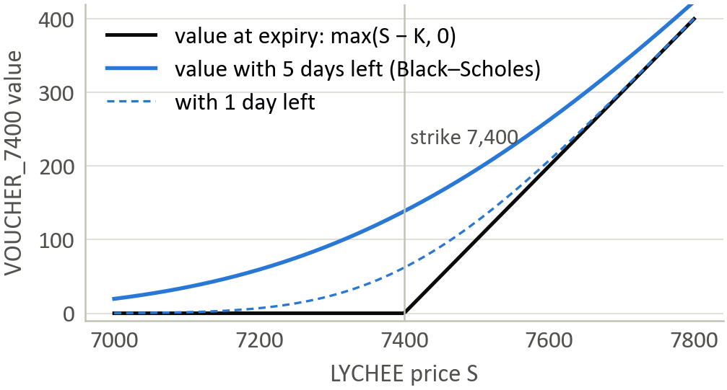
Backup · how we price a voucher
Black–Scholes (r = 0, T in days, σ per √day)
C = S·Φ(d₁) − K·Φ(d₂)
d₁ = [ln(S/K) + ½σ²T] / (σ√T), d₂ = d₁ − σ√T
The smile, refit every tick
σ(x) = a + b·x + c·x², x = 100·ln(K/S) / √T
Implied vol by Newton's method (price error ÷ vega)
Exposure and the shade
Δ = LYCHEE position + Σ delta × voucher position
fair −= 0.05 × (Δ − target) × delta, capped at 5 coins
target = −150 × clip((S − 7,436) / 60, −1, 1)
VOUCHER_7400 is a call: the right to buy LYCHEE at 7,400. Before expiry it's worth more than max(S − K, 0).

Slide 18
Backup · is LYCHEE really leashed?
−2.80
1 in 10
ADF t-stat; the 5% bar is −2.86
random walks look this leashed by luck
7,316–7,530
72 / 72
LYCHEE's whole range over 3 days
lean settings improved every hidden day
If there's no leash: the lean run backwards lost 10.0K / 12.0K / 15.6K a day; its expected value is about −0.7K a day. If the leash is real: about +11K a day.

Slide 19
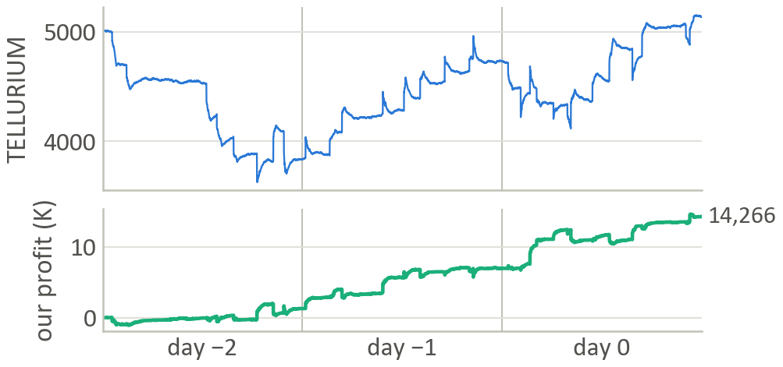
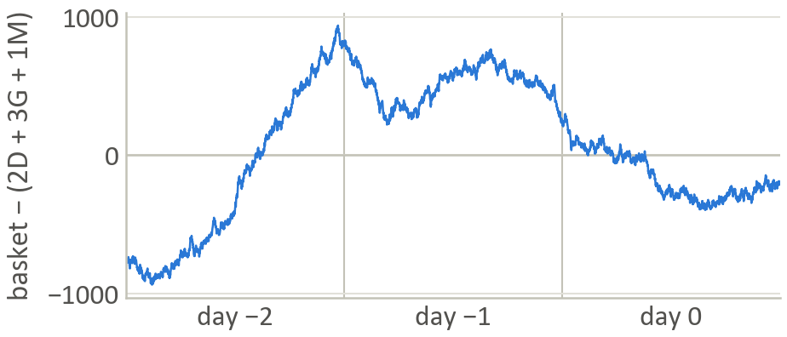
Backup · products with no pattern get tiny caps
TELLURIUM · join only, cap 6 → 14.3K
FRUIT_BASKET ≠ 2 DRAGON + 3 GRANADILLA + 1 MANGO
Top: 100–380-coin jumps. Bottom: our profit with a cap of 6 still climbs. Caps 4–8 were positive every day.
The basket minus its fruits drifts by hundreds instead of snapping back, so there's no safe arbitrage: cap 1.
JELLY and PEANUT_BUTTER: caps cut to 3. Day-to-day swing fell from sd 997 to 360 and from 2,028 to 755, with the same average.

Slide 20
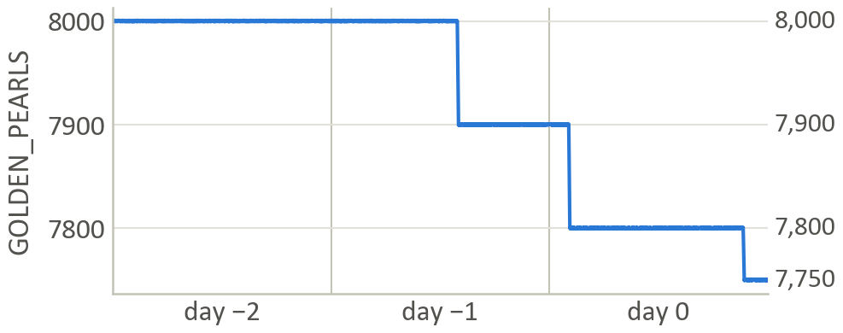
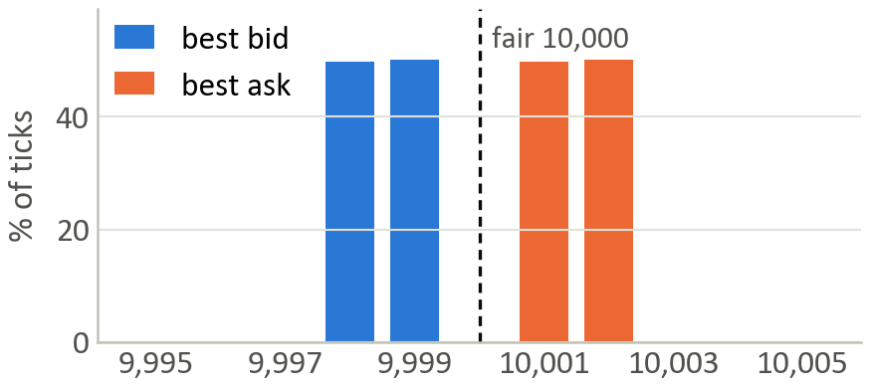
Backup · GOLDEN steps between levels; AMETHYST never moves
GOLDEN_PEARLS · ride the slide → 4.9K
AMETHYST · fixed at 10,000 → 1.6K
Flat at 8,000 for all of day −2, then slides to 7,900, 7,800, 7,750 at 1–2 coins a tick. Quote around a level; ride a break of 3+.
Best bid 9,998–9,999, best ask 10,001–10,002 on every tick. Nothing to take, only a tiny spread to earn.

Slide 21
Backup · every test a change had to pass
1
2
3
4
3 days
6 half-days
3-way rotation
Nearby settings
better on each training day
better on each half of each day
tune on 2 days, test on the hidden 3rd
a plateau, not a lucky peak
5
6
7
8
Stress days
Mirrored days
Wrong-world days
Fuzz test
TOFFEE home ±25, level steps, shifted pearl sum
prices flipped upside down
the pattern removed or reversed
3,000 broken ticks: 0 crashes, 0 bad orders, 0.27 ms a tick

