Slide 1
MMAConnect Connecting Minds, Empowering Futures
Group 5: Arham Anwar, Vivi Li, Kelly Liu, Ivy Lou, Hongyi Zhan

Slide 2

Project Overview
M
MMA Hub
Review
Connection
Career
Provide user-friendly online platform tailored to the needs of MMA students
Empower students to provide valuable course ratings and reviews
Form strong bonds among faculties, alumni, and students
Improve MMA students’ career opportunity by encourage industry-related connections

Slide 3
Mission Statement
MMAConnect aims to provide a comprehensive online platform for MMA students, offering course reviews, focused discussions, and networking opportunities with peers, faculties, and alumni.
Our platform enhances the MMA student experience by fostering collaboration and meaningful connections within the MMA community.

Slide 4
Mission Objective
01
03
Empowering Course Selection
Cultivating Alumni and Faculty Connections
To develop an efficient data entry system for MMA students to input ratings and feedback on their courses
To design a user-friendly interface for students to explore and access detailed reviews and insights about past courses
To implement a mechanism for students to discover alumni and faculties who are relevant to topics of interest
To develop a system where all users can post threads on the interested topics, fostering engaging discussions and knowledge exchange
02
04
Engaging in Industry Discourse
Nurturing a Unified Community
To set up topic-centric discussion threads for users to engage in industry-related conversations
To implement connection tools that allow students to work together on projects and initiatives

Slide 5
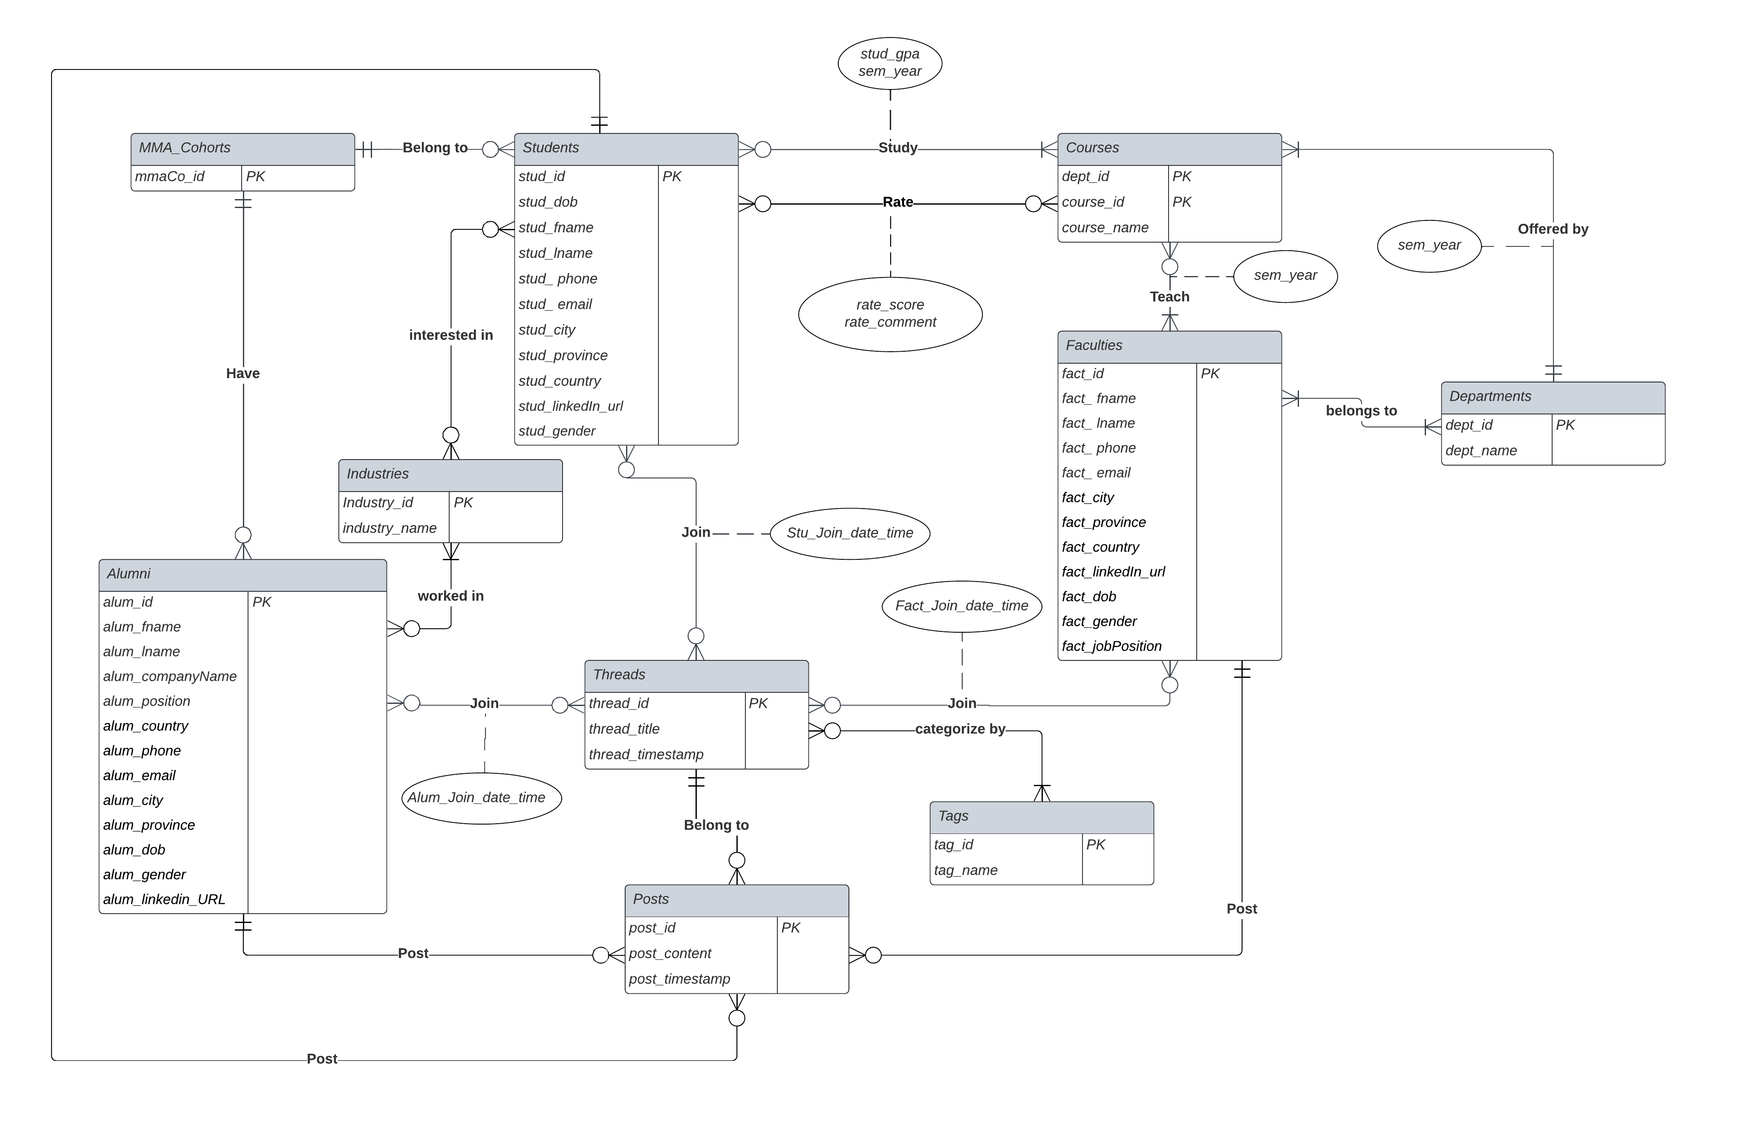
ERD

Slide 6
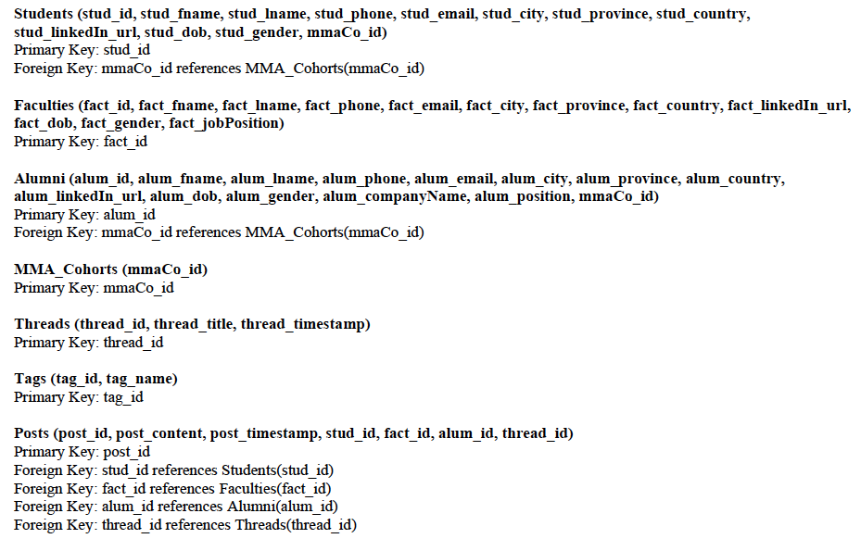
Relational Schema

Slide 7
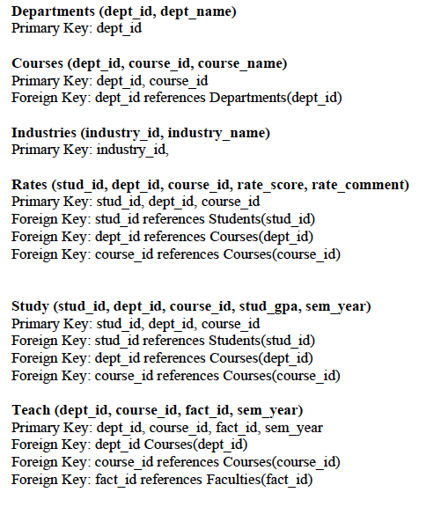
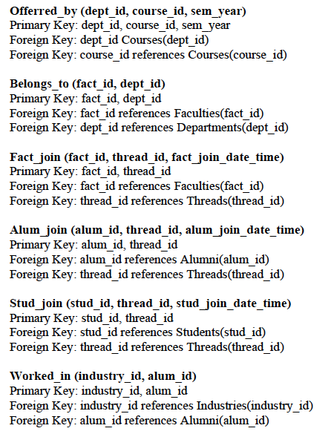
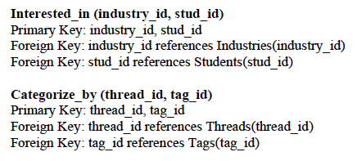
Relational Schema

Slide 8
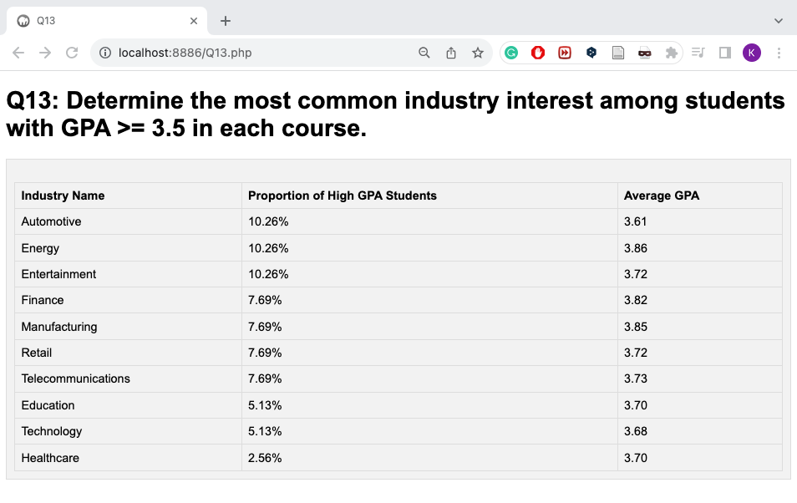
Interesting Queries
Query 1 (Q13) Determine the most common industry interest among students with GPA >= 3.5 in each course.
Knowing the most common interest among students can be beneficial for:
Organize career fairs focused on popular industries to ensure students have the best chance to kickstart their careers.
Network with companies in favored industries for internships and job opportunities.
Forge research and development partnerships with leading industry players.

Slide 9
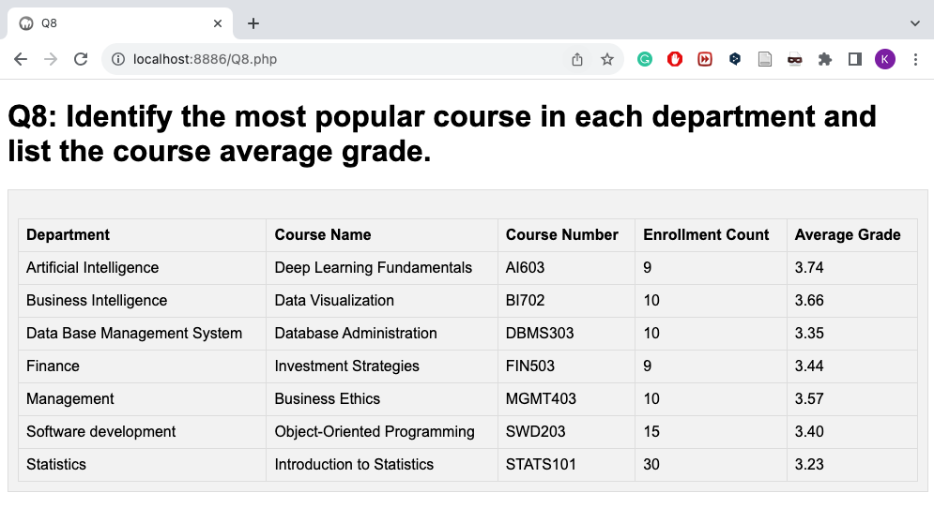
Interesting Queries
Query 2: Q8 Identify the most popular course in each department and list the course average grade.
Knowing the most popular courses and their average grades can be beneficial for:
Improve the current curriculum to align with students' interests and need.
Measure the teaching quality by assessing the relationship between enrollment count and average grade.
Integrate course popularity in resource-planning decision.

Slide 10




Learning Experience
Challenge 1:
Challenge 2
Conceptual Model Design
In the project, we always find some relations hard to have connections
Data Insertion
Our project faced a challenge due to disconnected data insertion processes that overlooked data constraints, resulting in unrealistic query outputs
1
2
Our Approach
We kept updating our model to accommodate evolving relation requirements
Our Approach
We kept updating tables and inserting new data to improve query results
1.1
2.1
Lesson Learnt 1
Lesson Learnt 2
Refine features for precise entity definitions
Establish clear scope to optimize goal alignment
Incorporate actual data for a more authentic query outcome
Ensure consensus on data types and ranges aligned with our objectives prior to data insertion

Slide 11
Looking Forward
Career Services: featuring job listings, internships, and industry-specific career resources
Alumni Mentors: use Alumni and Students tables for targeted networking based on industry, courses, and careers
Interactions: allow interaction among users by sending direct messages

Slide 12
Thank You

