Slide 1
Musculoskeletal abnormality classification
Arham Haq

Slide 2
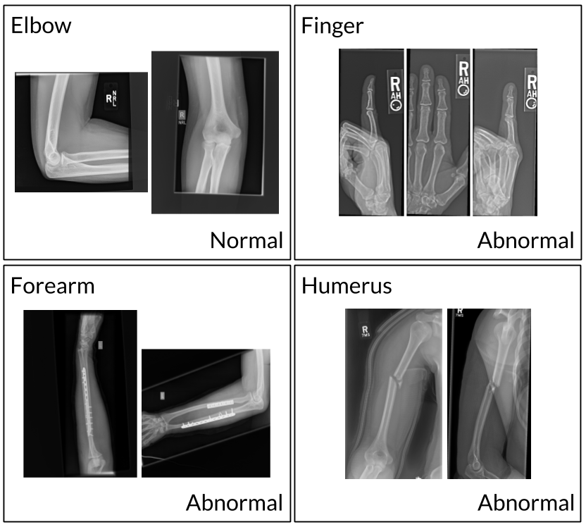
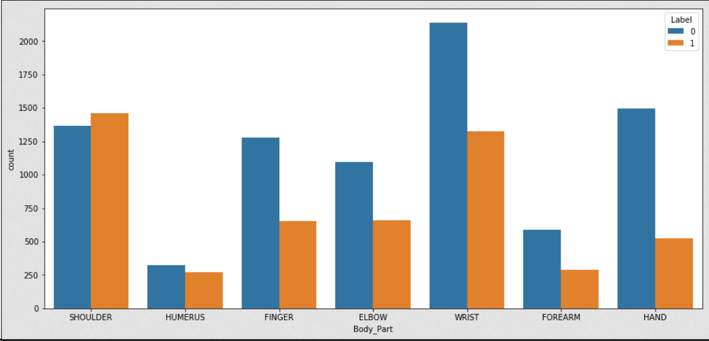
Dataset
MURA(musculoskeletal radiographs) Stanford Deep learning competition
40, 561images from 12,173 patients
Elbow, Finger, Forearm, Hand, Humerus, Shoulder, and Wrist
Notes:
Data collected between 2001 and 2012 labeled by board-certified radiologists Stanford Hospital
Split into 7 categories

Slide 3
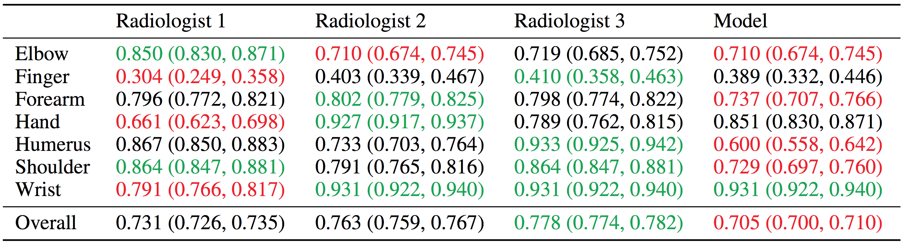
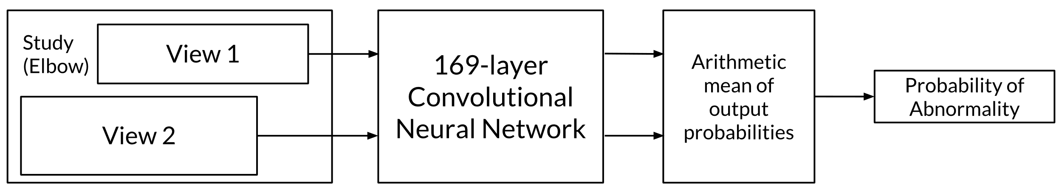
Research Questions / Hypothesized Outcome
How well can our model predict abnormalities compared to experienced Radiologist?
Notes:
The aim of this project is to create a model in order to accurately classify and predict whether or not an x-ray image is normal or abnormal.
Based on the test set these are the results from 3 randomly selected highly experienced Radiologists.
The model results are based on a 169-layer convolutional neural network by a team from Stanford.
Baseline performance is comparable to radiologist performance in detecting abnormalities on finger studies and equivalent on wrist studies.
However, baseline performance is lower than best radiologist performance in detecting abnormalities on elbow, forearm, hand, humerus, shoulder studies, and overall, indicating that the task is a good challenge for future research.

Slide 4
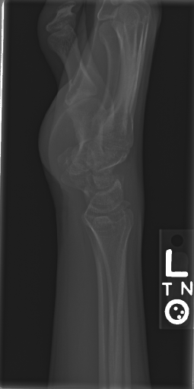
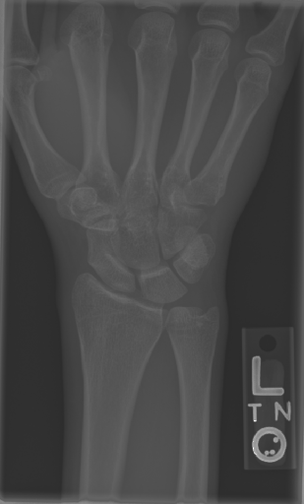
Planned Methodology
Data preprocessing:
Image manipulation
Flatten and convert to array
Splitting data into train/test
Choosing a classifier model
Evaluate best classifier (hyperparameter testing)
Notes:
Choosing model: start with simple models such as logistic regression, KNN, Decision Tree,
Evaluate hyperparameters of best model

Slide 5
Potential Challenges
Combining and creating a new dataset
Working with new libraries:
Pytorch (Image processing)
TensorFlow (Neural networks)
Computation time for training models
Notes:
Pytorch is a library which contains many tools for image processing/augmenting and outputting a dataset from a group of images
Use it to scale and transform images as neural networks require images of the same size
Computation time : as image data contains many features, especially for Convolutional neural networks will require a great deal of time for training the model as well as choosing the optimal hyperparameters via grid search.

Slide 6
Questions/Comments

