Slide 1

IILM UNIVERSITY
STUDENT CREDENTIALS
GREATER NOIDA, UTTAR PRADESH
ARHAM JAIN
Enrolment / Roll No.
Program & Section
CORIZO — ARTIFICIAL INTELLIGENCE INTERNSHIP
25SCS1003001426
B.Tech CSE-AI/ML, 2CSE-22
Cardiovascular Disease Prediction & Spotify Songs’ Genre Segmentation
A Machine Learning Internship Presentation Report
INTERNSHIP DURATION
HOST ORGANIZATION
05 December 2025 – 05 January 2026 (1 Month)
Corizo
Industry-Mentored AI Internship Program

Slide 2


Candidate & Program Overview
Candidate Details
Internship Profile
Student Name: Arham Jain
Roll Number: 25SCS1003001426
Degree: B.Tech CSE – AI/ML (IBM-ICE)
Section: 2CSE-22
Academic Batch: 2025-2029
University: IILM University, Greater Noida, U.P.
Program Name: Corizo — Artificial Intelligence Internship
Projects Undertaken: 2 (Cardiovascular Disease Prediction; Spotify Genre Segmentation)
Duration: 1 Month (05 Dec 2025 – 05 Jan 2026)
Corizo Dice ID: CRZ140452
Academic Head: Hemant Ingle
Arham Jain | 25SCS1003001426 | Corizo AI Internship
2

Slide 3



Organization Profile: Corizo
Corizo is an Indian ed-tech platform that provides internships, professional training programs, career guidance and mentorship to engineering and management students, aiming to bridge the gap between classroom learning and industry requirements.
2
MACHINE LEARNING PROJECTS COMPLETED
Mentorship Model: Pairs learners with experienced industry mentors through a structured, project-based curriculum.
96,965
Multi-Domain Training: Offers programs across Data Science, Machine Learning, Web Development, Cyber Security and Cloud Computing.
TOTAL DATASET RECORDS ANALYZED
22
Verified Certification: Issues an internship completion certificate on successful evaluation of assigned project work.
VISUALIZATIONS & CHARTS PRODUCED
Arham Jain | 25SCS1003001426 | Corizo AI Internship
3

Slide 4




Internship Objectives & Approach
Data Preprocessing
Exploratory Analysis
Model Building
Evaluation & Insight
Clean, validate and engineer features across two real-world datasets of over 96,000 combined records.
Visualize distributions, relationships and correlations to understand each dataset before modeling.
Train five supervised classifiers for disease prediction, and apply K-Means clustering for genre segmentation.
Compare models on accuracy, precision, recall and F1-score; interpret clusters against real genre labels.
Arham Jain | 25SCS1003001426 | Corizo AI Internship
4

Slide 5


Technologies & Tools Used
Language & Data
Visualization
Machine Learning
Environment & Source
• Python 3
• Pandas
• NumPy
• Matplotlib
• Seaborn
• Scikit-learn
• K-Means · PCA
• 5 classifiers
• Jupyter Notebook
• Kaggle datasets
Arham Jain | 25SCS1003001426 | Corizo AI Internship
5

Slide 6
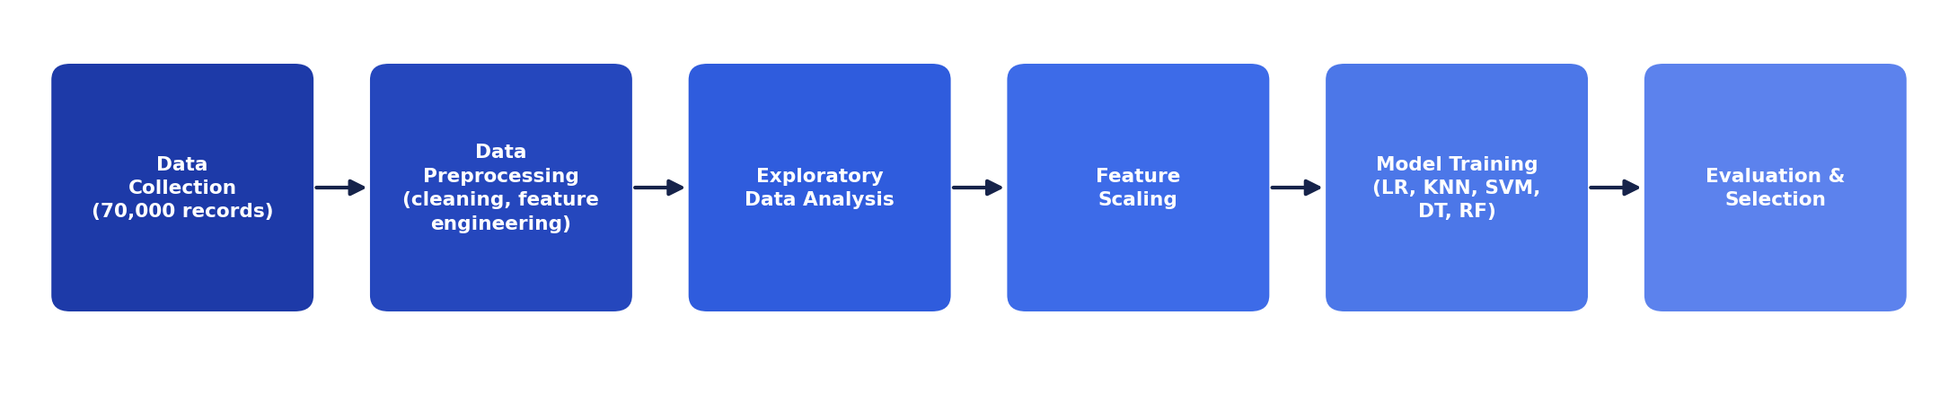
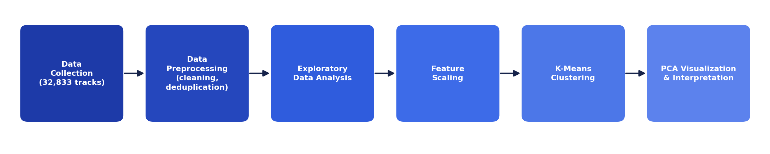
System Architecture
Project 1 — Cardiovascular Disease Prediction (Supervised Pipeline)
Project 2 — Spotify Songs’ Genre Segmentation (Unsupervised Pipeline)
Arham Jain | 25SCS1003001426 | Corizo AI Internship
6

Slide 7

Project 1: Cardiovascular Disease Prediction
The Health Challenge
The Dataset
Cardiovascular disease is the leading cause of death worldwide — the WHO estimates 19.8 million deaths in 2022, close to a third of all deaths globally. Many risk factors (blood pressure, cholesterol, glucose, lifestyle habits) are measurable well before a cardiac event, motivating data-driven early screening from routine health-check data.
70,000 anonymized patient records (68,613 after cleaning)
11 clinical & lifestyle attributes: age, gender, height, weight, blood pressure, cholesterol, glucose, smoking, alcohol, activity
2 engineered features: age in years, BMI
Binary target: presence / absence of cardiovascular disease (near-perfectly balanced, ~50/50)
Arham Jain | 25SCS1003001426 | Corizo AI Internship
7

Slide 8
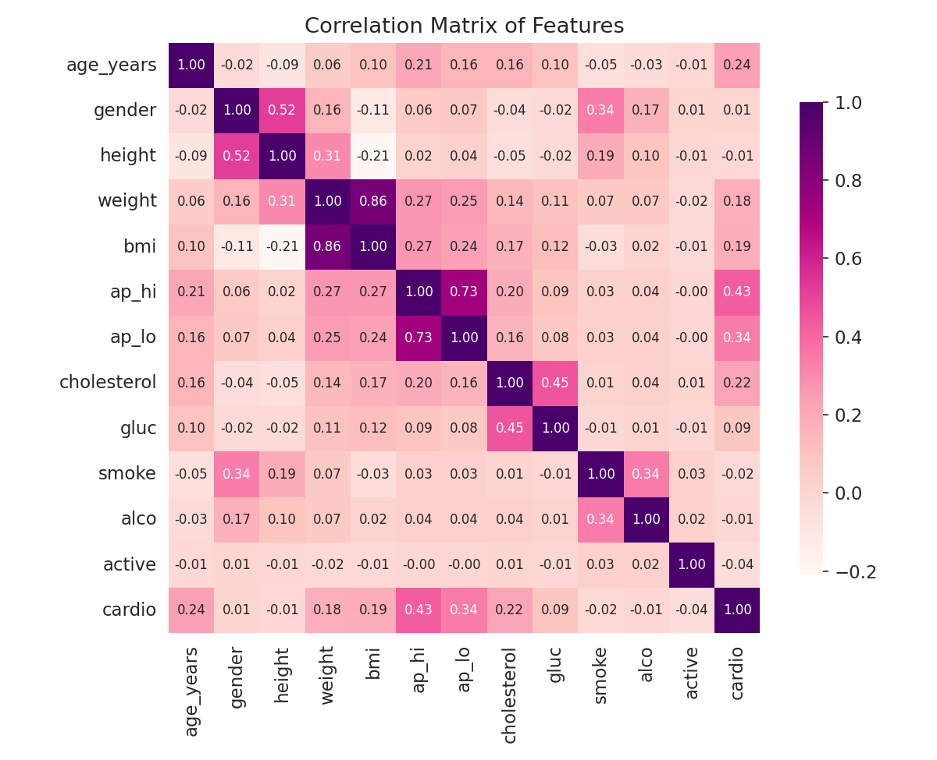
Cardiovascular Disease — Exploratory Findings
• Disease prevalence rises steadily with age and BMI, and sharply with cholesterol — from 43.5% (normal) to 76.2% (well above normal).
• Systolic BP (0.43), diastolic BP (0.34), age (0.24) and cholesterol (0.22) are the attributes most correlated with disease.
• Smoking, alcohol and activity show only a weak relationship in the raw data — most likely self-report bias rather than a true protective effect.
Arham Jain | 25SCS1003001426 | Corizo AI Internship
8

Slide 9
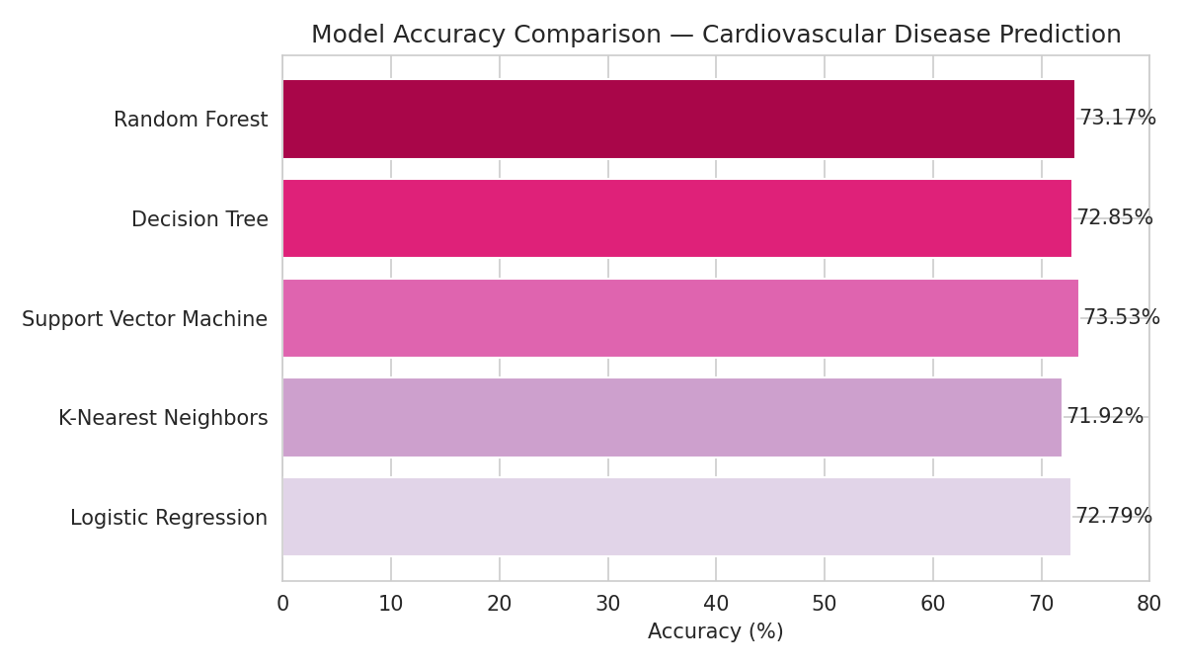
Cardiovascular Disease — Model Performance
Model | Accuracy | Precision | F1-score
Logistic Regression | 72.79% | 75.26% | 70.91%
K-Nearest Neighbors | 71.92% | 72.73% | 70.90%
Support Vector Machine ★ | 73.53% | 76.07% | 71.71%
Decision Tree | 72.85% | 73.19% | 72.18%
Random Forest | 73.17% | 75.45% | 71.44%
Support Vector Machine was the best performer at 73.53% accuracy. All five models cluster within a narrow 72–74% band — the ceiling here is set more by overlap in the clinical data itself than by algorithm choice.
Arham Jain | 25SCS1003001426 | Corizo AI Internship
9

Slide 10

Project 2: Spotify Songs’ Genre Segmentation
The Music Challenge
The Dataset
Streaming platforms curate music using numerical audio features (danceability, energy, valence, tempo) as much as explicit choices. Genre is a human, cultural label layered on a continuous acoustic space — two songs in the same genre can sound very different. This project explores whether audio features alone can recover meaningful genre-like groupings.
32,833 Spotify tracks (28,352 unique after de-duplication)
6 playlist genres: pop, rap, rock, latin, r&b, edm — across 24 subgenres
11 numerical audio features used: danceability, energy, key, loudness, mode, speechiness, acousticness, instrumentalness, liveness, valence, tempo
Unsupervised task — genre label used only to validate clusters afterward
Arham Jain | 25SCS1003001426 | Corizo AI Internship
10

Slide 11
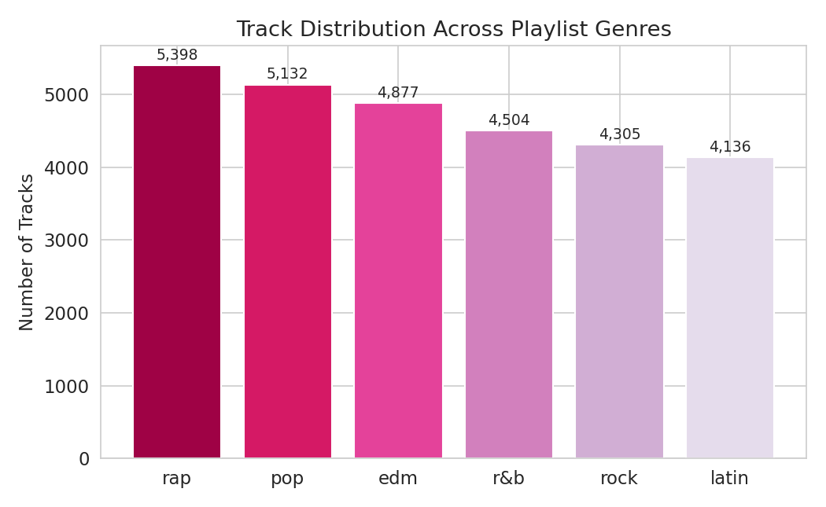
Spotify — Exploratory Findings
• The six genres are fairly evenly represented (4,136–5,398 tracks each), so no single genre dominates the clustering by sample size alone.
• EDM has the highest energy and lowest acousticness; rock has the lowest danceability; latin has the highest valence.
• Energy and loudness are strongly positively correlated; energy and acousticness are strongly negatively correlated.
Arham Jain | 25SCS1003001426 | Corizo AI Internship
11

Slide 12
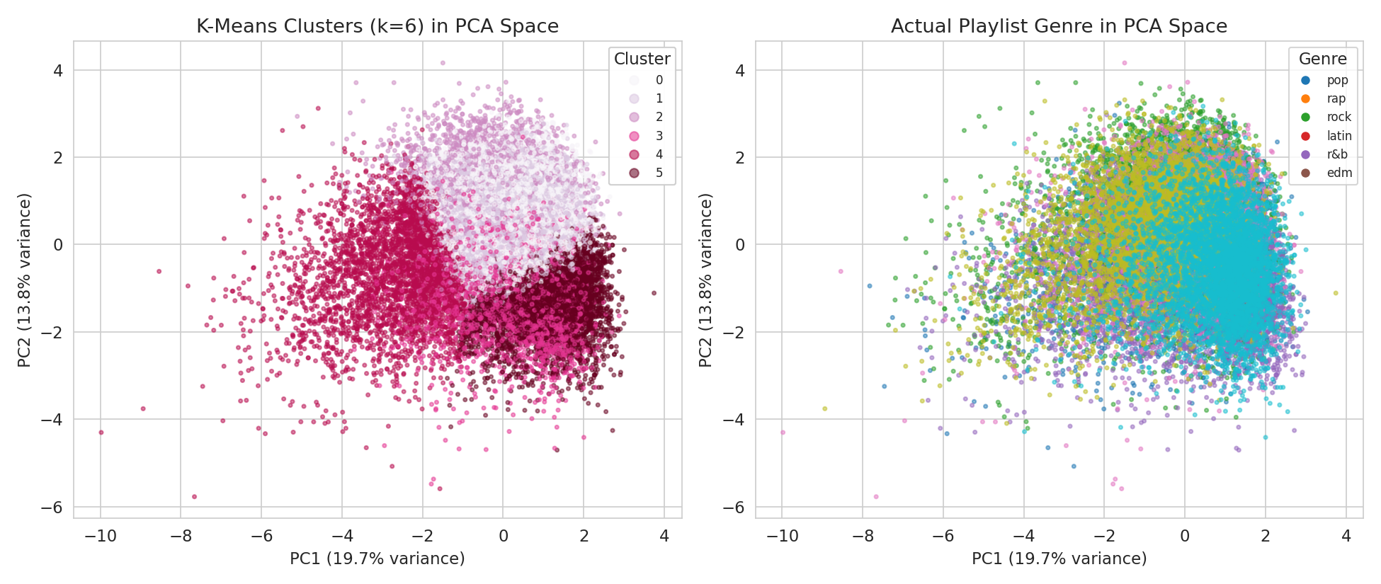
Spotify — Clustering Results
k = 6
0.114
CLUSTERS CHOSEN
SILHOUETTE SCORE
Rap (58.0%) and EDM (57.7%) form the purest clusters — each has a distinctive acoustic signature (high speechiness for rap; high energy, low acousticness for EDM) that K-Means isolates without ever seeing the genre label.
Pop, latin, r&b and rock overlap much more (21–32% purity) — audio features alone don’t cleanly separate these genres.
Arham Jain | 25SCS1003001426 | Corizo AI Internship
12

Slide 13

Key Outcomes & Skills Demonstrated
End-to-End Data Pipelines: Cleaned and engineered two real-world datasets totalling nearly 97,000 records, from raw CSV to analysis-ready form.
Supervised Classification: Trained and compared 5 algorithms (Logistic Regression, KNN, SVM, Decision Tree, Random Forest), reaching 73.53% accuracy with SVM.
Unsupervised Clustering: Applied K-Means and PCA to segment 28,352 tracks by audio features, and validated clusters against real genre labels.
Statistical & Visual Storytelling: Produced 22 charts — correlation heatmaps, cluster plots, confusion matrices — to communicate findings clearly.
Critical, Honest Evaluation: Reported counter-intuitive and weak results (e.g. smoking vs. disease rate, low silhouette score) rather than only favourable ones.
Arham Jain | 25SCS1003001426 | Corizo AI Internship
13

Slide 14
Certification & Official Verification
Verification Metric | Official Record / Credential Details
Internship Title | Artificial Intelligence Internship
Issuing Organization | Corizo
Duration | 05 December 2025 – 05 January 2026 (1 Month)
Corizo Dice ID | CRZ140452
Academic Head | Hemant Ingle
Certifying Partner | IIT Bombay’s Mood Indigo
Arham Jain | 25SCS1003001426 | Corizo AI Internship
14

Slide 15

Internship Completion Certificate
Arham Jain | 25SCS1003001426 | Corizo AI Internship
15

Slide 16

Thank You!
Arham Jain
Roll No: 25SCS1003001426
School of Computer Science & Engineering
IILM University, Greater Noida, U.P.

