Slide 1
AWS
Module 5

Slide 2
Details
AWS Management Tools, AWS CloudWatch, AWS CloudTrail, AWS Config,
AWS Systems Manager, AWS Cost Management, AWS Free Tier,
AWS Billing and Account Management, AWS Budgets, AWS Trusted Advisor

Slide 3
Management Tools
The AWS Management & Governance product suite allows you to enable, provision, and operate AWS resources to determine the health and predictability of your cloud workloads
AWS Management Console
AWS Config
Amazon CloudWatch
AWS Auto Scaling
AWS Command
Line Interface
AWS Trusted
Advisor
AWS Well-
Architected Tool
AWS
CloudTrail

Slide 4
CloudWatch
Amazon CloudWatch is a service used for monitoring and observing resources in real-time, built for DevOps engineers, developers, site reliability engineers (SREs), and IT managers.
CloudWatch provides users with data and actionable insights to monitor their respective applications, stimulate system-wide performance changes, and optimize resource utilization.
CloudWatch collects monitoring and operational data in the form of logs, metrics, and events, providing its users with an aggregated view of AWS resources, applications, and services that run on AWS. The CloudWatch can also be used to detect anomalous behavior in the environments, set warnings and alarms, visualize logs and metrics side by side, take automated actions, and troubleshoot issues.

Slide 5
Metrics by Cloudwatch
CloudWatch provides metrics for every services in AWS
Metric is a variable to monitor (CPUUtilization, NetworkIn…)
Metrics belong to namespaces
Dimension is an attribute of a metric (instance id, environment, etc…).
Up to 30 dimensions per metric
Metrics have timestamps
Can create CloudWatch dashboards of metrics
Can create CloudWatch Custom Metrics (for the RAM for example)

Slide 6
Components
Amazon CloudWatch is an open-source lightweight tool that is used to collect the data of the resources in which they are deployed. Some of the data is as follows
Metrics: Amazon CloudWatch agent will record the data of CPU utilization, memory usage, disk i/o other system-level stats.
Logs: It will collect all the logs which are used for the further analysis
Events: Launching of significant instances, modifications to security groups, and other events.

Slide 7
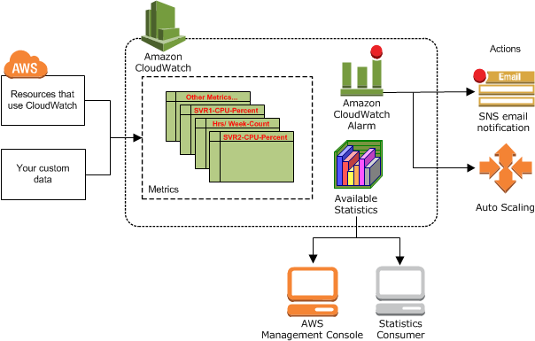

Slide 8
CloudWatch Metric Streams
Continually stream CloudWatch metrics to a destination of your choice, with near-real-time delivery and low latency.
Amazon Kinesis Data Firehose (and then its destinations)
3rd party service provider: Datadog, Dynatrace, New Relic, Splunk, Sumo Logic…
Option to filter metrics to only stream a subset of them

Slide 9
CloudWatch Logs (Destinations)
Log groups: arbitrary name, usually representing an application
Log stream: instances within application / log files / containers
Can define log expiration policies (never expire, 1 day to 10 years…)
CloudWatch Logs can send logs to:
  Amazon S3 (exports)
  Kinesis Data Streams
  Kinesis Data Firehose
  AWS Lambda
  OpenSearch
Logs are encrypted by default
Can setup KMS-based encryption with your own keys

Slide 10
CloudWatch Logs (Sources)
SDK, CloudWatch Logs Agent, CloudWatch Unified Agent
Elastic Beanstalk: collection of logs from application
ECS: collection from containers
AWS Lambda: collection from function logs
VPC Flow Logs: VPC specific logs
API Gateway
CloudTrail based on filter
Route53: Log DNS queries

Slide 11
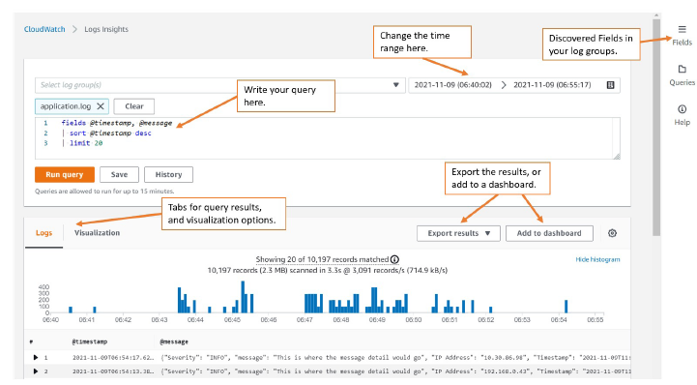
Insights

Slide 12
What can be done?
Search and analyze log data stored in CloudWatch Logs
Example: find a specific IP inside a log, count occurrences of “ERROR” in your logs…
Provides a purpose-built query language
  Automatically discovers fields from AWS services and JSON log events
  Fetch desired event fields, filter based on conditions, calculate aggregate statistics, sort events, limit number of events…
  Can save queries and add them to CloudWatch Dashboards
Can query multiple Log Groups in different AWS accounts
It’s a query engine, not a real-time engine

Slide 13
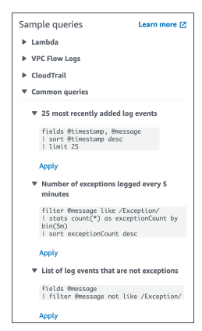
Sample

Slide 14
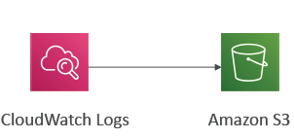
CloudWatch Logs – S3 Export
Log data can take up to 12 hours to become available for export
The API call is CreateExportTask
Not near-real time or real-time… use Logs Subscriptions instead

Slide 15
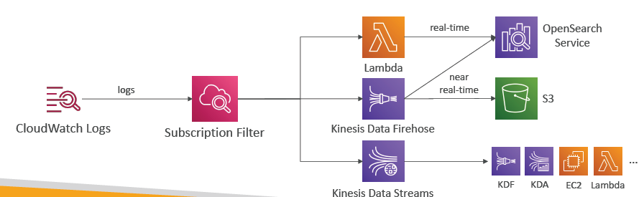
CloudWatch Logs Subscriptions
Get a real-time log events from CloudWatch Logs for processing and analysis
Send to Kinesis Data Streams, Kinesis Data Firehose, or Lambda
Subscription Filter – filter which logs are events delivered to your destination

Slide 16
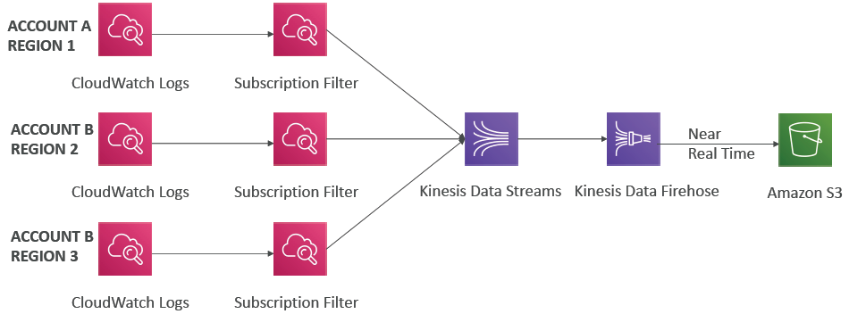
CloudWatch Logs Aggregation
Multi-Account & Multi Region

Slide 17
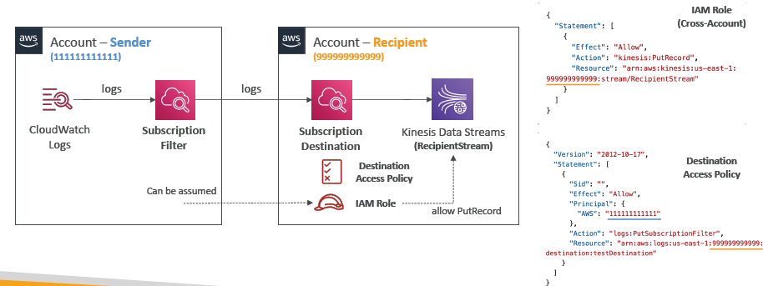
CloudWatch Logs Subscriptions
Cross-Account Subscription – send log events to resources in a different AWS account (KDS, KDF)

Slide 18
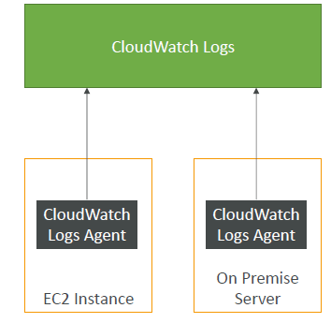
CloudWatch Logs for EC2
By default, no logs from your EC2 machine will go to CloudWatch
You need to run a CloudWatch agent on EC2 to push the log files you want
Make sure IAM permissions are correct
The CloudWatch log agent can be setup on-premises too

Slide 19
CloudWatch Logs Agent & Unified Agent
For virtual servers (EC2 instances, on-premises servers…)
CloudWatch Logs Agent
  Old version of the agent
  Can only send to CloudWatch Logs
CloudWatch Unified Agent
  Collect additional system-level metrics such as RAM, processes, etc…
  Collect logs to send to CloudWatch Logs
  Centralized configuration using SSM Parameter Store

Slide 20
CloudWatch Unified Agent – Metrics
Collected directly on your Linux server / EC2 instance
CPU (active, guest, idle, system, user, steal)
Disk metrics (free, used, total), Disk IO (writes, reads, bytes, iops)
RAM (free, inactive, used, total, cached)
Netstat (number of TCP and UDP connections, net packets, bytes)
Processes (total, dead, bloqued, idle, running, sleep)
Swap Space (free, used, used %)
Reminder: out-of-the box metrics for EC2 – disk, CPU, network (high level)

Slide 21
CloudWatch Alarms
Alarms are used to trigger notifications for any metric
Various options (sampling, %, max, min, etc…)
Alarm States:
  OK
  INSUFFICIENT_DATA
  ALARM
Period:
  Length of time in seconds to evaluate the metric
  High resolution custom metrics: 10 sec, 30 sec or multiples of 60 sec

Slide 22
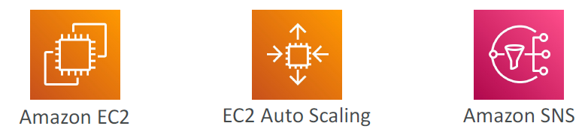
CloudWatch Alarm Targets
Stop, Terminate, Reboot, or Recover an EC2 Instance
Trigger Auto Scaling Action
Send notification to SNS (from which you can do pretty much anything)

Slide 23
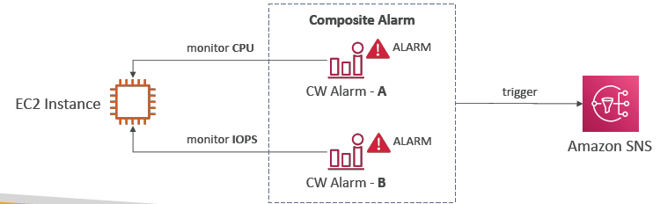
CloudWatch Alarms – Composite Alarms
CloudWatch Alarms are on a single metric
Composite Alarms are monitoring the states of multiple other alarms
AND and OR conditions
Helpful to reduce “alarm noise” by creating complex composite alarms

Slide 24
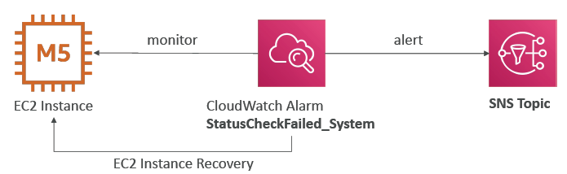
EC2 Instance Recovery
Status Check:
Instance status = check the EC2 VM
System status = check the underlying hardware
Recovery: Same Private, Public, Elastic IP, metadata, placement group

Slide 25
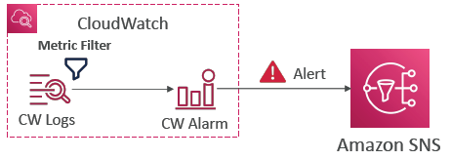
CloudWatch Alarm: good to know
Alarms can be created based on CloudWatch Logs Metrics Filters
• To test alarms and notifications, set the alarm state to Alarm using CLI
aws cloudwatch set-alarm-state --alarm-name "myalarm" --state-value
ALARM --state-reason "testing purposes"

Slide 26


Amazon EventBridge
(formerly CloudWatch Events)
Schedule: Cron jobs (scheduled scripts)
• Event Pattern: Event rules to react to a service doing something
• Trigger Lambda functions, send SQS/SNS messages…

Slide 27
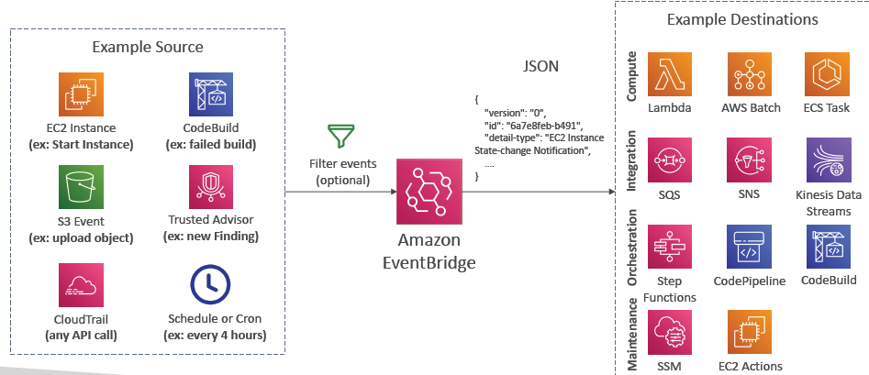
EventBridge Rules

Slide 28
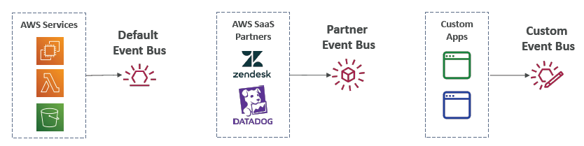
Amazon EventBridge
Event buses can be accessed by other AWS accounts using Resource-based Policies
You can archive events (all/filter) sent to an event bus (indefinitely or set period)
Ability to replay archived events

Slide 29
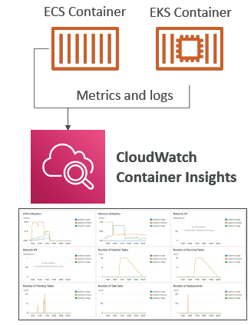
CloudWatch Container Insights
Collect, aggregate, summarize metrics and logs from containers
Available for containers on…
Amazon Elastic Container Service (Amazon ECS)
  • Amazon Elastic Kubernetes Services (Amazon EKS)
  • Kubernetes platforms on EC2
  • Fargate (both for ECS and EKS)
In Amazon EKS and Kubernetes, CloudWatch Insights is using a containerized version of the CloudWatch Agent to discover containers

Slide 30
CloudWatch Lambda Insights
Monitoring and troubleshooting solution for serverless applications running on AWS Lambda
Collects, aggregates, and summarizes system-level metrics including CPU time, memory, disk, and network
Collects, aggregates, and summarizes diagnostic information such as cold starts and Lambda worker shutdowns
Lambda Insights is provided as a
Lambda Layer

Slide 31
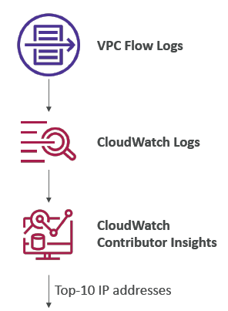
CloudWatch Contributor Insights
Analyze log data and create time series that display contributor data.
  See metrics about the top-N contributors
  The total number of unique contributors, and their usage.
This helps you find top talkers and understand who or what is impacting system performance.
Works for any AWS-generated logs (VPC, DNS, etc..)
For example, you can find bad hosts, identify the heaviest network users, or find the URLs that generate the most errors.
You can build your rules from scratch, or you can also use sample rules that AWS has created – leverages your CloudWatch Logs
CloudWatch also provides built-in rules that you can use to analyze metrics from other AWS services.

Slide 32
CloudWatch Application Insights
Provides automated dashboards that show potential problems with monitored applications, to help isolate ongoing issues
Your applications run on Amazon EC2 Instances with select technologies only (Java, .NET, Microsoft IIS Web Server, databases…)
And you can use other AWS resources such as Amazon EBS, RDS, ELB, ASG, Lambda, SQS, DynamoDB, S3 bucket, ECS, EKS, SNS, API Gateway…
Powered by SageMaker
Enhanced visibility into your application health to reduce the time it will take you to troubleshoot and repair your applications
Findings and alerts are sent to Amazon EventBridge

Slide 33
Operational Visibility
CloudWatch Container Insights
  ECS, EKS, Kubernetes on EC2, Fargate, needs agent for Kubernetes
  Metrics and logs
CloudWatch Lambda Insights
  Detailed metrics to troubleshoot serverless applications
CloudWatch Contributors Insights
  Find “Top-N” Contributors through CloudWatch Logs
CloudWatch Application Insights
  Automatic dashboard to troubleshoot your application and related AWS services

Slide 34
Cloud Trail
Provides governance, compliance and audit for your AWS Account
CloudTrail is enabled by default!
Get an history of events / API calls made within your AWS Account by:
  • Console
  SDK
  CLI
  AWS Services
Can put logs from CloudTrail into CloudWatch Logs or S3
A trail can be applied to All Regions (default) or a single Region.
If a resource is deleted in AWS, investigate CloudTrail first!

Slide 35
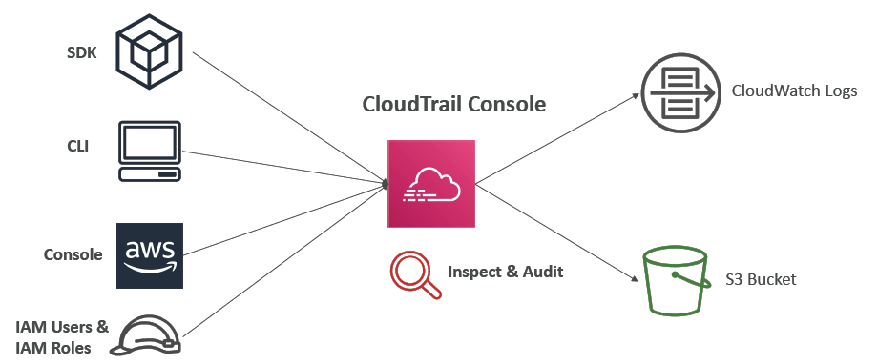
Diagram

Slide 36
Events
Management Events:
  Operations that are performed on resources in your AWS account
  Examples:
    Configuring security (IAM AttachRolePolicy)
    Configuring rules for routing data (Amazon EC2 CreateSubnet)
    Setting up logging (AWS CloudTrail CreateTrail)
  By default, trails are configured to log management events.
  Can separate Read Events (that don’t modify resources) from Write Events (that may modify resources)
Data Events:
  By default, data events are not logged (because high volume operations)
  Amazon S3 object-level activity (ex: GetObject, DeleteObject, PutObject): can separate Read and Write Events
• AWS Lambda function execution activity (the Invoke API)
CloudTrail Insights Events:

Slide 37
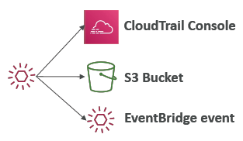
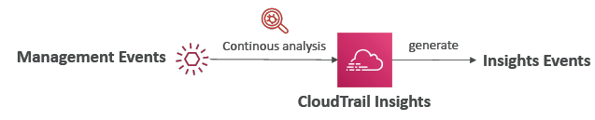
CloudTrail Insights
Enable CloudTrail Insights to detect unusual activity in your account:
  • inaccurate resource provisioning
  hitting service limits
  Bursts of AWS IAM actions
  Gaps in periodic maintenance activity
CloudTrail Insights analyzes normal management events to create a baseline
And then continuously analyzes write events to detect unusual patterns
  Anomalies appear in the CloudTrail console
  Event is sent to Amazon S3
  An EventBridge event is generated (for automation needs)

Slide 38
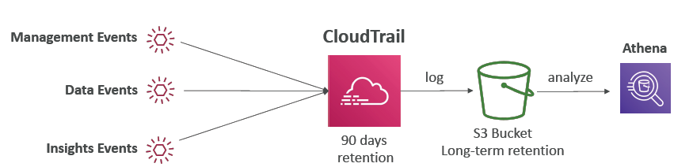
CloudTrail Events Retention
Events are stored for 90 days in CloudTrail
• To keep events beyond this period, log them to S3 and use Athena

Slide 39
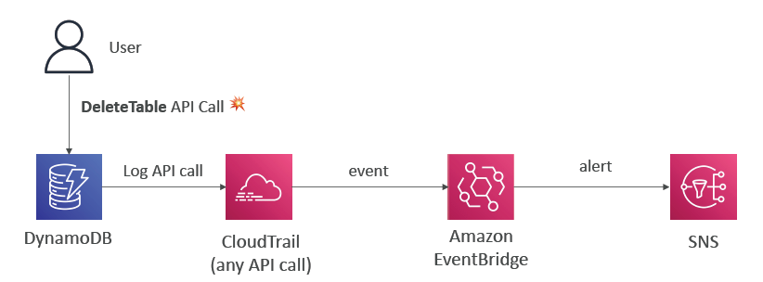
Work with API calls

Slide 40
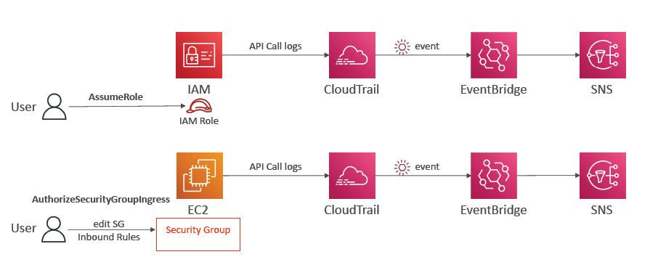
Cloud Trail usecases

Slide 41
AWS Config
Helps with auditing and recording compliance of your AWS resources
Helps record configurations and changes over time
Questions that can be solved by AWS Config:
  Is there unrestricted SSH access to my security groups?
  Do my buckets have any public access?
  How has my ALB configuration changed over time?
You can receive alerts (SNS notifications) for any changes
AWS Config is a per-region service
Can be aggregated across regions and accounts
Possibility of storing the configuration data into S3 (analyzed by Athena)

Slide 42
Details
Can use AWS managed config rules (over 75)
Can make custom config rules (must be defined in AWS Lambda)
  Ex: evaluate if each EBS disk is of type gp2
  Ex: evaluate if each EC2 instance is t2.micro
Rules can be evaluated / triggered:
  • For each config change
  • And / or: at regular time intervals
AWS Config Rules does not prevent actions from happening (no deny)
Pricing: no free tier, $0.003 per configuration item recorded per region, $0.001 per config rule evaluation per region

Slide 43
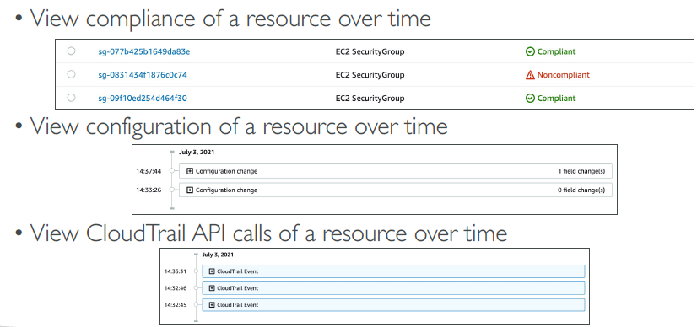
Resource

Slide 44
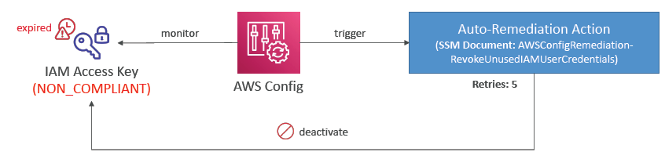
Remediations
Automate remediation of non-compliant resources using SSM Automation
Documents
Use AWS-Managed Automation Documents or create custom Automation Documents
You can set Remediation Retries if the resource is still non-compliant after autoremediation

Slide 45
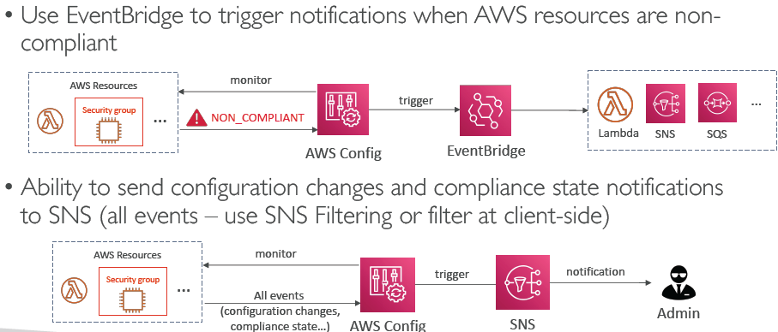
Notifications

Slide 46
CloudWatch vs CloudTrail vs Config
CloudWatch
  • Performance monitoring (metrics, CPU, network, etc…) & dashboards
  • Events & Alerting
  • Log Aggregation & Analysis
• CloudTrail
  • Record API calls made within your Account by everyone
  • Can define trails for specific resources
  • Global Service
• Config
  • Record configuration changes
  • Evaluate resources against compliance rules
  • Get timeline of changes and compliance

Slide 47
Ex: Load Balancer
CloudWatch:
  Monitoring Incoming connections metric
  Visualize error codes as % over time
  Make a dashboard to get an idea of your load balancer performance
CloudTrail:
  Track who made any changes to the Load Balancer with API calls
Config:
  Track security group rules for the Load Balancer
  Track configuration changes for the Load Balancer
  Ensure an SSL certificate is always assigned to the Load Balancer (compliance)

Slide 48
System Manager
is the operations hub for your AWS applications and resources
a secure end-to-end management solution for hybrid and multicloud environments that enables secure operations at scale

Slide 49
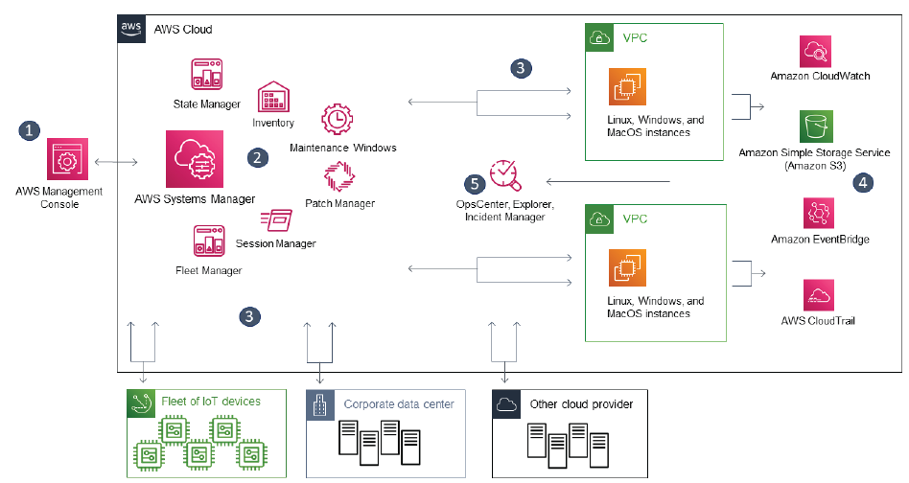

Slide 50
Capabilities
Application management
Change management
Node management
Operations management
Quick Setup
Shared resources

Slide 51
Os support
Linux
macOS (Amazon EC2 instances only)
Raspberry Pi OS (formerly Raspbian)
Windows Server

Slide 52
Security in AWS Systems Manager
Data protection in AWS Systems Manager
Identity and access management for AWS Systems Manager
Using service-linked roles for Systems Manager
Logging and monitoring in AWS Systems Manager
Compliance validation for AWS Systems Manager
Resilience in AWS Systems Manager
Infrastructure security in AWS Systems Manager
Configuration and vulnerability analysis in AWS Systems Manager
Security best practices for Systems Manager

Slide 53
AWS pricing model
Three fundamental drivers of cost with AWS
Compute
Storage
Data transfer
Charged per hour/second*
Varies by instance type
*Linux only
Charged typically per GB
Outbound is aggregated and charged
Inbound has no charge (with some exceptions)
Charged typically per GB

Slide 54


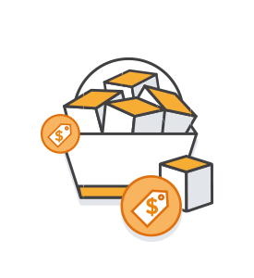
How do you pay for AWS?
Pay for what you use
Pay less when you reserve
Pay less when you use more and as AWS grows

Slide 55
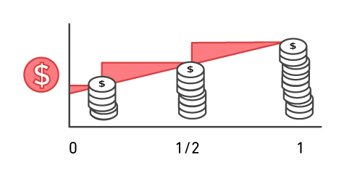
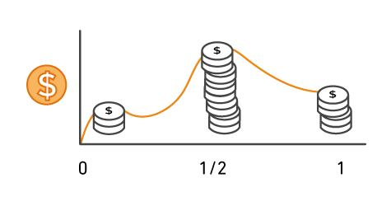
Pay for what you use
Pay only for the services that you consume, with no large upfront expenses.
On premises
AWS

Slide 56




Pay less when you reserve
Invest in Reserved Instances (RIs):
Save up to 75 percent
Options:
    All Upfront Reserved Instance (AURI) → largest discount
    Partial Upfront Reserved Instance (PURI) → lower discounts
    No Upfront Payments Reserved Instance (NURI) → smaller discount
EC2
instance
On
Demand
NURI
PURI
AURI

Slide 57
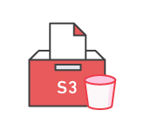
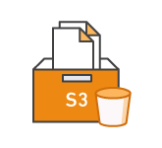
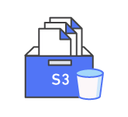


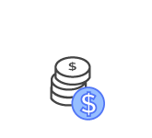
Pay less by using more
Realize volume-based discounts:
Savings as usage increases.
Tiered pricing for services like Amazon Simple Storage Service (Amazon S3), Amazon Elastic Block Store (Amazon EBS), or Amazon Elastic File System (Amazon EFS) → the more you use, the less you pay per GB.
Multiple storage services deliver lower storage costs based on needs.

Slide 58
Pay even less as AWS grows
As AWS grows:
AWS focuses on lowering cost of doing business.
This practice results in AWS passing savings from economies of scale to you.
Since 2006, AWS has lowered pricing 75 times (as of September 2019).
Future higher-performing resources replace current resources for no extra charge.

Slide 59

Custom pricing
Meet varying needs through custom pricing.
Available for high-volume projects with unique
requirements.

Slide 60


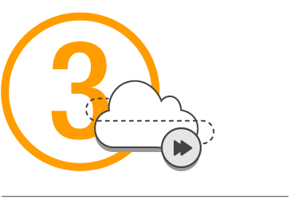
AWS Free Tier
Enables you to gain free hands-on experience with the AWS platform, products, and services. Free for 1 year for new customers.
Sign up for an
AWS account
Learn with 10-
minute tutorials
Start building
with AWS

Slide 61
Services with no charge
Amazon VPC
Elastic Beanstalk**
Auto Scaling**
AWS CloudFormation**
AWS Identity and Access Management (IAM)
**Note: There might be charges associated with other AWS services that are used with these services.

Slide 62
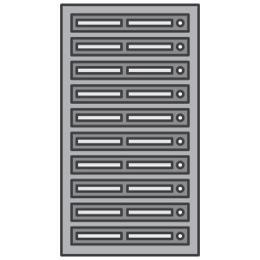







On-premises versus cloud
Traditional Infrastructure
AWS Cloud
≠
Resources and administration
No upfront expense—pay for what you use
Improve time to market and agility
Equipment
Scale up and down
Self-service infrastructure
Contracts
Cost

Slide 63


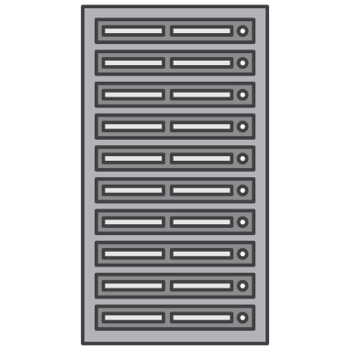
What is Total Cost of Ownership (TCO)?
Total Cost of Ownership (TCO) is the financial estimate to help identify direct and indirect costs of a system.
Why use TCO?
To compare the costs of running an entire infrastructure environment or specific workload on-premises versus on AWS
To budget and build the business case for moving to the cloud

Slide 64
TCO considerations
Hardware: Server, rack chassis power distribution units (PDUs), top-of-rack (TOR) switches (and maintenance)
Software: Operating system (OS), virtualization licenses
(and maintenance)
Facilities cost
1
Server Costs
Space
Power
Cooling
Hardware: Storage disks, storage area network (SAN) or Fibre Channel (FC) switches
Storage administration costs
Facilities cost
2
Storage Costs
Space
Power
Cooling
Network hardware: Local area network (LAN) switches, load balancer bandwidth costs
Network administration costs
Facilities cost
3
Network Costs
Space
Power
Cooling
Server administration costs
4
IT Labor Costs

Slide 65
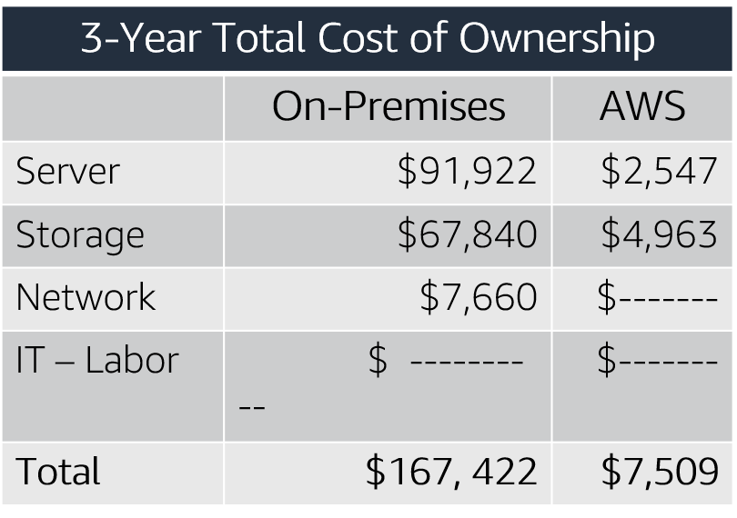
On-premises versus all-in-cloud
You could save up to 96 percent a year by moving your infrastructure to AWS.
Your 3-year total savings would be $159,913.
AWS cost includes business-level support and
a 3-year PURI EC2 instance

Slide 66
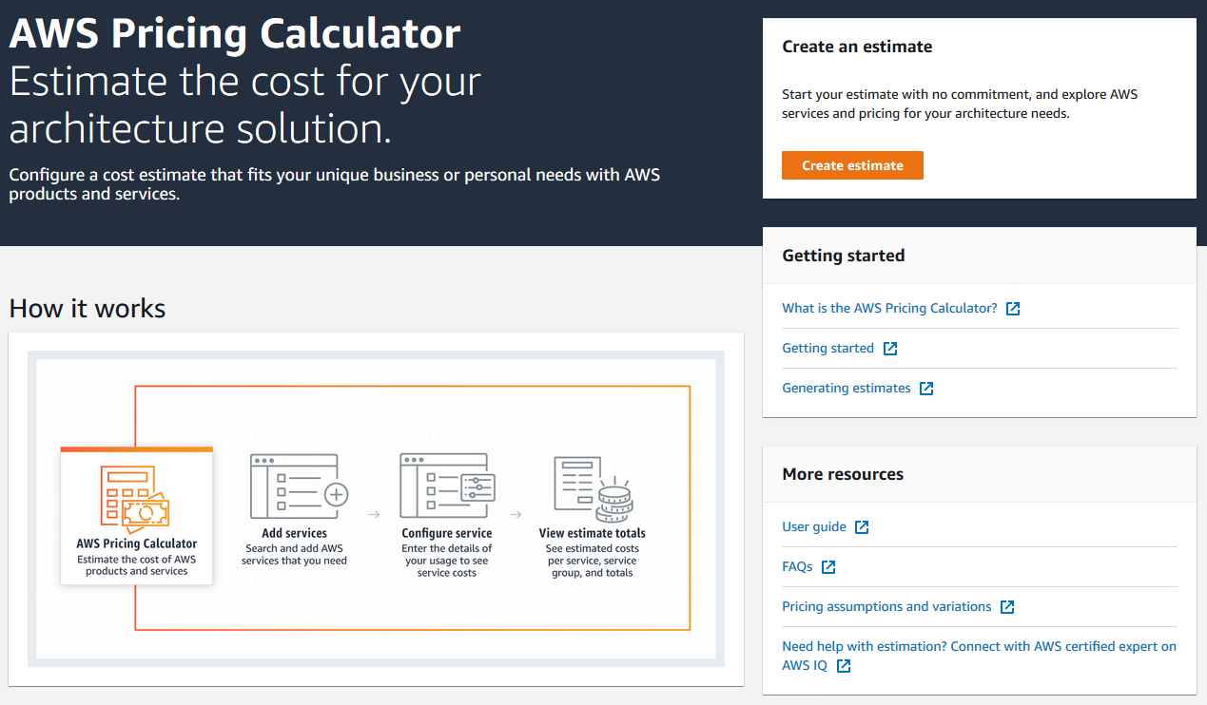
AWS Pricing Calculator
Use the AWS Pricing Calculator to:
Estimate monthly costs
Identify opportunities to reduce monthly costs
Model your solutions before building them
Explore price points and calculations behind your estimate
Find the available instance types and contract terms that meet your needs
Name your estimate and create and name groups of services

Slide 67
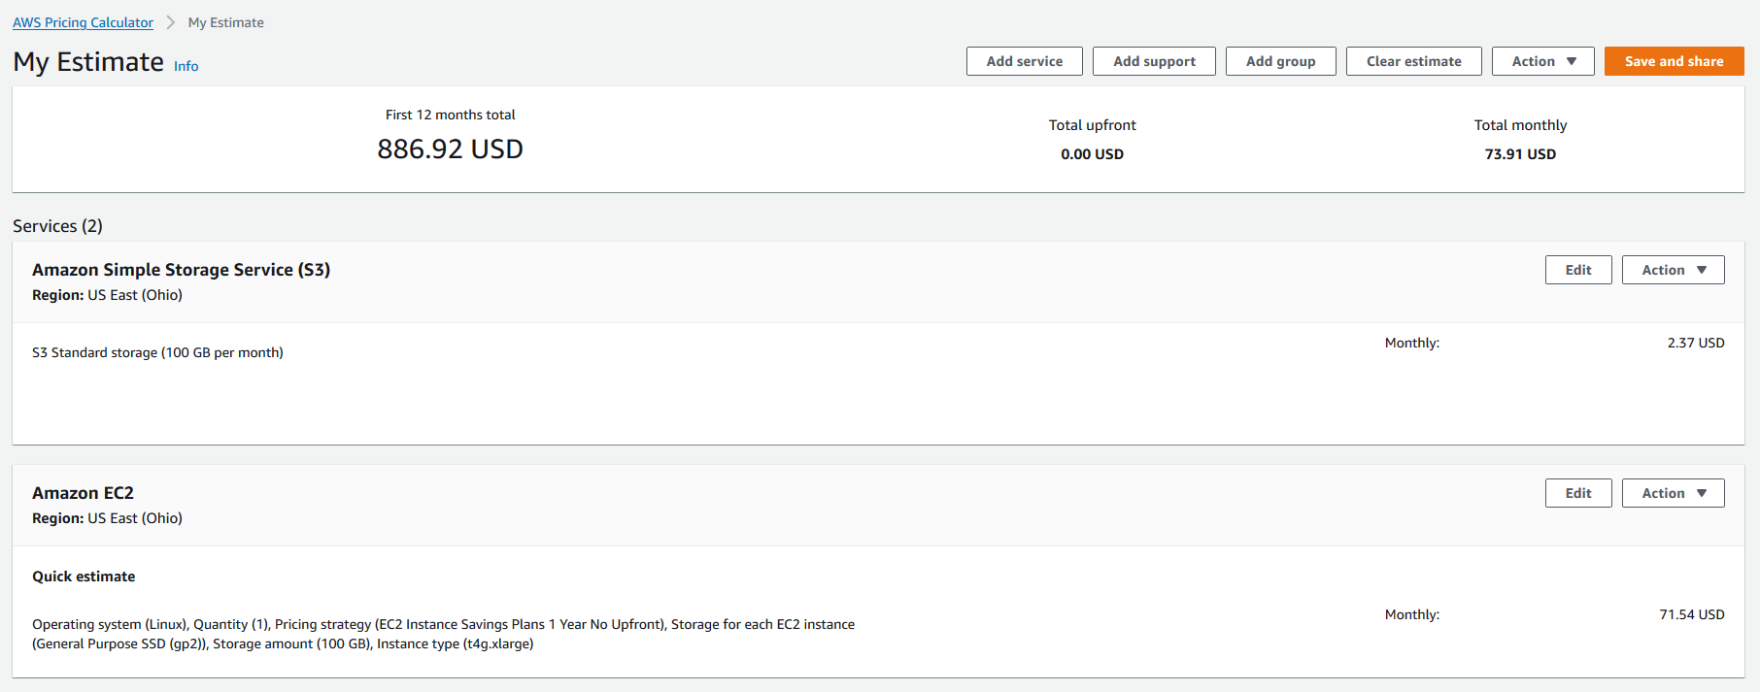
Reading an estimate
Your estimate is broken into: first 12 months total, total upfront, and total monthly.
First 12 months total
Total upfront
Total monthly
Notes:
AWS Pricing Calculator estimates are broken into:
The total for your first 12 months – The total estimate for your current group and all of the services and groups in your current group. It combines the upfront and monthly estimates.
Your total upfront – How much you are estimated to pay upfront as you set up your AWS stack.
Your total monthly – How much you're estimated to spend every month while you run your AWS stack.
Within a group, you can see how much each service is estimated to cost. If you want to price out different ways to build your AWS setup, you can use different groups for each variation of your setup and compare the estimates for the different setups.
For more information, see Reading an estimate at https://docs.aws.amazon.com/pricing-calculator/latest/userguide/what-is-pricing-calculator.html.
For accessibility: Example AWS Pricing Calculator estimate. The first 12 month total is $886.92, the total upfront cost is $0, and the total monthly cost is $73.91. End of accessibility description.

Slide 68
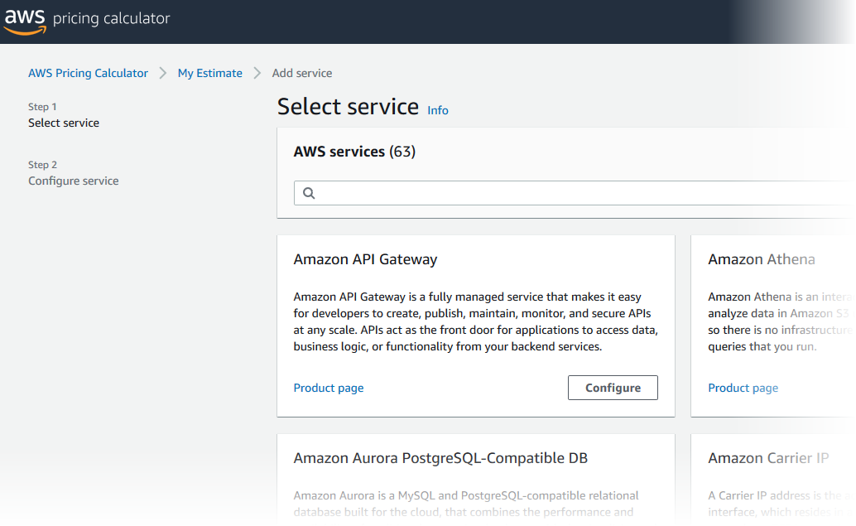
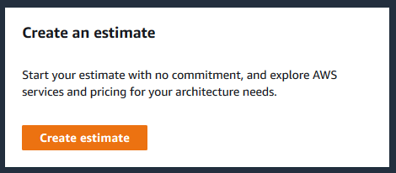
Activity: AWS Pricing Calculator activity
  Break up into groups of four or five and use the AWS Pricing Calculator and specifications provided to develop a cost estimate.
  Be prepared to report your findings back to the class.
AWS Pricing calculator website
Notes:
Break up into groups of four or five and use the AWS Pricing Calculator and the specifications provided to develop a cost estimate.
Be prepared to report your findings back to the class.

Slide 69
Additional benefit considerations
Hard benefits
Reduced spending on compute, storage, networking, security
Reductions in hardware and software purchases (capex)
Reductions in operational costs, backup, and disaster recovery
Reduction in operations personnel
Soft Benefits
Reuse of service and applications that enable you to define (and redefine solutions) by using the same cloud service
Increased developer productivity
Improved customer satisfaction
Agile business processes that can quickly respond to new and emerging opportunities
Increase in global reach

Slide 70

Case study: Total Cost Of Ownership (1 of 6)
Background:
Growing global company with over 200 locations
500 million customers, $3 billion annual revenue

Slide 71
Case study: Total Cost of Ownership (2 of 6)
Background:
Growing global company with over 200 locations
500 million customers, $3 billion annual revenue
Challenge:
Meet demand to rapidly deploy new solutions
Constantly upgrade aging equipment

Slide 72
Case study: Total Cost of Ownership (3 of 6)
Background:
Growing global company with over 200 locations
500 million customers, $3 billion annual revenue
Challenge:
Meet demand to rapidly deploy new solutions
Constantly upgrade aging equipment
Criteria:
Broad solution to handle all workloads
Ability to modify processes to improve efficiency and lower costs
Eliminate busy work (such as patching software)
Achieve a positive return on investment (ROI)

Slide 73
Case study: Total Cost of Ownership (4 of 6)
Background:
Is a growing global company with over 200 locations
Have 500 million customers, $3 billion (USD) annual revenue
Meet demand to rapidly deploy new solutions
Constantly upgrade aging equipment
Challenge:
Criteria:
Have a broad solution to handle all workloads
Be able to modify processes to improve efficiency and lower costs
Eliminate busy work (such as patching software)
Achieve a positive return on investment (ROI)
Solution:
Moved their on-premises data center to AWS
  Eliminated 205 servers (90 percent)
  Moved nearly all applications to AWS
Used 3-year Amazon EC2 Reserved Instances

Slide 74
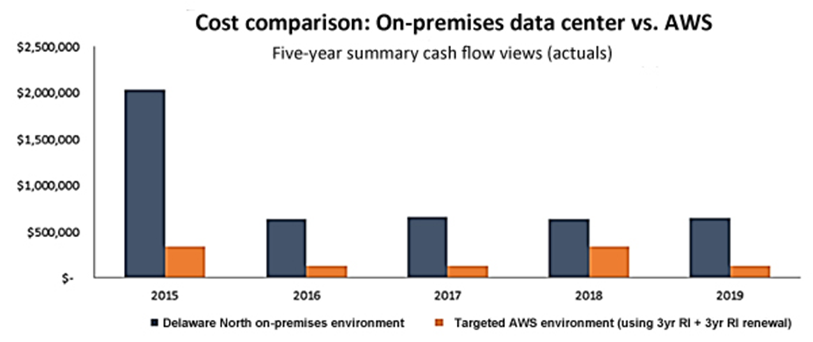
Case study: Total Cost of Ownership (5 of 6)

Slide 75
Case study: Total Cost of Ownership (6 of 6)
Business Goals:
Growth
Enhanced 24/7 business
Operational efficiency
Results:
Resource
optimization
Robust security compliance
Enhanced disaster recovery
Increased computing capacity
Speed to market
One day to provision new businesses
Just minutes to push out a service
Operational efficiency
Continuous cost optimization and reduction

Slide 76

Introducing AWS Billing and Cost Management
Notes:
AWS Billing and Cost Management is the service that you use to pay your AWS bill, monitor your usage, and budget your costs. Billing and Cost Management enables you to forecast and obtain a better idea of what your costs and usage might be in the future so that you can plan ahead.
You can set a custom time period and determine whether you would like to view your data at a monthly or daily level of granularity.
With the filtering and grouping functionality, you can further analyze your data using a variety of available dimensions. The AWS Cost and Usage Report Tool enables you to identify opportunities for optimization by understanding your cost and usage data trends and how you are using your AWS implementation.

Slide 77
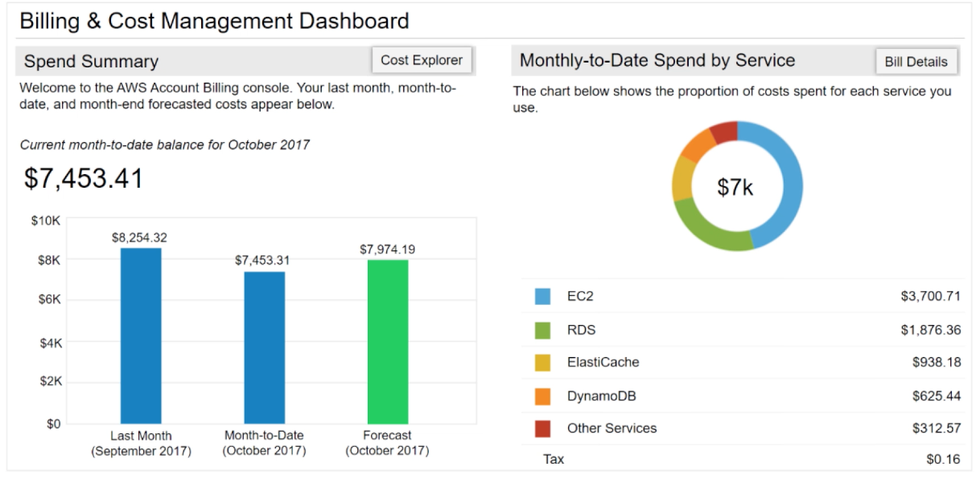
AWS Billing Dashboard
Notes:
The AWS Billing Dashboard lets you view the status of your month-to-date AWS expenditure, identify the services that account for the majority of your overall expenditure, and understand at a high level how costs are trending.
One of the graphs that is located on the dashboard is the Spend Summary. The Spend Summary shows you how much you spent last month, the estimated costs of your AWS usage for the month to date, and a forecast for how much you are likely to spend this month.
Another graph is Month-to-Date Spend by Service, which shows the top services that you use most and the proportion of costs that are attributed to that service.

Slide 78



Tools
AWS Budgets
AWS Cost and Usage Report
AWS Cost Explorer
Notes:
From the billing dashboard, you can access several other cost management tools that you can use to estimate and plan your AWS costs. These tools include AWS Bills, AWS Cost Explorer, AWS Budgets, and AWS Cost and Usage Reports.

Slide 79
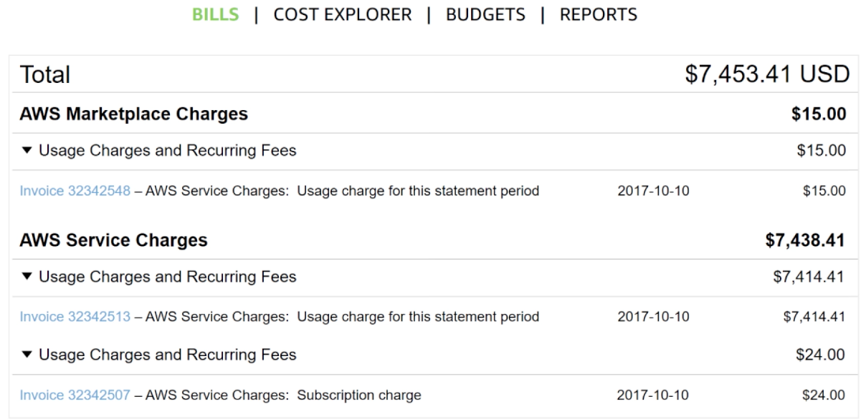
Monthly bills
Notes:
The AWS Bills page lists the costs that you incurred over the past month for each AWS service, with a further breakdown by AWS Region and linked account.
This tool gives you access to the most up-to-date information on your costs and usage, including your monthly bill and the detailed breakdown of the AWS services that you use.

Slide 80
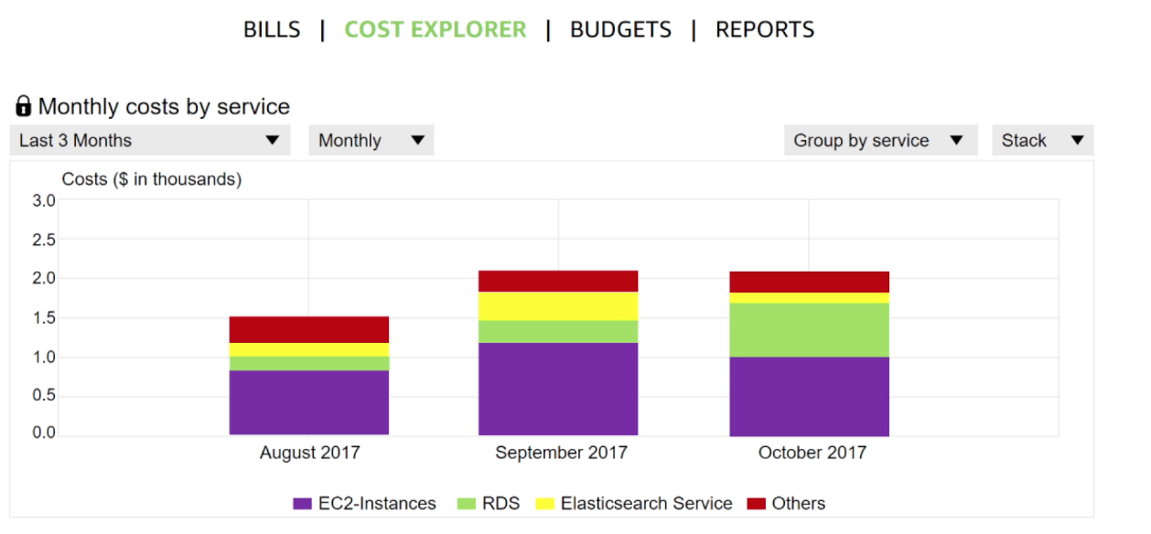
Cost Explorer
Notes:
The AWS Billing and Cost Management console includes the Cost Explorer page for viewing your AWS cost data as a graph.
With Cost Explorer, you can visualize, understand, and manage your AWS costs and usage over time.
The Cost Explorer includes a default report that visualizes your costs and usage for your top cost-incurring AWS services. The monthly running costs report gives you an overview of all your costs for the past 3 months. It also provides forecasted numbers for the coming month, with a corresponding confidence interval.
The Cost Explorer is a free tool that enables you to:
View charts of your costs.
View cost data for the past 13 months.
Forecast how much you are likely to spend over the next 3 months.
Discover patterns in how much you spend on AWS resources over time and identify cost problem areas.
Identify the services that you use the most
View metrics, like which Availability Zones have the most traffic or which linked AWS account is used the most.

Slide 81
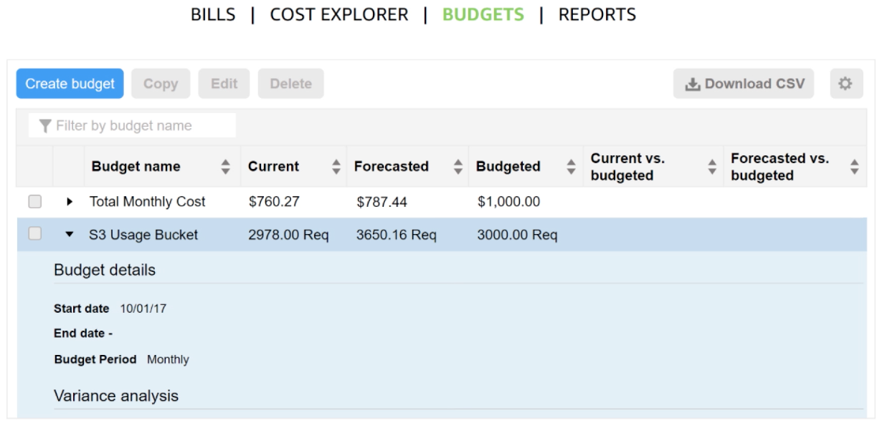
Forecast and track costs
Notes:
AWS Budgets uses the cost visualization that is provided by Cost Explorer to show you the status of your budgets and to provide forecasts of your estimated costs.
You can also use AWS Budgets to create notifications for when you go over your budget for the month, or when your estimated costs exceed your budget. Budgets can be tracked at the monthly, quarterly, or yearly level, and you can customize the start and end dates. Budget alerts can be sent via email or via Amazon Simple Notification Service (Amazon SNS).
For accessibility: The AWS Billing budgets panel showing budget names, current and future costs and usages, and headings for current and forecasted versus budgets. End of accessibility description.

Slide 82
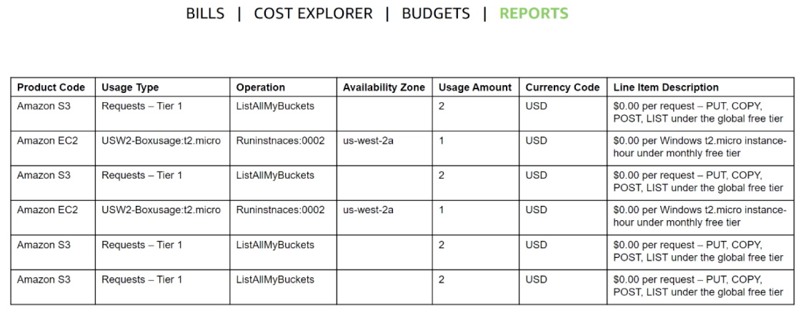
Cost and usage reporting
Notes:
The AWS Cost and Usage Report is a single location for accessing comprehensive information about your AWS costs and usage. This tool lists the usage for each service category that is used by an account (and its users) in hourly or daily line items, and any tax that you activated for tax allocation purposes.
You can choose to have AWS to publish billing reports to an S3 bucket. These reports can be updated once a day.

Slide 83
AWS Budgets
use AWS Budgets to track and take action on your AWS costs and usage.
You can use AWS Budgets to monitor your aggregate utilization and coverage metrics for your Reserved Instances (RIs) or Savings Plans

Slide 84
AWS Budgets
Cost budgets – Plan how much you want to spend on a service.
Usage budgets – Plan how much you want to use one or more services.
RI utilization budgets – Define a utilization threshold and receive alerts when your RI usage falls below that threshold. This lets you see if your RIs are unused or under-utilized.
RI coverage budgets – Define a coverage threshold and receive alerts when the number of your instance hours that are covered by RIs fall below that threshold. This lets you see how much of your instance usage is covered by a reservation.
Savings Plans utilization budgets – Define a utilization threshold and receive alerts when the usage of your Savings Plans falls below that threshold. This lets you see if your Savings Plans are unused or under-utilized.
Savings Plans coverage budgets – Define a coverage threshold and receive alerts when your Savings Plans eligible usage that is covered by Savings Plans fall below that threshold. This lets you see how much of your instance usage is covered by Savings Plans.

Slide 85
Creating Budget
1. Sign in to the AWS Management Console and open the AWS Cost Management console at https://console.aws.amazon.com/cost-management/home.
2. In the navigation pane, choose Budgets.
3. At the top of the page, choose Create budget.
4. Under Budget setup, choose Use a template (simplified).
5. Under Templates, choose a template that best matches your use case
6. Update the details and settings for your specific template.
7. Choose Create budget.

Slide 86
Budget Templates
Zero spend budget: A budget that notifies you after your spending exceeds AWS
Monthly cost budget: A monthly budget that notifies you if you exceed, or are forecasted to exceed, the budget amount.
Daily Savings Plans coverage budget: A coverage budget for your Savings Plans that notifies you when you fall below the defined target. This helps you to identify your on demand spend sooner so that you can consider purchasing a new commitment.
Daily reservation utilization budget: A utilization budget for your Reserved Instances that notifies you when you fall below the defined target. This helps you to identify when you're not using some of your hourly commitment that you already purchased.

Slide 87
Methods
Budget methods:
Fixed planned and Auto-adjusting

Slide 88
Trusted Advisor
draws upon best practices learned from serving hundreds of thousands of AWS customers.
inspects your AWS environment, and then makes recommendations when opportunities exist to save money, improve system availability and performance, or help close security gaps.
If you have a Basic or Developer Support plan, you can use the Trusted Advisor console to access all checks in the Service Limits category and six checks in the Security category.
If you have a Business, Enterprise On-Ramp, or Enterprise Support plan, you can use the Trusted Advisor console and the AWS Trusted Advisor API to access all Trusted Advisor checks.
You also can use Amazon CloudWatch Events to monitor the status of Trusted Advisor checks.

Slide 89
Steps
1. Sign in to the Trusted Advisor console at https://console.aws.amazon.com/trustedadvisor/ home.
2. On the Trusted Advisor Recommendations page, view the summary for each check category:
  Action recommended (red) – Trusted Advisor recommends an action for the check. For example, a check that detects a security issue for your IAM resources might recommend urgent steps.
  Investigation recommended (yellow) – Trusted Advisor detects a possible issue for the check. For example, a check that reaches a quota for a resource might recommend ways to delete unused resources.
  Checks with excluded items (gray) – The number of checks that have excluded items, such as resources that you want a check to ignore. For example, this might be Amazon EC2 instances that you don't want the check to evaluate.

Slide 90
Steps
  3. You can do the following on the Trusted Advisor Recommendations page:
    To refresh all checks in your account, choose Refresh all checks
    To create an .xls file that includes all check results, choose Download all checks.
    Under Checks summary, choose a check category, such as Security, to view the results.
    Under Potential monthly savings, you can view how much you can save for your account and the cost optimization checks for recommendations.
    Under Recent changes, you can view changes to check statuses within the last 30 days. Choose a check name to view the latest results for that check or choose the arrow icon to view the next page.

Slide 91
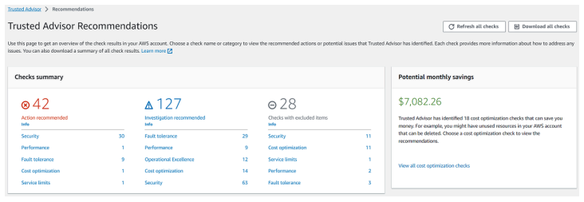
Sample

Slide 92
View Check Descriptions
You can view the check descriptions and results for the following check categories:
  Cost optimization – Recommendations that can potentially save you money. These checks highlight unused resources and opportunities to reduce your bill.
  Performance – Recommendations that can improve the speed and responsiveness of your applications.
  Security – Recommendations for security settings that can make your AWS solution more secure.
  Fault tolerance – Recommendations that help increase the resiliency of your AWS solution. These checks highlight redundancy shortfalls and overused resources.
  Service limits – Checks the usage for your account and whether your account approaches or exceeds the limit (also known as quotas) for AWS services and resources.
  Operational Excellence – Recommendations to help you operate your AWS environment effectively, and at scale.

Slide 93
Operations
Get the list of available Trusted Advisor checks
Refresh the list of available Trusted Advisor checks
Poll a Trusted Advisor check for status changes
Request a Trusted Advisor check result
Show details of a Trusted Advisor check

