Slide 1
AWS
Module 4

Slide 2
Details
AWS Database ServiceS, Amazon RDS (Relational Database Service), RDS Multi-AZ Deployments, RDS Read Replicas,
Amazon Aurora,
Amazon DynamoDB, DynamoDB Streams

Slide 3
AWS Database Services
Amazon DynamoDB
Amazon Aurora
Amazon Relational Database Service
Amazon Timestream
Amazon Neptune
Amazon Quantum Ledger Database (QLDB)
Amazon RDS on VMware

Slide 4




Amazon RDS
Amazon Relational Database Service (Amazon RDS)
Managed service that sets up and operates a relational database in the cloud.
AWS Cloud
Users
Application
Servers
Amazon RDS

Slide 5




Unmanaged versus managed services
Unmanaged:
Managed:
Scaling, fault tolerance, and availability are managed by you.
Scaling, fault tolerance, and availability are typically built into the service.

Slide 6
Challenges In Relational Databases
Server maintenance and energy footprint
Software installation and patches
Database backups and high availability
Limits on scalability
Data security
Operating system (OS) installation and patches

Slide 7

On premise to RDS
Database in Amazon Elastic Compute Cloud (Amazon EC2)
Database in Amazon RDS or Amazon Aurora
On-premises database
Application optimization
Scaling
High Availability
Database backups
Database software patches
Database software installs
Operation system patches
Operating system install
Server maintenance
Rack and stack servers
Power, HVAC, network
Application optimization
Scaling
High Availability
Database backups
Database software patches
Database software installs
Operation system patches
Operating system install
Server maintenance
Rack and stack servers
Power, HVAC, network
Application optimization
Scaling
High Availability
Database backups
Database software patches
Database software installs
Operation system patches
Operating system install
Server maintenance
Rack and stack servers
Power, HVAC, network
AWS
provides
AWS
provides

Slide 8
Managed services responsibilities
You manage:
Application optimization
AWS manages:
OS installation and patches
Database software installation and patches
Database backups
High availability
Scaling
Power and racking and stacking servers
Server maintenance

Slide 9
Amazon RDS
=
MySQL
DB Instance Class
CPU
Memory
Network performance
DB Instance Storage
Magnetic
General Purpose (solid state drive, or SSD)
Provisioned IOPS
M
Amazon Aurora
Microsoft SQL Server
Amazon RDS DB main instance
PostgreSQL
MariaDB
Oracle
DB engines

Slide 10






Amazon RDS in a virtual private cloud (VPC)
AWS Cloud
Availability Zone
VPC
Public subnet
Internet gateway
Users
Amazon EC2
Private subnet
Amazon RDS

Slide 11

High Availability :Multi A-Z Deployment
AWS Cloud
Availability Zone 1
Availability Zone 2
VPC
Public subnet
Amazon EC2
Application
Private subnet
Private subnet
M
Synchronous
S
Amazon RDS
instance
RDS Standby
instance

Slide 12
High Availability :Multi A-Z Deployment
AWS Cloud
Availability Zone 1
Availability Zone 2
VPC
Public subnet
Amazon EC2
Application
Private subnet
Private subnet
M
Synchronous
S
Amazon RDS
instance
RDS Standby
instance

Slide 13
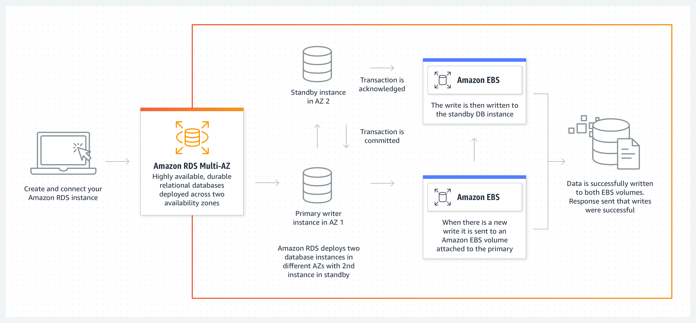

Slide 14
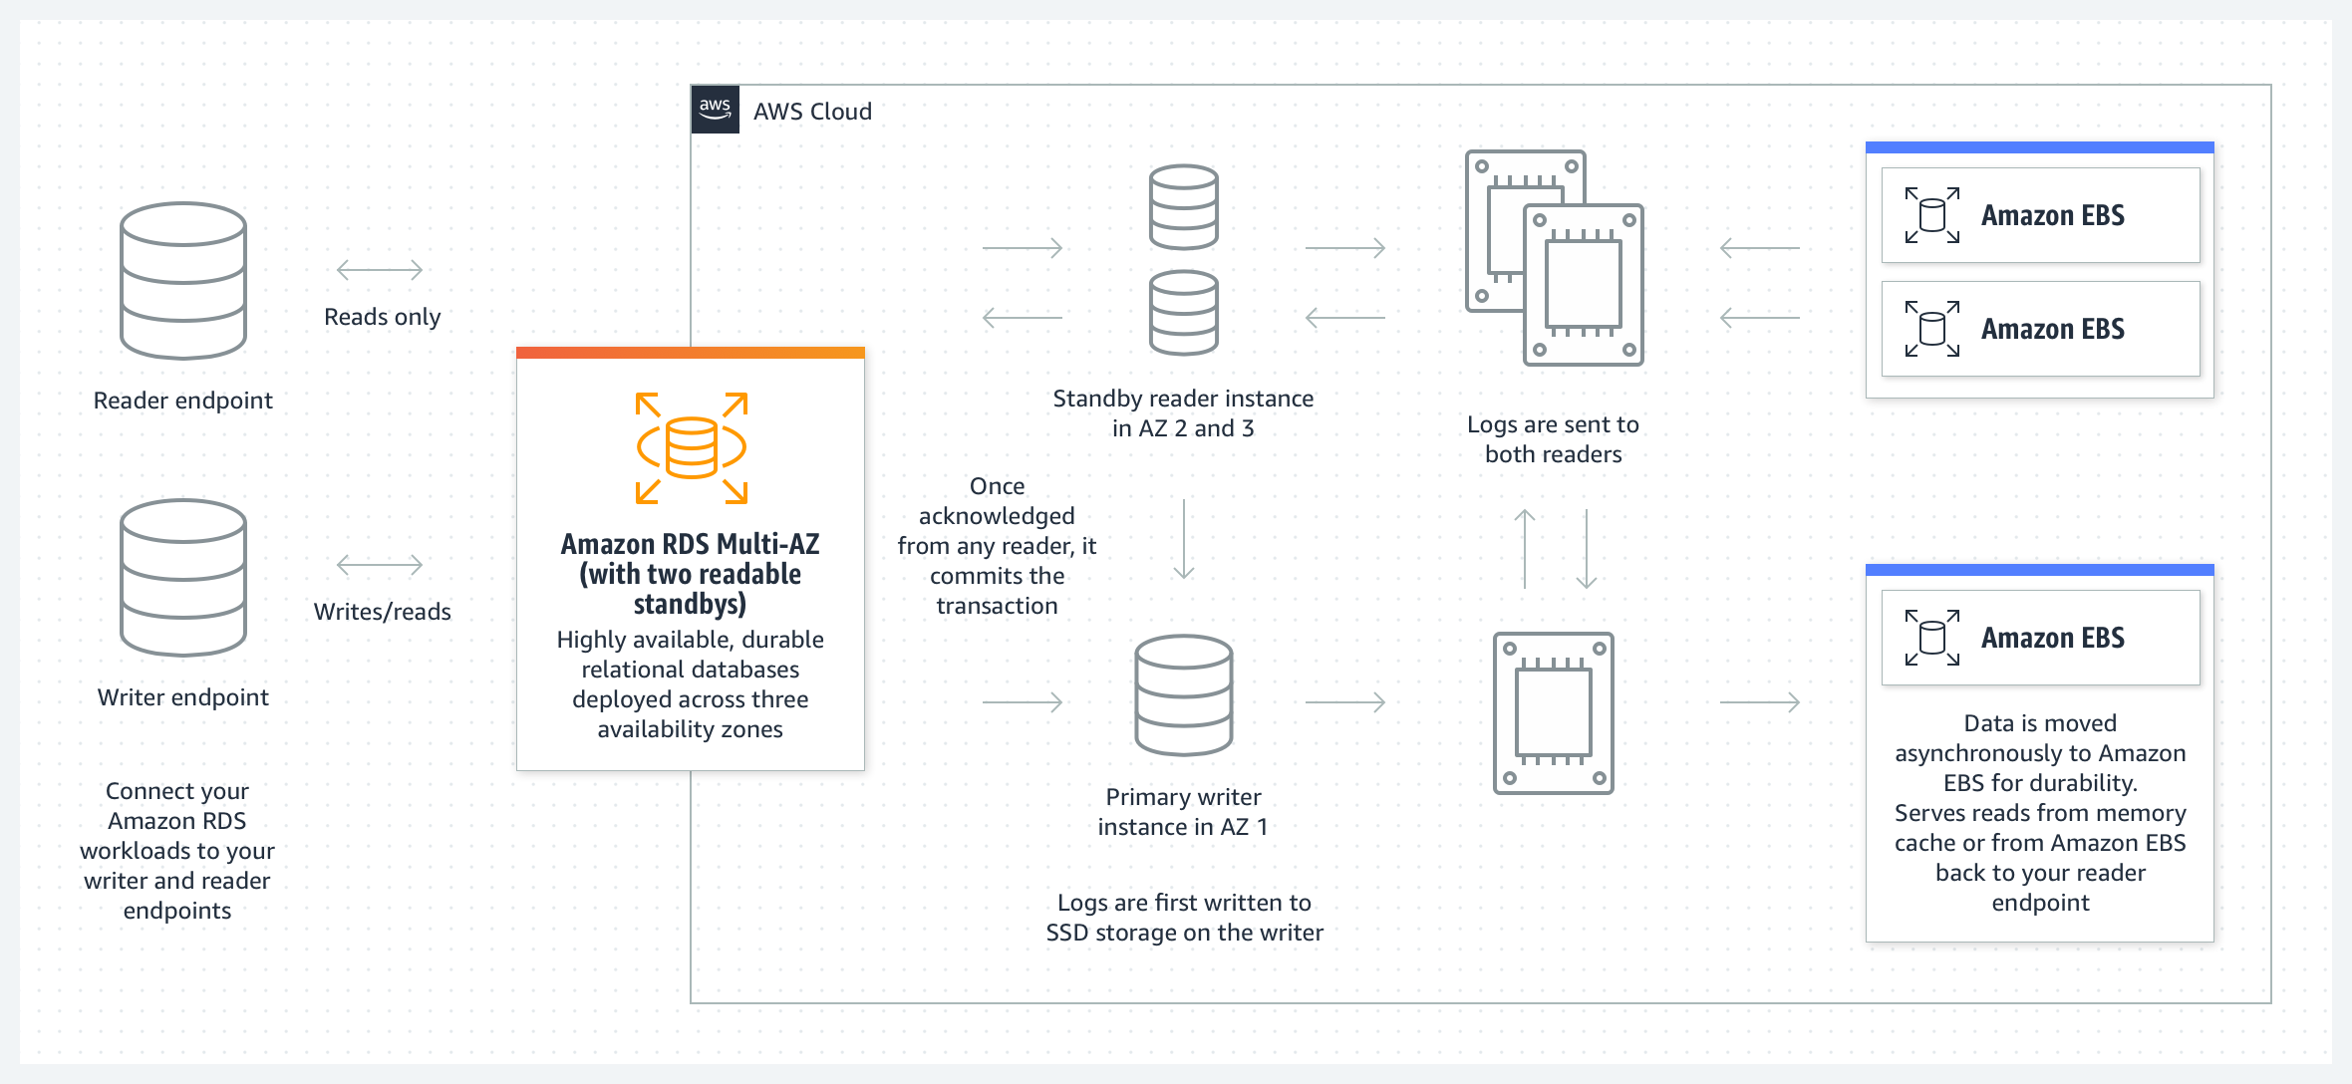

Slide 15
Amazon RDS read replicas
Features
Offers asynchronous replication
Can be promoted to primary if needed
Functionality
Use for read-heavy database workloads
Offload read queries
AWS Cloud
Availability Zone
VPC
Public subnet
Amazon EC2
Application
Private subnet
P
R
Amazon RDS
primary instance
Read replica
instance

Slide 16
Usecase
Web and mobile applications | High throughput Massive storage scalability High availability
Ecommerce applications | Low-cost database Data security Fully managed solution
Mobile and online games | Rapidly grow capacity Automatic scaling Database monitoring

Slide 17
When to Use Amazon RDS
Use Amazon RDS when your application requires:
Complex transactions or complex queries
A medium to high query or write rate – Up to 30,000 IOPS (15,000 reads + 15,000 writes)
No more than a single worker node or shard
High durability
Do not use Amazon RDS when your application requires:
Massive read/write rates (for example, 150,000 write/second)
Sharding due to high data size or throughput demands
Simple GET or PUT requests and queries that a NoSQL database can handle
Relational database management system (RDBMS) customization

Slide 18
Amazon RDS: Clock-hour billing and database characteristics
Clock-hour billing –
  Resources incur charges when running
Database characteristics –
  Physical capacity of database:
    Engine
    Size
    Memory class

Slide 19
Amazon RDS: DB purchase type and multiple DB instances
DB purchase type –
  On-Demand Instances
    Compute capacity by the hour
  Reserved Instances
    Low, one-time, upfront payment for database instances that are reserved with a 1-year or 3-year term
Number of DB instances –
  Provision multiple DB instances to handle peak loads

Slide 20
Amazon RDS: Storage
Provisioned storage –
  No charge
    Backup storage of up to 100 percent of database storage for an active database
  Charge (GB/month)
    Backup storage for terminated DB instances
Additional storage –
  Charge (GB/month)
    Backup storage in addition to provisioned storage

Slide 21
Amazon RDS: Deployment type and data transfer
Requests –
  The number of input and output requests that are made to the database
Deployment type—Storage and I/0 charges vary, depending on whether you deploy to –
  Single Availability Zone
  Multiple Availability Zones
Data transfer –
  No charge for inbound data transfer
  Tiered charges for outbound data transfer

Slide 22
DynamoDB

Slide 23
Relational versus non-relational databases
 | Relational (SQL) | Non-Relational
Data Storage | Rows and columns | Key-value, document, graph
Schemas | Fixed | Dynamic
Querying | Uses SQL | Focuses on collection of documents
Scalability | Vertical | Horizontal
Example
ISBN | Title | Author | Format
3111111223439 | Withering Depths | Jackson, Mateo | Paperback
3122222223439 | Wily Willy | Wang, Xiulan | Ebook
{
ISBN: 3111111223439,
Title: “Withering Depths”,
Author: ”Jackson, Mateo”,
Format: “Paperback”
}

Slide 24

What is Amazon DynamoDB?
Fast and flexible NoSQL database service for any scale
NoSQL database tables
Virtually unlimited storage
Items can have differing attributes
Low-latency queries
Scalable read/write throughput
Amazon DynamoDB

Slide 25
Properties
Fully managed, highly available with replication across multiple AZs
NoSQL database - not a relational database - with transaction support
Scales to massive workloads, distributed database
Millions of requests per seconds, trillions of row, 100s of TB of storage
Fast and consistent in performance (single-digit millisecond)
Integrated with IAM for security, authorization and administration
Low cost and auto-scaling capabilities
No maintenance or patching, always available
Standard & Infrequent Access (IA) Table Class

Slide 26
Basics
DynamoDB is made of Tables
Each table has a Primary Key (must be decided at creation time)
Each table can have an infinite number of items (= rows)
Each item has attributes (can be added over time – can be null)
Maximum size of an item is 400KB
Data types supported are:
  Scalar Types – String, Number, Binary, Boolean, Null
  Document Types – List, Map
  Set Types – String Set, Number Set, Binary Set
Therefore, in DynamoDB you can rapidly evolve schemas

Slide 27
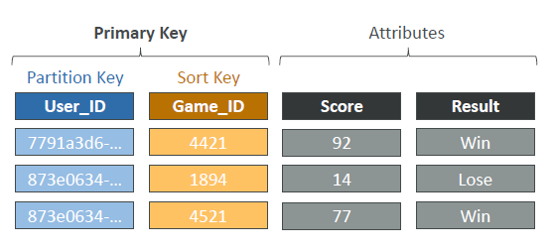
Example

Slide 28
DynamoDB – Read/Write Capacity Modes
Provisioned Mode (default)
  Owner can specify the number of reads/writes per second
  Need to plan capacity beforehand
  Pay for provisioned Read Capacity Units (RCU) & Write Capacity Units (WCU)
  Possibility to add auto-scaling mode for RCU & WCU
On-Demand Mode
  Read/writes automatically scale up/down with workloads
  No capacity planning needed
  Pay as per use, more expensive ($$$)
  Great for unpredictable workloads, steep sudden spikes

Slide 29
Components
Tables, items, and attributes are the core DynamoDB components
DynamoDB supports two different kinds of primary keys: Partition key and partition and sort key

Slide 30
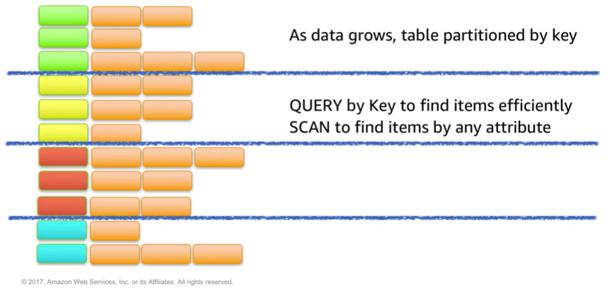
Partitioning

Slide 31
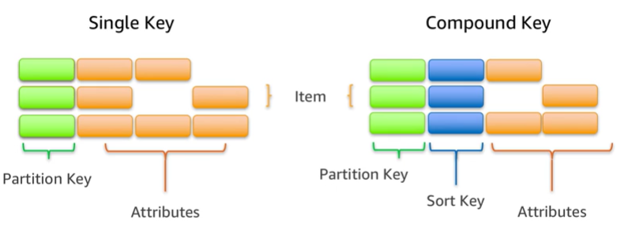
Items in a table must have a key

Slide 32
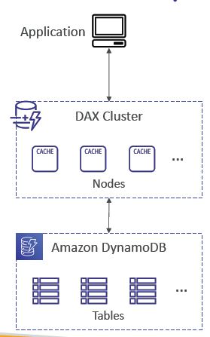
DynamoDB Accelerator (DAX)
Fully-managed, highly available, seamless inmemory
cache for DynamoDB
Help solve read congestion by caching
Microseconds latency for cached data
Doesn’t require application logic modification
(compatible with existing DynamoDB APIs)
5 minutes TTL for cache (default)

Slide 33
DynamoDB – Stream Processing
Ordered stream of item-level modifications (create/update/delete) in a table
Use cases:
React to changes in real-time (welcome email to users)
Real-time usage analytics
Insert into derivative tables
Implement cross-region replication
Invoke AWS Lambda on changes to your DynamoDB table

Slide 34
Options
DynamoDB Streams
• 24 hours retention
• Limited # of consumers
• Process using AWS Lambda Triggers, or
DynamoDB Stream Kinesis adapter
Kinesis Data Streams (newer)
• 1 year retention
• High # of consumers
• Process using AWS Lambda, Kinesis Data
Analytics, Kineis Data Firehose, AWS Glue
Streaming ETL…

Slide 35
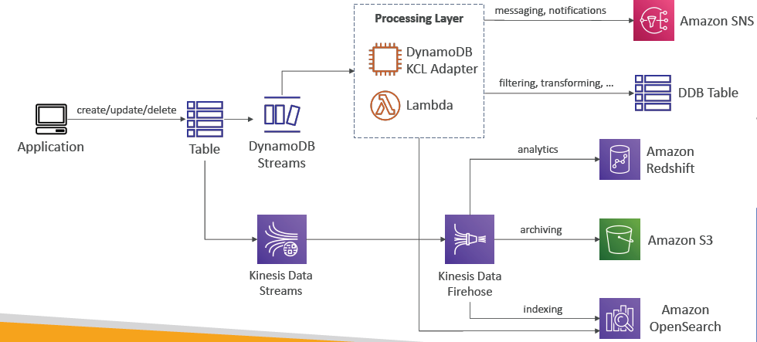
Dynamo DB straems

Slide 36
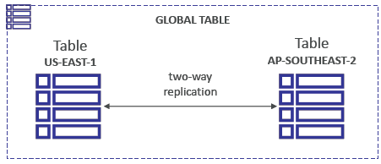
DynamoDB Global Tables
Make a DynamoDB table accessible with low latency in multiple-regions
• Active-Active replication
• Applications can READ and WRITE to the table in any region
• Must enable DynamoDB Streams as a pre-requisite

Slide 37
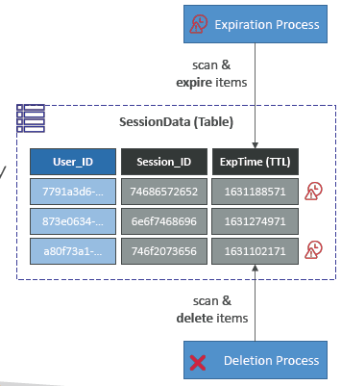
DynamoDB – Time To Live
Automatically delete items after an expiry timestamp
Use cases: reduce stored data by keeping only current items, adhere to regulatory obligations, web session handling

Slide 38
DynamoDB – Backups for disaster recovery
Continuous backups using point-in-time recovery (PITR)
  Optionally enabled for the last 35 days
  Point-in-time recovery to any time within the backup window
  The recovery process creates a new table
On-demand backups
  Full backups for long-term retention, until explicitely deleted
  Doesn’t affect performance or latency
  Can be configured and managed in AWS Backup (enables cross-region copy)
  The recovery process creates a new table

Slide 39
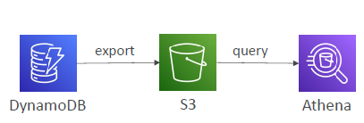
DynamoDB – Integration with Amazon S3
Export to S3 (must enable PITR)
Works for any point of time in the last 35 days
Doesn’t affect the read capacity of your table
Perform data analysis on top of DynamoDB
Retain snapshots for auditing
ETL on top of S3 data before importing back into DynamoDB
Export in DynamoDB JSON or ION format

Slide 40
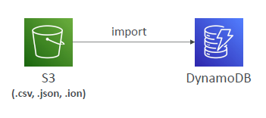
DynamoDB – Integration with Amazon S3 (2)
Import from S3
Import CSV, DynamoDB JSON or ION format
Doesn’t consume any write capacity
Creates a new table
Import errors are logged in CloudWatch Logs

Slide 41
A retail company uses an Amazon DB service instance for its e-commerce application’s database. Suddenly, during a seasonal sale, the application experiences high read traffic, leading to increased latency and customer complaints about slow page loads. The management wants to ensure high availability, minimal downtime, and optimal performance, especially during peak hours. The company also has strict requirements for automated backups and disaster recovery.
Which DB service is relevant? What are the features you expect?

Slide 42
AWS Aurora

Slide 43

Amazon Aurora
Enterprise-class relational database
Compatible with MySQL or PostgreSQL
Automate time-consuming tasks (such as provisioning, patching, backup, recovery, failure detection, and repair).
Amazon Aurora

Slide 44
Basics
Aurora is a proprietary technology from AWS (not open sourced)
Postgres and MySQL are both supported as Aurora DB (that means your drivers will work as if Aurora was a Postgres or MySQL database)
Aurora is “AWS cloud optimized” and claims 5x performance improvement over MySQL on RDS, over 3x the performance of Postgres on RDS
Aurora storage automatically grows in increments of 10GB, up to 128 TB.
Aurora can have up to 15 replicas and the replication process is faster than
MySQL (sub 10 ms replica lag)
Failover in Aurora is instantaneous. It’s HA (High Availability) native.
Aurora costs more than RDS (20% more) – but is more efficient

Slide 45
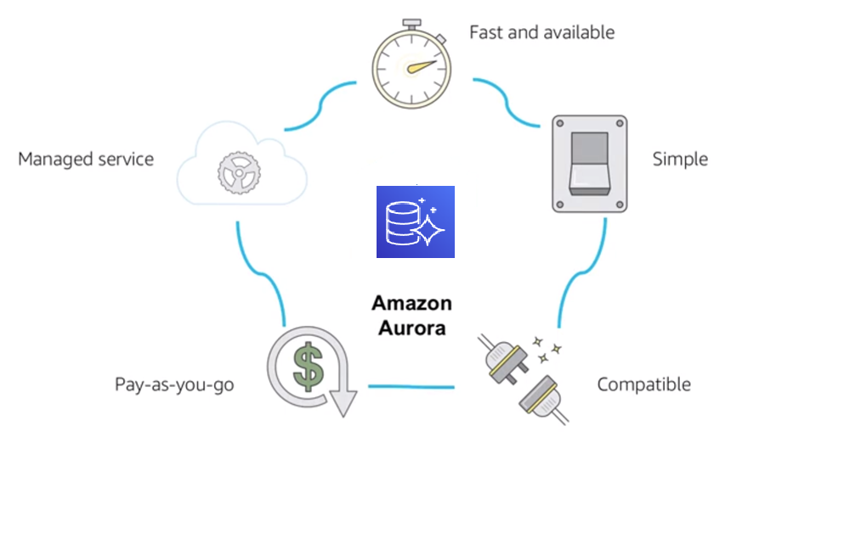
Benefits

Slide 46
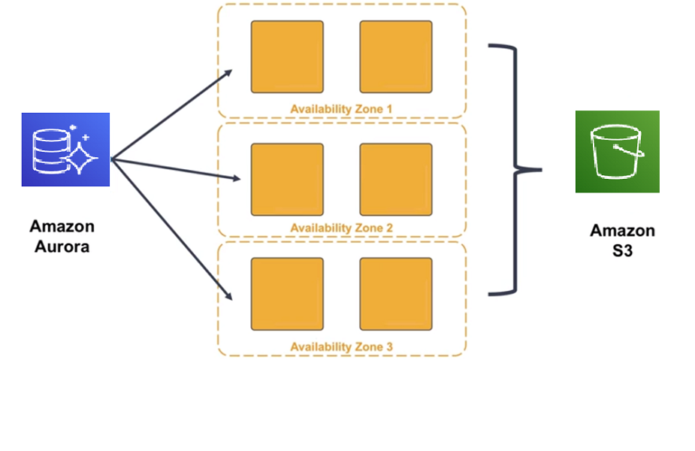
High Availability

Slide 47
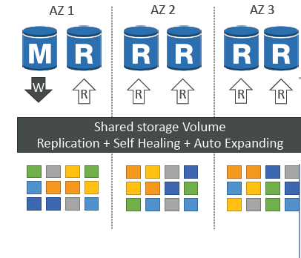
Aurora High Availability and Read Scaling
copies of your data across 3 AZ:
4 copies out of 6 needed for writes
3 copies out of 6 need for reads
Self healing with peer-to-peer replication
Storage is striped across 100s of volumes
One Aurora Instance takes writes (master)
Automated failover for master in less than 30 seconds
Master + up to 15 Aurora Read Replicas serve reads
Support for Cross Region Replication

Slide 48
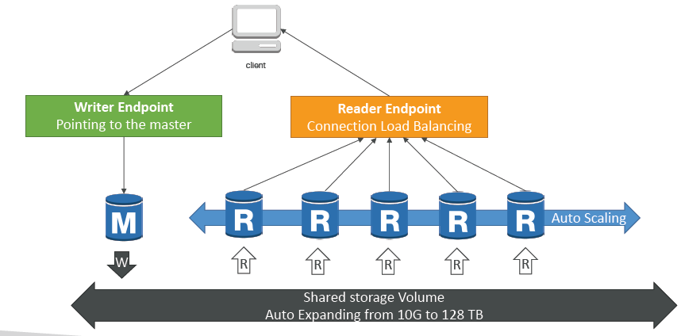
Aurora DB Cluster

Slide 49
Features
Automatic fail-over
Backup and Recovery
Isolation and security
Industry compliance
Push-button scaling
Automated Patching with Zero Downtime
Advanced Monitoring
Routine Maintenance
Backtrack: restore data at any point of time without using backups

Slide 50
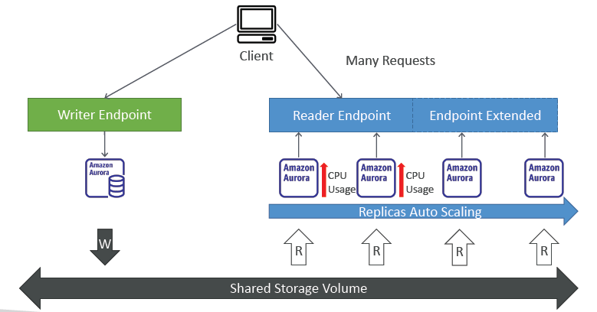
Aurora Replicas Auto-scaling

Slide 51
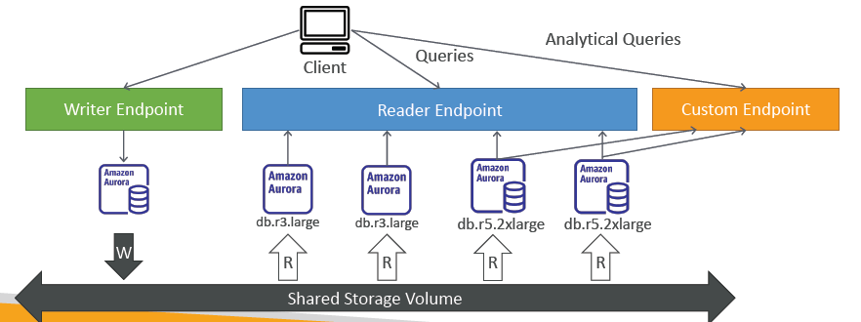
Aurora- Custom Endpoints
Define a subset of Aurora Instances as a Custom Endpoint
Example: Run analytical queries on specific replicas
The Reader Endpoint is generally not used after defining Custom Endpoints

Slide 52
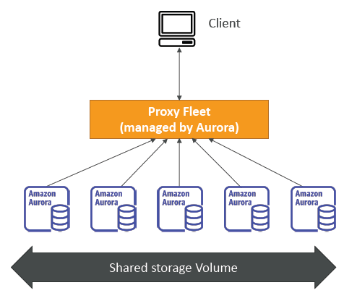
Aurora Serverless
Automated database instantiation and autoscaling based on actual usage
Good for infrequent, intermittent or unpredictable workloads
No capacity planning needed
Pay per second, can be more cost-effective

Slide 53
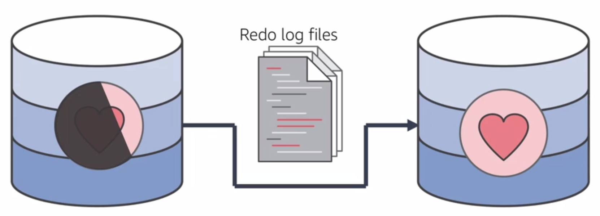
Resilient design

Slide 54
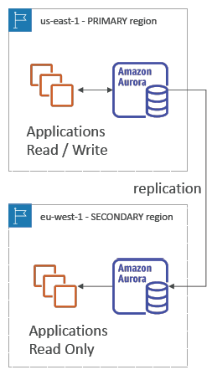
Global Aurora
Aurora Cross Region Read Replicas:
  Useful for disaster recovery
  Simple to put in place
Aurora Global Database (recommended):
  1 Primary Region (read / write)
  Up to 5 secondary (read-only) regions, replication lag is less than 1 second
  Up to 16 Read Replicas per secondary region
  Helps for decreasing latency
  Promoting another region (for disaster recovery) has an RTO of < 1 minute
  Typical cross-region replication takes less than 1 second

Slide 55
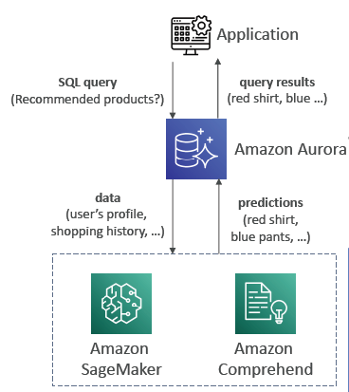
Aurora Machine Learning
Enables you to add ML-based predictions to your applications via SQL
Simple, optimized, and secure integration between Aurora and AWS ML services
Supported services
  Amazon SageMaker (use with any ML model)
  Amazon Comprehend (for sentiment analysis)
You don’t need to have ML experience
Use cases: fraud detection, ads targeting, sentiment analysis, product recommendations

Slide 56
What are my requirements?
Enterprise-class relational database | Amazon RDS
Fast and flexible NoSQL database service for any scale | Amazon DynamoDB
Operating system access or application features that are not supported by AWS database services | Databases on Amazon EC2
Specific case-driven requirements (machine learning, data warehouse, graphs) | AWS purpose-built database services

Slide 57
Database backups and Security

Slide 58
RDS Backups
Automated backups:
  • Daily full backup of the database (during the backup window)
  Transaction logs are backed-up by RDS every 5 minutes
  => ability to restore to any point in time (from oldest backup to 5 minutes ago)
  1 to 35 days of retention, set 0 to disable automated backups
Manual DB Snapshots
  Manually triggered by the user
  Retention of backup for as long as you want
Trick: in a stopped RDS database, you will still pay for storage. If you plan on stopping it for a long time, you should snapshot & restore instead

Slide 59
Aurora Backups
Automated backups
  1 to 35 days (cannot be disabled)
  point-in-time recovery in that timeframe
Manual DB Snapshots
  Manually triggered by the user
  Retention of backup for as long as you want

Slide 60
RDS & Aurora Restore options
Restoring a RDS / Aurora backup or a snapshot creates a new database
Restoring MySQL RDS database from S3
  Create a backup of your on-premises database
  Store it on Amazon S3 (object storage)
  Restore the backup file onto a new RDS instance running MySQL
Restoring MySQL Aurora cluster from S3
  Create a backup of your on-premises database using Percona XtraBackup
  Store the backup file on Amazon S3
  Restore the backup file onto a new Aurora cluster running MySQL

Slide 61
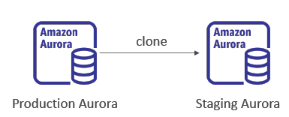
Aurora Database Cloning
Create a new Aurora DB Cluster from an existing one
Faster than snapshot & restore
Uses copy-on-write protocol
  Initially, the new DB cluster uses the same data volume as the original DB cluster (fast and efficient no copying is needed)
  When updates are made to the new DB cluster data, then additional storage is allocated and data is copied to be separated
Very fast & cost-effective
Useful to create a “staging” database from a “production” database without impacting the production database

Slide 62
RDS & Aurora Security
At-rest encryption:
  Database master & replicas encryption using AWS KMS – must be defined as launch time
  If the master is not encrypted, the read replicas cannot be encrypted
  To encrypt an un-encrypted database, go through a DB snapshot & restore as encrypted
In-flight encryption: TLS-ready by default, use the AWS TLS root certificates client-side
IAM Authentication: IAM roles to connect to your database (instead of username/pw)
Security Groups: Control Network access to your RDS / Aurora DB
No SSH available except on RDS Custom
Audit Logs can be enabled and sent to CloudWatch Logs for longer retention

Slide 63
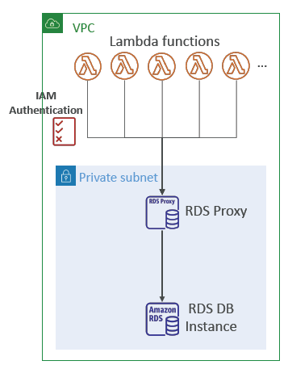
Amazon RDS Proxy
Fully managed database proxy for RDS
Allows apps to pool and share DB connections established with the database
Improving database efficiency by reducing the stress on database resources (e.g., CPU, RAM) and minimize open connections (and timeouts)
Serverless, autoscaling, highly available (multi-AZ)
Reduced RDS & Aurora failover time by up 66%
Supports RDS (MySQL, PostgreSQL, MariaDB, MS SQL Server) and Aurora (MySQL, PostgreSQL)
No code changes required for most apps
Enforce IAM Authentication for DB, and securely store credentials in AWS Secrets Manager
RDS Proxy is never publicly accessible (must be accessed from VPC)

Slide 64
Database Activity 1
A data protection and management company that provides services to enterprises. They must provide database services for over 55 petabytes of data. They have two types of data that require a database solution. First, they need a relational database store for configuration data. Second, they need a store for unstructured metadata to support a de-duplication service. After the data is de-duplicated, it is stored in Amazon S3 for quick retrieval, and eventually moved to Amazon S3 Glacier for long-term storage. The following diagram illustrates their architecture.

Slide 65




Solve
AWS Cloud
Configuration
database
???
Metadata database
???
Corporate data center
Amazon EC2
Amazon Simple Storage Service (Amazon S3)
Amazon Simple Storage Service Glacier

Slide 66
Database Activity 2
A commercial shipping company that uses an on-premises legacy data management system. They must migrate to a serverless ecosystem while they continue to use their existing database system, which is based on Oracle. They are also in the process of decomposing their highly structured relational data into semistructured data. The following diagram illustrates their architecture.

Slide 67



Solve
Database
???
AWS AppSync
AWS Lambda
AWS Lambda
Corporate data center
Oracle database
AWS Lambda
Amazon Simple Notification Service (Amazon SNS)

Slide 68
Database Activity 3
An online payment processing company that processes over1 million transactions per day. They must provide services to ecommerce customers who offer flash sales (sales that offer greatly reduced prices for a limited time), where demand can increase by 30 times in a short time period. They use IAM and AWS KMS to authenticate transactions with financial institutions. They need high throughput for these peak loads. The following diagram illustrates their architecture.

Slide 69







Solve
AWS Cloud
Database
???
AWS Identity and Access Management (IAM)
Elastic Load Balancing
Internet
Banks
AWS SDK
AWS Key Management Service (AWS KMS)
Amazon EC2 instances
Read replicas

