Slide 1
AWS
Module 6

Slide 2
Details
AWS Security and Compliance, AWS Shared Responsibility Model,
AWS Key Management Service (KMS), AWS WAF (Web Application Firewall), AWS Shield,
AWS Security Best Practices

Slide 3
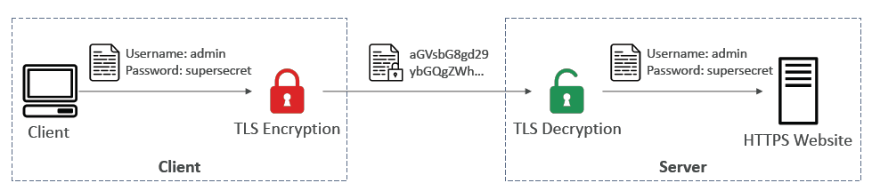
AWS Security
TLS encryption is used.

Slide 4
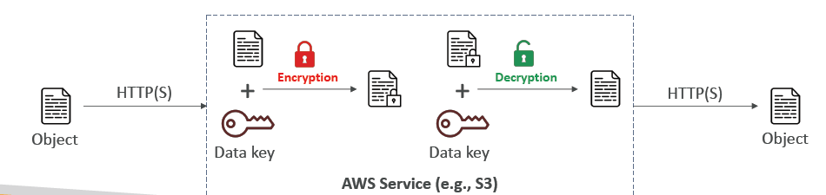
Server side (at rest)
Data is encrypted after being received by the server.

Slide 5
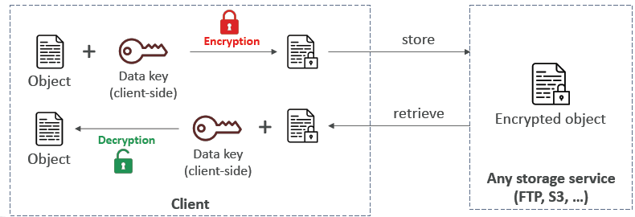
Client Side
Encryption by client cannot be decrypted by server
Can be decrypted by receiving client only.

Slide 6
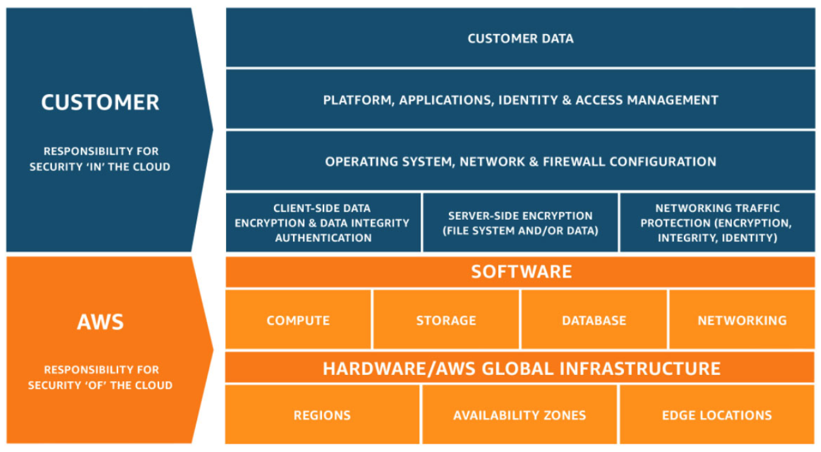
AWS shared responsibility model

Slide 7




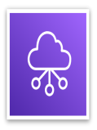



AWS responsibility: Security of the cloud
AWS responsibilities:
Physical security of data centers
  Controlled, need-based access
Hardware and software infrastructure
  Storage decommissioning, host operating system (OS) access logging, and auditing
Network infrastructure
  Intrusion detection
Virtualization infrastructure
  Instance isolation
AWS services
Compute
Storage
Database
Networking
AWS Global
Infrastructure
Regions
Availability Zones
Edge locations

Slide 8
Customer responsibility: Security in the cloud
Customer responsibilities:
Amazon Elastic Compute Cloud (Amazon EC2) instance operating system
  Including patching, maintenance
Applications
  Passwords, role-based access, etc.
Security group configuration
OS or host-based firewalls
  Including intrusion detection or prevention systems
Network configurations
Account management
  Login and permission settings for each user
Customer data
Applications, IAM
Operating system, network, and firewall configuration
Client-side data
encryption and data integrity authentication
Server-side encryption
(file system or data)
Network traffic protection
(encryption, integrity, identity)
Customer-configurable

Slide 9






Service characteristics and security responsibility (1 of 2)
Example services managed by the customer
Infrastructure as a service (IaaS)
Customer has more flexibility over configuring networking and storage settings
Customer is responsible for managing more aspects of the security
Customer configures the access controls
Platform as a service (PaaS)
Customer does not need to manage the underlying infrastructure
AWS handles the operating system, database patching, firewall configuration, and disaster recovery
Customer can focus on managing code or data
Amazon
EC2
Amazon Elastic Block Store (Amazon EBS)
Amazon
Virtual Private Cloud (Amazon VPC)
Example services managed by AWS
AWS
Lambda
Amazon
Relational Database Service (Amazon RDS)
AWS Elastic Beanstalk

Slide 10



Service characteristics and security responsibility (2 of 2)
SaaS examples
Software as a service (SaaS)
Software is centrally hosted
Licensed on a subscription model or pay-as-you-go basis.
Services are typically accessed via web browser, mobile app, or application programming interface (API)
Customers do not need to manage the infrastructure that supports the service
AWS Trusted
Advisor
AWS Shield
Amazon Chime

Slide 11

AWS account root user access versus IAM access
Account root user
IAM
Best practice: Do not use the AWS account root user except when necessary.
  Access to the account root user requires logging in with the email address (and password) that you used to create the account.
Example actions that can only be done with the account root user:
  Update the account root user password
  Change the AWS Support plan
  Restore an IAM user's permissions
  Change account settings (for example, contact information, allowed Regions)
Integrates with other AWS services
Identity federation
Privileges cannot be controlled
Secure access for applications
Full access to all resources
Granular permissions

Slide 12
Securing a new AWS account: Account root user
Step 1: Stop using the account root user as soon as possible.
  The account root user has unrestricted access to all your resources.
To stop using the account root user:
  While you are logged in as the account root user, create an IAM user for yourself. Save the access keys if needed.
  Create an IAM group, give it full administrator permissions, and add the IAM user to the group.
  Disable and remove your account root user access keys, if they exist.
  Enable a password policy for users.
  Sign in with your new IAM user credentials.
  Store your account root user credentials in a secure place.

Slide 13

Securing a new AWS account: MFA
Step 2: Enable multi-factor authentication (MFA).
  Require MFA for your account root user and for all IAM users.
  You can also use MFA to control access to AWS service APIs.
Options for retrieving the MFA token –
  Virtual MFA-compliant applications:
    Google Authenticator.
    Authy Authenticator (Windows phone app).
  U2F security key devices:
    For example, YubiKey.
  Hardware MFA options:
    Key fob or display card offered by Gemalto.
MFA token

Slide 14
Securing a new AWS account: AWS CloudTrail
Step 3: Use AWS CloudTrail.
  CloudTrail tracks user activity on your account.
    Logs all API requests to resources in all supported services your account.
  Basic AWS CloudTrail event history is enabled by default and is free.
    It contains all management event data on latest 90 days of account activity.
To access CloudTrail –
  Log in to the AWS Management Console and choose the CloudTrail service.
  Click Event history to view, filter, and search the last 90 days of events.
To enable logs beyond 90 days and enable specified event alerting, create a trail.
  From the CloudTrail Console trails page, click Create trail.
  Give it a name, apply it to all Regions, and create a new Amazon S3 bucket for log storage.
  Configure access restrictions on the S3 bucket (for example, only admin users should have access).

Slide 15
Securing a new AWS account: Billing reports
Step 4: Enable a billing report, such as the AWS Cost and Usage Report.
Billing reports provide information about your use of AWS resources and estimated costs for that use.
AWS delivers the reports to an Amazon S3 bucket that you specify.
  Report is updated at least once per day.
The AWS Cost and Usage Report tracks your AWS usage and provides estimated charges associated with your AWS account, either by the hour or by the day.

Slide 16





Activity: Scenario 1 of 2
Consider this deployment. Who is responsible – AWS or the customer?
Upgrades and patches to the operating system on the EC2 instance?
Physical security of the data center?
Virtualization infrastructure?
EC2 security group settings?
Configuration of applications that run on the EC2 instance?
Oracle upgrades or patches If the Oracle instance runs as an Amazon RDS instance?
Oracle upgrades or patches If Oracle runs on an EC2 instance?
S3 bucket access configuration?
AWS Cloud
Virtual Private Cloud (VPC)
Amazon Simple Storage Service (Amazon S3)
Amazon
EC2
Oracle instance
AWS Global Infrastructure

Slide 17
Activity: Scenario 1 of 2 Answers
Consider this deployment. Who is responsible – AWS or the customer?
Upgrades and patches to the operating system on the EC2 instance?
  ANSWER: The customer
Physical security of the data center?
  ANSWER: AWS
Virtualization infrastructure?
  ANSWER: AWS
EC2 security group settings?
  ANSWER: The customer
Configuration of applications that run on the EC2 instance?
  ANSWER: The customer
Oracle upgrades or patches If the Oracle instance runs as an Amazon RDS instance?
  ANSWER: AWS
Oracle upgrades or patches If Oracle runs on an EC2 instance?
  ANSWER: The customer
S3 bucket access configuration?
  ANSWER: The customer
AWS Cloud
Virtual Private Cloud (VPC)
Amazon Simple Storage Service (Amazon S3)
Amazon
EC2
Oracle instance
AWS Global Infrastructure

Slide 18








Activity: Scenario 2 of 2
Consider this deployment. Who is responsible – AWS or the customer?
Secure Shell (SSH) keys
Ensuring that the AWS Management Console is not hacked?
Configuring the subnet?
Configuring the VPC?
Protecting against network outages in AWS Regions?
Securing the SSH keys
Ensuring network isolation between AWS customers' data?
Ensuring low-latency network connection between the web server and the S3 bucket?
Enforcing multi-factor authentication for all user logins?
AWS Command Line Interface (AWS CLI)
AWS Management Console
Internet gateway
VPC
Subnet
Web server on Amazon EC2
S3 bucket with objects

Slide 19
Activity: Scenario 2 of 2 Answers
Consider this deployment. Who is responsible – AWS or the customer?
Ensuring that the AWS Management Console is not hacked?
  ANSWER: AWS
Configuring the subnet?
  ANSWER: The customer
Configuring the VPC?
  ANSWER: The customer
Protecting against network outages in AWS Regions?
  ANSWER: AWS
Securing the SSH keys
  ANSWER: The customer
Secure Shell (SSH) keys
Ensuring network isolation between AWS customers' data?
  ANSWER: AWS
Ensuring low-latency network connection between the web server and the S3 bucket?
  ANSWER: AWS
Enforcing multi-factor authentication for all user logins?
  ANSWER: The customer
AWS Command Line Interface (AWS CLI)
AWS Management Console
Internet gateway
VPC
Subnet
Web server on Amazon EC2
S3 bucket with objects

Slide 20
Overview of Compliance in AWS
When customers move their production workloads to the AWS cloud, both parties become responsible for managing the IT environment.
The customers are responsible for setting up their environment in a secure and controlled manner.
The customers also need to maintain adequate governance over their entire IT control environment.

Slide 21
Strong Compliance Governance
By deploying to the AWS Cloud, customers have options to apply different types of controls and various verification:
Take a holistic approach. Review the information available from AWS together with all
other information to understand as much of the IT environment as they can. After this is
complete, document all compliance requirements.
2. Design and implement control objectives to meet the organization’s compliance
requirements.
3. Identify and document controls owned by all third parties.
4. Verify that all control objectives are met and all key controls are designed and operating
effectively.

Slide 22
AWS KMS
Anytime you hear “encryption” for an AWS service, it’s most likely KMS
AWS manages encryption keys for us
Fully integrated with IAM for authorization
Easy way to control access to your data
Able to audit KMS Key usage using CloudTrail
Seamlessly integrated into most AWS services (EBS, S3, RDS, SSM…)
Never ever store your secrets in plaintext, especially in your code!
KMS Key Encryption also available through API calls (SDK, CLI)
Encrypted secrets can be stored in the code / environment variables

Slide 23
KMS Keys Types
KMS Keys is the new name of KMS Customer Master Key
Symmetric (AES-256 keys)
  • Single encryption key that is used to Encrypt and Decrypt
  • AWS services that are integrated with KMS use Symmetric CMKs
  • You never get access to the KMS Key unencrypted (must call KMS API to use)
Asymmetric (RSA & ECC key pairs)
  • Public (Encrypt) and Private Key (Decrypt) pair
  • Used for Encrypt/Decrypt, or Sign/Verify operations
  • The public key is downloadable, but you can’t access the Private Key unencrypted
  • Use case: encryption outside of AWS by users who can’t call the KMS API

Slide 24
KMS
Types of KMS Keys:
  • AWS Owned Keys (free): SSE-S3, SSE-SQS, SSE-DDB (default key)
  • AWS Managed Key: free (aws/service-name, example: aws/rds or aws/ebs)
  • Customer managed keys created in KMS: $1 / month
  • Customer managed keys imported (must be symmetric key): $1 / month + pay for API call to KMS ($0.03 / 10000 calls)
Automatic Key rotation:
  • AWS-managed KMS Key: automatic every 1 year
  • Customer-managed KMS Key: (must be enabled) automatic every 1 year
  • Imported KMS Key: only manual rotation possible using alias

Slide 25
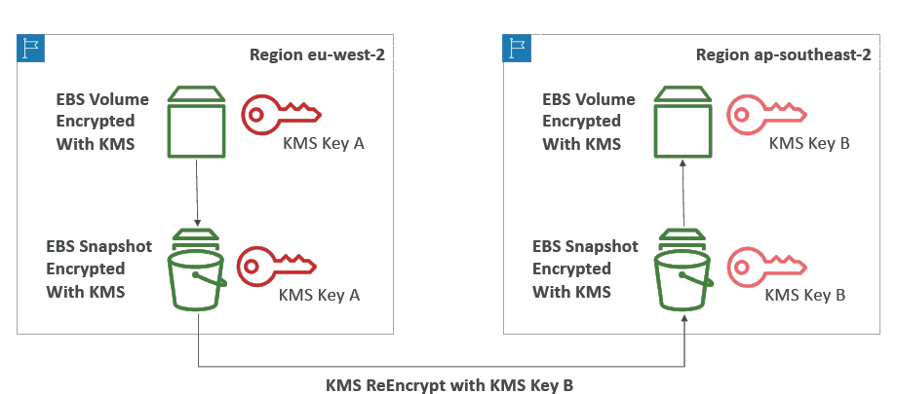
Copying snapshots across regions

Slide 26
KMS key policies
Control access to KMS keys, “similar” to S3 bucket policies
Difference: you cannot control access without them
Default KMS Key Policy:
  Created if you don’t provide a specific KMS Key Policy
  Complete access to the key to the root user = entire AWS account
Custom KMS Key Policy:
  Define users, roles that can access the KMS key
  Define who can administer the key
  Useful for cross-account access of your KMS key

Slide 27
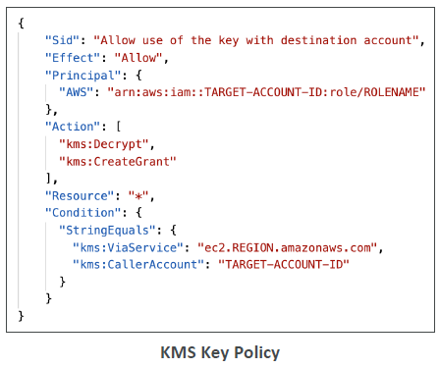
Copy snapshots across accounts
1.Create a Snapshot, encrypted with your own KMS Key (Customer Managed Key)
2. Attach a KMS Key Policy to authorize cross-account access
3. Share the encrypted snapshot
4. (in target) Create a copy of the Snapshot, encrypt it with a CMK in your account
5. Create a volume from the snapshot

Slide 28
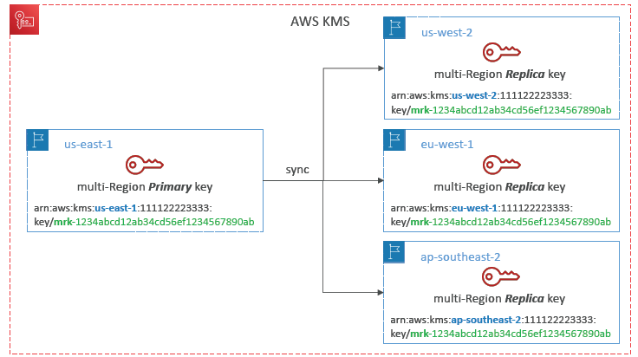
KMS Multi-Region Keys

Slide 29
Multi-region keys
Identical KMS keys in different AWS Regions that can be used interchangeably
Multi-Region keys have the same key ID, key material, automatic rotation…
Encrypt in one Region and decrypt in other Regions
No need to re-encrypt or making cross-Region API calls
KMS Multi-Region are NOT global (Primary + Replicas)
Each Multi-Region key is managed independently
Use cases: global client-side encryption, encryption on Global DynamoDB, Global Aurora

Slide 30
DynamoDB Global Tables and KMS Multi- Region Keys Client-Side encryption
We can encrypt specific attributes client-side in our DynamoDB table using the Amazon DynamoDB Encryption Client
Combined with Global Tables, the client-side encrypted data is replicated to other regions
If we use a multi-region key, replicated in the same region as the DynamoDB Global table, then clients in these regions can use low latency API calls to KMS in their region to decrypt the data client-side
Using client-side encryption we can protect specific fields and guarantee only decryption if the client has access to an API key

Slide 31
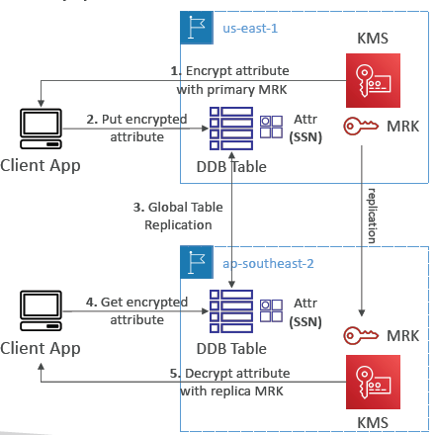

Slide 32
Global Aurora and KMS Multi-Region Keys Client-Side encryption
We can encrypt specific attributes client-side in our Aurora table using the AWS
Encryption SDK
Combined with Aurora Global Tables, the client-side encrypted data is replicated to other regions
If we use a multi-region key, replicated in the same region as the Global Aurora DB, then clients in these regions can use low-latency API calls to KMS in their region to decrypt the data client-side
Using client-side encryption we can protect specific fields and guarantee only decryption if the client has access to an API key, we can protect specific fields even from database admins

Slide 33
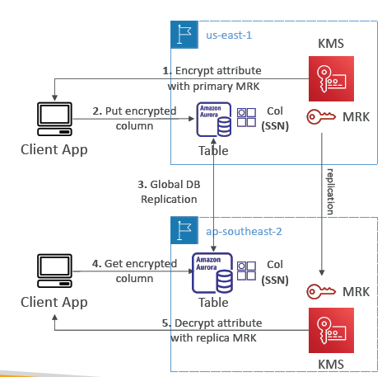

Slide 34
S3 replication encryption
Unencrypted objects and objects encrypted with SSE-S3 are replicated by default
Objects encrypted with SSE-C (customer provided key) can be replicated
For objects encrypted with SSE-KMS, you need to enable the option
  Specify which KMS Key to encrypt the objects within the target bucket
  Adapt the KMS Key Policy for the target key
  An IAM Role with kms:Decrypt for the source KMS Key and kms:Encrypt for the target KMS Key
  You might get KMS throttling errors, in which case you can ask for a Service Quotas increase
You can use multi-region AWS KMS Keys, but they are currently treated as independent keys by Amazon S3 (the object will still be decrypted and then encrypted)

Slide 35
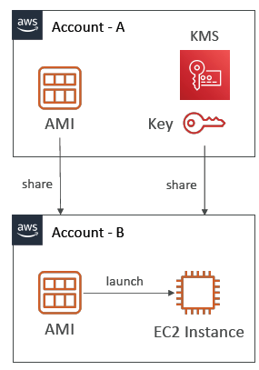
AMI Sharing Process Encrypted via KMS
1. AMI in Source Account is encrypted with KMS Key from Source Account
2. Must modify the image attribute to add a Launch Permission which corresponds to the specified target AWS account
3. Must share the KMS Keys used to encrypted the snapshot the AMI references with the target account / IAM Role
4. The IAM Role/User in the target account must have the permissions to DescribeKey, ReEncrypted, CreateGrant, Decrypt
5. When launching an EC2 instance from the AMI, optionally the target account can specify a new KMS key in its own account to re-encrypt the volumes

Slide 36
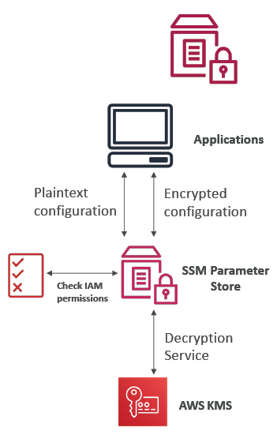
SSM Parameter Store
Secure storage for configuration and secrets
Optional Seamless Encryption using KMS
Serverless, scalable, durable, easy SDK
Version tracking of configurations / secrets
Security through IAM
Notifications with Amazon EventBridge
Integration with CloudFormation

Slide 37
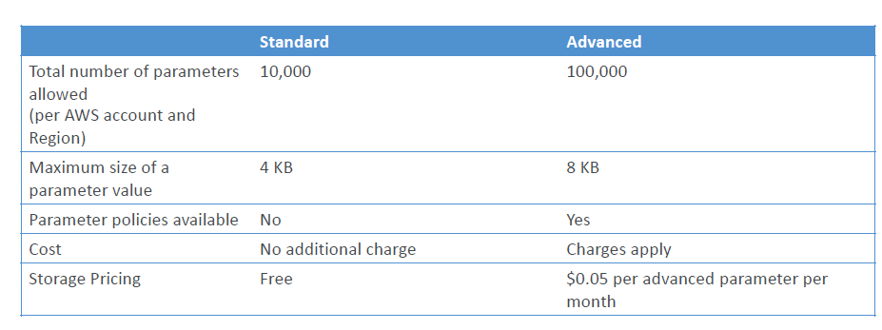
Parameter tiers

Slide 38
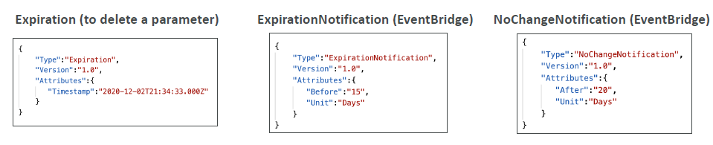
Parameters Policies (for advanced parameters)
Allow to assign a TTL to a parameter (expiration date) to force updating or deleting sensitive data such as passwords
Can assign multiple policies at a time

Slide 39
AWS WAF – Web Application Firewall
Define Web ACL (Web Access Control List) Rules:
  IP Set: up to 10,000 IP addresses – use multiple Rules for more Ips
  HTTP headers, HTTP body, or URI strings Protects from common attack – SQL injection and Cross-Site Scripting (XSS)
  Size constraints, geo-match (block countries)
  Rate-based rules (to count occurrences of events) – for DDoS protection
Web ACL are Regional except for CloudFront
A rule group is a reusable set of rules that you can add to a web ACL

Slide 40
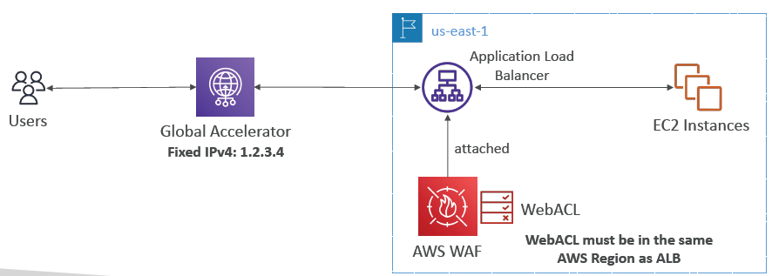
WAF – Fixed IP while using WAF with a Load Balancer
WAF does not support the Network Load Balancer (Layer 4)
We can use Global Accelerator for fixed IP and WAF on the ALB

Slide 41
AWS Shield: protect from DDoS attack
DDoS: Distributed Denial of Service – many requests at the same time
AWS Shield Standard:
  Free service that is activated for every AWS customer
  Provides protection from attacks such as SYN/UDP Floods, Reflection attacks and other layer 3/layer 4 attacks
AWS Shield Advanced:
  Optional DDoS mitigation service ($3,000 per month per organization)
  Protect against more sophisticated attack on Amazon EC2, Elastic Load Balancing (ELB), Amazon CloudFront, AWS Global Accelerator, and Route 53
  24/7 access to AWS DDoS response team (DRP)
  Protect against higher fees during usage spikes due to DDoS
  Shield Advanced automatic application layer DDoS mitigation automatically creates, evaluates and deploys AWS WAF rules to mitigate layer 7 attacks

Slide 42
AWS Firewall Manager
Manage rules in all accounts of an AWS Organization
Security policy: common set of security rules
  WAF rules (Application Load Balancer, API Gateways, CloudFront)
  AWS Shield Advanced (ALB, CLB, NLB, Elastic IP, CloudFront)
  Security Groups for EC2, Application Load BAlancer and ENI resources in VPC
  AWS Network Firewall (VPC Level)
  Amazon Route 53 Resolver DNS Firewall
  Policies are created at the region level
Rules are applied to new resources as they are created (good for compliance) across all and future accounts in your Organization

Slide 43
Comparisons
WAF, Shield and Firewall Manager are used together for comprehensive protection
Define your Web ACL rules in WAF
For granular protection of your resources, WAF alone is the correct choice
If you want to use AWS WAF across accounts, accelerate WAF configuration, automate the protection of new resources, use Firewall Manager with AWS WAF
Shield Advanced adds additional features on top of AWS WAF, such as dedicated support from the Shield Response Team (SRT) and advanced reporting.
If you’re prone to frequent DDoS attacks, consider purchasing Shield Advanced

Slide 44
AWS Best Practices for DDoS Resiliency
Edge Location Mitigation (BP1, BP3)
BP1 – CloudFront
  Web Application delivery at the edge
  Protect from DDoS Common Attacks (SYN floods, UDP reflection…)
BP1 – Global Accelerator
  Access your application from the edge
  Integration with Shield for DDoS protection
  Helpful if your backend is not compatible with CloudFront
BP3 – Route 53
  Domain Name Resolution at the edge
  DDoS Protection mechanism

Slide 45
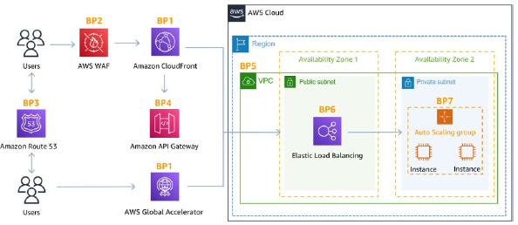

Slide 46
AWS Best Practices for DDoS Resiliency
Best pratices for DDoS mitigation
Infrastructure layer defense(BP1, BP3, BP6)
  Protect Amazon EC2 against high traffic
  That includes using Global Accelerator, Route 53, CloudFront, Elastic Load Balancing
Amazon EC2 with Auto Scaling (BP7)
  Helps scale in case of sudden traffic surges including a flash crowd or a DDoS attack
Elastic Load Balancing (BP6)
  Elastic Load Balancing scales with the traffic increases and will distribute the traffic to many EC2 instances

Slide 47
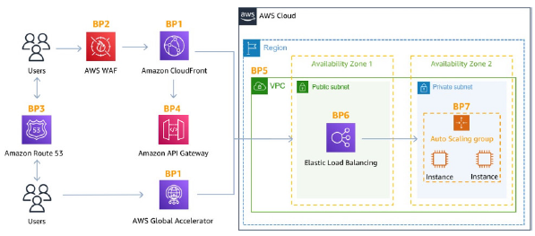

Slide 48
AWS Best Practices for DDoS Resiliency
Application Layer Defense
Detect and filter malicious web requests (BP1, BP2)
  CloudFront cache static content and serve it from edge locations, protecting your backend
  AWS WAF is used on top of CloudFront and Application Load Balancer to filter and block requests based on request signatures
  WAF rate-based rules can automatically block the IPs of bad actors
  Use managed rules on WAF to block attacks based on IP reputation, or block anonymous Ips
  CloudFront can block specific geographies
Shield Advanced (BP1, BP2, BP6)
Shield Advanced automatic application layer DDoS mitigation automatically creates, evaluates and deploys AWS WAF rules to mitigate layer 7 attacks

Slide 49
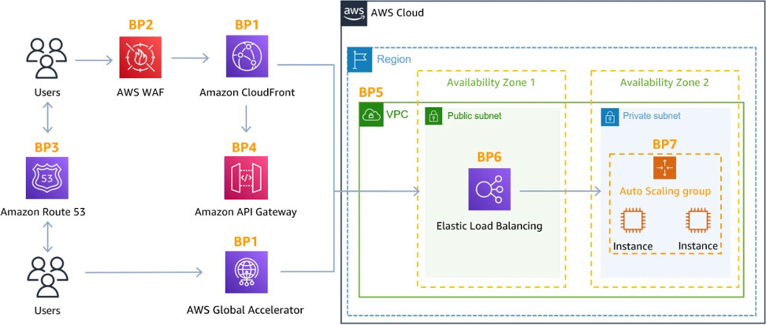

Slide 50
AWS Best Practices for DDoS Resiliency
Attack surface reduction
Obfuscating AWS resources (BP1, BP4, BP6)
  Using CloudFront, API Gateway, Elastic Load Balancing to hide your backend resources (Lambda functions, EC2 instances)
Security groups and Network ACLs (BP5)
  Use security groups and NACLs to filter traffic based on specific IP at the subnet or ENI-level
  Elastic IP are protected by AWS Shield Advanced
Protecting API endpoints (BP4)
  Hide EC2, Lambda, elsewhere
  Edge-optimized mode, or CloudFront+ regional mode (more control for DDoS)
  WAF + API Gateway: burst limits, headers filtering, use API keys

