Slide 1


BCSE307L – Compiler Design
Module 4 – Intermediate-Code Generation

Slide 2
Contents
Variants of Syntax trees
Three Address Code
Types, Declarations
Procedures
Assignment Statements
Translation of Expressions
Control Flow
Back Patching
Switch
Case Statements

Slide 3
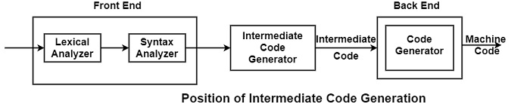
Intermediate Code
Front End - analyses source program and creates an intermediate representation.
Back End - generates target code from intermediate representation.
An language between source and target language
Intermediate code is generated because the compiler can’t generate machine code directly in one pass.
  It converts the source program into intermediate code, which performs efficient generation of machine code further
Provides an intermediate level of abstraction
  More details than source and Fewer details than the target.

Slide 4
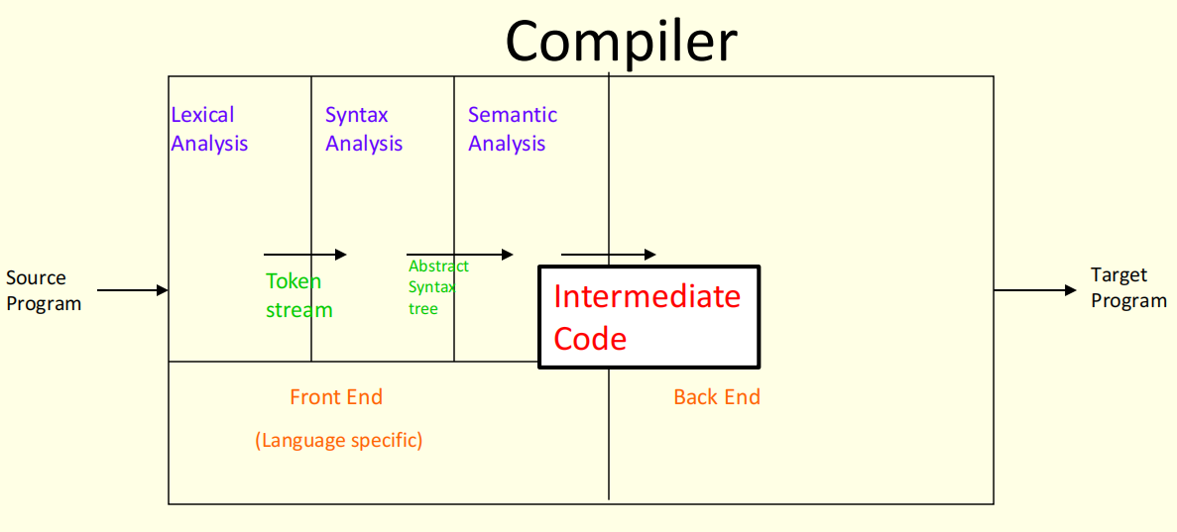

Slide 5
Benefits of Intermediate Codes
A compiler for different machines can be created by attaching different backend to the existing front ends of each machine.
A compiler for different source languages (on the same machine) can be created by providing front ends for the corresponding source languages to existing back end.
A machine independent code optimizer can be applied to intermediate code in order to optimize the code generation.

Slide 6
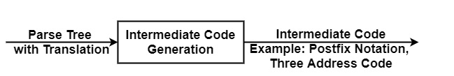
Different Intermediate Forms
Abstract syntax tree & DAG
Postfix notation
Three address code

Slide 7
1. Abstract syntax tree & DAG
A syntax tree depicts the natural hierarchical structure of a source program.
A DAG gives the same information but in a more compact way because common sub-expressions (sub expression that occur more than once) are identified.
Ex: a=b*-c+b*-c
=
=
+
+
a
a
*
*
*
b
uminus
b
uminus
b
uminus
c
c
c
Syntax Tree
DAG

Slide 8
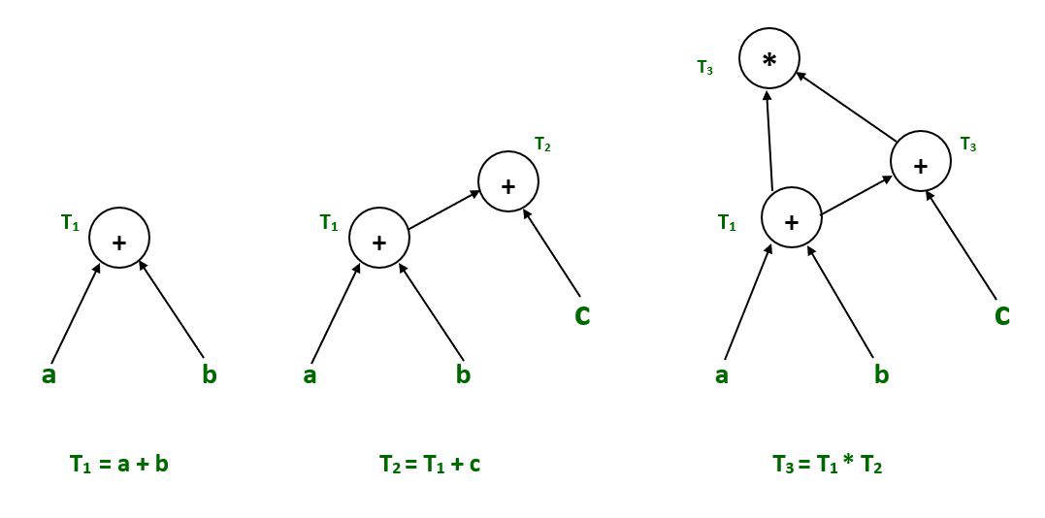
Directed Acyclic Graph (DAG)
A DAG is a three-address code that is generated as the result of an intermediate code generation.
It demonstrates how the statement’s computed value is used in subsequent statements
Example :
  T1 = a + b
  T2 = T1 + c
  T3 = T1 x T2

Slide 9
Variants of Syntax Trees
Nodes in syntax tree represent constructs in the source program
The children of a node represent the meaningful components of a construct.
DAG can be constructed by using the same techniques that construct syntax trees.
Example – DAG for the expression a + a * (b - c) + (b - c) * d
Leaf node ‘a’ has two parents, because it appears twice in the expression.
Common expression (b-c)are represented by one parent node (-). That node has two parents

Slide 10
Variants of Syntax Trees
Construction of DAG
Using SDD
Using Value Number Method
The above SDD can construct either syntax tree or DAG
Steps to construct syntax tree or DAG

Slide 11
Variants of Syntax Trees
Construction of DAG Using Value Number Method
Often the nodes of a syntax tree or DAG are stored in an array of records
Each row of the array represents one record. In each record, the first field is an operation code that indicating the label of the node.
Leaf nodes have one additional field which holds the lexical value.
Non leaf node or interior nodes have two additional fields indicating the left and right child.
Example – Nodes of a DAG for i=i+10 allocated in an array.
DAG
Array

Slide 12
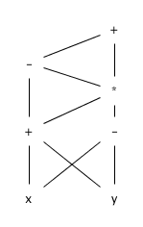
Exercise 1
Construct the DAG for the expression
((x + y) - ((x + y) * (x - y))) + ((x + y) * (x - y))

Slide 13
Exercise 2
Construct the DAG and identify the value numbers for the subexpressions of the following expressions, assuming + associates from the left.
a) a + b + (a + b)
b) a + b + a + b
c) a + a + (a + a + a + (a + a + a + a))

Slide 14
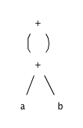
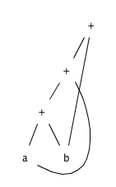
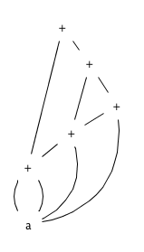
Solution
a)
b)
c)

Slide 15
2. Postfix Notation
Postfix notation is a linearization of a syntax tree.
In postfix notation the operands occurs first and then operators are arranged.
Ex: (A + B) * (C + D)
Ex: (A + B) * C
Ex: (A * B) + (C * D)
Postfix notation: A B + C D + *
Postfix notation: A B + C *
Postfix notation: A B * C D * +

Slide 16
3. Three address code
Three address code is a sequence of statements of the general form,
a:= b op c
Where a, b or c are the operands that can be names or constants and op stands for any operator.
Example: a = b + c + d
t₁=b+c
t₂=t₁+d
a=t₂
Here t₁ and t₂ are the temporary names generated by the compiler.
Three-address code
  There are at most three addresses allowed (two for operands and one for result).
  The addresses can be a name or a constant or compiler generated temporary.

Slide 17
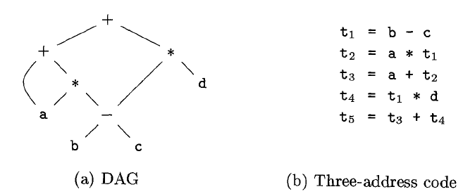
3. Three address code
a + a * (b - c) + (b - c) * d

Slide 18
Types of three address statements
Binary Assignment statements
Unary Assignment statements
Copy statements
Unconditional jump
Conditional jump
Procedural call
Indexed assignments
Address and pointer assignments

Slide 19
1. & 2. Assignment Statements
Binary Assignment statements
  Syn: X = Y op Z
  Ex: a = b+c*d
  Three address statement
  t1 = c * d
  t2 = b + t1
  a = t2
Unary Assignment statements
  Syn: X = op Y
  Ex: a = -c
  Three address statement
  t1 = -c
  a = t1
3. Copy statements
Syn: X = Y
Ex: a = b
Three address statement
a = b

Slide 20
4. Unconditional jump & 5. Conditional jump
Unconditional jump
  Syn: goto L [the control will be transferred to the three address statement labelled with L]
Conditional jump
  Syn: if x relop y goto L
  Ex: if x > y goto L
    True → the control will be transferred to statement labelled with L
    False → next statement after conditional jump statement

Slide 21
Conditional jump
  Example
  do i=i+1; while(a[i]<v)
  Multiplication of i*8 is appropriate for an array of elements that each take 8 units of space.

Slide 22
6. Procedure call
Syn: P (x1, x2, …, xn)
Three address statement
  Param x1
  Param x2
  …
  Param xn
  Call P, n
Syn: return y
Three address statement
return y

Slide 23
7. Indexed Assignments
Syn: x = y[index] & y[index] = x
Ex: a[i]=b[i]
Three address statement
t1=b[i]
a[i]=t1

Slide 24
8. Address and pointer assignments
Syn: x = & y, x = *y, *x = y
Ex: *x = *y
Three address statement
t = *y
*x = t

Slide 25
Different Representation of Three Address Code
There are three types of representation used for three address code:
  Quadruples
  Triples
  Indirect triples
Ex: x= -a*b + -a*b
t₁= - a
t₂ = t₁ * b
t₃= - a
t₄ = t₃ * b
t₅ = t₂ + t₄
x= t₅

Slide 26
Quadruple
Representation of three address instructions in a data structure (object or records with fields of operators and operands).
The quadruple is a structure with at the most four fields such as op, arg1, arg2 and result.
The op field is used to represent the internal code for operator.
The arg1 and arg2 represent the two operands.
And result field is used to store the result of an expression.
Quadruple
x= -a*b + -a*b
t₁= - a
t₂ = t₁ * b
t₃= - a
t₄ = t₃ * b
t₅ = t₂ + t₄
x= t₅
No. | Operator | Arg1 | Arg2 | Result
(0) | uminus | a |  | t₁
(1) | * | t₁ | b | t₂
Pointer to an entry in the symbol table (including the temp variables)
(2) | uminus | a |  | t₃
(3) | * | t₃ | b | t₄
(4) | + | t₂ | t₄ | t₅
(5) | = | t₅ |  | x

Slide 27
Quadruple
The quadruple is a structure with at the most four fields such as op, arg1, arg2 and result.
The op field is used to represent the internal code for operator.
The arg1 and arg2 represent the two operands.
And result field is used to store the result of an expression.
Exceptions to the above

Slide 28
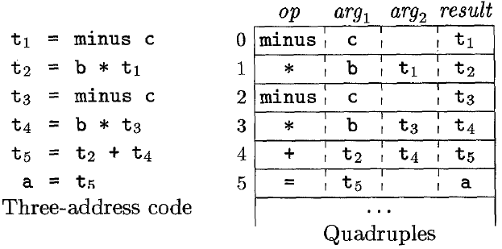
Quadruple

Slide 29
Triples
To avoid entering temporary names into the symbol table, we might refer a temporary value by the position of the statement that computes it.
Triples representation only has three fields: op, arg1 and arg2.
Parenthesized number (0) represents pointers into the triple structure itself.
x= -a*b + -a*b
Quadruple
Triple
No. | Operator | Arg1 | Arg2 | Result
No. | Operator | Arg1 | Arg2
(0) | uminus | a |  | t₁
(0) | uminus | a
(1) | * | t₁ | b | t₂
(1) | * | (0) | b
(2) | uminus | a |  | t₃
(2) | uminus | a
(3) | * | t₃ | b | t₄
(3) | * | (2) | b
(4) | + | t₂ | t₄ | t₅
(4) | + | (1) | (3)
(5) | = | t₅ |  | x
(5) | = | x | (4)

Slide 30
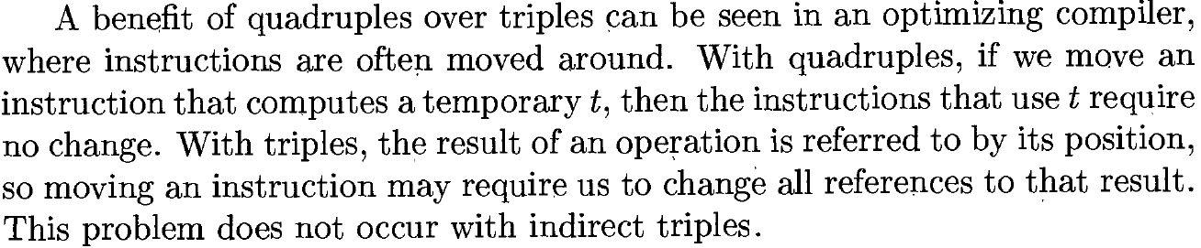
Triples

Slide 31
Indirect Triples
In the indirect triple representation consists of listing pointers to triples.
This implementation is called indirect triples.
Triple
Indirect Triple
No. | Operator | Arg1 | Arg2
 | Statement
No. | Operator | Arg1 | Arg2
(0) | uminus | a
(0) | (14)
(0) | uminus | a
(1) | * | (0) | b
(1) | (15)
(1) | * | (14) | b
(2) | uminus | a
(2) | (16)
(2) | uminus | a
(3) | * | (2) | b
(3) | (17)
(3) | * | (16) | b
(4) | + | (1) | (3)
(4) | (18)
(4) | + | (15) | (17)
(5) | = | x | (4)
(5) | (19)
(5) | = | x | (18)

Slide 32
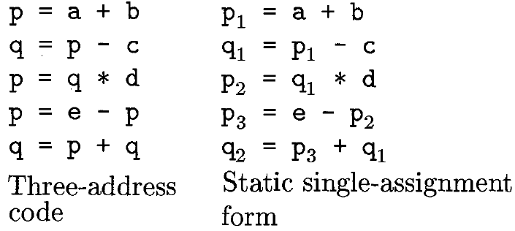
Static Single Assignment Form
Static Single Assignment (SSA) form is an intermediate representation that facilitates certain code optimizations.
All assignment in SSA are to variables with distinct names.
It uses ϕ-function to combine the various definitions of same variable
Three address code and SSA representation for an expression
e-(((a+b)-c)*d)+(a+b)-c

Slide 33
Static Single Assignment Form
It uses ϕ-function to combine the various definitions of same variable.
Example
If (flag) x=-1 else x=1
Y=x*a
If we use SSA then
If (flag) x1=-1 else x2=1
Y=x*a ??? (Use of ϕ-function)
Φ(x1,x2) – based on the condition, it returns either x1 or x2. Based on the return value, Y will be calculated.

Slide 34
Example 2
Translate the arithmetic expression a + -(b + c) into:
a) A syntax tree.
b) Quadruples.
c) Triples.
d) Indirect triples.

Slide 35
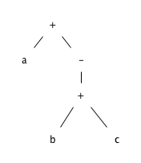
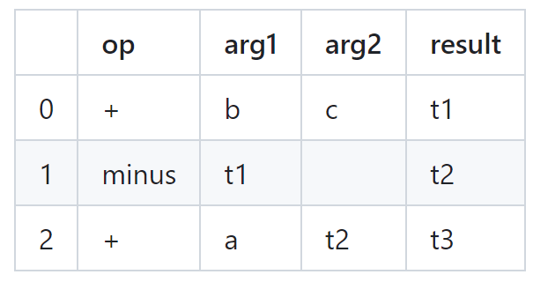
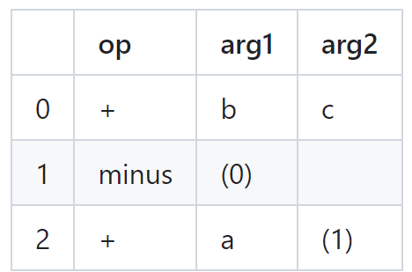
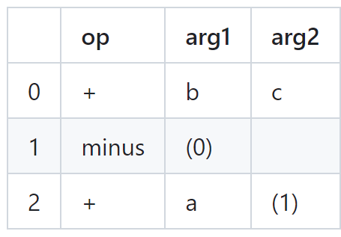
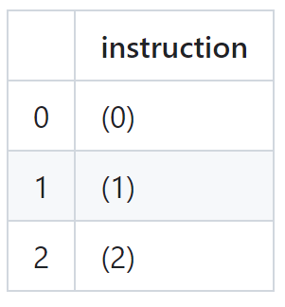
Solution
Syntax Tree | Quadruples
Triples | Indirect Triples

Slide 36
Exercise
Write quadruple, triple and indirect triple for following:
a = b[i] + c[j]
a[i] = b*c - b*d
x = f(y+1) + 2

Slide 37
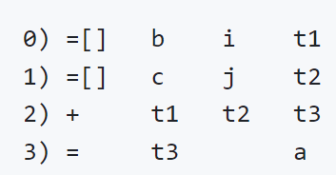
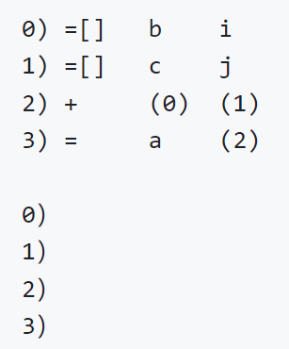
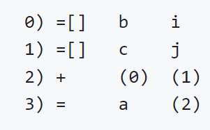
Solution 1
Quadruples
Indirect Triples
Triples

Slide 38
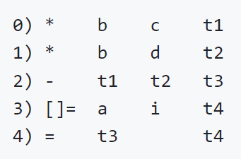
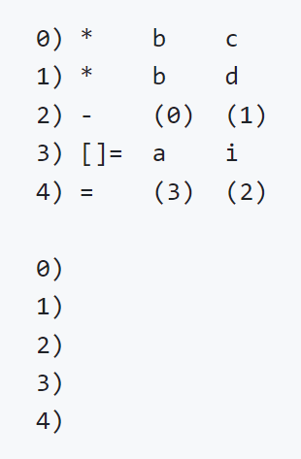
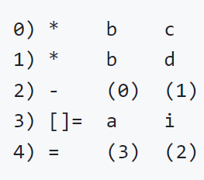
Solution 2
Quadruples
Indirect Triples
Triples

Slide 39
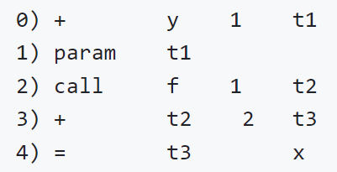
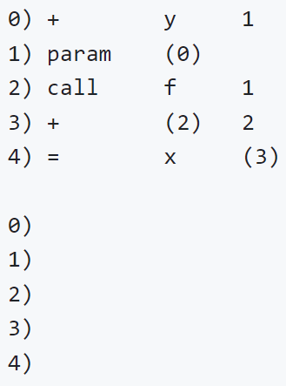
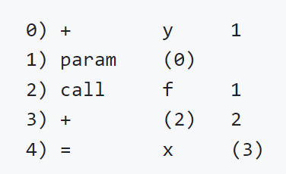
Solution 3
Quadruples
Indirect Triples
Triples

