Slide 1


BCSE307L – Compiler Design
Module 4 – Intermediate-Code Generation

Slide 2
Contents
Variants of Syntax trees
Three Address Code
Types, Declarations
Procedures
Assignment Statements
Translation of Expressions
Control Flow
Back Patching
Switch Case Statements

Slide 3
Types
The Application of types can be grouped under
1. Type Checking and 2. Translation Application
Type Checking:
  It uses logical rules to reason about the behaviour of a program at run time.
  It ensures the types of the operands match the type expected by an operator.
    For example, the && operator in Java expects its two operands to be Booleans; the result is also of type Boolean.

Slide 4
Types
The Application of types can be grouped under
1. Type Checking and 2. Translation Application
Translation Application: From the type of a name, a compiler can determine the storage that will be needed for that name at run time.
Type information is also needed to
  Calculate the address denoted by an array reference.
  Insert explicit type conversions.
  Choose the right version of an arithmetic operator, among other things.

Slide 5
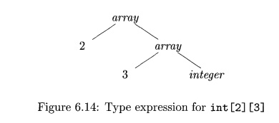
Types
Type Expressions
A type expression is either a basic type or is formed by applying an operator called a type constructor to a type expression.
The sets of basic types and constructors depend on the language to be checked.
Example: int[2][3] - array(2,array(3,integer))
The array type int [2] [3] can be read as "array of 2 arrays of 3 integers each"

Slide 6
Types
Definitions of Type Expressions
A basic type is a type expression:
  basic types for a language include boolean, char, integer, float, and void
A type name is a type expression
A type expression can be formed by applying the array type constructor to a number and a type expression.
A record is a data structure with named field
  A type expression can be formed by applying the record type constructor to the field names and their types.
A type expression can be formed by using the type constructor for function types.
If s and t are type expressions, then their Cartesian product s*t is a type expression

Slide 7
Types
Type expressions may contain variables whose values are type expressions.
Graph - Way to represent type expression.
The value-number method, can be adapted to construct a DAG for a type expression, with interior nodes for type constructors and leaves for basic types, type names, and type variables.

Slide 8
Types
Type Equivalence – When 2 type expressions are equivalent?
If two type expressions are equal then return a certain type else error.
When type expressions are represented by graphs, two types are structurally equivalent if and only if one of the following conditions is true:
  They are the same basic type.
  They are formed by applying the same constructor to structurally equivalent types.
  One is a type name that denotes the other.

Slide 9

Declarations
Types and declarations using a simplified grammar that declares just one name at a time.
Nonterminal D generates a sequence of declarations.
Nonterminal T generates basic, array, or record types.
Nonterminal B generates one of the basic types int and float.
Nonterminal C generates strings of zero or more integers, each integer surrounded by brackets.
An array type consists of a basic type specified by B, followed by array components specified by nonterminal C.
A record type (the second production for T) is a sequence of declarations for the fields of the record, all surrounded by curly braces.

Slide 10
Declarations
Storage layout for local names
From the type of a name, we can determine the amount of storage that will be needed for the name at run time.
At compile time, we can use these amounts to assign each name a relative address.
The type and relative address are saved in the symbol-table entry for the name.
Data of varying length, such as strings, or data whose size cannot be determined until run time, such as dynamic arrays, is handled by reserving a known fixed amount of storage for a pointer to the data.

Slide 11
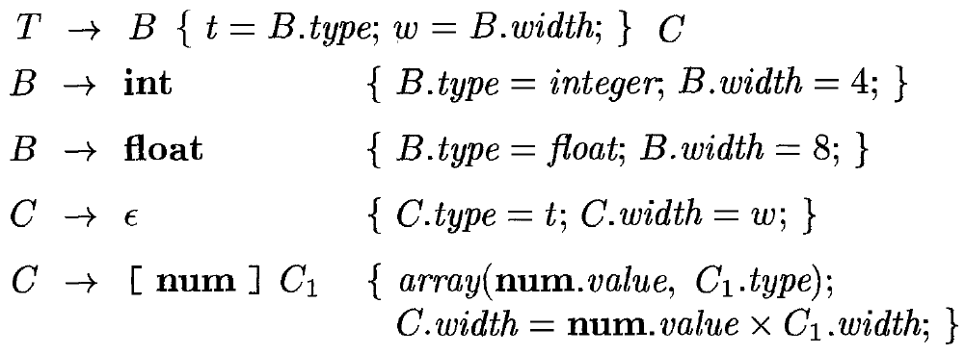
Declarations
Storage layout for local names
The translation scheme (SDT) computes types and their widths for basic and array types.
The SDT uses s-attributes type and width for each nonterminal and two variables t and w to pass type and width information from a B node in a parse tree to the node for the production C→epsilon.

Slide 12
Declarations
Storage layout for local names
Example:
Parse Tree – Type int[2][3]

Slide 13
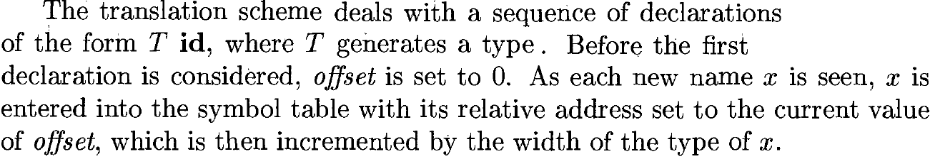
Declarations
Sequences of Declarations
Languages such as C and Java allow all the declarations in a single procedure to be processed as a group.
Therefore, we can use a variable, say offset, to keep track of the next available relative address.

