Slide 1


BCSE307L – Compiler Design
Module 4 – Intermediate-Code Generation

Slide 2
Contents
Variants of Syntax trees
Three Address Code
Types, Declarations
Procedures
Assignment Statements
Translation of Expressions
Control Flow
Back Patching
Switch Case Statements

Slide 3
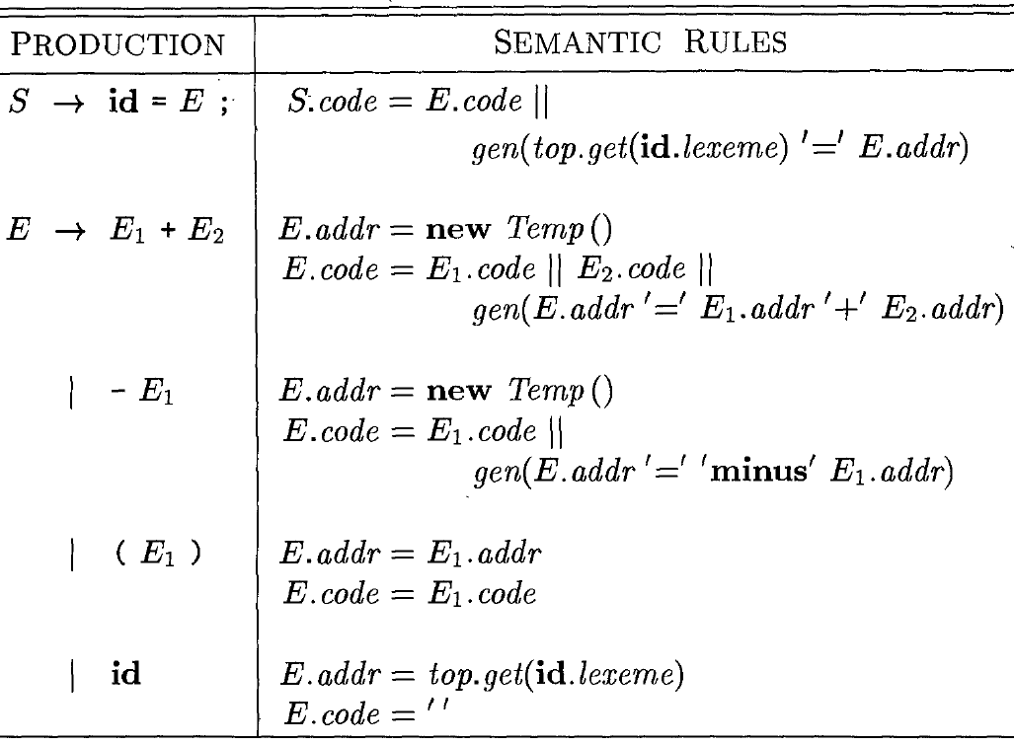
Translation of Expressions
Translation of Expressions into 3 Address Code
Given SDD builds up the
3 address code for an
assignment statement.

Slide 4
Translation of Expressions
Translation of Expressions into 3 Address Code
We use the following attributes
S.code represents the 3-address code for the assignment S.
E.addr is the name that will hold the value of E,
E.code represents the sequence of 3-address statements evaluating E.
id.lexme is the name that holds the value of id which may be found by consulting the symbol table at id.entry.
The function newtemp returns a sequence of distinct names and
|| is used to denote the concatenation of strings.
Function top.get retrieves the entry when it is applied to the string representation id.lexeme of this instance of id.
gen builds an instruction and returns it.

Slide 5
Translation of Expressions
Translation of Expressions into 3 Address Code
Example:a=b+c
3 Address code
t1=b+c
a=t1

Slide 6
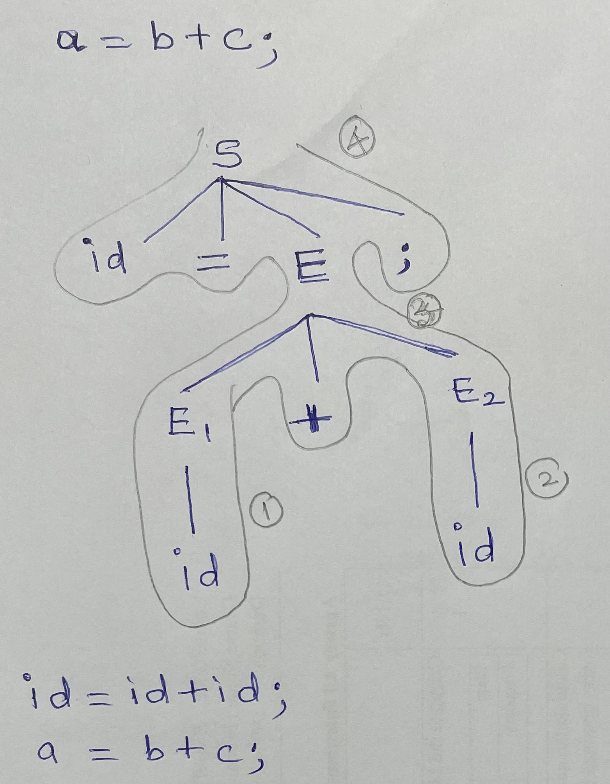
Translation of Expressions – 3 Address Code
Example:a=b+c
3 Address code
t1=b+c
a=t1

Slide 7
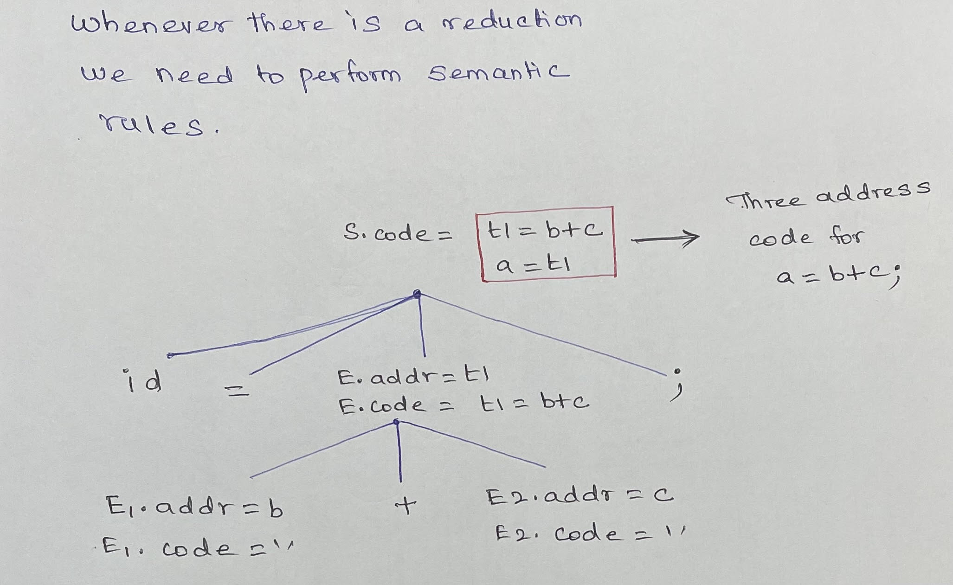
Translation of Expressions – 3 Address Code
Example:a=b+c
3 Address code
t1=b+c
a=t1

Slide 8
Incremental Translation of Expressions
Code attribute can be long strings. So they are usually generated incrementally.
Here gen is not only constructs 3 address instruction. It appends the instruction to the sequence of instructions generated so far.
Example:a=b+c
3 Address code
t1=b+c
a=t1
Code attribute not used.
Seq. of instrn created by
Successive calls to gen.

