Slide 1


BCSE307L – Compiler Design
Module 4 – Intermediate-Code Generation

Slide 2
Contents
Variants of Syntax trees
Three Address Code
Types, Declarations
Procedures
Assignment Statements
Translation of Expressions
Control Flow
Back Patching
Switch Case Statements

Slide 3
Control Flow
The translation of statements if-else and while is tied to the Boolean Expression.
In Programming Language, Boolean expressions are often used to:
  Alter the flow of control: Boolean expressions are used as conditional expressions in statements that alter the flow of control. The value of such boolean expression is implicit in a position reached in a program. Example: If (Condn) then S1
  Compute logical values – represent True/False. Res=a && b
Boolean expressions – composed of Boolean operators (&&,||, and !). Boolean operators are applied over Boolean variables or relational expression.

Slide 4

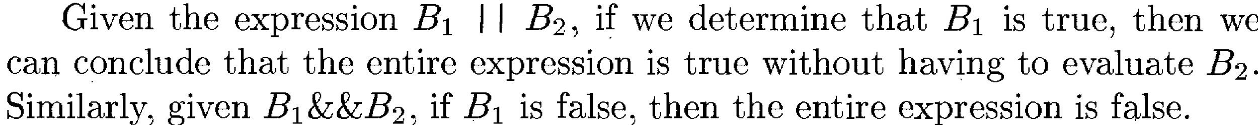
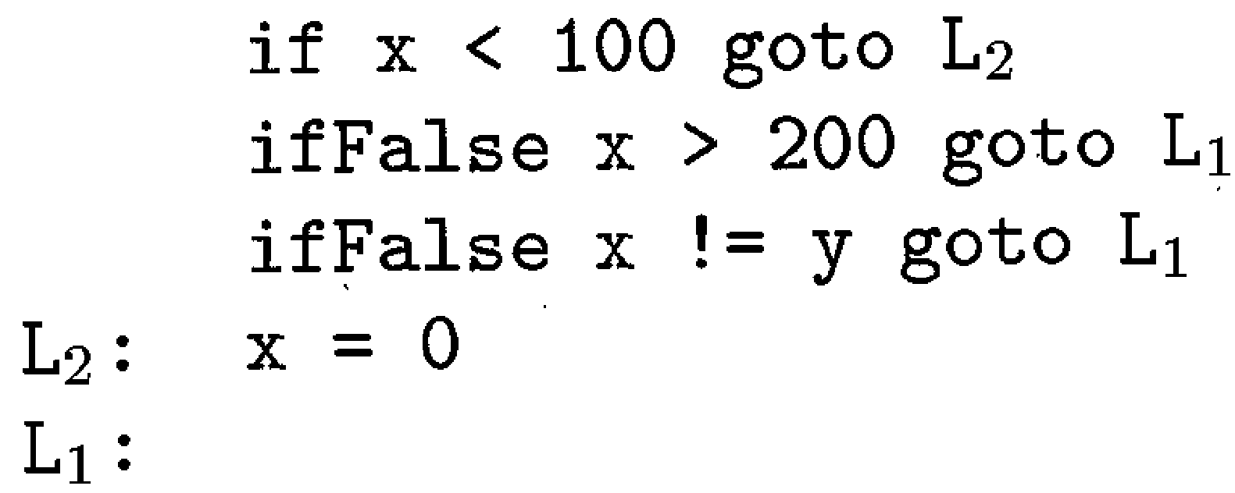
Control Flow
Boolean Expression
Short circuit code
In short-circuit(jumping) code, the Boolean operators &&,||,! translate Jumps. In this translation, the Boolean expression is true if the control reaches label L2.
If False, control goes to L1.

Slide 5
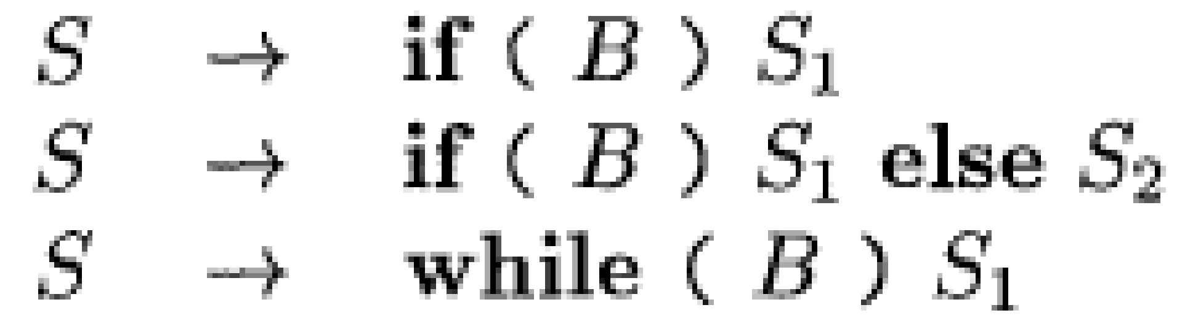
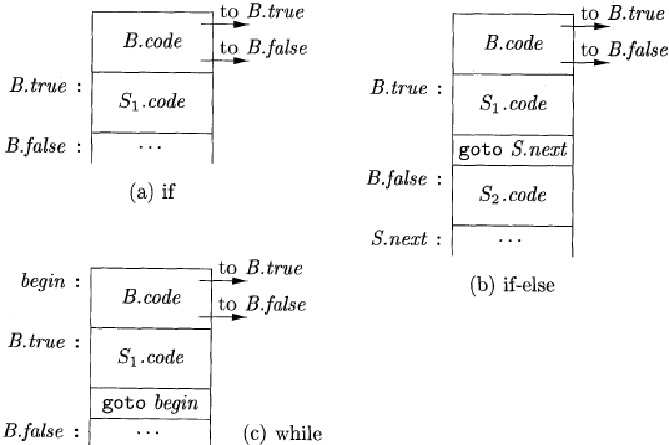
Flow of Control Statements
Translation of BE into 3 address code - Statements generated by the Grammar. B - Boolean Exp and S - Statement.
The translation of if(B) S1 consists of B.code followed by S1.code. Within B.code, there is jumps based on the value B.
If B is True – control flows to the 1st instruction of S1.code
If B is False – control flows to the instruction immediately following S1.code.

Slide 6
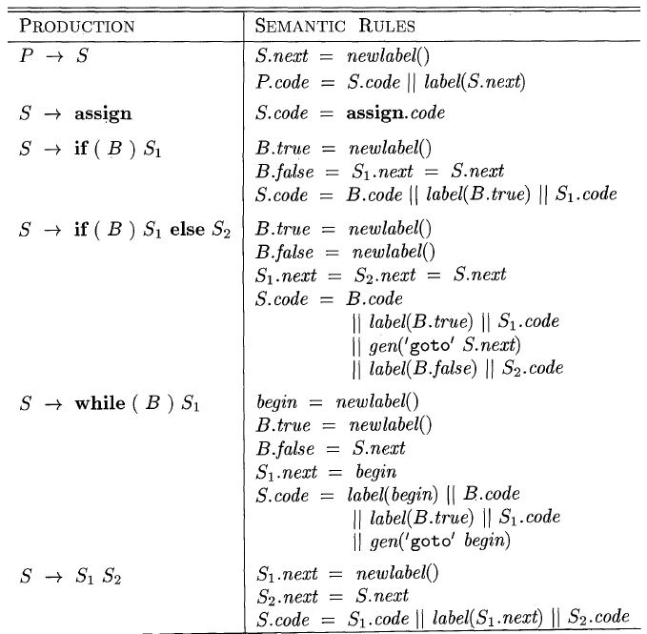
SDD for Flow-of-Control Statements

Slide 7
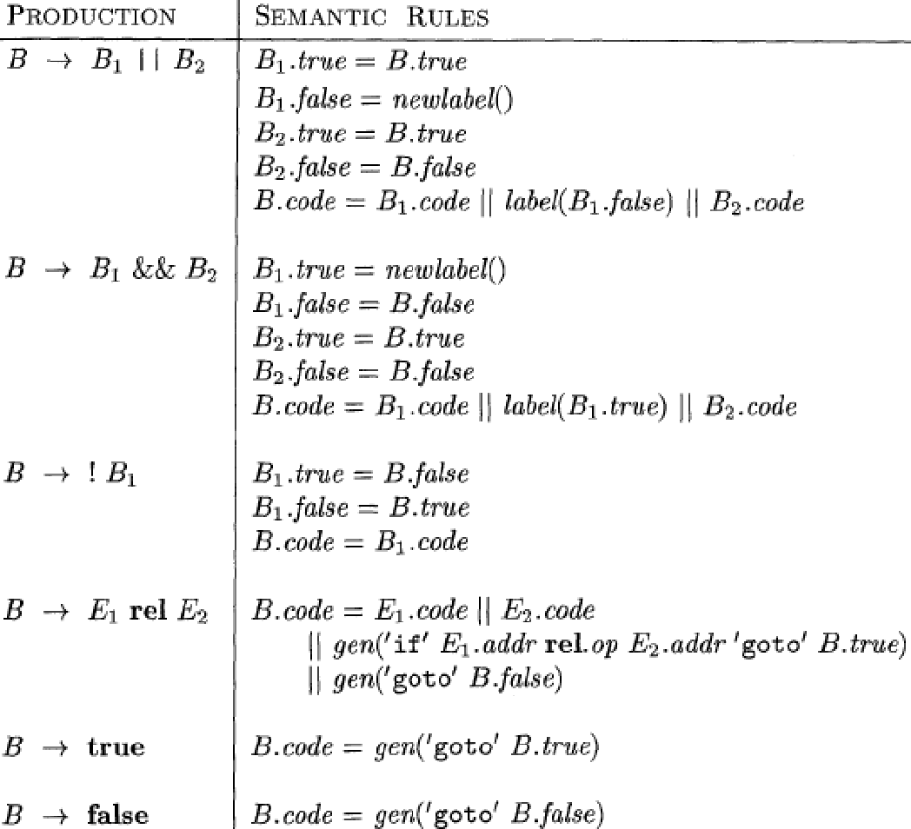
SDD - Control flow translation of Boolean Expression

Slide 8
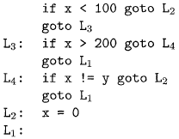
Translation of simple if statement

Slide 9
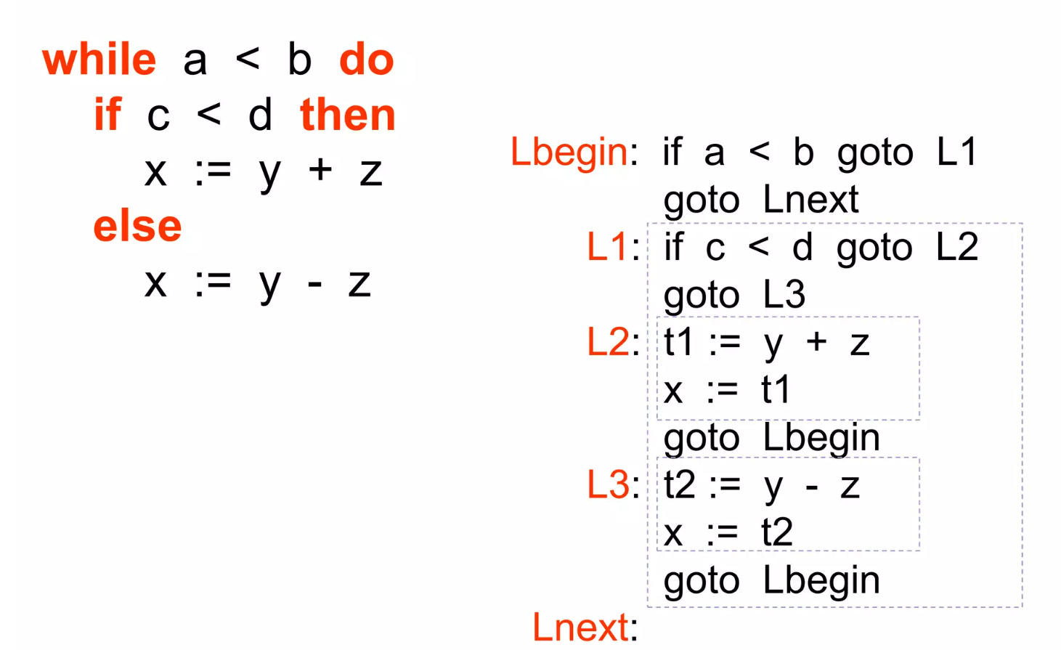
Translation of while statement

Slide 10
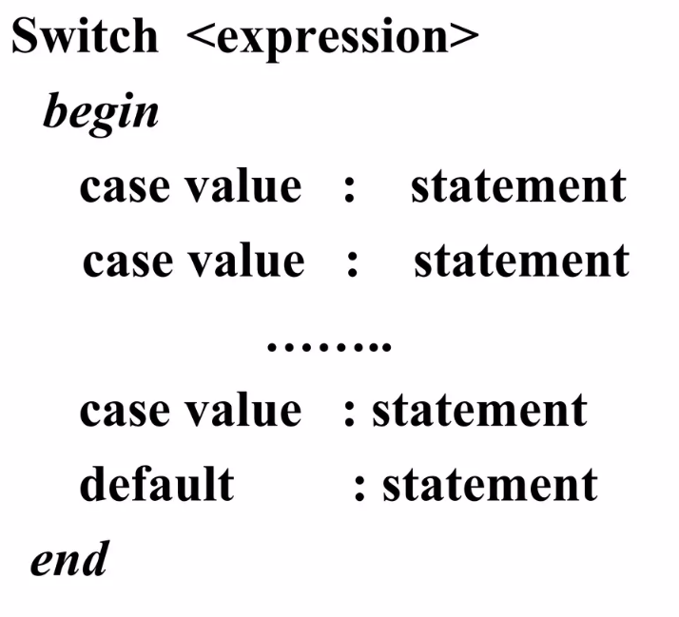
Case Statements

Slide 11
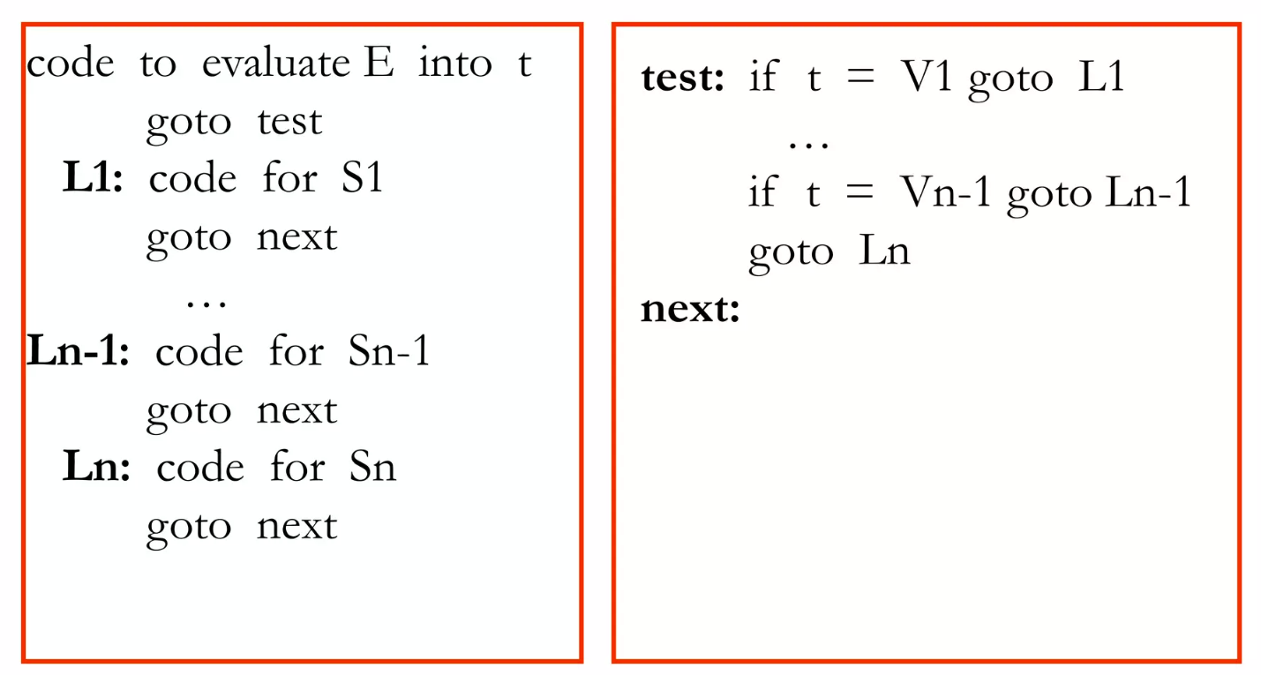
Translation of a case statement

Slide 12
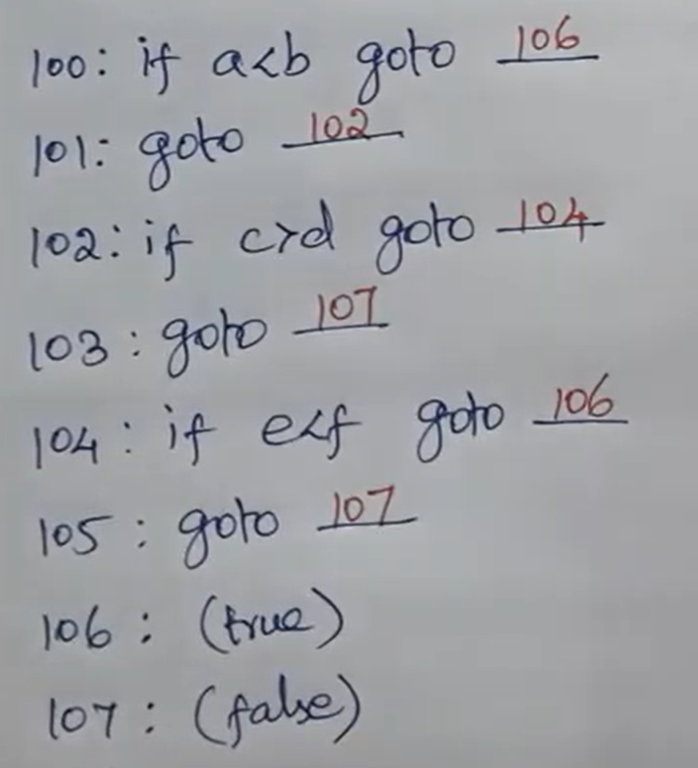
Backpatching
Boolean expressions insert symbolic labels for jumps.
Problem generated by short-circuit code in generation of 3ac
Leaves the label unspecified and fill it later
Ex: a<b or c>d and e<f
x < 100 || x > 200 && x ! = y

Slide 13
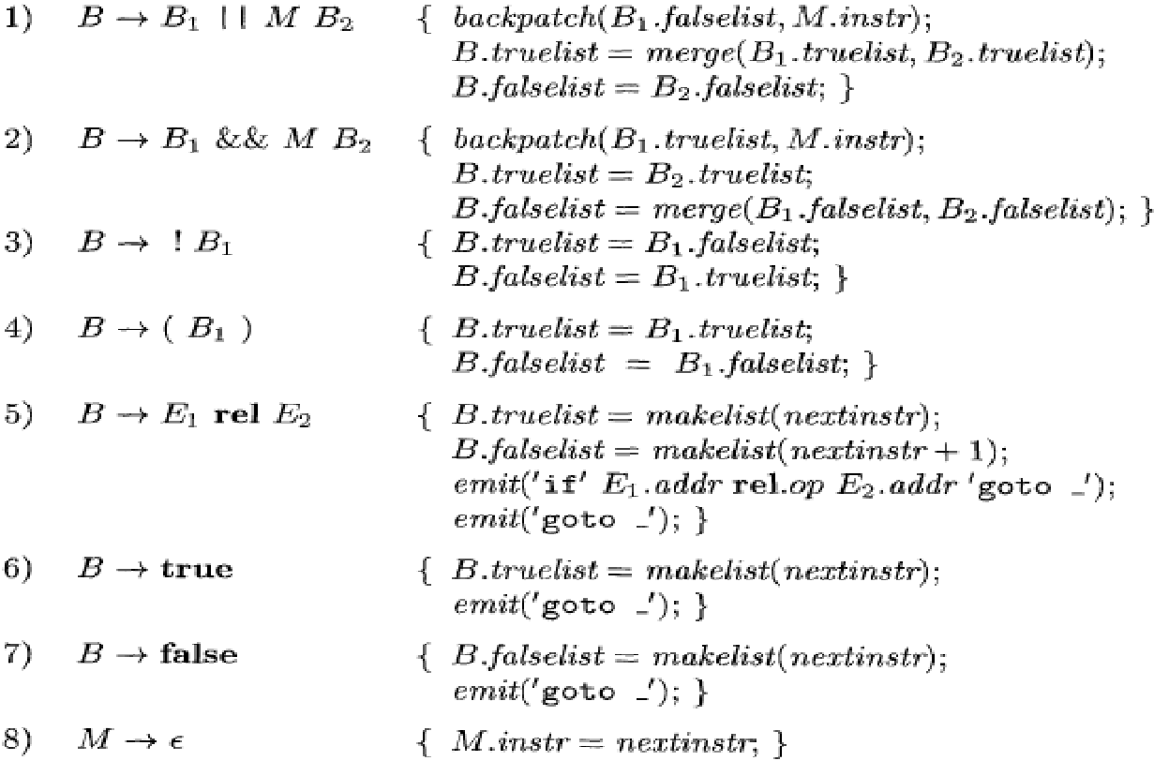
Backpatching for Boolean Expressions

Slide 14
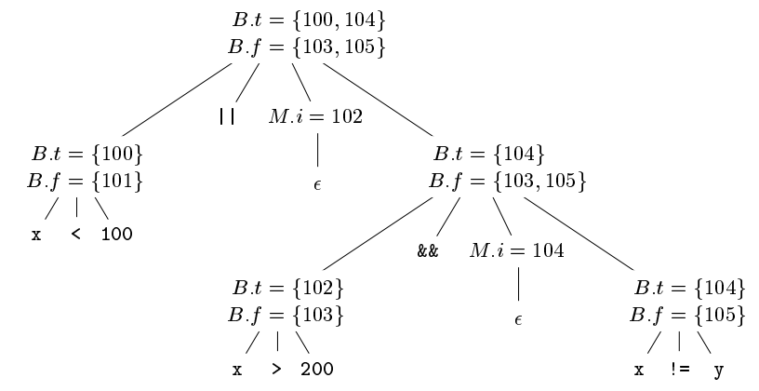
Example 2
Generate Intermediate code for the following expression using backpatching
x < 100 || x > 200 && x ! = y

Slide 15
Functions in backpatching
Makelist(i) – creates a new list with index, i
Merge(L1, L2) – concatenate List, L1 with list, L2
Backpatch(L, label) – fills all 3ac in list L with the target Label
Nextquad – gives index of next quadruple

