Slide 1
Interview trainer agent
CAPSTONE PROJECT
Presented By:
Student name : Mohd Arham Zayyan
College Name & Department : Jyothishmathi Institute of technology and science (CSE)

Slide 2
OUTLINE
Problem Statement
Technology used
Wow factor
End users
Result
Conclusion
Git-hub Link
Future scope
IBM Certifications

Slide 3
Problem Statement
Job seekers often struggle to prepare effectively for interviews due to the wide variety of roles, unpredictable questions, and evolving industry expectations. Manual preparation is time-consuming and often lacks personalization.
Proposed Solution: An AI Interview Trainer Agent powered by Retrieval-Augmented Generation (RAG) that delivers customized interview question sets, model answers, and preparation strategies based on user-provided job titles, experience levels, or resumes. It retrieves real-world interview data from professional sources, covers both technical and soft skills, and provides improvement feedback — boosting confidence and increasing hiring success.

Slide 4
Technology used
IBM cloud lite services
Natural Language Processing (NLP)
Retrieval Augmented Generation (RAG)
IBM Granite model

Slide 5
IBM cloud services used
IBM Cloud Watsonx AI Studio
IBM Cloud Watsonx AI runtime
IBM Cloud Agent Lab
IBM Granite foundation model

Slide 6
Wow factors
This agent will drastically reduce interview prep time, personalize preparation to individual career paths, and boost user confidence. It empowers job seekers with realistic, targeted practice and improves performance across both technical and behavioral rounds — enhancing job readiness and increasing hiring success.
Unique features:
Role-specific question generation using real interview data
Behavioural and HR scenario simulation with model responses
Citation and reference analysis to trace influence
Experience based targeting : adapts question sets to user experience level
Domain aware preparation tips based on job title and industry trends

Slide 7
End users
Fresh Graduates
Job Seekers Switching Roles
Working Professionals
Career counsellors

Slide 8
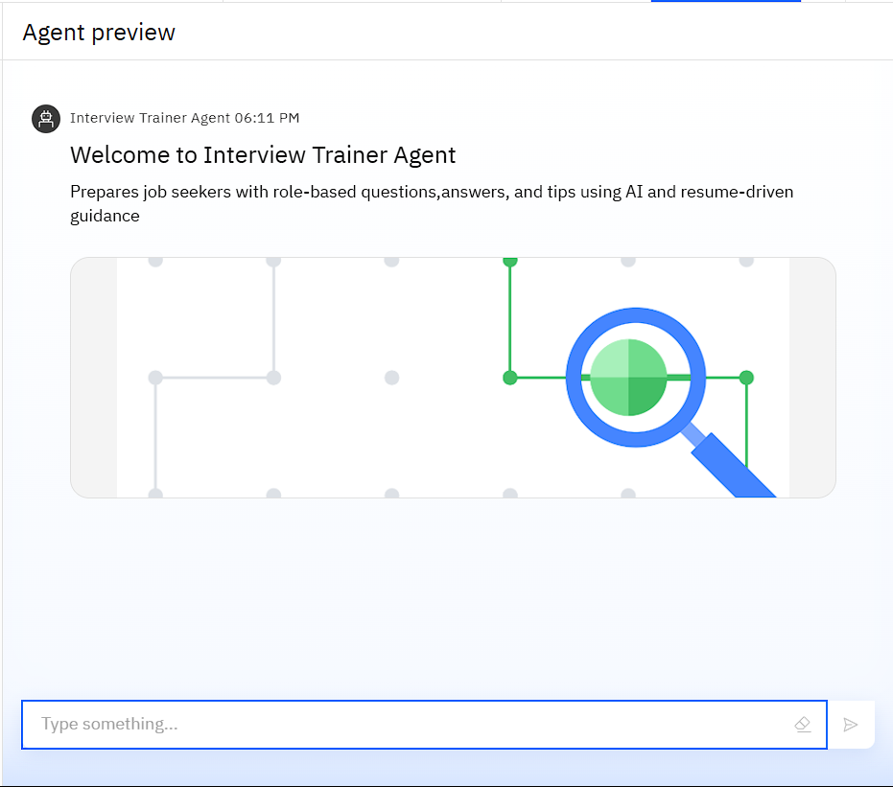
Results

Slide 9
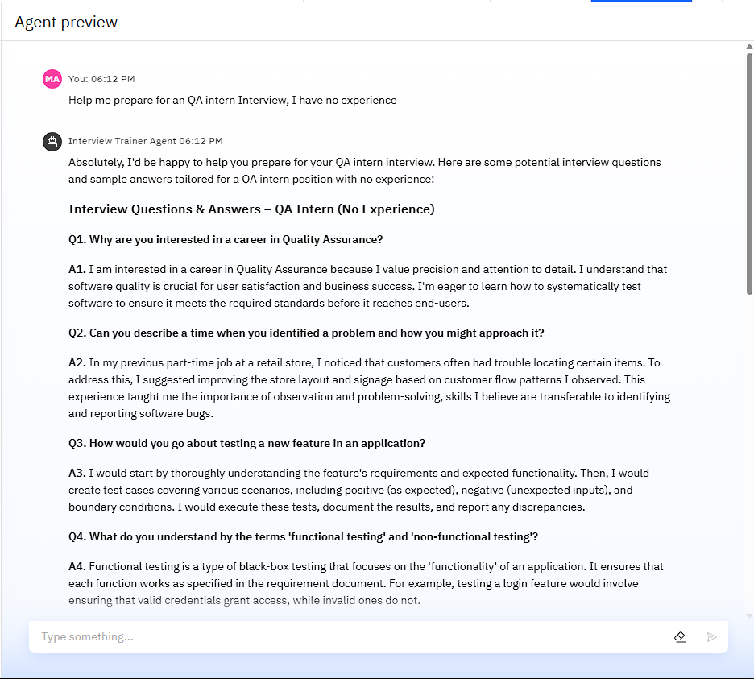
Results

Slide 10
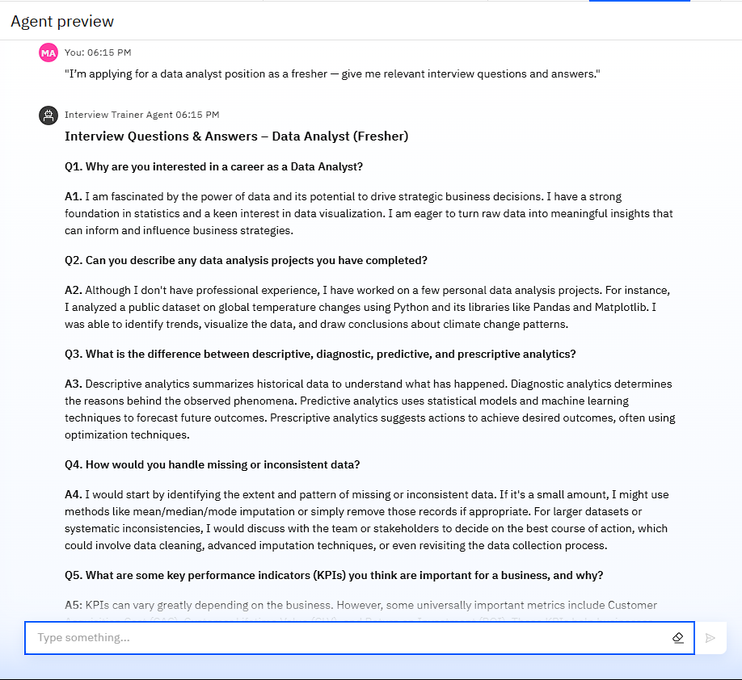
Results

Slide 11
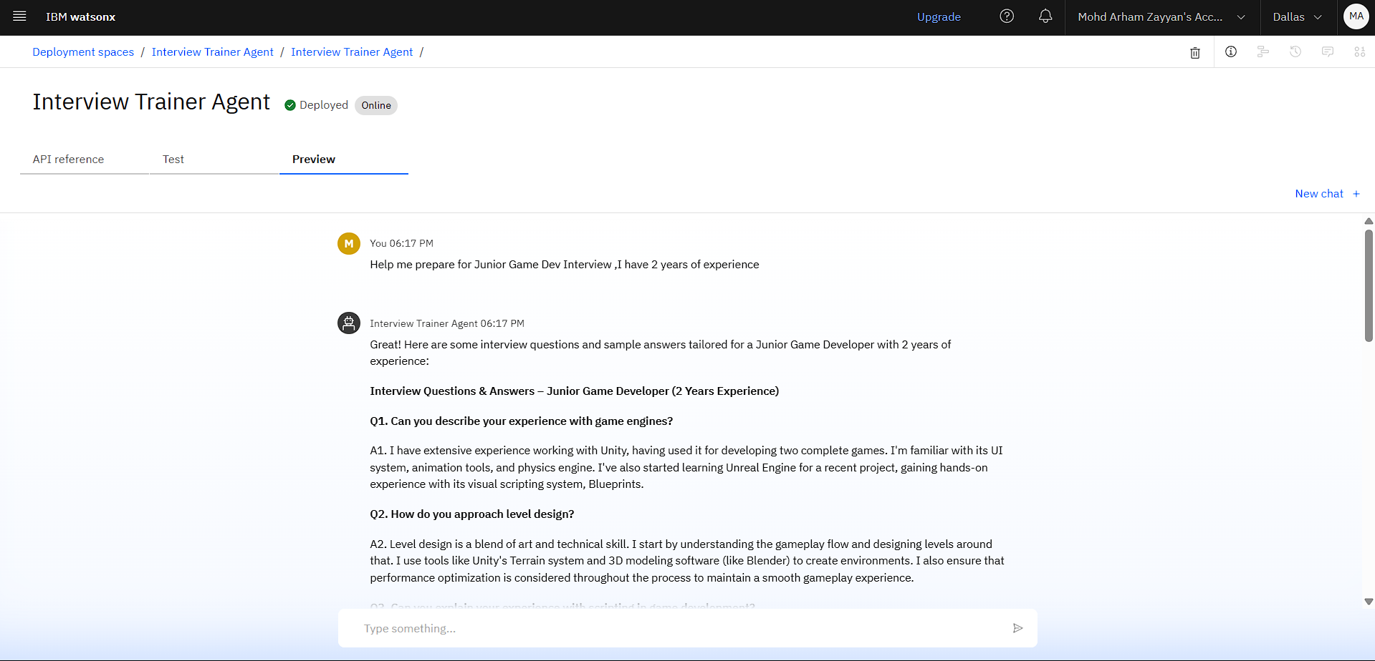
Results
Deployed AI Agent

Slide 12
Conclusion
The agent delivers tailored guidance based on job role and experience, making interview preparation faster and more effective.
It helps users improve both technical and soft skills, ensuring confidence across different interview formats.
This solution offers scalable support for individuals and institutions aiming to enhance career readiness.

Slide 13
Future scope
Voice based interaction for practicing spoken answers
Adaptive question difficulty based on user performance.
Personalized daily interview prep plans.
Smart tracking of user progress and improvement areas.
Integration with external Platforms.

Slide 14
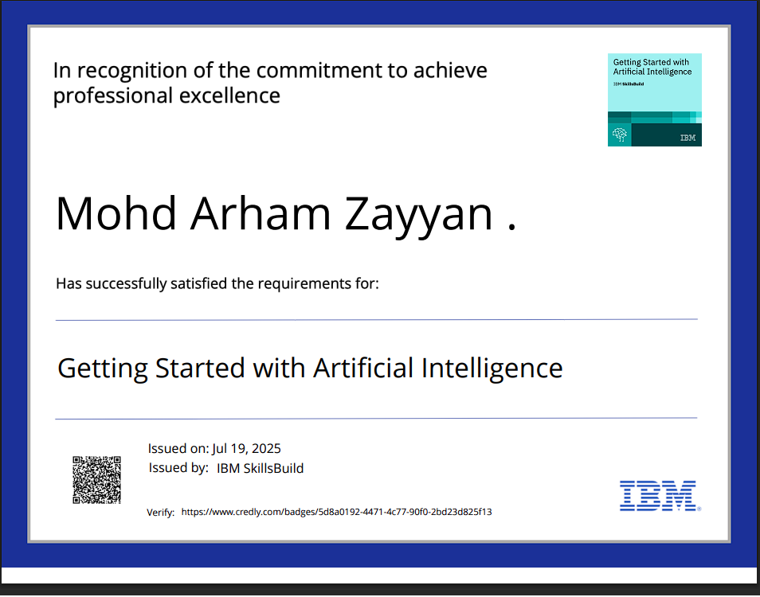
IBM Certifications

Slide 15
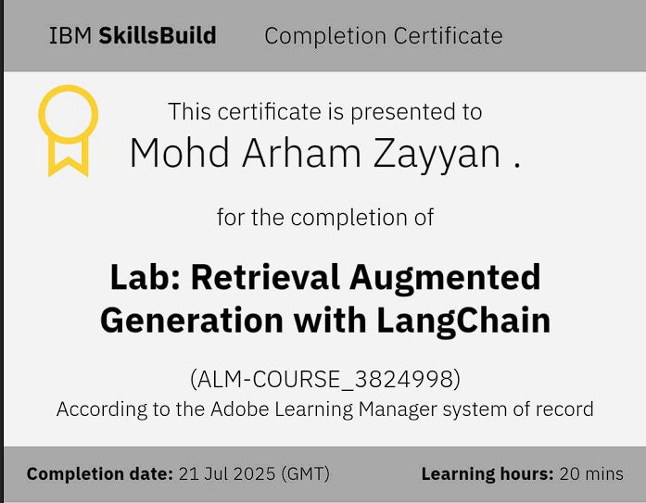
IBM Certifications

Slide 16
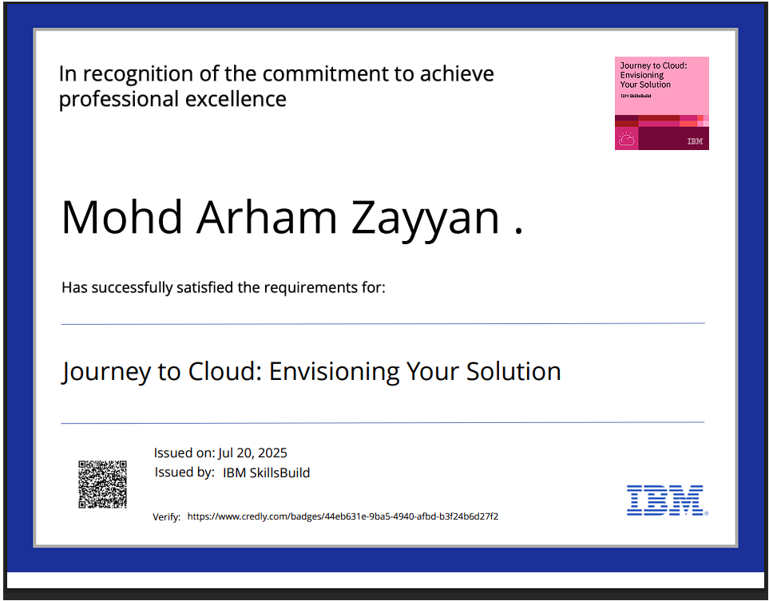
IBM Certifications

Slide 17
GitHub Link
github_link: https://github.com/arhamzayyan12/Interview_Trainer_Agent

Slide 18
THANK YOU

