Slide 1

TENNIS 360
A Big Data project on the enormous data of the sport
Team members:
Arhant Jain (aj1973@nyu.edu),
Chintan Kotadiya (crk349@nyu.edu),
Harshit Singh (hps257@nyu.edu).

Slide 2
Tennis Tournaments
Official Tennis Organizing Bodies
ATP (Association of Tennis Professionals) for Men
WTA (Women's Tennis Association) for Women
ATP and WTA manage hundreds of matches played across various tournaments each tour year
The four Grand Slam tournaments (Major Tournaments) are
The Australian Open played on hard courts
The French Open played on red clay courts
Wimbledon played on grass courts, and
The US Open also played on hard courts

Slide 3
Tennis Tournaments – A Glimpse
ATP Tournaments
WTA Tournaments
The ATP Finals - played at the end of season by Top 8 Players
The ATP World Tour Masters 1000 - 9 tournaments that form the second-highest tournaments in men's tennis.
ATP World Tour 500 series - 11 tournaments
ATP World Tour 250 series with 40 tournaments
ATP Challenger tour and International (ITF) tournaments
The WTA Finals - played annually at the end of the season for the Top 8 players
The WTA premier mandatory – 4 tournaments that form second highest tournaments in women’s tennis
Premier Five: 5 tournaments
Premier: Twelve tournaments
The International Tournaments - tournaments of Women's Tennis Association consisting of 32 events.

Slide 4
Data
Tennis ATP and WTA master data contains records of all matches played from 1968 to 2018
Each records contain tournament name, date, type of surface, winner, loser details, match score and other details.
Rankings File – Rankings List for Top 300 players updated each Monday from 1970s
Career Prize Money – List of career prize money won by every player as of April 30th 2018

Slide 5










Architecture
Data
Transformations
Analysis
Official ATP/WTA
Site’s Data
Data in CSV
and xls
Pandas
for Preprocessing
Machine
Learning

Slide 6
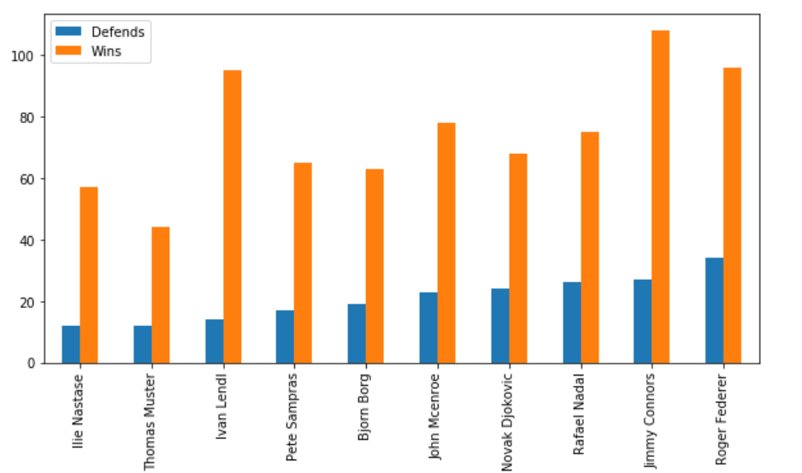
Spark Analysis – 1: Best at Defending Title (Men’s)
Titles
Players

Slide 7
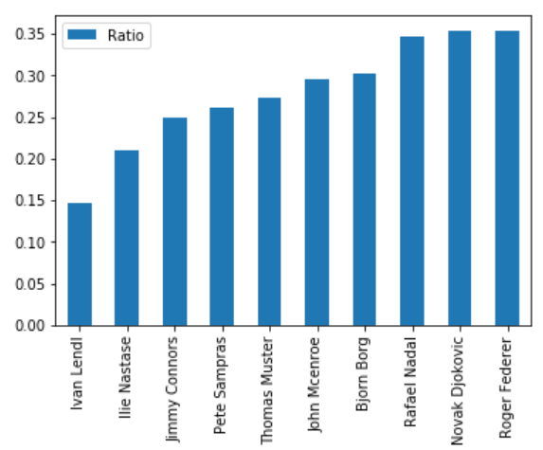
Spark Analysis – 1: Best at Defending Title (Men’s)
Ratio
(Titles Defended/
Titles Won)
Players

Slide 8
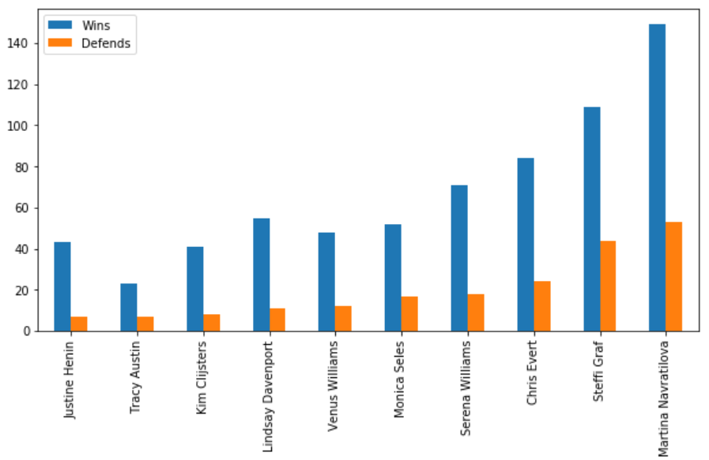
Spark Analysis – 1: Best at Defending Title (Women’s)
Titles
Players

Slide 9
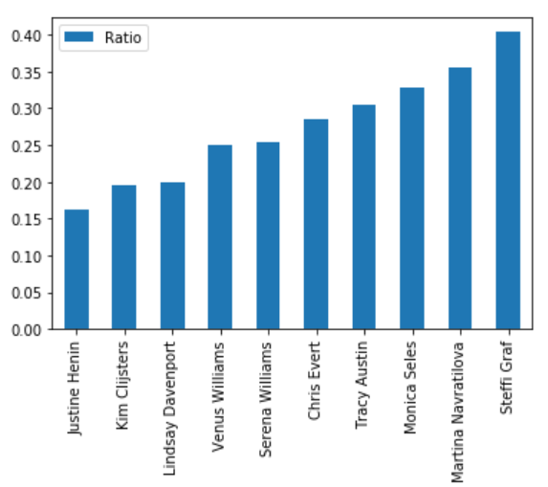
Spark Analysis – 1: Best at Defending Title (Women’s)
Ratio
(Titles Defended/
Titles Won)
Players

Slide 10
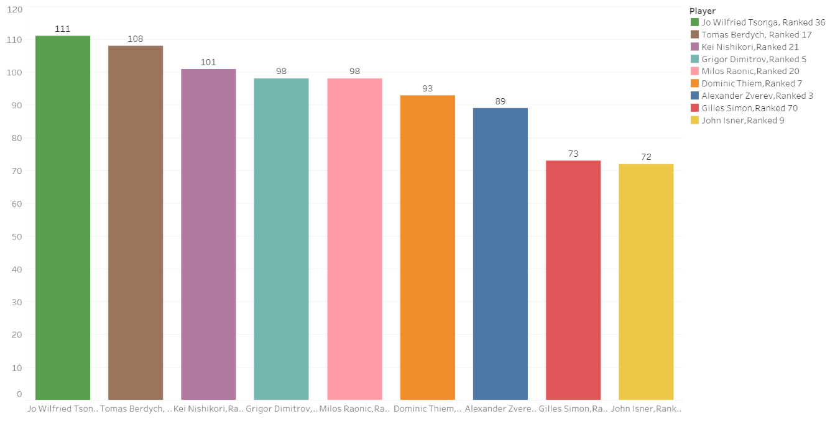
Spark Analysis – 2: First Grand Slam winning Likelihood (Men’s)
Points
(Based on
Ranking,
Prize Money,
and
Non GS
titles won)
Players

Slide 11
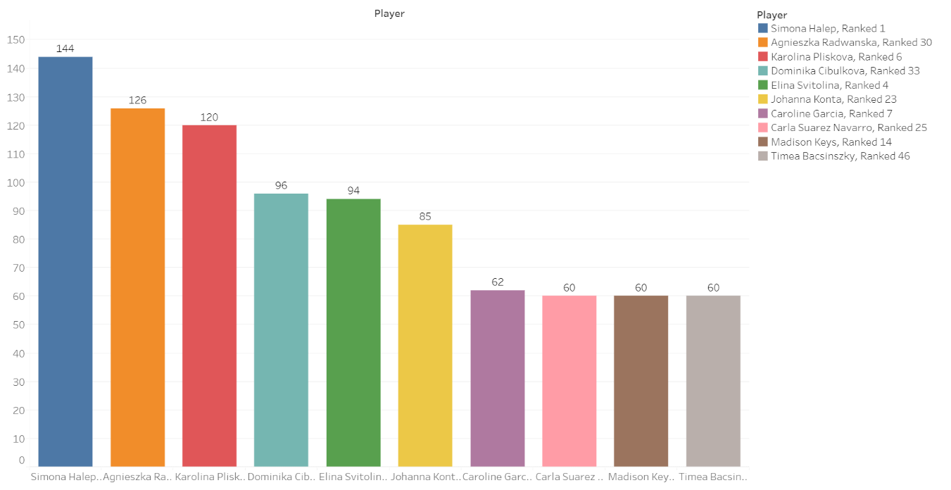
Spark Analysis – 2: First Grand Slam winning Likelihood (WOMen’s)
Points
(Based on
Ranking,
Prize Money,
and
Non GS
titles won)
Players

Slide 12
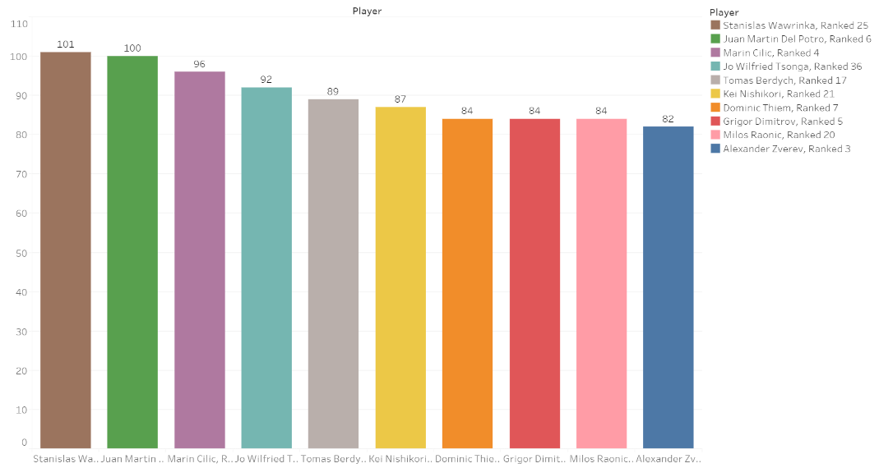
Spark Analysis – 3: LIKELIHOOD OF REACHING ATP #1 (Men’s)
Points
(Based on
GS titles,
Prize Money,
and
Non GS
titles won)
Players

Slide 13
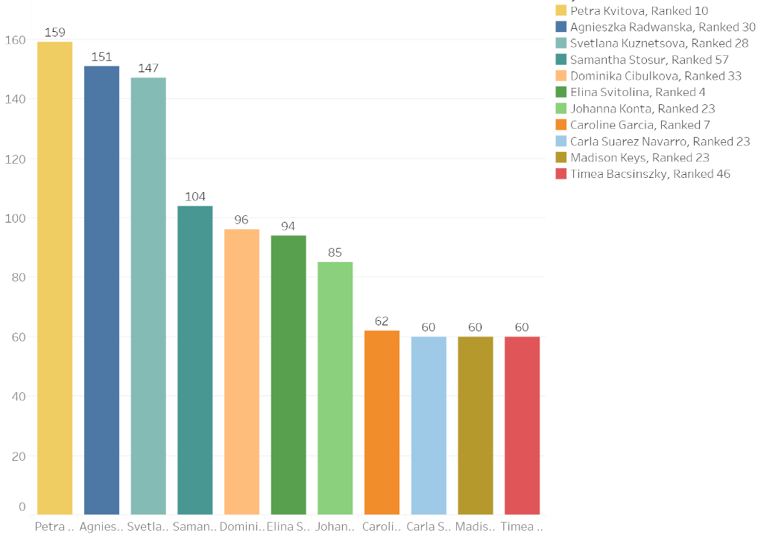
Spark Analysis – 3: LIKELIHOOD OF REACHING WTA #1 (WOMen’s)
Points
(Based on GS titles, Prize Money, and
Non GS
titles won)
Players

Slide 14
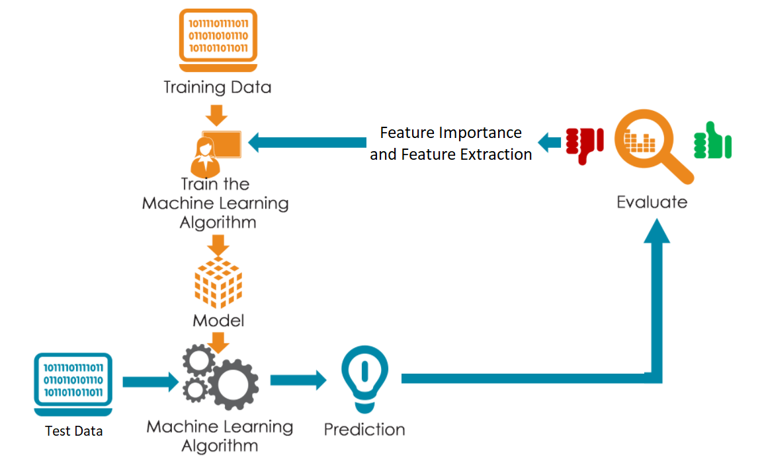
Machine Learning Model

Slide 15

Machine Learning Prediction – ATP for Clay 2018 DEMO
1. Rafael Nadal
2. David Ferrer
3. Dominic Thiem
4. Pablo Cuevas
5. Albert Ramos
6. Fabio Fogini
7. Andy Murray
8. Novak Djokovic
9. Pablo Carreño Busta
10. Borna Coric

Slide 16
Usage and Future
USAGE:
Predicting players to sponsor for equipment's/clothing for the Companies
Helping bookies in match betting (legal betting, of course!)
FUTURE:
Data is going to increase tenfold
The processing and approach, being scalable, could be performed on incoming data

