Slide 1
Graduation Project
By
Ahmed Reda Hassan

Slide 2
CONTENTS
Information about project
MCUs used
Application layers for MCUs
Schematic simulation

Slide 3
Information about project
A project is a small smart home were using UART communication protocol to control two LEDs by Bluetooth module.
Using two MCUs, one as a MASTER and another as a SLAVE and the communication between them by SPI protocol.
If there was a time, I would have been interface ESP8266 (TCP/IP) with Atmega32A and control LEDs by WIFI, but it well.

Slide 4
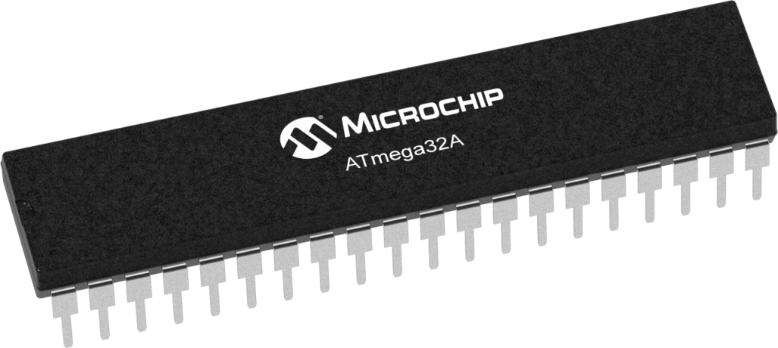
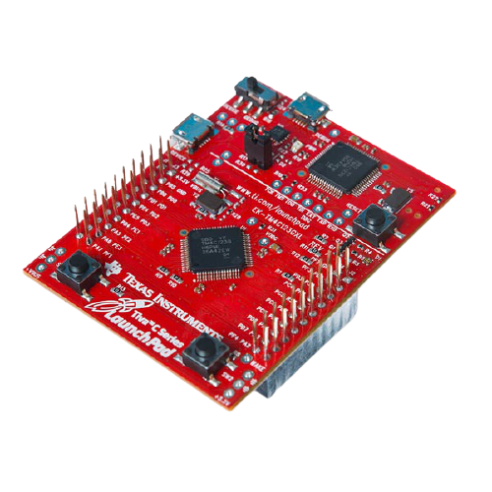
MCUs Used
Project (1) with simulation MASTER : Atmega32A SLAVE : Atmega32A
Project (2) without simulation MASTER : EK-TM4C123GXL Evaluation board SLAVE : Atmega32A

Slide 5
Application Layer for MASTER
APP
Main program
HAL
Bluetooth Module
UART Module
SPI Module DIO Module
MCAL
MCU
Microcontroller Hardware

Slide 6
Application Layer for SLAVE
APP
Main program
HAL
LEDs Module
MCAL
SPI Module DIO Module
MCU
Microcontroller Hardware

Slide 7
Schematic Simulation

Slide 8
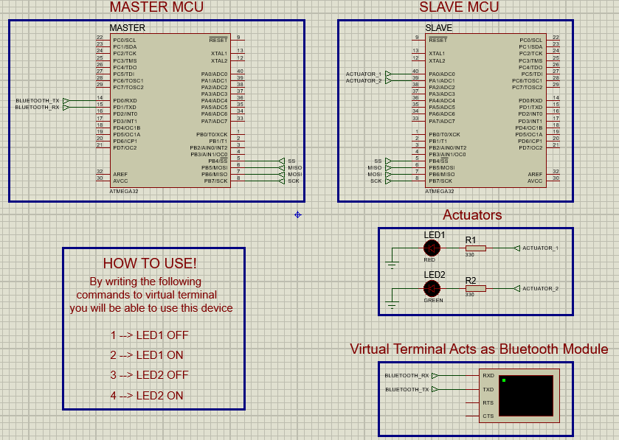

Slide 9
THE END -- Thanks --

