Slide 1
SOAP
By: Andrew Hemminger
Bellevue university web-420
Assignment 3.3

Slide 2
What SOAP is:
“SOAP – Simple Object Access Protocol – defines a very strongly typed messaging framework which relies heavily on XML and schemas.” (RESTfulAPI.net)
“SOAP is a lightweight protocol for exchange of information in a decentralized, distributed environment.” (W3C.org)
It is an XML based protocol that consists of three parts:
Envelope: defines a framework for describing what is in a message and how to process it.
Set of Coding Rules: expresses instances of application-defined datatypes.
A Convention: used for representing remote procedure calls and responses. (W3C.org)

Slide 3
Envelopes:
“A SOAP message is an XML document that consists of a mandatory SOAP envelope” (W3C.org)
The SOAP envelope combined with the header and body create a SOAP message.
“The Envelope is the top element of the XML document representing the message.” (W3C.org)
The envelope will contain namespace declarations along with additional attributes.
The attributes must be namespace qualified.
The envelope may also contain sub-elements which also must be namespace qualified. (W3C.org)

Slide 4
Headers:
“The Header is a generic mechanism for adding features to a SOAP message in a decentralized manner without prior agreement between the communicating parties.” (W3C.org)
Designed to contain meta-information like encryption data for the body element.
May contain the public key used to unlock encrypted text. (Scribner, 2002)
The SOAP header is an optional section of the message.
The SOAP Envelope and Body are mandatory parts of the message.
If a header exists is must follow the envelope.
May contain a set of entries but must be namespace qualified. (W3C.org)

Slide 5
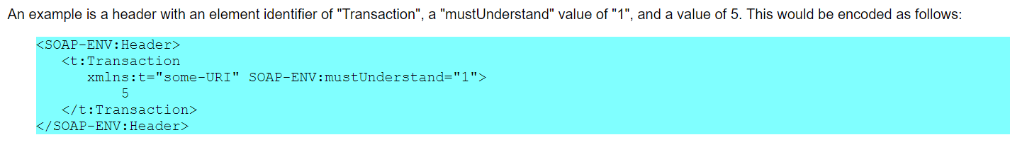
SOAP header example:
(W3C.org)

Slide 6
Faults and Fault Codes:
SOAP defines one element for the body, which is the Fault element used for reporting errors.
The Fault element in SOAP is used to carry error and status information within the message.
If a fault exists it must appear in the body and only once.
The faultcode element is used to identify the fault by software.
The faultcode must apper in the Fault element.
The faultcode must be a qualified name. (W3C.org)

Slide 7
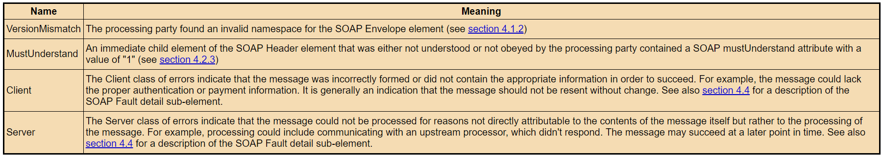
A few of the common faultcodes used in SOAP as documented by W3C.org:

Slide 8
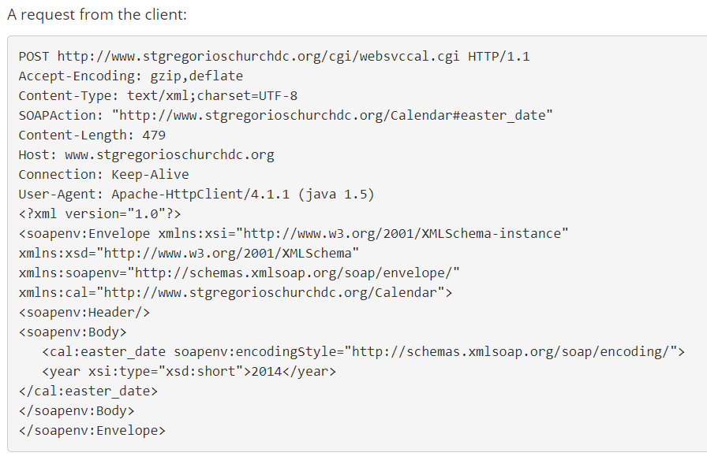
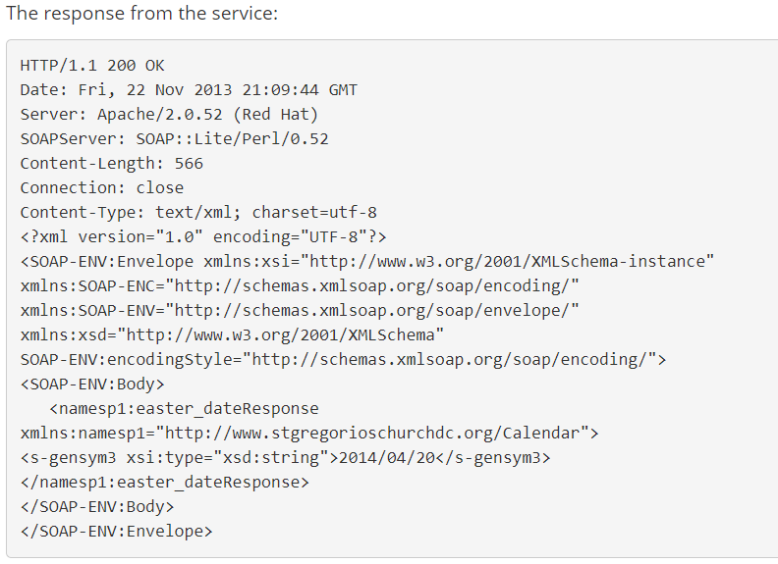
End-to-end data flow of a SOAP API:
https://www.soapui.org/learn/api/soap-vs-rest-api.html

Slide 9
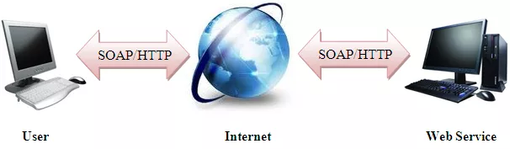
End-to-end data flow of a SOAP API: continued..
A simplified graphical representation from patsonusa.com

Slide 10

End-to-end data flow of a SOAP API: continued..
The data flow begins with a SOAP request from the client.
The message itself must be formatted in XML.
The message type is a POST.
Their must be one root element the envelope.
The response then comes from the service.
HTTP protocol is commonly used but SOAP is not limited to that protocol. (SoapUI.org)

Slide 11
References
W3C. (2000). Simple Object Access Protocol (SOAP) 1.1. Retrieved from https://www.w3.org/TR/soap11/#XML
RESTfulAPI. (2019). Comparing SOAP vs REST APIs. Retrieved from https://www.w3.org/TR/soap11/#XML
Scribner, Kenn. (March, 2002) Understanding SOAP. Retrieved from www.pcmag.com
SoapUI. (2019). SOAP vs REST 101: Understand The Differences. Retrieved from https://www.soapui.org/learn/api/soap-vs-rest-api.html

