Slide 1

Data Science & Machine Learning Internship Project | IBM Telco Customer Churn Dataset
Customer Churn Prediction &
Intelligent
Retention System
Presented by : Arti Reddy

Slide 2
Business Problem & Financial Impact
Why churn prediction is a high-leverage lever for the business
26.5%
Overall Churn Rate
7,043
Customers Analyzed
1,869
Customers Lost to Churn
5-25x
Cost to Acquire vs. Retain*
● The revenue problem: roughly 1 in 4 customers churns, representing a continuous, compounding drain on recurring subscription revenue.
● The acquisition-cost problem: replacing a lost customer costs significantly more than retaining one — every churned customer is a doubly expensive loss.
● The status-quo problem: without predictive scoring, retention efforts are either wasted on blanket-wide offers or applied too late, after a customer has already decided to leave.
● The opportunity: a model that reliably flags at-risk customers early lets the business target retention spend where it has the highest return.
*Widely cited industry benchmark for customer acquisition vs. retention cost.
Customer Churn Prediction & Intelligent Retention System
2

Slide 3
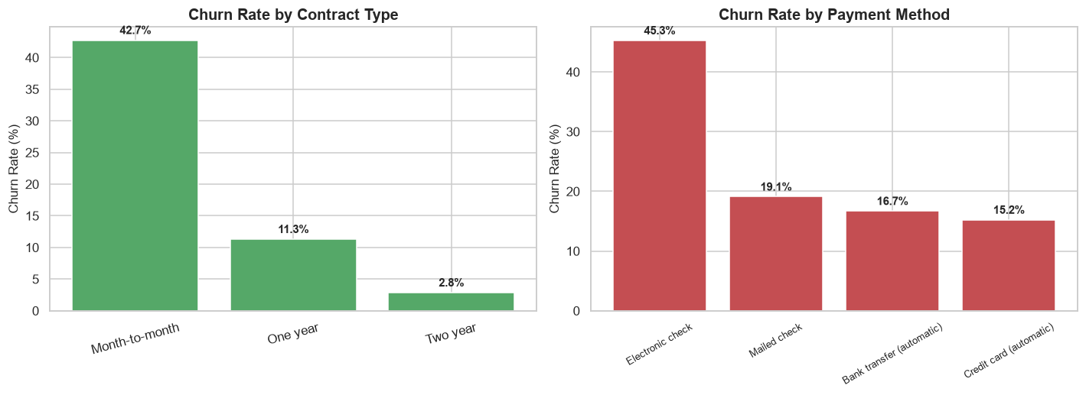
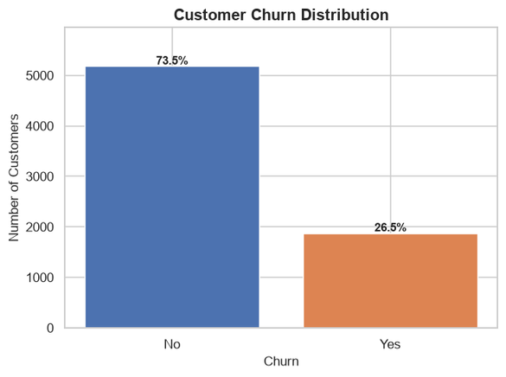
Exploratory Data Analysis — Key Insights
What the data reveals about who churns, and why
● Contract type dominates: month-to-month customers churn far more than one- or two-year contract holders — the single strongest churn signal in the data.
Customer Churn Prediction & Intelligent Retention System
3

Slide 4
Machine Learning Pipeline & Feature Engineering
From raw data to a production-ready feature matrix
1. Data Hygiene
Coerce TotalCharges to numeric; impute 11 blank-string values (new customers, tenure = 0) as 0.
2. Feature Engineering
Create Total_Services_Used, Estimated_LTV, Tenure_Group, and Payment_Risk_Score.
3. Encoding & Scaling
One-hot encode nominal features; standard-scale continuous features (tenure, charges, LTV).
4. Stratified Split
80/20 train-test split, stratified on Churn, random_state=42, to preserve class balance.
Engineered Features
● Total_Services_Used — count of subscribed add-on services (0-6); higher counts signal engagement.
● Estimated_LTV — MonthlyCharges × tenure; a proxy for cumulative customer value.
● Tenure_Group — lifecycle-stage bucket (0-12 / 12-24 / 24-48 / 48+ months).
● Payment_Risk_Score — flags non-automatic payment methods as higher churn risk.
Customer Churn Prediction & Intelligent Retention System
4

Slide 5
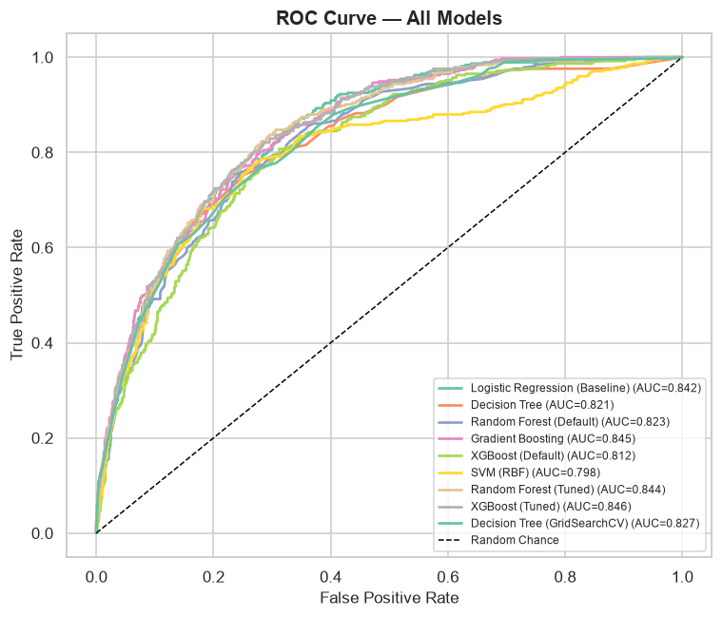
Model Comparison & Evaluation Metrics
Champion model: XGBoost (Tuned) | ROC-AUC 0.846 | Recall 81.5%
Model | Accuracy | Precision | Recall | F1-Score | ROC-AUC
XGBoost (Tuned) | 0.7410 | 0.5075 | 0.8155 | 0.6256 | 0.8456
Gradient Boosting | 0.8013 | 0.6577 | 0.5241 | 0.5833 | 0.8447
Random Forest (Tuned) | 0.7516 | 0.5212 | 0.7888 | 0.6277 | 0.8436
Logistic Regression (Baseline) | 0.7999 | 0.6554 | 0.5187 | 0.5791 | 0.8424
Decision Tree (GridSearchCV) | 0.7942 | 0.6312 | 0.5401 | 0.5821 | 0.8267
Random Forest (Default) | 0.7885 | 0.6258 | 0.5053 | 0.5592 | 0.8234
Decision Tree | 0.8006 | 0.6667 | 0.4973 | 0.5697 | 0.8213
XGBoost (Default) | 0.7708 | 0.5780 | 0.5053 | 0.5392 | 0.8120
SVM (RBF) | 0.7984 | 0.6654 | 0.4840 | 0.5604 | 0.7979
● Priority metrics: Recall and ROC-AUC are prioritized over raw Accuracy — a missed churner (False Negative) costs far more than a wasted retention offer (False Positive).
● Champion selection: XGBoost (Tuned) achieves the best balance of ROC-AUC and Recall after 5-fold Stratified cross-validated hyperparameter tuning.
Customer Churn Prediction & Intelligent Retention System
5

Slide 6
Strategic Retention Playbook
Five actionable strategies mapped directly to model findings
1
Personalized Offers
Target high-risk customers (70%+ churn probability) with tailored discounts, credits, or upgrades instead of generic promotions.
2
Loyalty Rewards
Incentivize migration from month-to-month to annual contracts — the single strongest churn driver identified by the model.
3
Early Churn Alerts
Score every customer monthly; automatically alert the retention team when risk crosses into the medium/high band.
4
Engagement Campaigns
Invest in structured onboarding during the first 12 months, when churn risk is highest.
5
Upgrade Incentives
Bundle add-on services (security, tech support) at a discount to raise switching costs and perceived value.
Customer Churn Prediction & Intelligent Retention System
6

Slide 7
Conclusion & Implementation Roadmap
● XGBoost (Tuned) is production-ready: ROC-AUC of 0.846 and Recall of 81.5% on held-out data, correctly identifying roughly 4 in 5 at-risk customers.
● Findings map directly to action: contract type, tenure, and payment method are both the top predictive features and the top retention levers.
● The system closes the loop: predict risk → intervene proactively → measure impact on churn rate over time.
Next Steps
● Deploy the scoring pipeline into the CRM for real-time customer risk flags
● A/B test retention offers against model-identified risk segments
● Integrate Early Churn Alerts into the retention team's workflow
● Retrain the model periodically as customer behavior evolves
Thank you

