Slide 1

IODA Report Studio
Evidence-first outage briefs for journalists, built from IODA's raw measurements
18/18
5
0
validation checks pass against IODA-published timelines
reference outages, including an IODA glitch control
numbers read off chart images: all from the IODA API
VIP IODA · Subteam 2: AI-Assisted Documentation & Public Reporting · November 2026
Notes:
IODA Report Studio is our answer to the three open items from Week 5: raw data not validated, unsupported cause and impact claims, and no human-review gate. Headline: every number in a brief now comes from the IODA API, the detector reproduces IODA-published timelines on 18 of 18 checks, and an LLM only writes wording on top of a fixed evidence packet.

Slide 2



Journalists misread IODA charts in three ways
"% of normal" read as "% of people"
One noisy signal read as an outage
IODA's own glitches read as blackouts
IODA counts blocks of addresses, not users. Probing at 4% of normal is not "96% of the country offline".
IODA's own rule: 2+ signals dropping together, or 1 signal plus an outside confirmation.
On 18 Oct 2026, 189 countries "lost" probing in the same minute. None of them had an outage.
Week 5 left three items open: raw IODA API data not downloaded or validated · cause and user impact unsupported · no human-review gate in the tooling
Notes:
Motivation. These are the three errors we kept seeing when IODA data is reported: percentages of address blocks turned into percentages of people, single noisy signals treated as outages, and platform-side glitches mistaken for real events. Week 5 also left three audit items open, which this project closes.

Slide 3
Goal: every sentence traces back to IODA data
1
2
3
4
5
Pull raw data
Build evidence packet
Draft the brief
Audit every claim
Human gate
IODA API v2: signals, outage events, summaries
Baselines, drops, glitch check. Deterministic code
Rule-based Template F, or any LLM
PASS, REVISE or BLOCK, claim by claim
Named editor, then IODA team review
What the LLM may do
What the LLM may not do
Choose wording, order and plain-language explanations of the numbers already in the packet.
Add numbers, causes, actors or counts of people. Convert to local time. Claim that service was restored.
Notes:
Intended outcome: a repeatable pipeline. Steps 1 and 2 are deterministic code, so every figure is reproducible. Step 3 can be our rule-based draft or any LLM. Step 4 is an adversarial audit prompt. Step 5 is a human editor and IODA review; nothing is published automatically.

Slide 4
One shared library drives every output
Rule-based Template F brief
IODA API v2
lib/ioda-core.js
Public · no key · CORS open
Same code in the browser and in Node
LLM prompt + packet bundle
/signals/raw
1
Parse four signals + IODA forecast
AI draft (Claude or any LLM)
2
Baseline and robust drop test
/outages/events
3
Merge simultaneous drops
Claim audit: PASS / REVISE / BLOCK
/outages/summary
4
Glitch check, then classify
IODA documentation row (CSV)
/entities/query
5
Evidence packet (JSON)
Evidence packet with fingerprint
Delivered through index.html (dashboard), cli/report.mjs (bundles) and cli/validate.mjs (tests). No dependencies, no API key.
Notes:
System diagram. One dependency-free JavaScript library does all analysis and is shared by the dashboard and the command-line tools, so the browser and the validation suite can never disagree. Outputs on the right are all generated from the same evidence packet.

Slide 5
Fixed rules find drops, never the LLM
Signal | "Normal" is | A reading counts as a drop when
BGP (routing) | Median of the 7 days before | 4×MAD below normal and 3%+ under it
Active probing | Median of the 7 days before | 4×MAD below normal and 10%+ under it
Network telescope | Median of the 7 days before | 3×MAD below normal and 40%+ under it
Google traffic | IODA's own SARIMA forecast | Below IODA's threshold and 30%+ under forecast
Then each drop is classified
Outage
2+ signals drop together, and one of them is BGP or probing.
Needs confirmation
One signal only, or only telescope + Google traffic.
Drops under 20 min are ignored. Drops within 30 min of each other count as simultaneous.
Likely IODA glitch
20+ other countries show the same drop within ±20 minutes.
Notes:
Detection is plain, inspectable code. MAD is the median absolute deviation, a robust spread measure, so normal noise does not trigger alerts. Google traffic reuses IODA's own forecast. The classification adds one condition to IODA's published 2-signal rule, which we found necessary in validation, plus a glitch check that queries every country's events.

Slide 6
Two prompts: a careful writer and a strict auditor
prompts/01_brief_writer.md
prompts/02_claim_auditor.md
Defines the reader: reporters on deadline, four questions in order
Typed input: the evidence packet schema
12 rules, each with its reason, so the model generalises
Fixed Template F skeleton with six headings
Bad → good sentence table from real failure modes
Silent self-check before answering
Assumes the draft is wrong until proven right
Maps every claim to a packet field path
Six verdicts, from SUPPORTED to UNTAGGED
BLOCK on any WRONG or OVERSTATED claim
PASS means "ready for an editor", never "publish"
Best run in a fresh chat or on another model
Every sentence ends in one of five evidence tags (extends the Week 5 scheme):
IODA-DATA
measured from raw signals
IODA-ALERT
IODA's own detector
CORROBORATED
outside source, added by a human
INTERPRETED
hedged inference
MISSING
cause, people, user recovery
Notes:
Prompt engineering choices: rules carry their reasons; the output skeleton is fixed so drafts are comparable across models; the bad/good table comes from real failure modes such as the Afghanistan a.m./p.m. confusion. The auditor is deliberately adversarial and is run separately from the writer.

Slide 7
AI helped build and write; validation checks it
How AI was used
Validation set: 5 outages, 18 checks
Where | Model | Role
Building the repo | Claude Code (Opus 5.5) | Pair-programmer: API analysis, code, prompts, docs. Every output run against the live API
Brief drafting | Any LLM; Claude in the hosted demo | Writes prose from the packet only
Claim audit | Any LLM, ideally a different one | Fact-checks the draft against the packet
Afghanistan, 29 Sep 2025
Nationwide shutdown; conflicting published times
Iran, 8 Jan 2026
Long shutdown with staged recovery
Haiti, 27 Oct 2026
Partial drop in three signals
Detection, every number and the documentation row are deterministic code, not LLM output.
Ireland, 18 Oct 2026
Negative control: an IODA-wide glitch
Guam, 17 Oct 2026
Probing-only outage with a glitch inside
Notes:
Disclosure of AI use as the rubric asks. The tool itself was built with Claude Code; the pipeline uses an LLM only for wording and for the audit. The validation suite pulls live IODA data and compares the detector with what IODA published, including a negative control that must not be called an outage.

Slide 8
Validation caught four problems; all fixed and tested
Problem | What we saw | Fix
False positive | v0.1.0 called a 1-hour telescope + Google dip in Ireland an outage (16/17 checks) | An outage now needs BGP or probing among its 2+ signals
Glitch inside a real outage | Guam's lowest probing reading (19.6%) fell on the 18 Oct glitch minute | Exclude the glitch span; quote 40.5% at 01:40 UTC
API clips event lengths | /outages/events returned every glitch event as exactly 20 minutes | Query 6 hours past the time of interest
Hosted page cannot call the API | Published demo pages block requests to outside sites | Demo opens on saved real cases; live mode runs locally
Also resolved: the published Afghanistan article said both "12:30 a.m." and "12:30 PM UTC". The writer prompt now forbids a.m./p.m. and local time.
Notes:
Major challenges. The false positive is the most important research result here: IODA's 2-signal rule is not enough when both signals are the noisiest ones. Each fix came with a new validation check so it cannot silently regress. The first run's report is kept in the repo for the record.

Slide 9
All 18 checks match IODA's published timelines
18/18
Case | IODA published | Detector found (raw API data) | Checks
Afghanistan | Sustained drop ~12:30 UTC; probing < 5% | Probing falls 11:30, BGP 12:10 UTC; low 3.8% | 5/5
Iran | Onset 16:30 UTC; telescope near zero by 18:45 | Probing falls 16:30 UTC; telescope 0% at 18:45 | 5/5
Haiti | Google 17:30, BGP 17:50 UTC | Probing 17:20, BGP 17:50, Google 18:00 UTC | 3/3
Ireland (control) | 189 countries "dropped" at 00:00 UTC | Flagged as an IODA glitch; nothing called an outage | 1/1
Guam | Probing-only disruption | Probing only; glitch reading excluded; low 40.5% | 4/4
validation checks pass (v0.1.1)
First run, v0.1.0: 16/17. The failure led to the tightened outage rule.
Source: data/validation/validation-report.md, generated 12 Nov 2026 against the live IODA API v2.
Notes:
Results. The detector reproduces every published onset to within one data step, including Iran exactly at 16:30 UTC and the telescope reaching zero at 18:45. It also behaves correctly on the negative control.

Slide 10
Afghanistan's shutdown began at 12:30 PM UTC, not a.m.
11:30 UTC
Probing starts to fall on 29 Sep
12:10 UTC
BGP follows; Google fell from 12:00
3.8%
Probing low, 15:30 UTC
12:50 UTC, 1 Oct
Probing back (published: ~11:45)
Source: IODA API v2 raw signals (saved case AF-2025-09-29). Percentages are of each signal's normal level, not of people.
Notes:
This settles the internal conflict in the published IODA article. All three signals start falling between 11:30 and 12:10 UTC, and the sustained drop is in place by about 12:30 PM UTC. Nothing in the raw series supports 12:30 a.m. Recovery: probing is back above its threshold at 12:50 UTC on 1 October, about an hour after the ~11:45 restoration IODA cited.

Slide 11
Iran: routing hid the shutdown; recovery was staggered
94%+
BGP daily median every day, while probing sat near 3.5%. A routing-only brief would have missed the shutdown.
Back above threshold
BGP
18 Jan
Google
22 Jan
Telescope
24 Jan
Probing
28 Jan
Source: IODA API v2 raw signals (saved case IR-2026-01-08). Google traffic compared with IODA's forecast; gaps are days IODA has no data.
Notes:
Two findings. First, BGP barely moved (daily median 94% or more, hourly low 86%) while probing collapsed to about 3.5% and the telescope to zero, which matches IODA's own note that routing is not a sufficient proxy in Iran. Second, signals recovered on four different dates, which is why our prompts forbid a single "service restored" claim.

Slide 12
IODA-wide glitches are common: every brief needs a check
Guam, 18 Oct 2026
19.6% → 40.5%
Guam's lowest probing reading landed on the 18 Oct glitch minute. Excluding the glitch's span gives the real low: 40.5% at 01:40 UTC.
A real outage, with its depth overstated by a measurement fault.
Real outages (teal) stand alone. Glitches (grey) hit 52 to 189 countries at once; the check flags 20+.
Source: IODA /outages/events, all countries, 13 Oct – 12 Nov 2026; glitch check results from the saved cases.
Notes:
Platform-wide glitches happened at least four times in 30 days. Real outages stand alone: Afghanistan's drop matched no other country, Haiti's matched one. Any automated or AI pipeline over IODA data needs this check, both at the start of a drop and at its lowest point, as the Guam case shows.

Slide 13
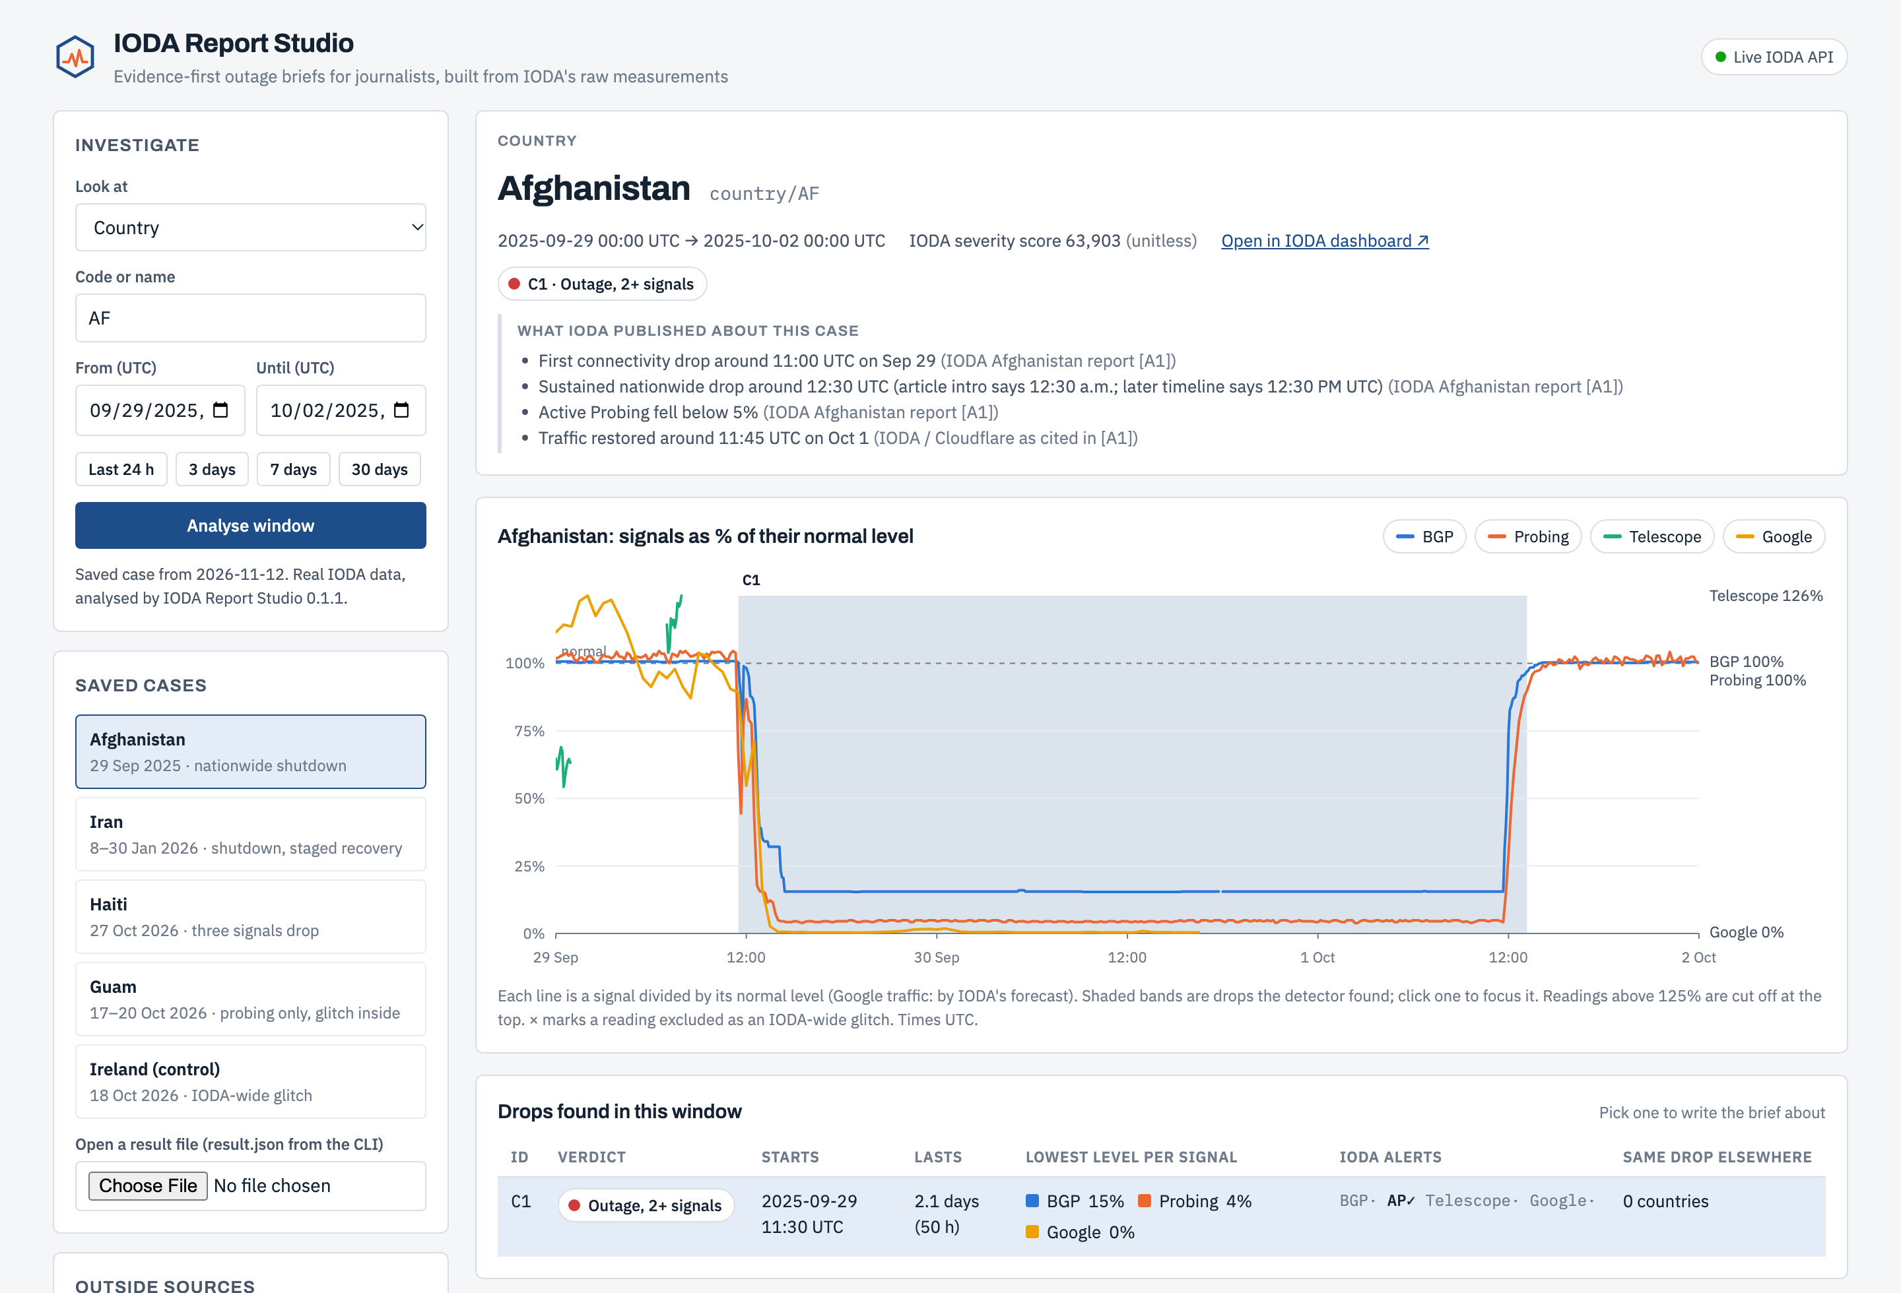
Demo: from a place and a time window to a reviewed brief
1
Pick Afghanistan: every signal collapses on 29 Sep
2
Brief draft: rule-based Template F, every line tagged
3
AI draft: Claude writes from the packet only
4
Audit: PASS, REVISE or BLOCK with a claim table
5
Add an outside source: it appears as CORROBORATED E1
6
Ireland and Guam: the glitch caught, then excluded
Hosted demo: claude.ai/artifact/Sz2gLaJrBrqQb1P3zF4oBA
Run locally for live data: python3 -m http.server 8000
Notes:
Live demo script. Open the hosted link (or localhost). Afghanistan first; walk through the six tabs: brief draft, AI draft, audit, LLM prompt, documentation row, evidence packet. Add an outside source and show it flow into the brief. Finish on Ireland (glitch caught) and Guam (the x marker where the glitch reading was excluded).

Slide 14






What version 0.1 cannot claim yet
Small reference set
Baseline ignores daily cycles
Mobile shutdowns may be downgraded
Thresholds tuned on 5 cases. Regional, ASN, mobile and throttling cases are untested.
A 7-day median can flag night-time dips where traffic is strongly diurnal.
Requiring BGP or probing trades recall for caution.
LLM drafts not yet evaluated
No journalist testing yet
Hosted demo is offline
No multi-model comparison or human fact-check benchmark yet.
Reading order and wording are still proposals.
Published pages cannot reach the API; live mode runs locally.
Notes:
Limitations, stated plainly. The biggest is sample size: five cases are enough to find real failure modes, not to estimate accuracy. Compute was not a constraint; data access was (the hosted demo cannot call the API).

Slide 15
Next: scale the evaluation, then test with journalists
1
2
3
4
Evaluate at scale
Model controls
Reader testing
Deploy and review
30+ documented outages
Precision and recall by type
Hour-of-week baseline
Same packets, 3+ models
Score with the auditor and a human
Measure auditor agreement
3–5 journalists
Rule-based vs AI briefs
Do readers confuse % of normal with % of people?
GitHub Pages live mode
Cloudflare Radar as outside source
IODA team sign-off
Full task list with detail for new members: README.md, section 5.
Notes:
Next steps in order. Evaluation at scale comes first because every later step depends on trustworthy detection. GitHub Pages works as-is for live data because the IODA API allows cross-origin requests.

Slide 16
Problem statement for the next phase (Spring 2027)
Journalists need fast, correct explanations of Internet disruptions, but IODA's signals are easy to misread and AI tools readily overstate them. Report Studio v0.1 showed that a deterministic evidence packet, an evidence-tagged prompt and an adversarial audit can reproduce IODA's published timelines and catch platform-wide glitches.
The next phase must answer:
1
Does detection stay accurate across 30+ outages of different types and scopes?
2
Do LLM drafts pass independent fact-checking at a measurable rate?
3
Do journalists using the briefs make fewer interpretation errors than with the dashboard alone?
Deliverable: an evaluated, IODA-reviewed workflow and a public deployment plan.
Notes:
Problem statement for the next VIP phase. The rubric names Fall 2026 as the next phase; since we are presenting in November 2026, we framed it as Spring 2027. Adjust if the program calendar differs.

Slide 17
Everything needed to reproduce this is in the repository
Repository map
Reproduce in three commands
index.html
dashboard
node cli/validate.mjs
node cli/report.mjs --type country \
--code HT --from 2026-10-27T00:00Z \
--until 2026-10-29T12:00Z
python3 -m http.server 8000
lib/ioda-core.js
shared pipeline
prompts/01_brief_writer.md
writer prompt
prompts/02_claim_auditor.md
auditor prompt
cli/report.mjs
report bundles
cli/validate.mjs
validation suite
data/reference_cases.json
cases + checks
data/cases/
saved API pulls
Code: github.com/arhilhorst/ioda-report-studio
Demo: claude.ai/artifact/Sz2gLaJrBrqQb1P3zF4oBA
Needs: Node 18+, Python 3. No API keys, no npm packages.
data/validation/
reports v0.1.0, v0.1.1
README.md
full documentation
Notes:
Documentation for new members: the README follows the rubric (goal, methods, results, limitations, next steps) and includes the system diagram, data formats and tuning guidance. Thresholds live at the top of lib/ioda-core.js; re-run validation after any change.

