Slide 1

Development update
IODA Report Studio v0.2.0: research progress, the choices behind the dashboard, and how we improve it next
5
18/18
6
iterations, each triggered by a test result or a new need
validation checks, re-run on v0.2.0 against the live IODA API
audience profiles added in v0.2.0, one analysis to six prompts
VIP IODA · Subteam 2: AI-Assisted Documentation & Public Reporting · 12 November 2026
Notes:
Purpose of this update: show where the research stands after Week 5, explain the main design choices behind the Report Studio dashboard (and the alternatives we rejected), and agree on what to improve next. Sources are numbered and listed on the last slide.

Slide 2
Week 5's open items are closed, except IODA review
Week 5 claim-audit item | Week 5 status | Now | How it was addressed
Raw hourly measurements | OPEN | CLOSED | Every brief is built from raw IODA API series; detector validated on 5 cases, 18/18 checks [1][7]
Start-time provenance | PASS WITH NOTE | RESOLVED | Afghanistan onset read from raw data: signals fell 11:30–12:10 UTC, so "12:30 PM UTC" is right [3][7]
User impact & cause | OPEN | GUARDED | Prompt rules and the auditor block unsupported cause and people counts; always listed as [MISSING]
IODA team / human approval | OPEN | STILL OPEN | An editorial gate is in every brief, but no IODA review has happened yet
Week 5 items "Published event / place" and "Signal description" passed then and still pass.
Sources: [6] Week 5 deck, slide 14 (claim audit); [7] data/validation/validation-report.md (v0.2.0); [3] IODA Afghanistan report.
Notes:
Status against the Week 5 claim audit. Three of the four open or noted items are now closed or guarded by the tooling. The one that remains open, IODA team review, needs a person, not code. That is one of the decisions on slide 13.

Slide 3
Five iterations, each triggered by evidence
1
2
3
4
5
API study
v0.1.0
v0.1.1
v0.1.1 fixes
v0.2.0
Mapped IODA API v2. Found platform-wide glitches: 189 countries "dropped" in one minute.
Detector, Template F draft, writer and auditor prompts, validation suite.
Ireland false positive: telescope + Google alone. Outage now needs BGP or probing.
Guam low point fell on a glitch: exclude the glitch span. API clips event lengths: query 6 h ahead.
Audience prompts: six profiles, auditor v1.1, CLI flags, language choice.
Became the glitch check
16/17 checks
17/17 checks
18/18 checks
18/18 re-run
Sources: [7] repository commit history and validation reports v0.1.0 (16/17) and v0.2.0 (18/18); [1] IODA API v2 /outages/events, all countries, 13 Oct – 12 Nov 2026.
Notes:
Every change after v0.1.0 came from a failed or suspicious validation result, and each fix added a new check so it cannot regress. v0.2.0 is the first change driven by a user need rather than a test: different readers need different outputs.

Slide 4
Choice 1: numbers come from code, words from the model
 | Option | Why
✗ | LLM reads IODA chart images (Week 5) | Values estimated by eye; cannot be audited
✗ | LLM reads the raw API JSON | 7,000–10,000 data points per case; the model would do the arithmetic
✓ | Code builds an evidence packet; LLM only writes | Every number reproducible and fingerprinted; the auditor checks claims against fields
The packet is 12–34× smaller than the raw pull, and every value in it is already computed.
Sources: [7] data/cases/*.json (saved IODA API pulls, 12 Nov 2026) and packets built by lib/ioda-core.js v0.2.0; [6] Week 5 method (chart images).
Notes:
This is the central design decision. Week 5 asked an LLM to work from published charts, so values were estimated. Giving the model raw JSON would be worse: thousands of points and arithmetic the model can get wrong. Instead deterministic code computes everything into a compact packet with a SHA-256 fingerprint, and the model only chooses words.

Slide 5
Choice 2: one library, local-first, demo on real saved cases
Decision | Options considered | Chosen | Why
Where analysis runs | Python backend · separate Python CLI and JS dashboard · one JS library for both | One JS library (browser + Node) | Dashboard and validation suite can never disagree; nothing to install, no API key
Hosting | Own server · GitHub Pages · claude.ai artifact | Local + hosted demo now; Pages later | Hosted artifact pages cannot call outside APIs; Pages needs a decision to make the repo public
Demo data | Mock data · saved real API pulls | Saved real pulls (5 cases) | The demo shows real evidence and works offline; same files feed validation
Prompts | Strings in code · markdown files | Markdown files in prompts/ | The team edits prompts without touching code; every change is versioned in git
Sources: [7] repository (lib/ioda-core.js, index.html, cli/, prompts/); [1] IODA API v2 (allows cross-origin requests); [8] hosted demo.
Notes:
Architecture choices. The single library was chosen so the browser and the validation suite run identical code. Hosting is local-first because the hosted claude.ai page cannot reach the IODA API; it opens on saved real cases instead. GitHub Pages would give everyone live data, but only if the repo is public.

Slide 6
Choice 3: our own drop rules, with IODA's alerts as evidence
Why not use IODA's alerts alone
What we chose
IODA logged Guam's probing event as 623 hours; the real dip lasted about 3 days
/outages/events reaches 14 days past the window by default, pulling in old events
Alerts give no per-signal lowest point or recovery time, which briefs need
Alerts include platform-wide glitches with no flag
Robust baseline: 7-day median and MAD, so normal noise does not alert
Google traffic judged against IODA's own forecast, which models daily cycles
IODA's rule (2+ signals) plus one condition: BGP or probing must be one of them
Glitch check at the start and at the lowest point: 20+ countries within ±20 min
IODA's own alerts attached to every drop as [IODA-ALERT] evidence
Sources: [1] IODA API v2 /outages/events and /signals/raw; [5] IODA training deck (outage = 2+ signals, or 1 + outside confirmation); [7] validation report.
Notes:
We did not discard IODA's detector; its alerts are attached as evidence. But briefs need per-signal timing and depth, and IODA's event log has long-tail durations and no glitch flag, so we compute drops ourselves with robust, inspectable rules.

Slide 7



Choice 4: a writer and an independent auditor
Rejected
Chosen
Next to test
One prompt that writes and checks itself
Writer + independent auditor
Structured JSON output, then a template
The draft and its check share the same blind spots; self-review tends to approve its own work.
The auditor assumes the draft is wrong, maps every claim to a packet field, and BLOCKs wrong or overstated claims. Best run as a fresh chat or another model.
More control over every number, less fluent prose. A candidate for the model-controls study.
Both prompts give each rule a reason, so models apply the intent to cases the rules do not name. Evidence tags extend the Week 5 scheme.
Sources: [7] prompts/01_brief_writer.md, prompts/02_claim_auditor.md (v1.1); [6] Week 5 evidence tags.
Notes:
We separated writing from checking because a model reviewing its own draft tends to confirm it. The structured-output option is not rejected; it is the next thing to compare in the model-controls study.

Slide 8
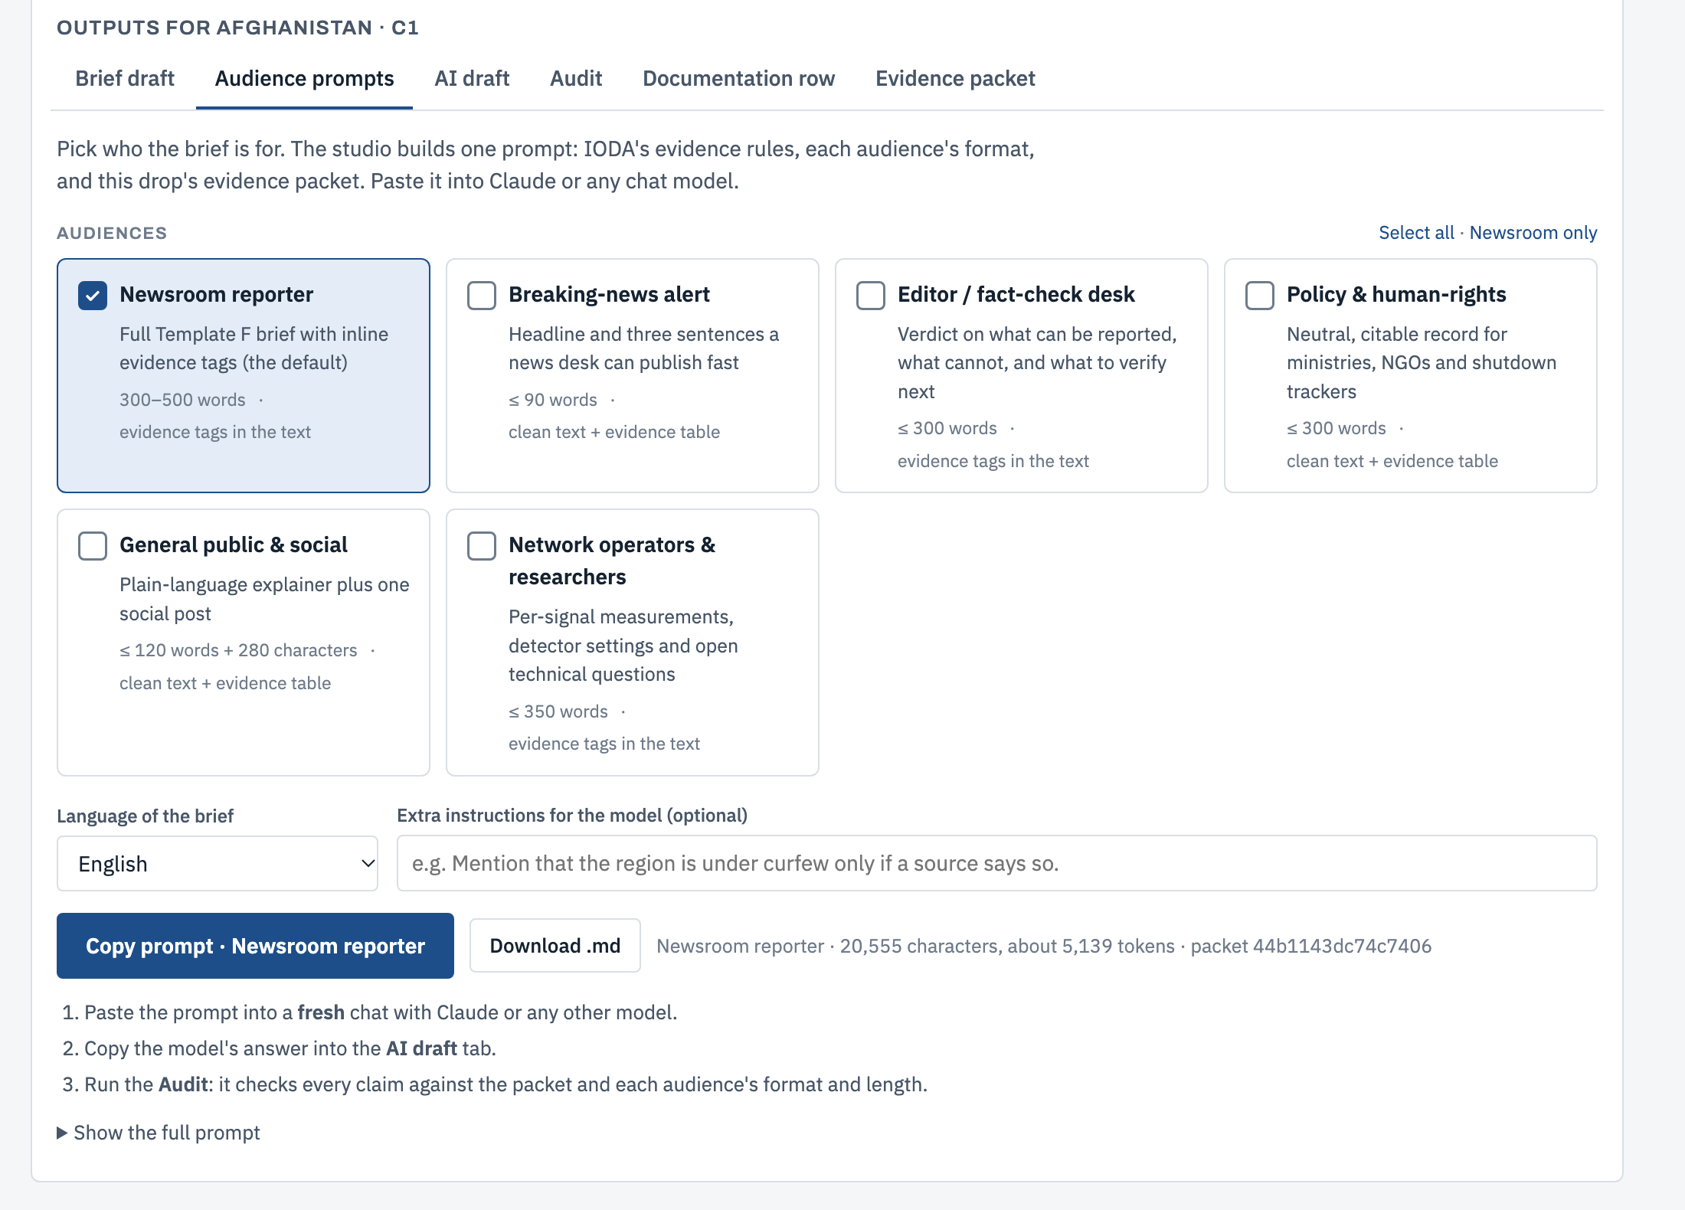
New in v0.2.0: one analysis, six audience-ready prompts
1
Analyse a place and time window
2
Pick one or more audiences and a language
3
Copy the prompt; paste it into Claude or any model
4
Paste the answer back; the audit checks claims, format and length
Also on the command line: --audience wire,policy or --audience all, with --language.
Sources: [7] index.html and cli/report.mjs (v0.2.0); screenshot of the dashboard running locally on the Afghanistan case, 12 Nov 2026.
Notes:
The new feature. After analysing a window, the Audience prompts tab builds a single prompt containing the evidence rules, the chosen audience formats and the evidence packet. In the hosted demo the same prompt can be sent to Claude directly. Choices are remembered per browser.

Slide 9
Each audience gets its own format, limit and evidence style
Audience | What they get | Hard limit | Evidence style
Newsroom reporter | Template F brief, six sections (the default) | 300–500 words | Tags in the text
Breaking-news alert | Headline and three sentences a desk can publish | ≤ 90 words | Clean text + evidence table
Editor / fact-check desk | Verdict, safe to say, not supported, verify next | ≤ 300 words | Tags in the text
Policy & human rights | Neutral key-facts table and suggested citation | ≤ 300 words | Clean text + evidence table
General public & social | Plain-language explainer and one social post | ≤ 120 words + 280 characters | Clean text + evidence table
Network operators & researchers | Per-signal measurements and open technical questions | ≤ 350 words | Tags in the text
Any language: the text is translated, but times stay HH:MM UTC and evidence tags stay in English for the audit.
Source: [7] prompts/03_audiences.md (audience profiles v1.0).
Notes:
The six profiles. Formats that may be published as-is (alert, policy text, public explainer) keep the text clean and carry evidence in a table underneath. Formats read by professionals who check sources keep tags inline.

Slide 10




How the audience feature keeps every claim checkable
Clean text, evidence underneath
One classification rule for everyone
A social post cannot carry "[IODA-DATA S1]". Publishable formats put tags in an evidence table after the text, so the auditor still checks every claim.
A likely IODA glitch never becomes an alert, a post or a policy summary, whatever the audience.
Profiles are markdown, not code
Language without losing rigor
Add or tune an audience by editing one file. The dashboard and the CLI read the same profiles.
Text in the chosen language; UTC times, tags and network names unchanged so the audit works.
Sources: [7] prompts/03_audiences.md and prompts/02_claim_auditor.md v1.1 (audience format and length check).
Notes:
The design risk of audience versions is that shorter, friendlier text drops its evidence. These four choices keep the audit possible for every audience, and keep the most important safeguard, the glitch rule, identical across all of them.

Slide 11
Next iterations, ranked by impact and effort
Do first
High impact · lower effort
Plan next
High impact · higher effort
Grow the reference set to 30+ IODA-reported outages
Few-shot examples for each audience
GitHub Pages live mode (needs a public repo)
Model controls: 3+ models × 6 audiences, auditor + human scoring
Reader testing with 3–5 journalists
Hour-of-week baseline for daily cycles
Quick wins
Lower impact · lower effort
Defer
Lower impact · higher effort
Cloudflare Radar link for each window
Export a brief as a Word file
Automated cause research from local news: high risk of unsupported claims
Sources: items from [7] README.md section 5 and [6] Week 5 deck, slide 16 (next steps); placement is the team's judgment as of 12 Nov 2026.
Notes:
Placement is the team's judgment today, to revisit after the evaluation. Growing the reference set comes first because every other result depends on trustworthy detection. Automated cause research is deferred on purpose: it is where unsupported claims are most likely.

Slide 12
How we will measure the next iteration
Question | Metric | Method | Proposed target
Does detection hold up? | Precision and recall by outage type and scope | 30+ IODA-documented outages plus glitch controls | ≥ 90% recall on country-level shutdowns
Are AI drafts accurate? | Share of claims SUPPORTED | Auditor, then an independent human fact-check | ≥ 95% supported; zero WRONG or OVERSTATED
Do drafts fit the audience? | Format and length compliance | Auditor's audience check, per profile | 100% within hard limits
Do readers understand? | Errors reading "% of normal" as "% of people" | 3–5 journalists, think-aloud, brief vs dashboard alone | Fewer errors than with the dashboard alone
Targets are proposals for team discussion, not results.
Sources: [7] README.md section 5 (next steps); [6] Week 5 deck, slides 12 and 16 (desk-review hypotheses, next steps).
Notes:
Four questions, each with a metric we can actually compute. The reader-comprehension question tests the Week 5 hypothesis that readers misread normalized charts as shares of people.

Slide 13
Decisions we need from the team and IODA
1
Make the repository public?
Needed for free GitHub Pages hosting of live mode. Check IODA's data terms first: IODA marks its data All Rights Reserved.
2
Which audiences matter most?
Rank the six profiles so evaluation effort follows IODA partners' needs.
3
Who reviews the rules?
An IODA reviewer for the classification rule and the 20-country glitch threshold.
4
Confirm the calendar
The rubric names Fall 2026 as the next phase; we planned for Spring 2027.
Sources: [2] IODA (data terms marked on API responses); [7] README.md (limitations, next phase).
Notes:
These four decisions block the next iteration. The first two can be made in this meeting; the third needs a contact on the IODA team.

Slide 14
Sources
[1]
IODA API v2: documentation and endpoints. Accessed 12 Nov 2026.
api.ioda.inetintel.cc.gatech.edu/v2/
[2]
IODA dashboard, Georgia Tech Internet Intelligence Lab.
ioda.inetintel.cc.gatech.edu
[3]
IODA, "Taliban Expands Moral Crackdown in Afghanistan From Localized Internet Shutdowns to Nationwide Shutdown" (Week 5 source A1)
ioda.inetintel.cc.gatech.edu/reports/taliban-expands-moral-crackdown-in-afghanistan-from-localized-internet-shutdowns-to-nationwide-shutdown/
[4]
IODA, "A Comparative Look at Internet Shutdowns in Iran: 2019, 2022, 2025, and 2026" (Week 5 source I1)
ioda.inetintel.cc.gatech.edu/reports/a-comparative-look-at-internet-shutdowns-in-iran-2019-2022-2026-and-2026/
[5]
IODA DataWorks Training, "Tracking Internet Shutdowns and Disruptions using the IODA platform" (team-supplied slides).
[6]
VIP IODA Subteam 2, "AI-Assisted Documentation & Public Reporting, Week 05", 12 Nov 2026 (team-supplied slides).
[7]
IODA Report Studio repository: code, prompts, saved cases, validation reports v0.1.0 and v0.2.0.
github.com/arhilhorst/ioda-report-studio
[8]
IODA Report Studio hosted demo (saved cases, Claude drafting).
claude.ai/artifact/Sz2gLaJrBrqQb1P3zF4oBA
Notes:
All URLs were checked on 12 November 2026. Note that the Iran report URL slug reads "2019-2022-2026-and-2026" although its title lists 2025; that is IODA's own URL.

