Slide 1
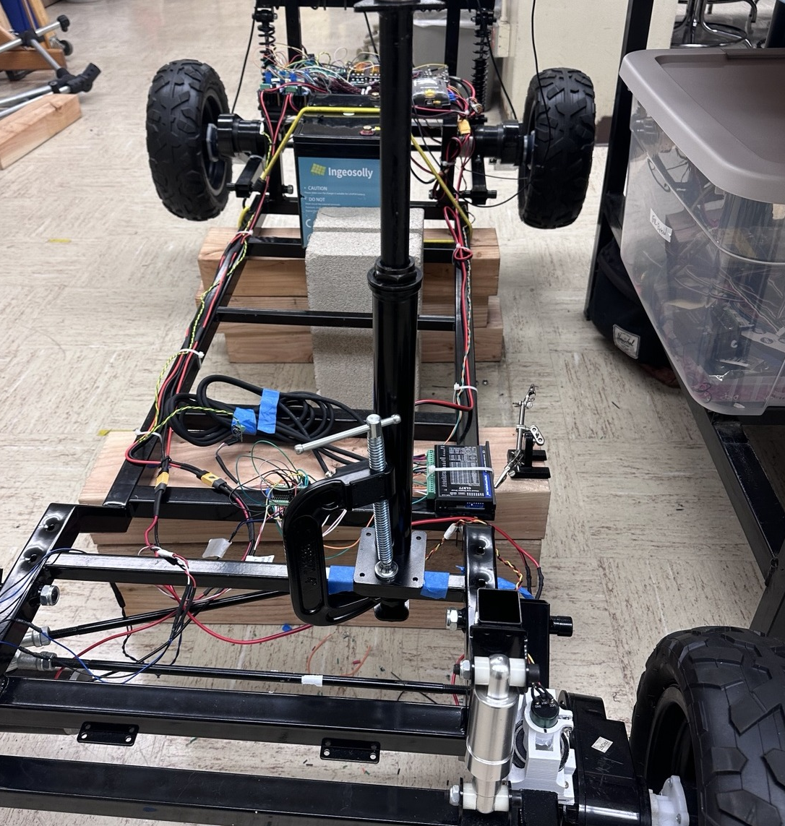
AVL Drive-by-Wire Platform
System Integration Progress Review
Summer Cohort 2026 • Hardware-focused update before final presentation
Wireless Jetson integration
Power architecture redesign
Harness routing + safety
Validated CAN/DBW stack
Team Lead: Garrett Anderson
Team: Isaac Alvarado, Jonathan Villalobos, Ethan Ranario, Richard Yam-Ciau, Syed Wassay Naqvi
AVL Summer Cohort 2026
1

Slide 2
Executive summary: final progress review focus
The project has moved from proving individual subsystems to building the infrastructure for final system demonstration.
3
controller layers
2
regulated low-voltage rails
CAN
validated command network
Wireless
Jetson SSH + UART bridge
Completed since last review
Current emphasis for today
• Jetson Nano integrated as onboard computer
• Wireless operation through hotspot + SSH
• Jetson communicates with STM32 through UART
• New 12 V power rail added alongside existing 5 V rail
• Dedicated fuse boxes and high-side converter input fusing added
• Harnesses cleaned up, remade, and routed for system serviceability
Hardware maturity: power distribution, wiring, wireless compute integration, and safety architecture. Firmware is included only where it proves hardware interfaces: UART, CAN, heartbeat, and teleop validation.
Bottom line: the platform is now moving from a tethered embedded prototype toward a wireless, onboard-compute, autonomous-ready research system.
AVL Summer Cohort 2026
2

Slide 3
Progress since previous presentation
The latest work focuses on integration infrastructure, electrical robustness, and wireless operation.
Previous baseline
Current progress
Final review target
Distributed CAN drive-by-wire
Motor + encoder validation
Steering hardware present
5 V logic rail and core wiring
Jetson Nano installed
Wireless SSH + data logging
UART bridge to STM32
12 V rail + fuse box added
Harnesses remade and routed
Power rails documented
Wireless architecture shown
Sensor expansion plan ready
Final demo criteria defined
Shift in project narrative
From: subsystem bring-up and debug → To: hardware integration, serviceability, safety, and wireless autonomy interface.
AVL Summer Cohort 2026
3

Slide 4
Updated system architecture: wireless layered control stack
The Jetson now separates high-level compute from deterministic embedded control.
Host Laptop
operator station
SSH + monitoring
Wi-Fi Hotspot
wireless network
untethered access
Jetson Nano
onboard compute
algorithms + logging
STM32 Master
UART command input
CAN arbitration
CAN Backbone
heartbeat
commands + status
Throttle Teensy
4 motor channels
encoder feedback
Steering Teensy
differential/steering path
limit + encoder inputs
Power Architecture
24 V + 12 V + 5 V
fused rails
Architecture implication
Laptop control no longer needs to be physically tethered to the STM32. The Jetson becomes the onboard bridge for remote operation, data logging, and algorithm execution while STM32/CAN nodes keep low-level control deterministic.
AVL Summer Cohort 2026
4

Slide 5
Jetson Nano integration: onboard compute + wireless access
The platform now has an onboard computer layer that supports remote operation and data logging.
Host Laptop
remote operator
Phone / Lab Hotspot
wireless network
Jetson Nano
SSH + logging + algorithms
STM32 Master
UART command bridge
Wireless control path
Hardware value
• Jetson connects to hotspot and is accessed wirelessly by host laptop
• SSH provides remote terminal access without a USB tether to the vehicle
• Data logging can run onboard while control commands are forwarded to the STM32
• UART provides a simple, deterministic bridge from high-level compute to the embedded master
• Creates a clean separation between autonomy compute and real-time actuation
• Avoids rewiring the proven STM32 → CAN → Teensy control stack
• Allows the final demo to show a realistic autonomous platform architecture
Today's framing
Jetson integration is presented as a hardware and communications milestone: wireless access, UART link, and onboard logging environment are now part of the system architecture.
AVL Summer Cohort 2026
5

Slide 6
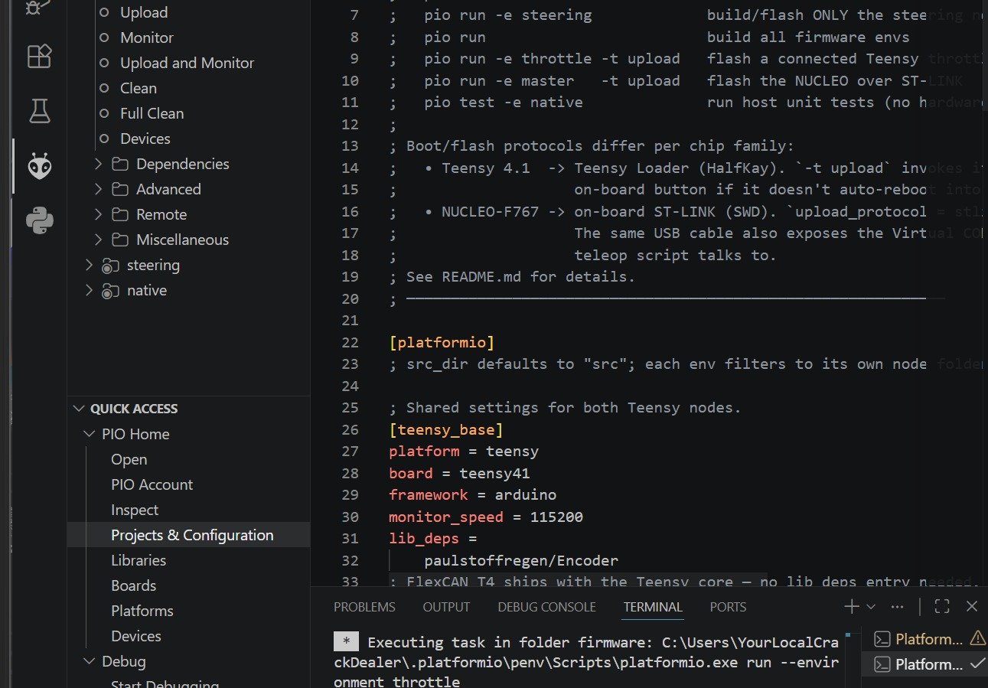
UART interface: high-level commands enter through the STM32 master
Firmware details are intentionally light; the main takeaway is the hardware/software boundary.
Jetson Nano
algorithm output
teleop bridge
UART Serial Link
command stream
D vx wz / stop / e-stop
STM32 Master
mode, arbitration, safety
CAN packetization
What is proven
Why UART is appropriate
Firmware boundary
• Jetson can be reached wirelessly
• UART communication path to STM32 is established
• STM32 remains the low-level command authority
• Existing CAN nodes are preserved
• Simple physical interface
• Easy debugging through serial logs
• Works with existing teleop command format
• Keeps high-level and low-level systems decoupled
The firmware team can expand higher-level command handling while hardware maintains a stable Jetson → STM32 → CAN pathway.
Reproducible PlatformIO workflow remains the firmware deployment backbone.
AVL Summer Cohort 2026
6

Slide 7
Updated power architecture: 48 V bus with dedicated 12 V and 5 V domains
The electrical system was cleaned up and expanded to support onboard compute and future sensors.
24 V Battery
main vehicle source
Main Protection
service isolation + main fuse
24 V Bus
high-power distribution
Drive Motor Power
BTS7960 drivers w/ Fuse Box
12 V DC-DC
new rail
5 V DC-DC
existing logic rail
High-side input fuses
before each converter
12 V Fuse Box
Jetson + fans + future loads
5 V Fuse Box
STM32 + CAN + sensors
Key design change: 12 V and 5 V are now separate low-voltage domains instead of one general logic supply.
AVL Summer Cohort 2026
7

Slide 8
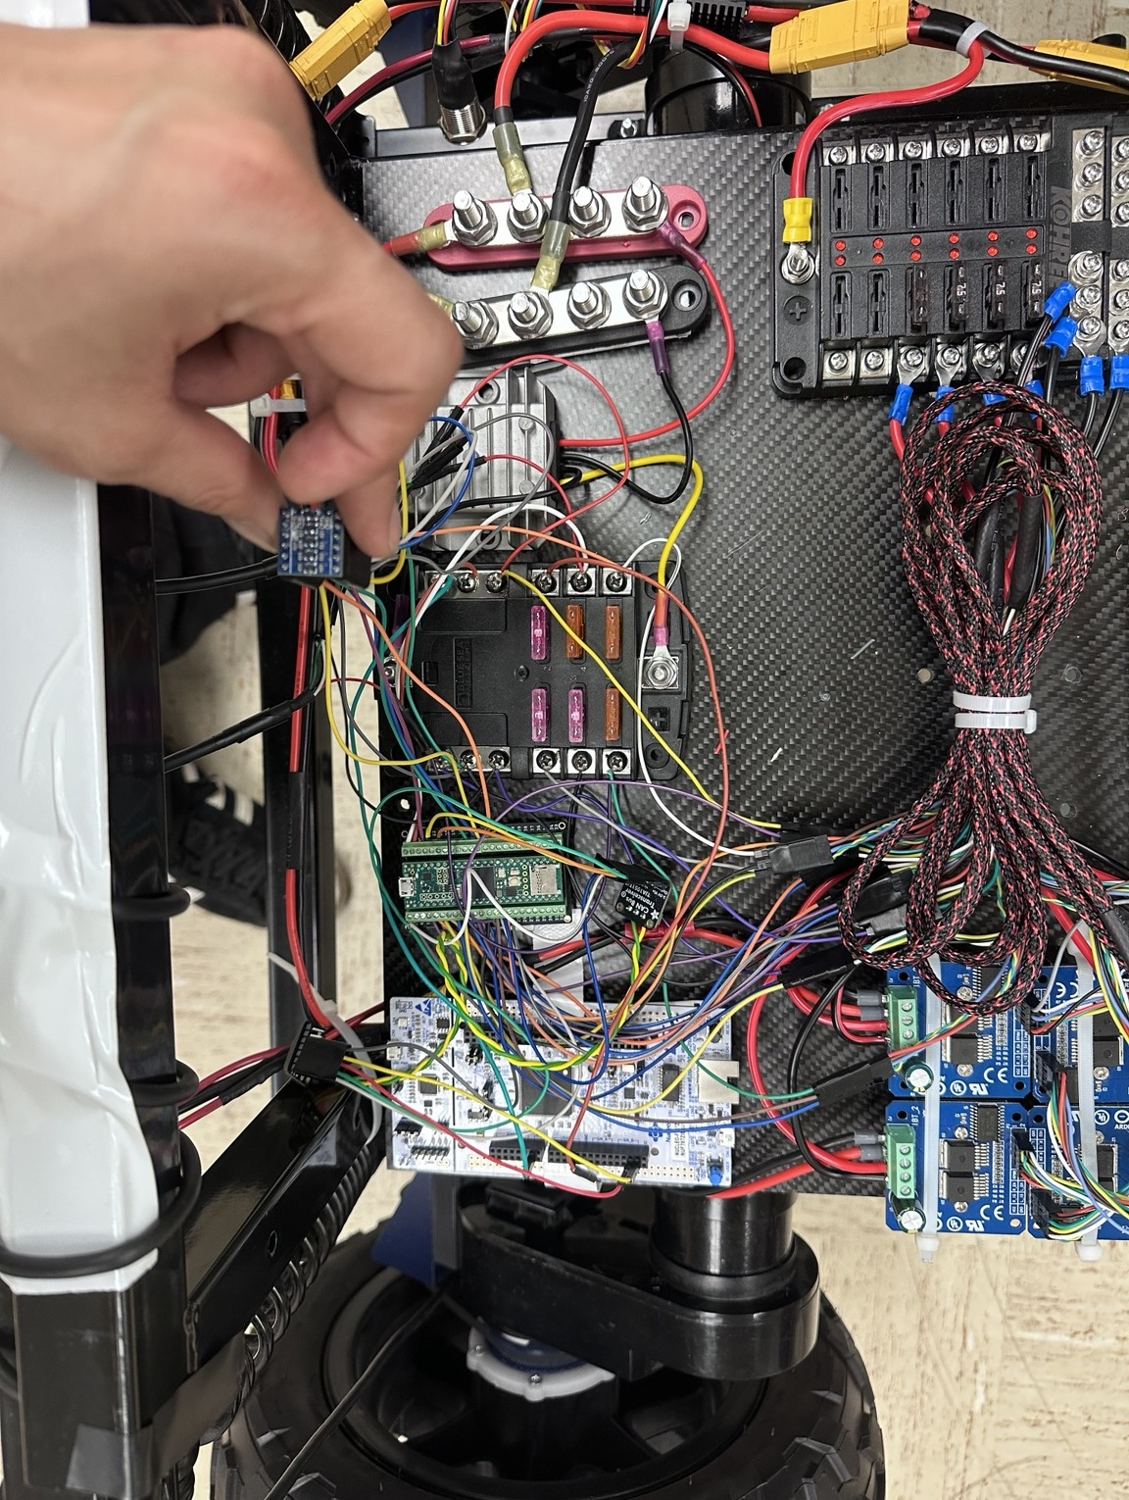
Electrical safety improvements: fused converter inputs and modular distribution
Safety and serviceability improved alongside the new power architecture.
High-side DC-DC protection
Independent fused outputs
Fuses were added before the 12 V and 5 V converter inputs, limiting fault current before a converter or wiring failure can propagate.
Dedicated fuse boxes make it easier to isolate loads, diagnose faults, and safely expand the platform with additional sensors or compute.
System-level benefit
Final demo value
Power faults become easier to localize: high voltage, 12 V loads, and 5 V logic can be checked independently during bring-up.
A cleaner power system supports reliable wireless operation, data logging, and future closed-loop control without relying on temporary wiring.
Engineering focus: reliability before autonomy. The power system was upgraded to support additional compute and instrumentation without destabilizing the low-level drive-by-wire stack.
AVL Summer Cohort 2026
8

Slide 9
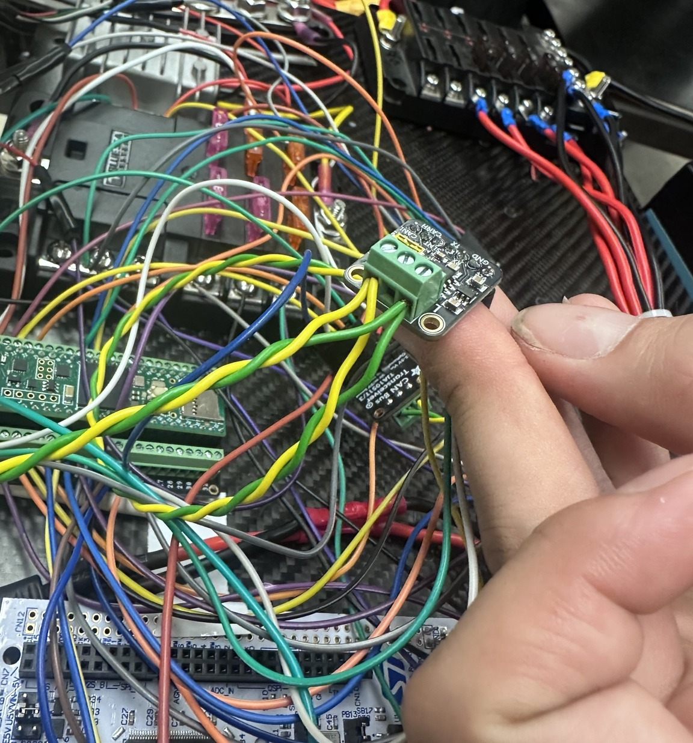
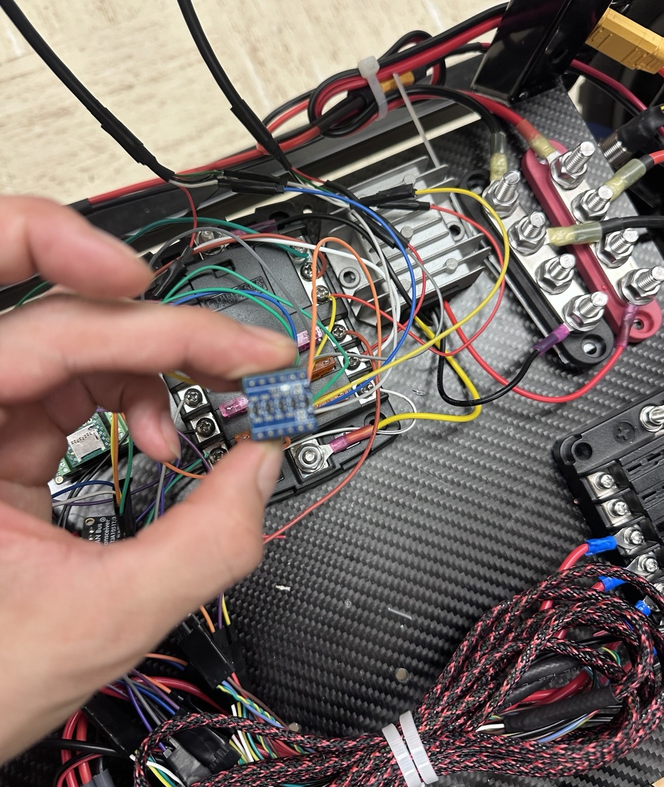
Wiring and harness improvements: from prototype wiring to serviceable integration
Harnesses were remade, routed, and organized to improve reliability and maintainability.
Harness work completed
• New harnesses fabricated and routed
• Wiring paths cleaned up for the controller area
• Signal groups separated for easier debug
• CAN, UART, power, and motor paths are more traceable
• Higher confidence for final demo serviceability
Why this matters
Most integration failures are not component failures; they are wiring, power, connector, or routing issues. Improving harness quality directly improves the reliability of CAN, UART, sensor, and motor interfaces.
AVL Summer Cohort 2026
9

Slide 10
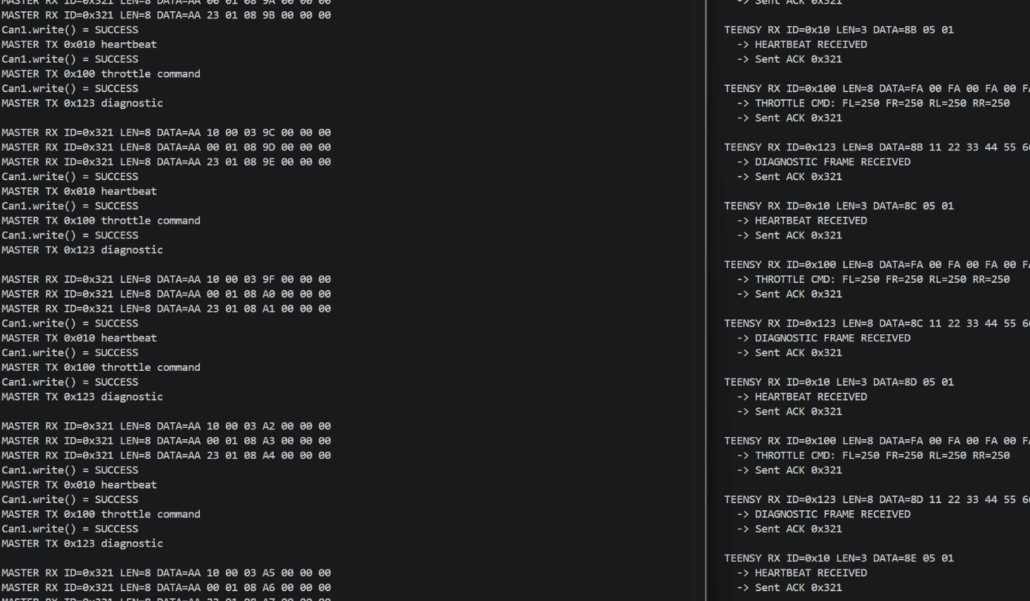
Drive-by-wire validation: CAN and throttle path are now verified
Firmware is not the main focus today, but it validates the hardware communication path.
Validation result
Bidirectional CAN communication was verified between the STM32 master and throttle Teensy. The master transmits heartbeat/throttle/diagnostic frames and receives acknowledgments back from the Teensy.
Hardware interpretation
CAN transceivers, bus termination, TX/RX wiring, and microcontroller CAN peripherals were validated through a focused diagnostic test and oscilloscope inspection.
Production relevance
The validated CAN layer supports the current hardware architecture: Jetson → UART → STM32 → CAN → distributed Teensy nodes.
AVL Summer Cohort 2026
10

Slide 11
Current hardware validation matrix
Tracking progress by subsystem keeps the final two-week push focused and measurable.
Subsystem
Evidence / current status
Status
Priority
Power architecture
24 V bus now feeds separate 12 V and 5 V converter/fuse-box domains
Updated
High
Wireless Jetson
Hotspot/SSH remote access and data logging environment working
Validated
High
UART bridge
Jetson-to-STM32 communication path established
Validated
High
CAN network
STM32 ↔ Teensy bidirectional communication verified
Validated
High
Motor drivers
Four BTS7960 channels and motor motion confirmed
Validated
High
Wiring harnesses
Harnesses remade, routed, and cleaned up for serviceability
Updated
High
IMU
MPU9250 identified; implementation pending
Planned
Med
Current sensing
Five INA238 sensors planned; waiting to order
Planned
Med
Steering
Differential/steering status unchanged; still included in final path
In progress
Med
Key message: the project has shifted from “does each board work?” to “how do we support reliable integrated operation for the final demo?”
AVL Summer Cohort 2026
11

Slide 12
Upcoming sensor expansion: current monitoring and IMU feedback
These are planned next integrations that build on the new power and compute architecture.
INA238 #1
Front Left motor
Planned INA238 value
The five-sensor network will monitor each brushed motor individually and add one central low-voltage logic rail monitor for brownout detection, current draw trends, and system health logging.
INA238 #2
Front Right motor
INA238 #3
Rear Left motor
STM32 / Jetson logging
fault detection + power trends
Planned MPU9250 value
The IMU will provide acceleration and orientation feedback to support motion validation, algorithm testing, and future sensor-fusion work.
INA238 #4
Rear Right motor
INA238 #5
5 V logic rail
Why it fits now
The new 12 V/5 V architecture and Jetson logging layer make power and motion telemetry useful instead of isolated bench data.
AVL Summer Cohort 2026
12

Slide 13
Final two-week integration plan
The remaining work is organized around final demo readiness, not open-ended development.
1
Lock hardware baseline
Document 12 V/5 V rails, fuses, harness routing, and known-good CAN wiring.
2
Validate wireless flow
Run command path through laptop → hotspot → Jetson → UART → STM32 → CAN.
3
Final subsystem checks
Confirm throttle, differential drive, encoder logging, and safe stop behavior.
4
Add planned sensors if available
Integrate INA238 network and MPU9250 only if parts/time allow without risking final demo stability.
5
Rehearse final demo
Run a repeatable, low-risk demo sequence with clear pass/fail criteria.
Final demo principle
Do not destabilize the proven drive-by-wire platform for optional features. Sensor expansion should be staged only after the wireless and power architecture are consistently repeatable.
AVL Summer Cohort 2026
13

Slide 14
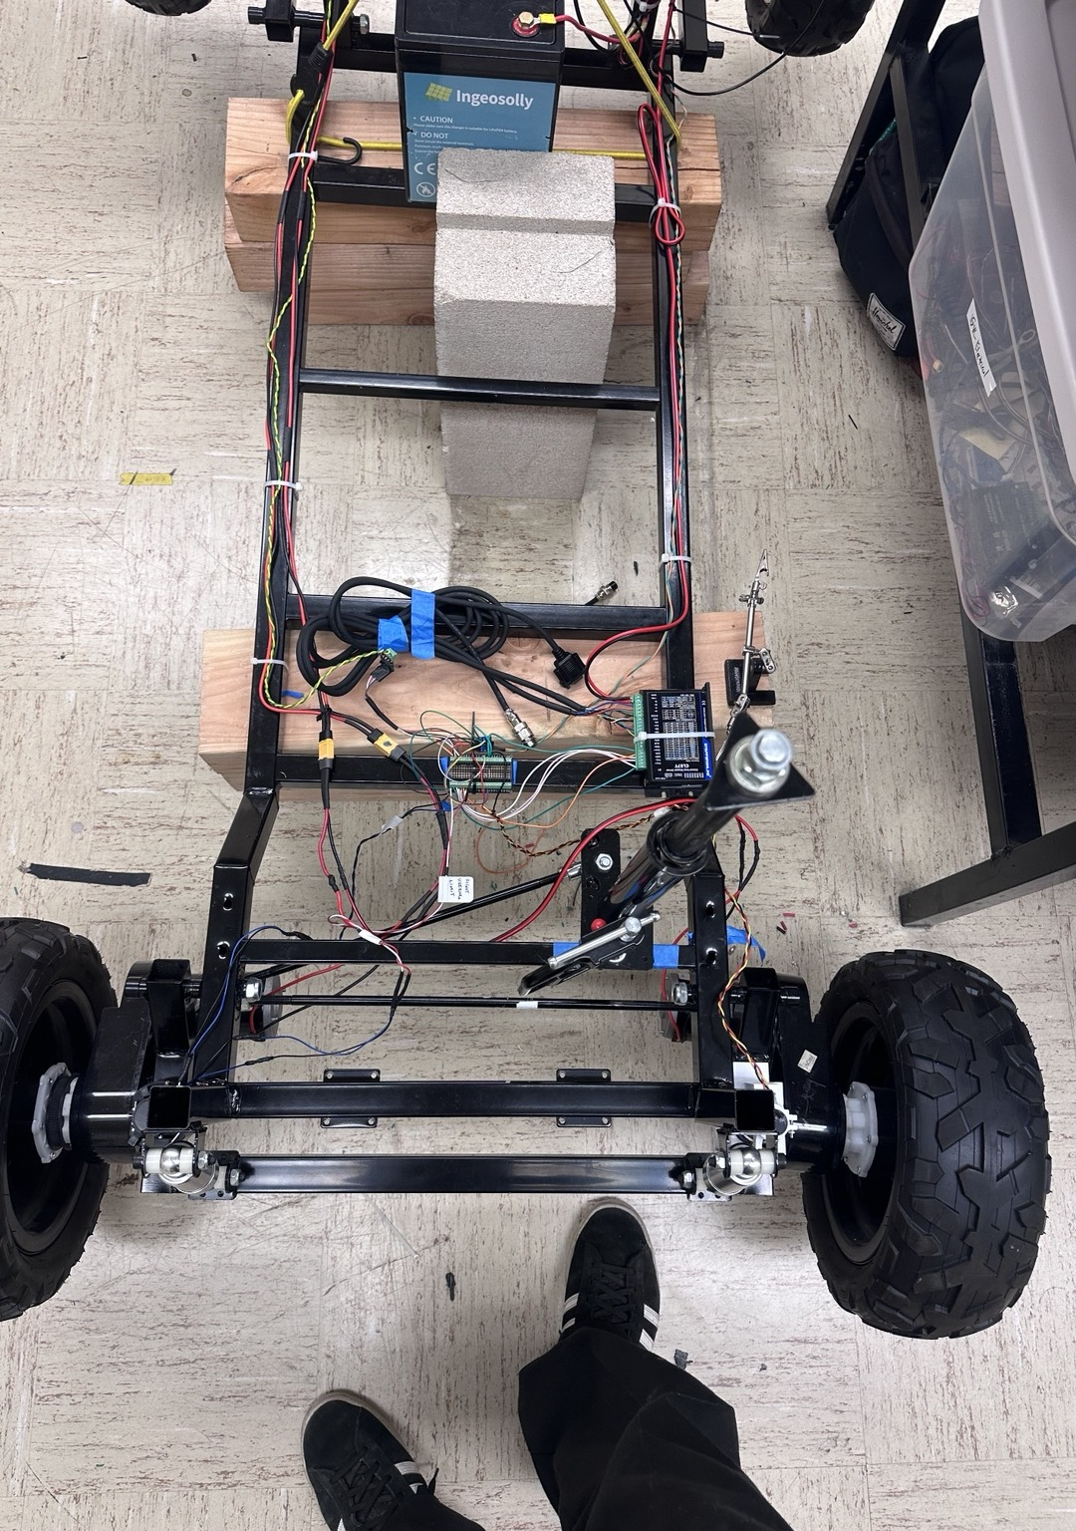
Review ask: confirm final integration priorities
Today’s meeting should align the team on what must be completed before the final presentation.
Power architecture
Final demo scope
Sensor priorities
Does the dual 12 V / 5 V rail strategy cover the expected final loads, and are the DC-DC input fuses placed appropriately for safety and serviceability?
What is the minimum successful final demonstration: wireless operation, DBW control, data logging, sensor integration, or all of the above?
If INA238 parts arrive late, should the team prioritize the logic rail monitor first or motor-by-motor current sensing?
Questions
Next review should be the final demonstration of an integrated, wireless, autonomous-ready drive-by-wire platform.
AVL Summer Cohort 2026
14

