Slide 1
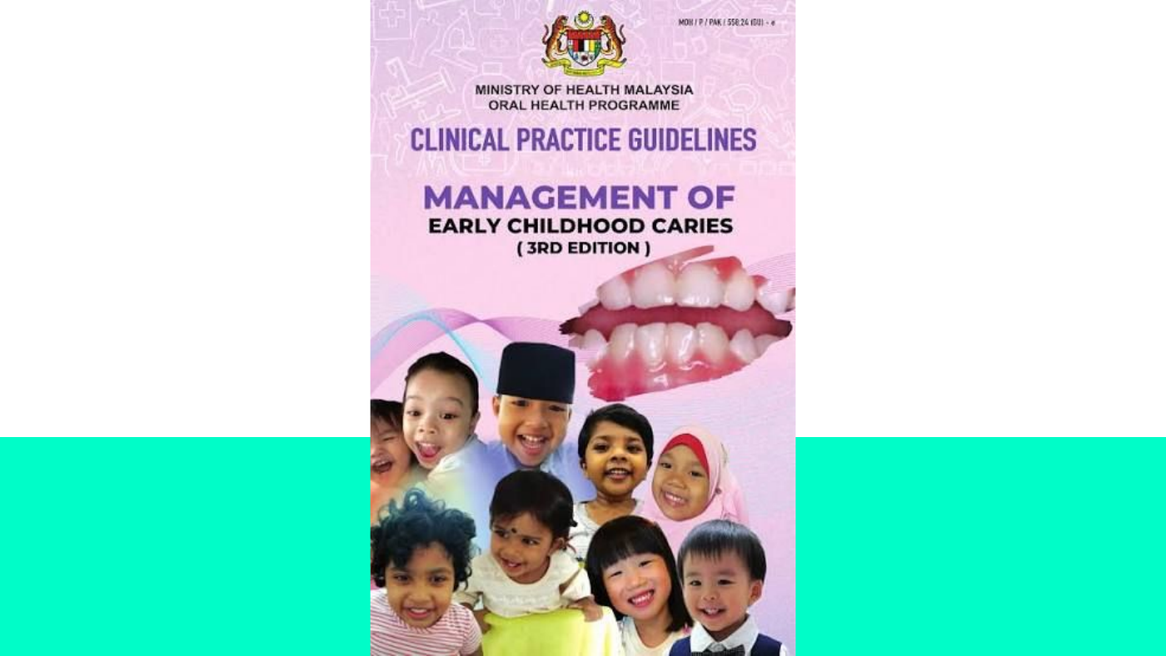
CLINICAL PRACTICE GUIDELINE
CPG Management of Early Childhood Caries
Dr Nur Diyana Ramli | Klinik Pergigian Dato Keramat
Source-faithful main deck + enhanced options appendix
Prepared as a conservative, government-facing briefing. Clinical claims are retained close to the original CPG slide source; optional professionalised variants are separated at the end.
Klinik Pergigian Dato Keramat | CPG ECC
01

Slide 2
OUTLINE OF PRESENTATION
Contents
Original structure retained.
01
02
03
Introduction; what is ECC?
What is the risk factor?
How to check?
04
05
06
How to prevent ECC?
What is the treatment
Take home message
Klinik Pergigian Dato Keramat | CPG ECC
02

Slide 3
01
Introduction
What is Early Childhood Caries?
Source pages: definition, epidemiology in Malaysia, severe-ECC criteria and clinical presentation.
Klinik Pergigian Dato Keramat | CPG ECC
03

Slide 4
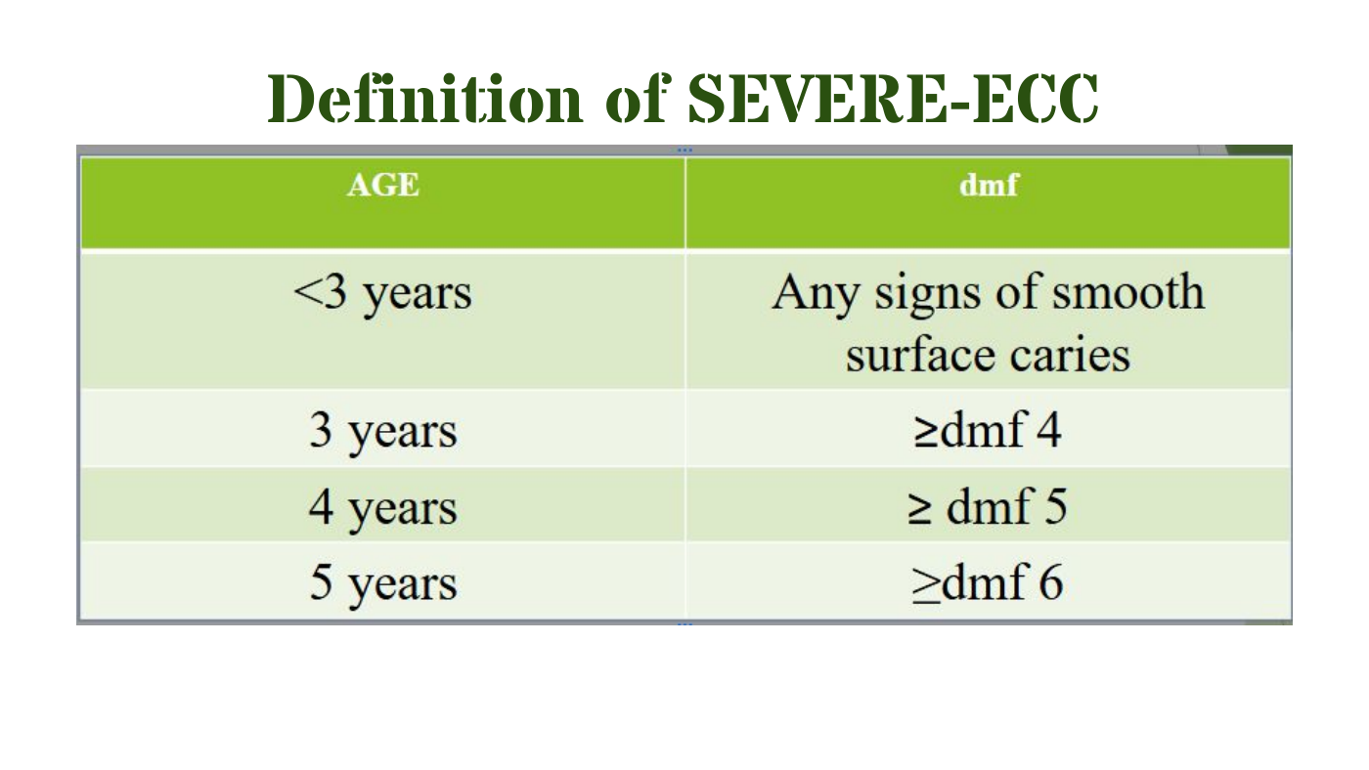
DEFINITION + EPIDEMIOLOGY
Definition of ECC
The presence of a primary tooth with one or more carious (non-cavitated or cavitated lesions), missing (due to caries), or filled surfaces in a child under the age of six years (72 months).
Source wording retained with compact layout.
Epidemiology in Malaysia
NOHPS reported a small decreasing trend in caries prevalence among preschool children: 76.2% in 2005 and 71.2% in 2015. There was also a slow decreasing trend in caries severity: dft 5.8 in 1995 and 4.8 in 2015.
SEVERE-ECC criteria shown from source
Klinik Pergigian Dato Keramat | CPG ECC
04

Slide 5
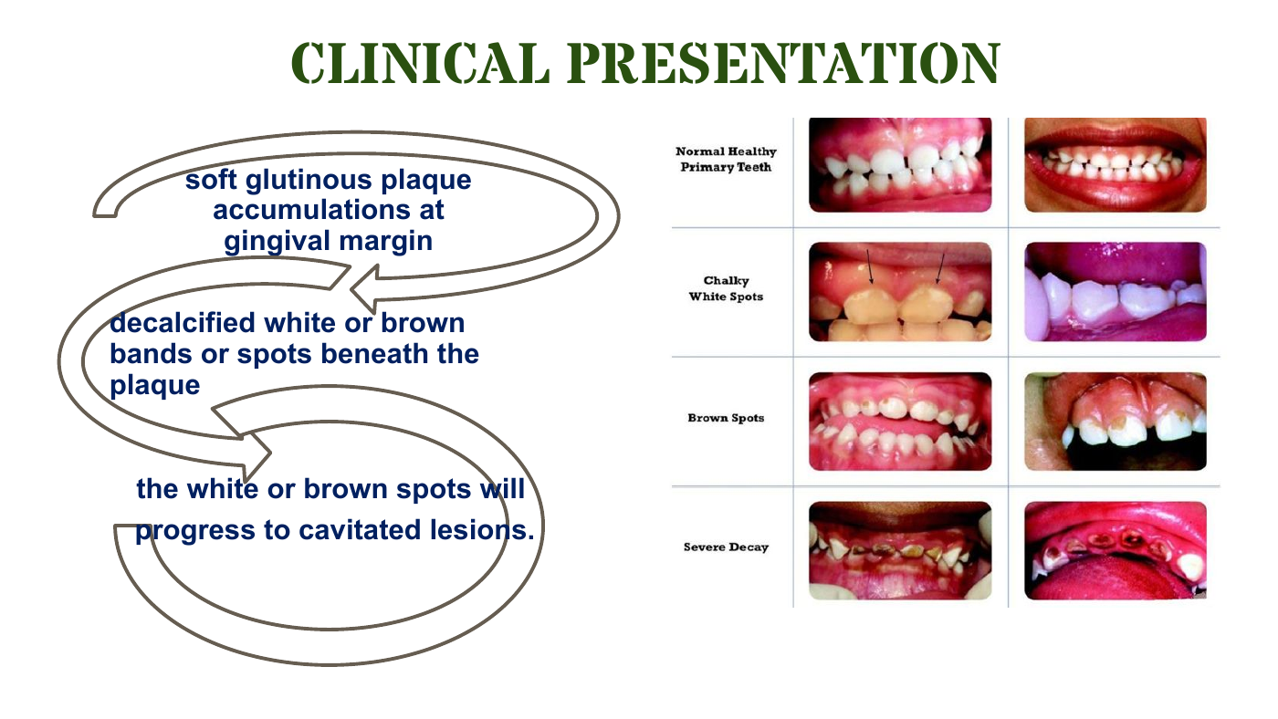
CLINICAL PRESENTATION
Clinical Presentation of ECC
Soft glutinous plaque accumulations at gingival margin.
Decalcified white or brown bands or spots beneath the plaque.
The white or brown spots will progress to cavitated lesions.
No added staging beyond source.
Enhanced staging language is moved to the appendix for presenter choice.
Klinik Pergigian Dato Keramat | CPG ECC
05

Slide 6
02
Risk & Protective Factors
What is the risk factor?
Main deck keeps the original categories. Professional explanation is placed after the main deck as an optional variant.
Klinik Pergigian Dato Keramat | CPG ECC
06

Slide 7
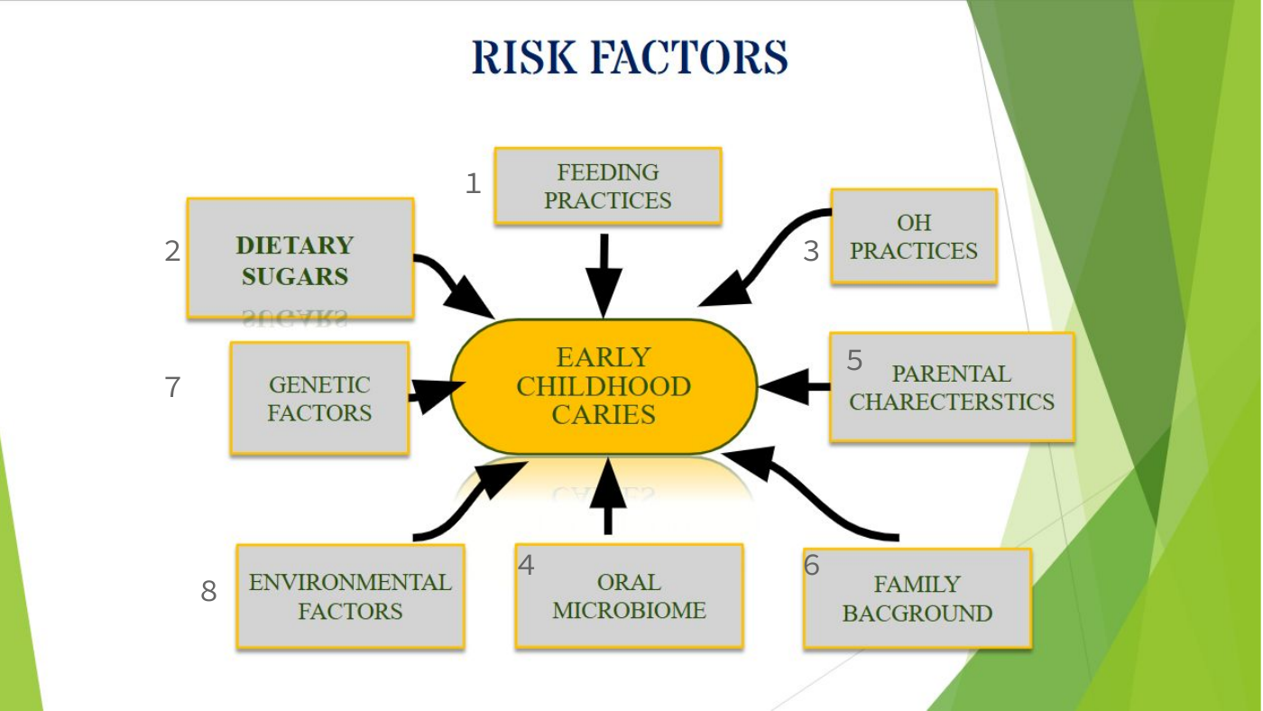
RISK FACTORS
Eight risk factor areas
Feeding practices
Dietary sugars
Oral microbiome
Poor OH practices
Source headings retained.
Prolonged exposure
Socioeconomic status
Low salivary flow
Lack of protective factors
Caries develops where susceptible tooth/host, cariogenic microorganisms and fermentable carbohydrates interact over sufficient time.
Klinik Pergigian Dato Keramat | CPG ECC
07

Slide 8
PROTECTIVE FACTORS
Protective factors against ECC
Dietary protective factors
Saliva - innate defence
Milk and cheese mitigate metabolic acids and lower plaque acidity. High fruit and vegetable intake is associated with reduced ECC risk. Whole fruit consumption OR 0.47; milk consumption OR 0.50; daily water and dairy products protective.
Physical properties: pH and buffering capacity. Chemical properties: inorganic ions, proteins and peptides. Antibacterial properties: remove microorganisms and sugar aggregation.
Dietary protection and saliva retained.
Clinical use: explain risk reduction and protective habits together, without overstating beyond the CPG evidence levels.
Klinik Pergigian Dato Keramat | CPG ECC
08

Slide 9
03
Examination & Diagnosis
How to check?
History taking, visual examination, radiographic examination and ICDAS remain the core sequence.
Klinik Pergigian Dato Keramat | CPG ECC
09

Slide 10
EXAMINATION AND DIAGNOSIS
Detection and diagnosis methods
History taking
Visual examination
Radiographic examination
ICDAS
Essential before examination. Guides risk, symptoms, feeding and oral hygiene context.
Standard method used for caries diagnosis. Conducted under light source on clean and dry teeth.
Commonly used as an adjunct. Bitewing radiography provides additional diagnostic yield for proximal dentinal caries.
International Caries Detection and Assessment System. Visual inspection with standardised scoring to aid diagnosis.
Condensed from source slides.
For patients without evidence of disease and with open proximal contacts, radiographic examination may not be required at the initial visit.
Klinik Pergigian Dato Keramat | CPG ECC
10

Slide 11
04
Prevention of ECC
Evidence-based strategies to prevent Early Childhood Caries
Diet advice, plaque control, fluoride toothpaste, oral health education, motivational interviewing, anticipatory guidance, CRA and professional interventions.
Klinik Pergigian Dato Keramat | CPG ECC
11

Slide 12
DIET ADVICE + PLAQUE CONTROL
Prevention starts at home
6-12 months
12-24 months
2-6 years
Oral hygiene counselling; assess feeding practices; dietary counselling.
Repeat six-month procedures; assess no-spill training cups; individual risk status.
Assess diet and BMI; counselling or referral as indicated.
Age-group counselling and supervised toothbrushing.
Parent-supervised toothbrushing twice daily.
<3 years: smear / rice-sized amount.
3-6 years: pea-sized amount.
Supervise until at least 7 years.
Spit out - do not rinse.
Recommendation 7: mechanical plaque control with electric or manual toothbrushes should be used. Chemical agents may be considered as an adjunct.
Klinik Pergigian Dato Keramat | CPG ECC
12

Slide 13
OHE | MI | AG
Behavioural interventions
Oral Health Education (OHE)
Motivational Interviewing (MI)
Anticipatory Guidance (AG)
Providing personally relevant information about oral health based on scientific principles and evidence; motivating, teaching and training individuals and small groups.
Collaborative, person-centred communication style aimed at improving health behaviours by invoking intrinsic motivation.
Proactive developmental counselling addressing physical, emotional, psychological and developmental changes; complements risk assessment with protective factors.
Original intervention types retained.
Recommendations 9-13 should remain close to source wording when presented as clinical guidance.
Klinik Pergigian Dato Keramat | CPG ECC
13

Slide 14
CRA + PROFESSIONAL PREVENTION
Risk assessment and preventive materials
Recommendation 14 - CRA
Recommendation 15 - Topical fluoride
Fissure sealant
CRA should be done for all children aged six years old and below.
Difluorosilane 0.9%: 3-monthly. NaF varnish 5%: 6-monthly. For children under six for prevention of ECC.
Consider for primary molars in ECC patients based on caries risk level, plaque control status, ability to isolate tooth and cooperation.
CRA sets recall and intervention.
CPP-ACP: daily 10% w/v CPP-ACP paste combined with regular toothbrushing using fluoride toothpaste did not show significant additional benefits in preventing caries on high-risk pre-school children with primary dentition over one year.
Klinik Pergigian Dato Keramat | CPG ECC
14

Slide 15
OTHER PREVENTIVE MATERIALS
Non-fluoride agents and water fluoridation
Non-fluoride agents
Water fluoridation
Xylitol wipes, arginine mint confection and 0.3% triclosan varnish have limited or specific evidence. AAPD supports xylitol only as a non-cariogenic sugar substitute, not as a remineralising agent.
A public health initiative designed to decrease tooth decay. Cochrane SR: reduced caries prevalence by 35%, dmft reduction 1.81, increased caries-free children by 15%.
Evidence hierarchy kept conservative.
Editorial tier labels are moved to the enhanced appendix unless the presenter chooses that structure.
Klinik Pergigian Dato Keramat | CPG ECC
15

Slide 16
05
Treatment
Managing ECC - from non-invasive to invasive approaches
Treatment slide keeps the original split: non-invasive methods and invasive methods.
Klinik Pergigian Dato Keramat | CPG ECC
16

Slide 17
TREATMENT METHODS
Non-invasive and invasive methods
Non-invasive methods
Invasive methods
For non-cavitated lesions: non-F remineralising agent, remineralising fluoride, fissure sealant, resin infiltration and sealing with composite resin where treatment cannot be done immediately.
For cavitated lesions requiring intervention: dental caries removal techniques, pulp therapy and restoration choices depending on clinical status.
Use as source-faithful treatment summary.
SWE - Stepwise Excavation
SCR - Selective Caries Removal
NSCR - Non-Selective Caries Removal
Klinik Pergigian Dato Keramat | CPG ECC
17

Slide 18
06
Take Home Message
Provide OHE and anticipatory guidance on feeding practices.
Advise supervised toothbrushing with fluoridated toothpaste.
Explain caries risk factors, protective factors and early signs.
Schedule regular dental visits / fluoride varnish application.
CRA for all toddlers under six years old; give LP1 appointment card based on risk.
Recall protocol
Duty of KKIA / IM officer
High risk: 3-monthly FV. Moderate: 6-monthly FV/review. Low: 6-12 monthly review/as indicated.
Prevention is always better than treatment.
Klinik Pergigian Dato Keramat | CPG ECC
18

Slide 19
TERIMA KASIH
Thank You
Dr Nur Diyana Ramli | Klinik Pergigian Dato Keramat | Kementerian Kesihatan Malaysia
Main source-faithful deck ends here. Enhanced options follow for presenter review.
Klinik Pergigian Dato Keramat | CPG ECC
19

Slide 20
PRESENTER REVIEW
Enhanced Options Appendix
Main slides preserve source wording and evidence posture.
Enhanced slides improve flow, attention span and clinic ownership.
Clinical claims should be accepted only if the presenter is comfortable with the wording.
This section is intentionally separated so choices are explicit.
Optional polished variants. Swap only if preferred.
Klinik Pergigian Dato Keramat | CPG ECC
20

Slide 21
ENHANCED OPTION A
Clinical presentation as a parent-friendly sequence
1. Plaque at gingival margin
2. White / brown spots
3. Cavitated lesions
Use the source phrase: soft glutinous plaque accumulations at gingival margin.
Decalcified white or brown bands or spots beneath the plaque.
The white or brown spots will progress to cavitated lesions.
Alternative for main Slide 5.
Professional enhancement: sequence makes the message easier to explain without adding new disease staging.
Klinik Pergigian Dato Keramat | CPG ECC
21

Slide 22
ENHANCED OPTION B
Risk conversation map
Keep the eight source risk headings.
Use the diagram as the visual anchor.
Explain that ECC is multifactorial, not only bottle-feeding.
Avoid adding unsupported risk hierarchy unless sourced.
Alternative for main Slide 7.
Grounded visual: source PDF risk-factor diagram
Klinik Pergigian Dato Keramat | CPG ECC
22

Slide 23
ENHANCED OPTION C
Clinic operating rhythm
1
2
3
4
5
Alternative for prevention / take-home slides.
>
>
>
>
OHE / AG
CRA
LP1 card
FV recall
Review
This is a professional operating summary, not a replacement for the evidence slides. It suits Klinik Pergigian Dato Keramat because it frames action for clinic workflow.
Klinik Pergigian Dato Keramat | CPG ECC
23

Slide 24
ENHANCED OPTION D
Visual grounding rule
Use MOH/CPG source visuals where possible.
If using people imagery: Malaysian caregiver, child and dental officer; Southeast Asian skin tones; no Western stock-photo aesthetic.
Keep modest, conservative, public-clinic context.
Avoid logos unless officially approved.
Malaysian public clinic, not generic stock.
Use source cover/figures before generic photos
Generated candidate available for review: https://slidesgpt.com/media/gen-ViDXmqf.png
Klinik Pergigian Dato Keramat | CPG ECC
24

