Slide 1



DR NUR DIYANA RAMLI
CPG BRIEFING
Pegawai Pergigian | CPG Brief
KLINIK PERGIGIAN DATO KERAMAT
LOW ATTENTION
68 -> 12
EARLY
CHILDHOOD
CARIES
Ringkasan CPG untuk tindakan klinik
ECC boleh dicegah lebih awal.
Friendly, structured and
AUDIENCE
REGISTER
FOCUS
SETTING
evidence-led.
KKIA / IM / Dental Team
Tataterbit kerajaan
Risk, prevention, action
Public dental clinic

Slide 2








ROADMAP
Satu Aliran
Risiko kepada tindakan susulan.
Isi CPG diringkaskan supaya mudah diingat dan digunakan.
01
02
重点
03
04
Kenapa ECC
Definisi
Risiko
Semakan
02
BURDEN
CASE LENS
PATTERN
ASSESSMENT
05
06
07
08
Pencegahan
Pendidikan
Rawatan
Tindakan
PREVENTION
OHE
CARE OPTIONS
CLINIC FLOW
READ LESS, ACT CLEARER

Slide 3


EPIDEMIOLOGY | MALAYSIA
Beban Masih Tinggi
Trend turun, kadar masih besar.
Trend turun, kadar masih besar.
71.2
%
NOHPS 2015
2005
2015
Age
76.2
4.8
<6
% prevalence
dft severity
years
Prevalens turun dari 76.2% pada 2005.
Prevention remains key.

Slide 4







DEFINITION + CLINICAL LENS
ECC
·
Lebih Dari Lubang
Karies, hilang, tampalan gigi susu.
Bawah 72 bulan; tanda awal boleh bermula sebagai white spot.
CLINICAL READING
<6
24
%
32
%
20
%
24
%
years
Non-cavitated
Cavitated
Missing
Filled
ECC age group
Non-cavitated
Cavitated
Missing
Filled
<3
WHITE SPOT
LESION
DUE CARIES
SURFACE
24
%
32
%
20
%
24
%
years
any smooth caries
Perubahan enamel
Memerlukan
Sejarah penyakit
awal.
rawatan.
aktif.
Masuk kiraan dmf.
Tangkap sebelum cavitation.

Slide 5

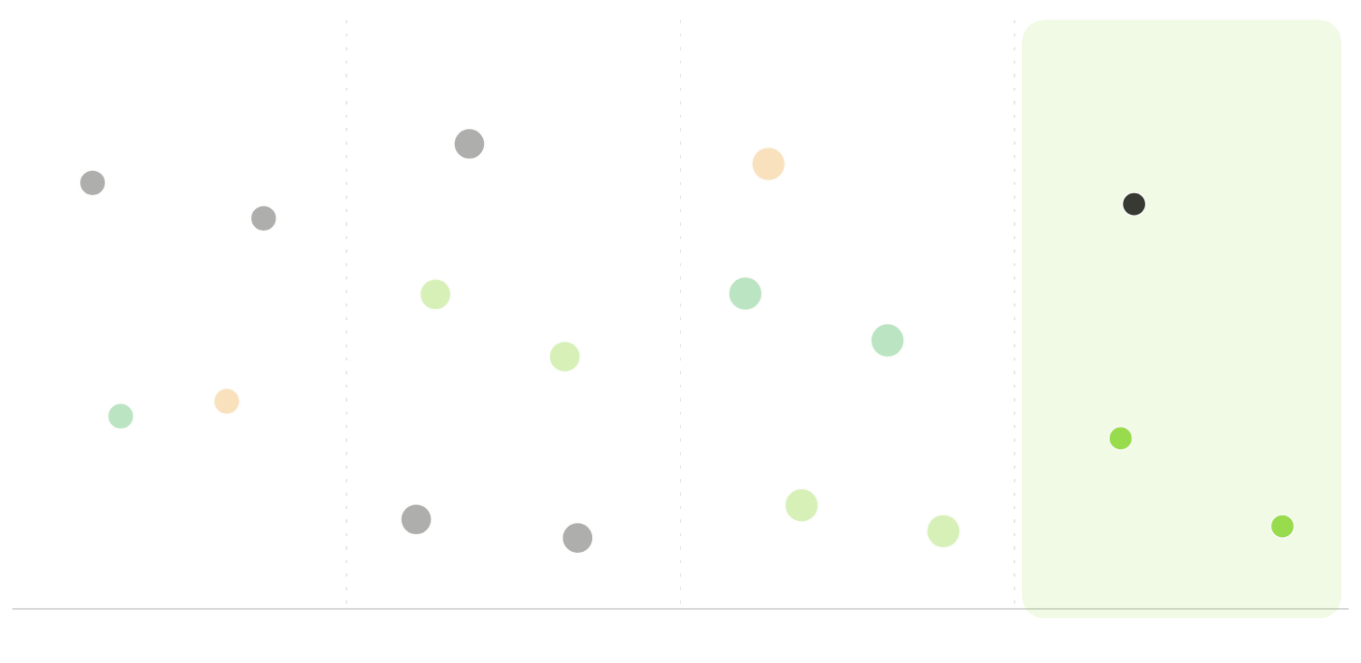




RISK PATTERN
Risiko Berkait
Feeding, gula, plak, perlindungan.
ECC multifaktorial; bukan isu
botol susu sahaja.
8
risk areas
Use for chairside prompt.
RELATIVE EMPHASIS
Feeding
Sugar
Plaque
Fluoride
Feeding
Dietary sugar
Plaque control
Protection
Risk talk must be practical.
Feeding
Dietary sugar
Plaque control
Protection
4
5
5
3
笔
笔
笔
笔
20
亿美元
20
亿美元
20
亿美元
20
亿美元

Slide 6

HOW TO CHECK
Semak
Ikut Laluan
ASSESS
CRA
CHAIRSIDE
Mulakan dengan sejarah, visual exam dan radiograf.
Risk sets recall
CRA untuk semua kanak-kanak bawah 6.
STEP
PRIORITY
USE CASE
History
5
/100
Feeding, sugar, symptoms.
Visual exam
5
/100
Clean, dry, light source.
Radiograph
3
/100
Adjunct when indicated.
ICDAS
3
/100
Structured scoring aid.
CRA
5
/100
Set interval and FV need.
CLINICAL FLOW
1
History
2
Visual
3
Diagnose
4
Risk
5
Recall
Record, classify, appoint.

Slide 7

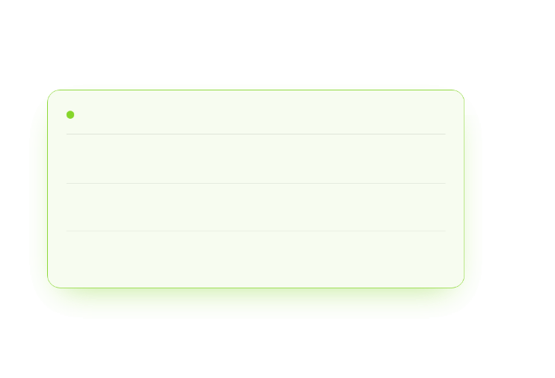

PREVENTION PACKAGE
Mula Penjaga
Diet, plak dan lawatan berkala.
Sesi penerangan ikut umur, risiko dan keluarga.
看好方向
谨慎方向
CAREGIVER TALK
CLINIC ACTION
01
6-12 bulan
01
OHE
Feeding and oral hygiene talk.
Mothers, new mothers, carers.
02
12-24 bulan
02
Plaque control
Repeat counselling by risk and need.
Mechanical cleaning first.
03
2-6 tahun
03
FV recall
Diet, BMI concern and referral.
Risk category sets appointment.
AGE-SPECIFIC EMPHASIS
Start
Daily
Recall
Counsel
Brush
Review
Feeding and sugar exposure.
Supervised with fluoride toothpaste.
CRA, FV and reinforcement.
Repeat small routines.

Slide 8








BRUSHING + FLUORIDE
Fluoride
Is Core
HOME CARE
Start brushing when primary teeth erupt; supervise and spit only.
Use 1000-1500 ppm fluoride.
DAILY BRUSHING SCRIPT
01
02
03
04
Erupt
Twice daily
Supervise
Spit only
Begin on first primary
Include last thing at
Adult support until at
Do not rinse after
tooth.
night.
least seven.
brushing.
DOSE BY AGE
smear
<3 years
pea
3-6 years
Small amount.
size
Pea-sized amount.
rice-size
A simple parent message.

Slide 9








OHE | MI | AG
Pendidikan
Perlu Berulang
BEHAVIOUR
OHE, MI and AG support long-term behaviour change.
CONVERSATION MODEL
TRAINED STAFF
01
02
03
04
05
Ask
Affirm
Advise
Agree
Recall
Feeding, brushing, barriers.
Start from what works.
One or two clear changes.
Set realistic home action.
Reinforce and adjust.
CAREGIVERS
HIGH RISK
AFTERBIRTH
SPECIAL NEEDS
OHE
MI
AG
Social stories
Expectant mothers, new mothers.
For parents, by trained staff.
Early proactive guidance.
Adjunct for selected young children.
REGISTER ANCHORS
sesi penerangan
penjaga
risiko tinggi
susulan
mesra klinik
Tailor advice.

Slide 10


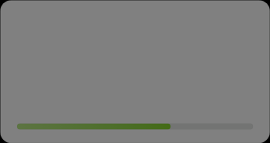
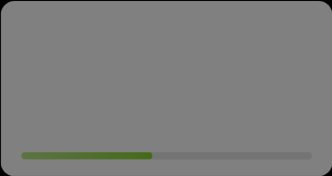
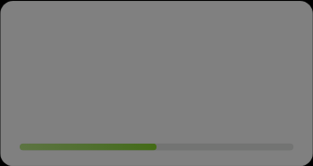
PREVENTIVE MATERIALS
Bukan Semua
Sama Kuat
PROFESSIONAL CARE
INTERVENTION NOTES
Prioritise fluoride and plaque control
01
before adjunct materials.
FLUORIDE VARNISH
02
PRIMARY MOLAR
FV
Sealant
DECISION CRITERIA
0.9% 3-monthly or 5% 6-monthly.
Consider risk and isolation.
01
Caries risk
确定性
90
%
确定性
65
%
High risk needs tighter recall.
02
Plaque control
Home routine must be realistic.
03
TOPICAL CREAM
04
SUBSTITUTE
Isolation
CPP-ACP
Xylitol
03
Consider before fissure sealant.
No clear added benefit shown.
As non-cariogenic sugar substitute.
04
Cooperation
45
%
50
%
Plan safe, staged treatment.
确定性
确定性
Use adjuncts carefully.

Slide 11

OFFICER WORKFLOW
Triage
Then Recall
KKIA / IM COORDINATION
Every child under six gets CRA, appointment card and risk-based follow-up.
CLINIC OPERATING RHYTHM
01
02
03
04
OHE + AG
CRA
LP1 card
FV recall
frontline
clinical
admin
follow-up
Feeding, brushing,
Classify every child under six.
Give card and explain interval.
Apply varnish by risk schedule.
caries awareness.
OHE + AG
CRA
LP1 CARD
FV RECALL
RECALL INTERVAL
High risk
Moderate
Low risk
Officer role
3-monthly FV appointment.
6-monthly review / FV.
6-12 monthly review.
Coordinate message and recall.
Risk, interval, action.

Slide 12


TAKE HOME
06
Ringkas
ECC prevention is a team habit.
Speak clearly, classify risk and repeat prevention.
OHE
AG
CRA
FV
Recall
Orderly, friendly.

