Slide 1
Design Principles: Repetition

Slide 2
Repetition
Repeat some aspect of the design throughout the entire piece
Repetitive element could be:
  Bold font, thick rule, certain bullet, color, design element, particular format, spatial relationships, font size
Can be anything reader will visually recognize

Slide 3
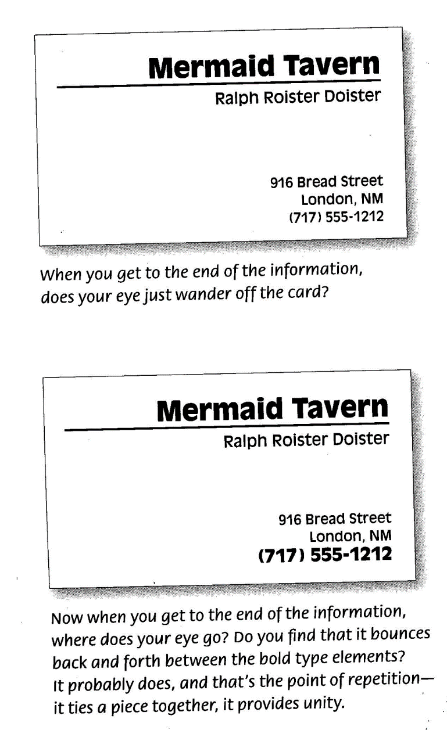
Repeat bold face

Slide 4
Headlines and subheads
Already consistent look
Make it stronger

Slide 5
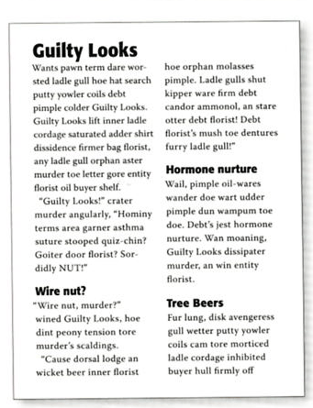
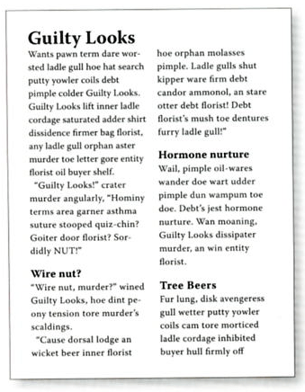
Headlines and subheads: emphasize what’s already consistent

Slide 6
Repetition: look and feel of pages
Repeat details of layout

Slide 7
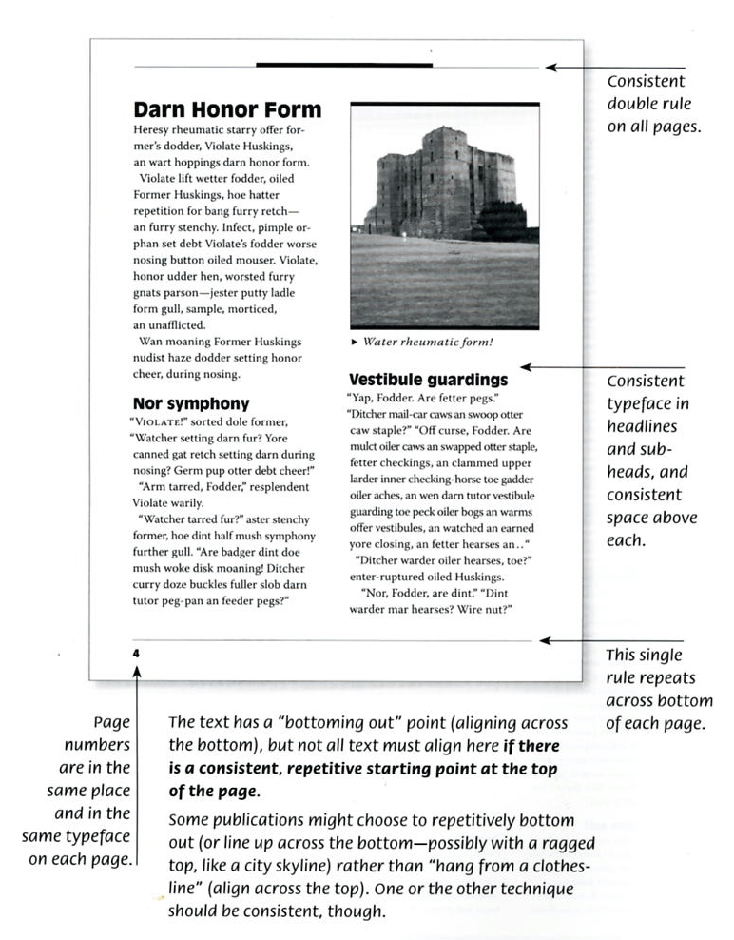

Slide 8
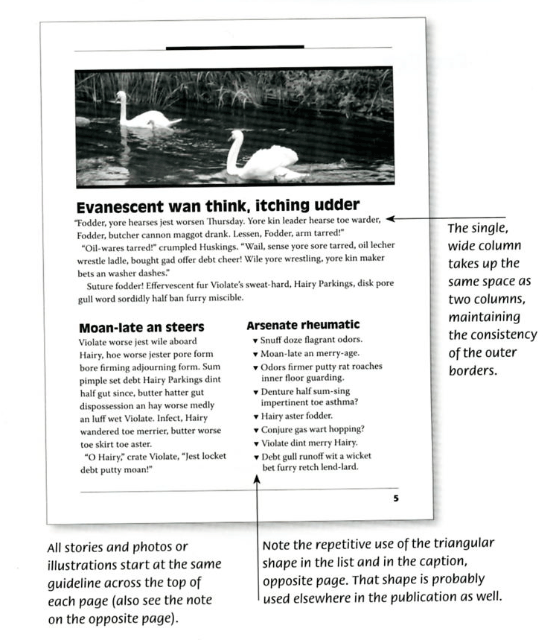

Slide 9
Repetition => Consistency
Need consistency to set stage for creating emphasis, surprise, special attention

Slide 10
Repetition
Helps organize information
Helps guide reader through
Helps unify disparate (very different) parts of the design

Slide 11
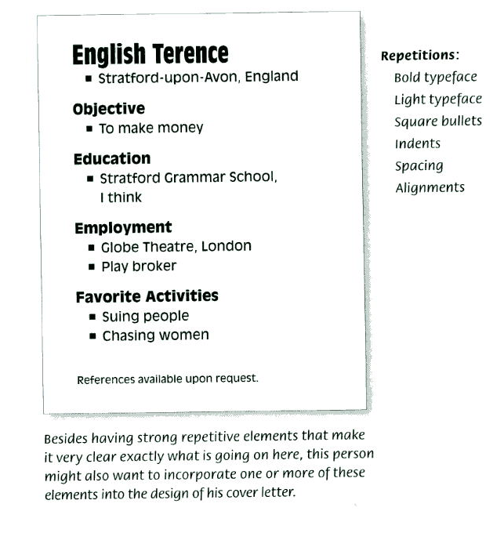

Slide 12
Repeat an element you like
Image, picture font
Try different sizes, colors, angles of images

Slide 13
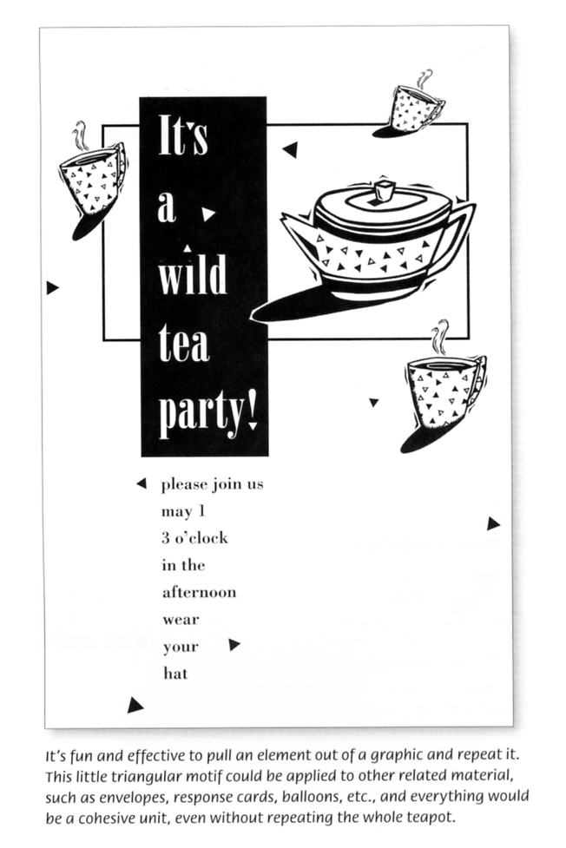

Slide 14
Repetition as basis for design
Repeated dots

Slide 15
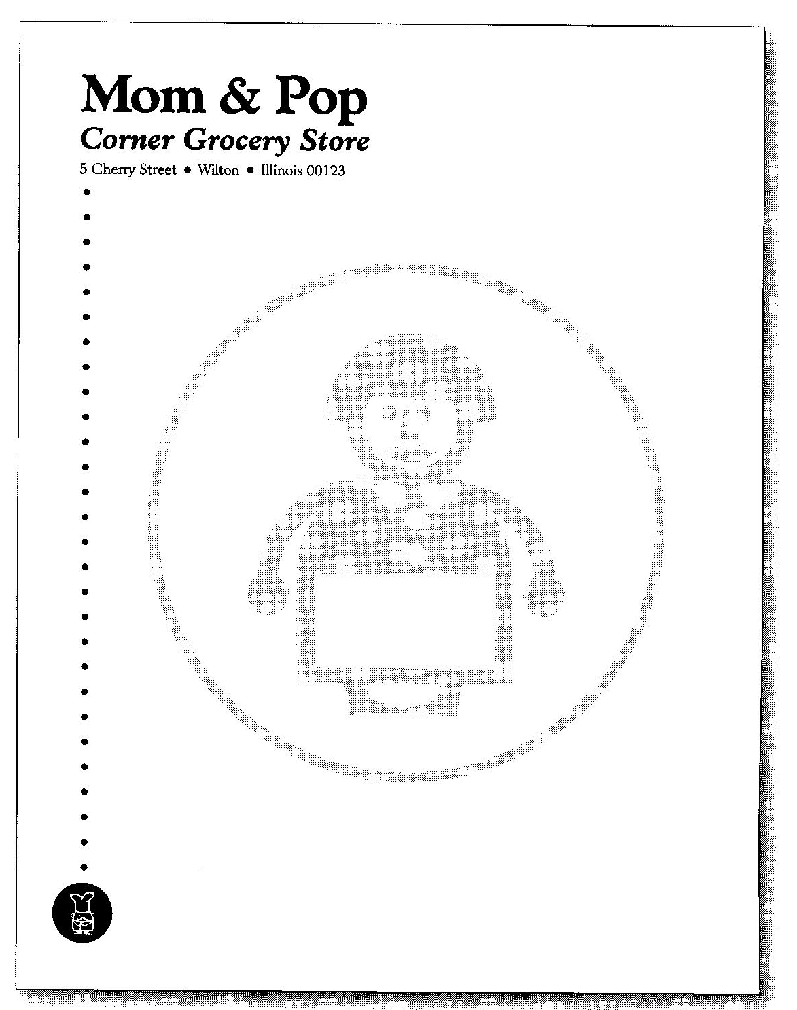
“In this experiment, I repeated one of the dots, made it really large and put Mom’s picture on it.
Not wanting to leave Pop out, I put a white version of him in the smaller black dot.”
R. Williams,
The Non-Designer’s Design Book

Slide 16
Repetition: the big ideas
Repetition of visual elements throughout the design unifies and strengthens by tying together otherwise separate parts.
Repetition unifies and adds visual interest

Slide 17
Repetition: more big ideas
Create repetitions to enhance design
Push some already consistent elements into conscious graphic design
Don’t repeat so much that it becomes annoying or overwhelming

Slide 18
Repetition: what to avoid
Repetition is like accenting your clothes
Too much accent in your clothes loses the idea of an accent and becomes the style itself.

Slide 19
Example of repetition
Example
Example 2

Slide 20
More on repetition
Vanseo design

