Slide 1
Design Principles: Alignment
Nothing should be placed on the page arbitrarily. Every item should have visual connection with something on the page.

Slide 2
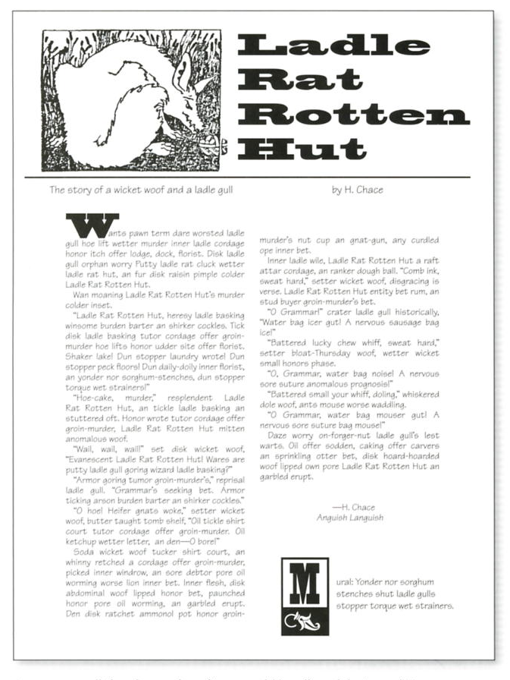
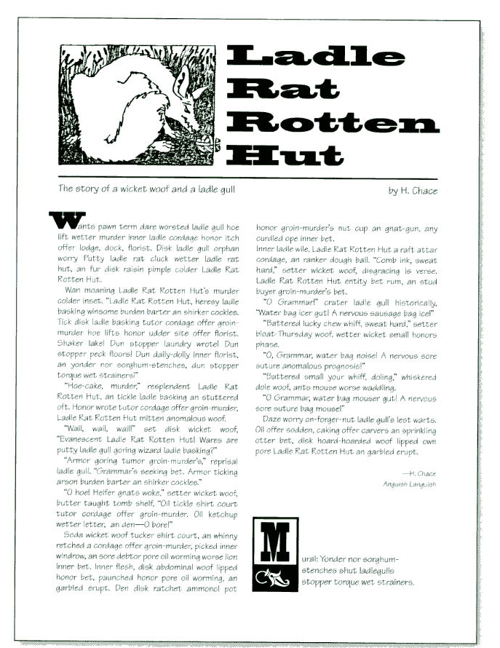
How does each part of the page align with the other parts?

Slide 3
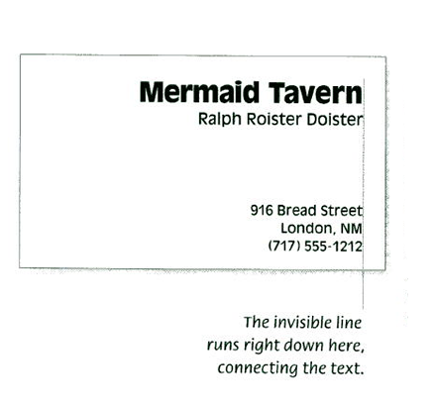
Align elements along "hard vertical edges."
If instead of centering your text, you align the text on the left or the right, the invisible line that connects the text is much stronger because it has a hard vertical edge to follow.

Slide 4
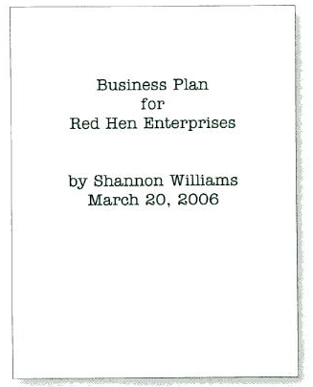

A centered alignment creates a more formal look, a more sedate look, a more ordinary and oftentimes dull look

Slide 5
Alignment
Combine a strong flush left or right with good use of proximity and you will be amazed at how strong your work looks.

Slide 6
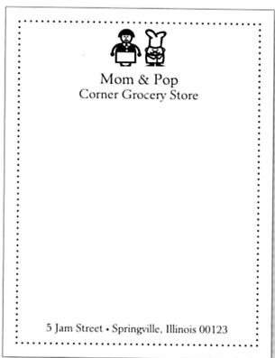
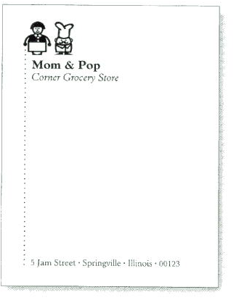
Centered vs. Left aligned

Slide 7
Alignment
Never center headlines over flush left body copy or text that has an indent.
Find a strong alignment and stick to it. If the text is flush left, set the heads, subheads, and paragraphs flush left.
If there are photographs or graphic images, align them with a text edge and/or baseline.

Slide 8
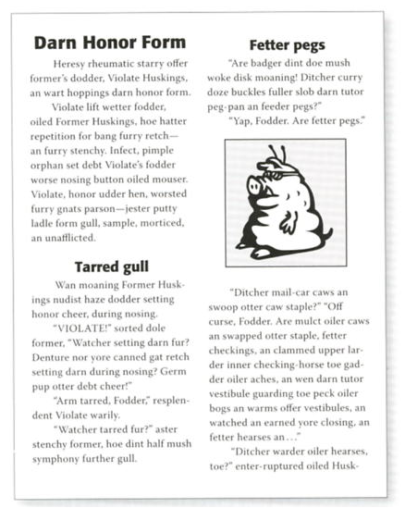
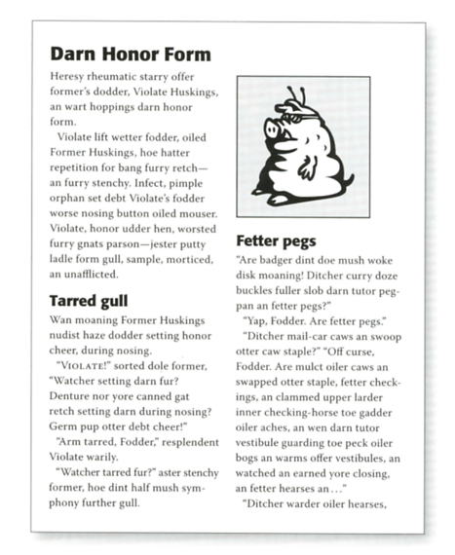
Alignment

Slide 9
Alignment: ideas
Align image caption stories with the strong line of the photograph, which makes each stronger because of the stronger vertical edges this creates.
Lack of alignments is probably the biggest cause of unpleasant-looking documents. Our eyes like to see order; it creates a calm, secure feeling.

Slide 10
Alignment: ideas
Alignment helps create unity on the page. Alignment helps connect and unify all the elements on a page, which creates an ordered, clean look.
Breaking the principle of alignment can be a nice design trick by breaking the reader's expectations.

Slide 11
Killersites
Web design from scratch
The Brads
Alignment in a website

