Slide 1
The Box Model
A giant step in the layout of web pages

Slide 2
Every element is a box
Divs, paragraphs, headings, lists, list items, links and all other elements are considered boxes

Slide 3
Every element is a box
Every box made up of
  Content
  Optional: padding, border and margins

Slide 4
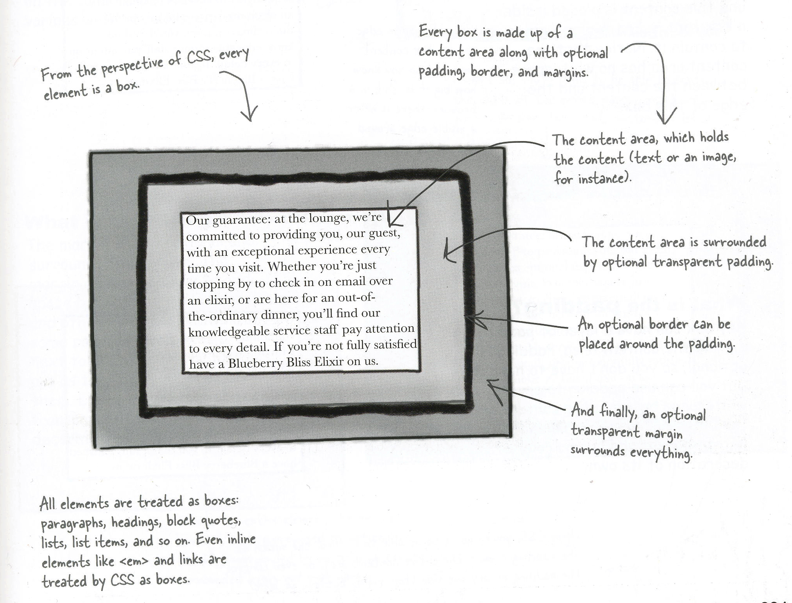

Slide 5
What is the content area?
Every element starts with some content
Content placed inside a box just big enough to contain it
Content area has no white space between content area and edge of box

Slide 6
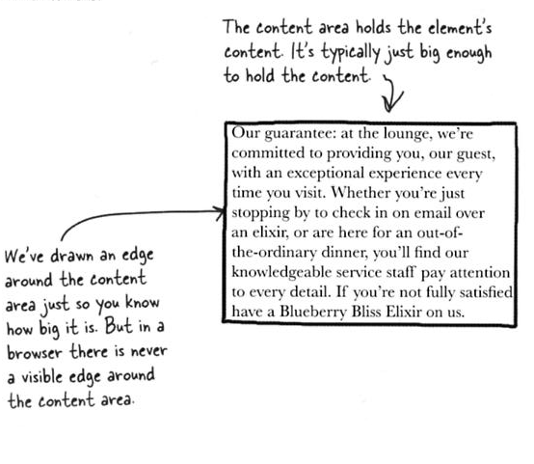

Slide 7
What is the padding?
Any box can have a layer of padding around content area
Padding optional
Use padding to create visual white space between content area and box border
Padding is transparent: no color or decoration

Slide 8
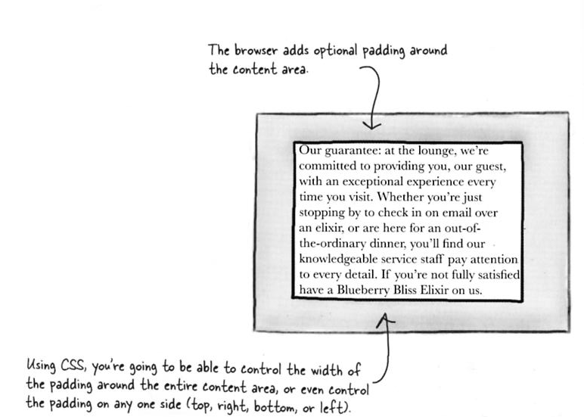

Slide 9
What is the border?
Elements can have a border around them
Border is optional
Border is a line that surrounds the padding & content
Border provides visual separation between elements
Can be various widths, colors & styles

Slide 10
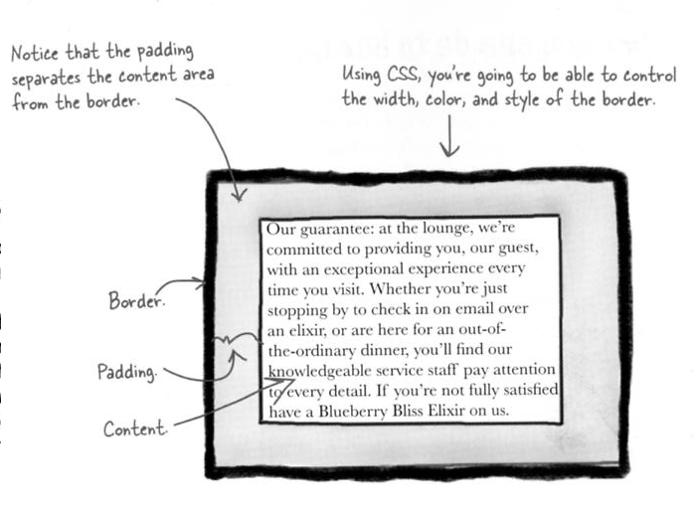

Slide 11
What is the margin?
Margin is optional and surrounds border
Provides a way to create space between elements on the page
Margin creates space between two boxes on the page
Margins are transparent: no color or decoration

Slide 12
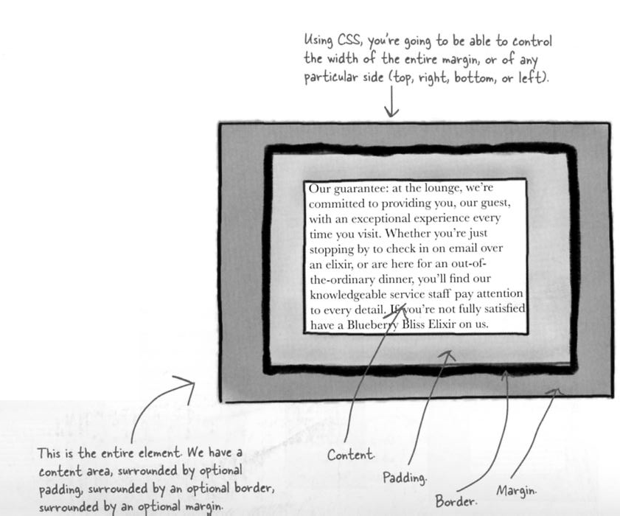

Slide 13
What you can do to boxes
Understanding box model helps with layout of an element
Manipulate internal spacing of the element (padding) & spacing around the element (margin)

Slide 14
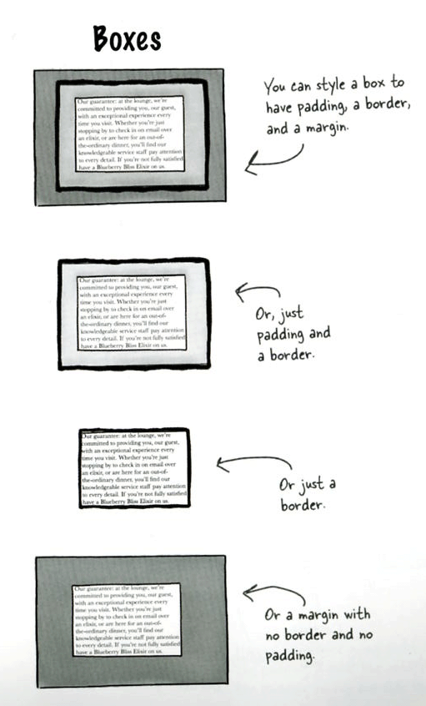
Many ways to determine layout of an element using CSS

Slide 15
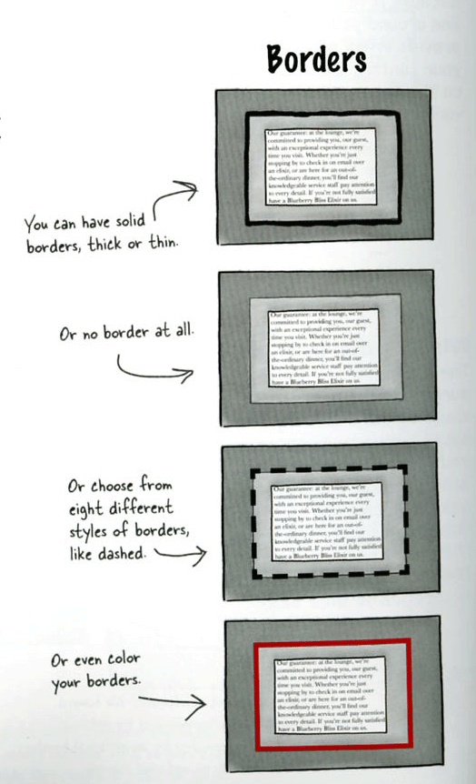
Using CSS to create and style the border

Slide 16
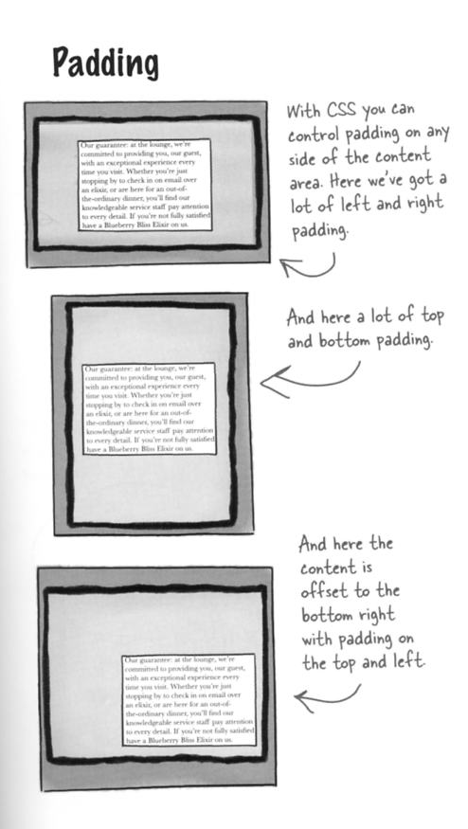
With CSS you can control padding on any side of the content

Slide 17
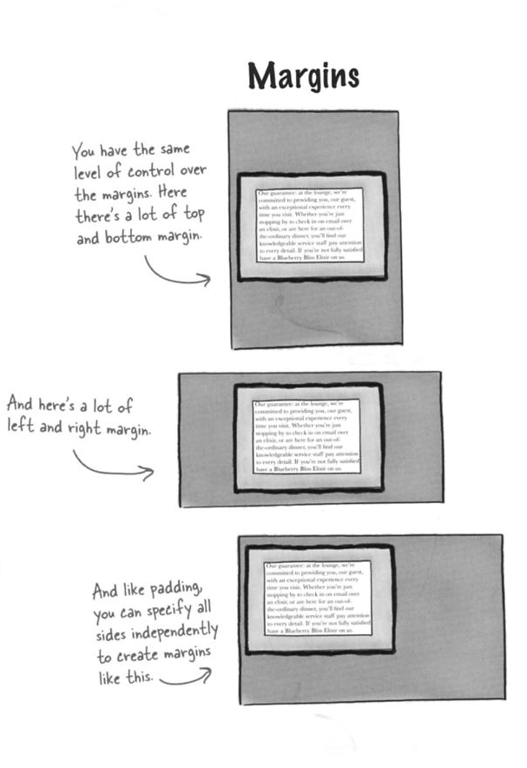
With CSS you can control margin on any side of the content

Slide 18
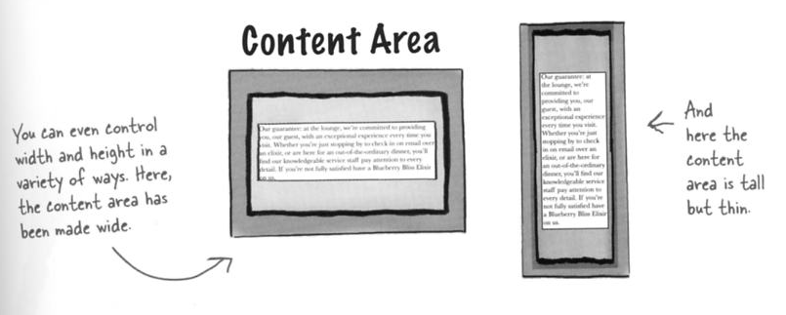
One can control width and height of the box in a variety of ways through CSS

Slide 19
Use CSS to style the box
Create classes and ids to style specific elements
<p class =“guarantee”>

Slide 20
The box model in action
The Head First Lounge

