Slide 1
gwiddle
https://gwiddle.co.uk/register

Slide 2
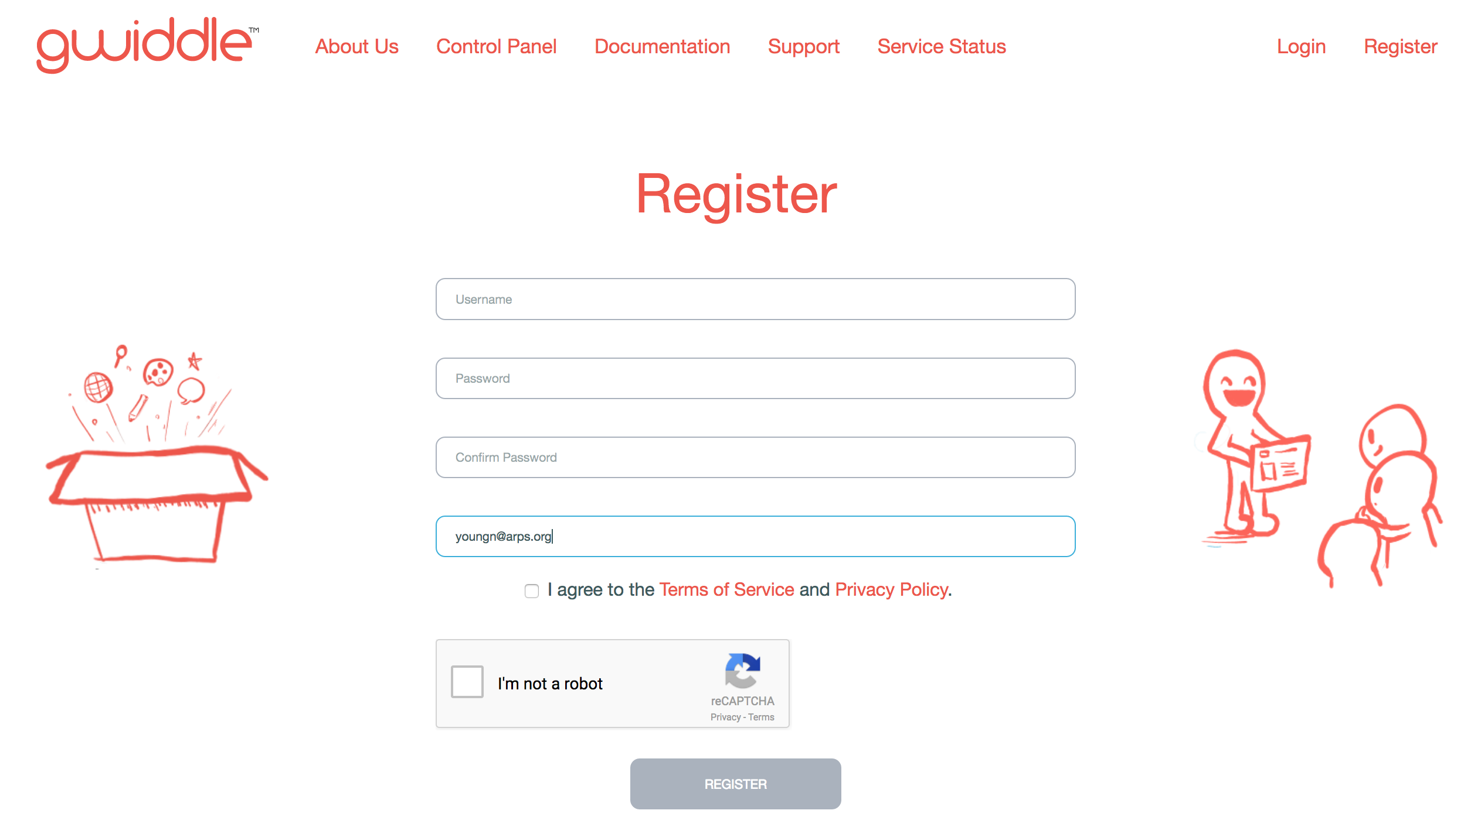
Register
Use your arps e-mail and it’s free

Slide 3
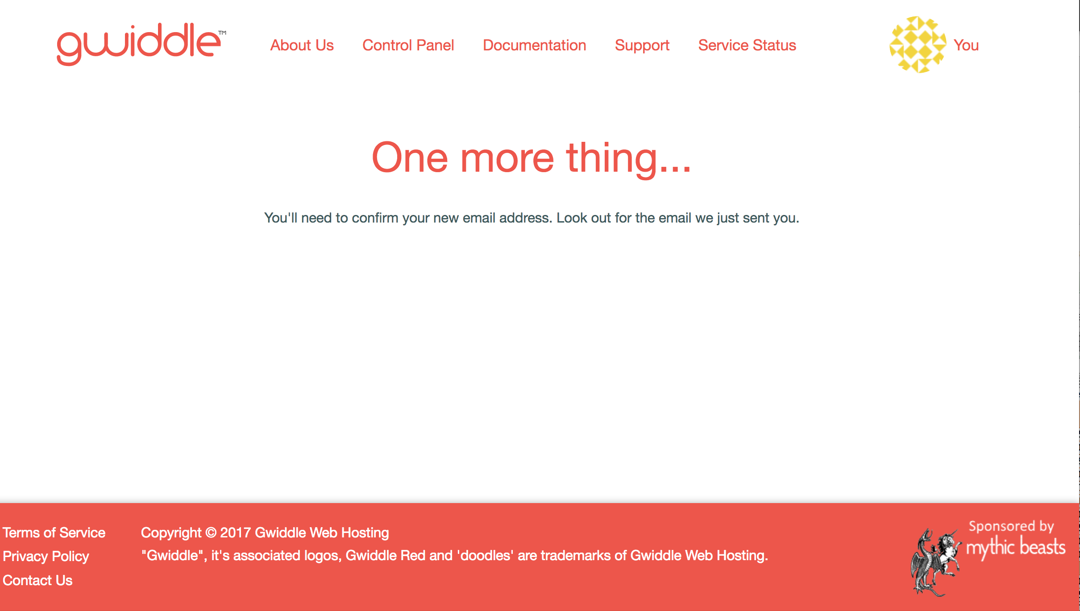

Slide 4


Slide 5
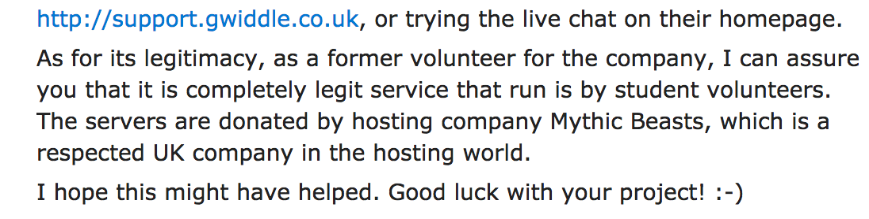

Slide 6
At home you can use FTP to upload the whole site at once. However, at school, we are limited to uploading one file at a time.
I am providing instructions for both methods.
First, the “at school” method:

Slide 7
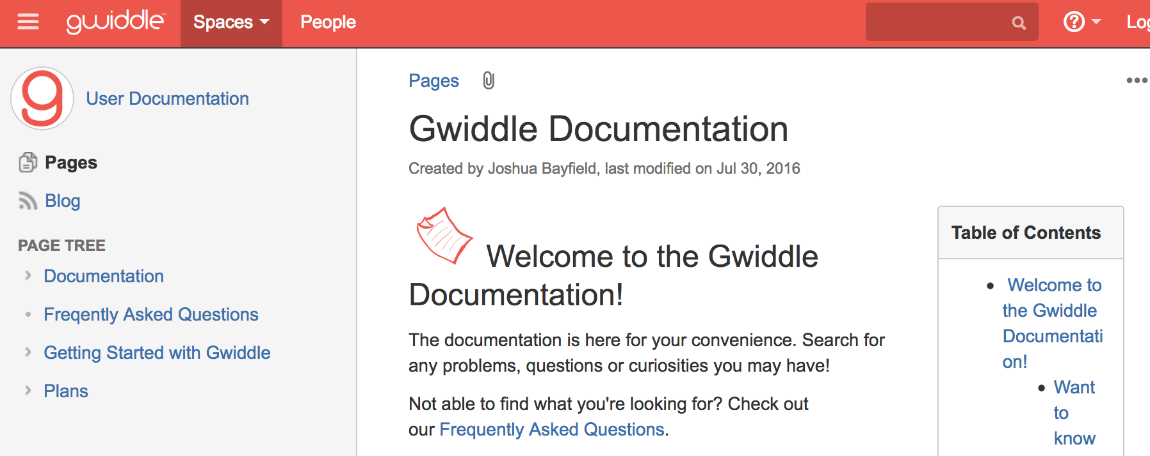

Slide 8


Slide 9
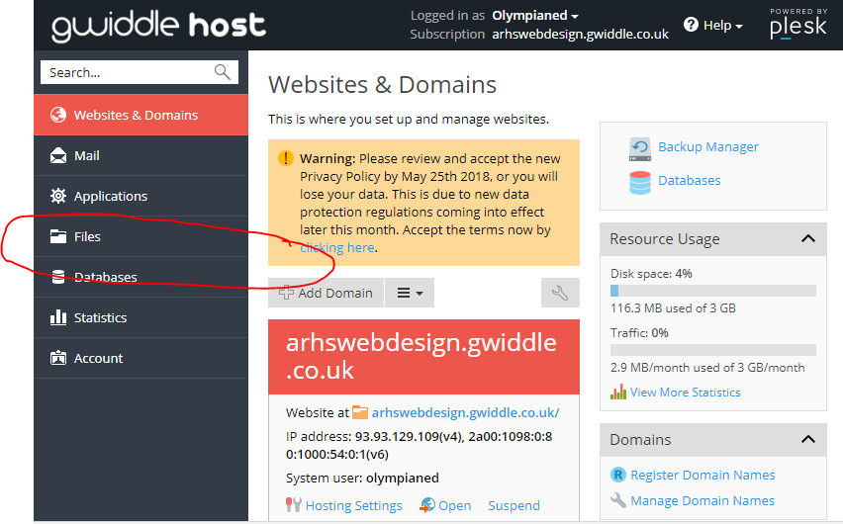

Slide 10
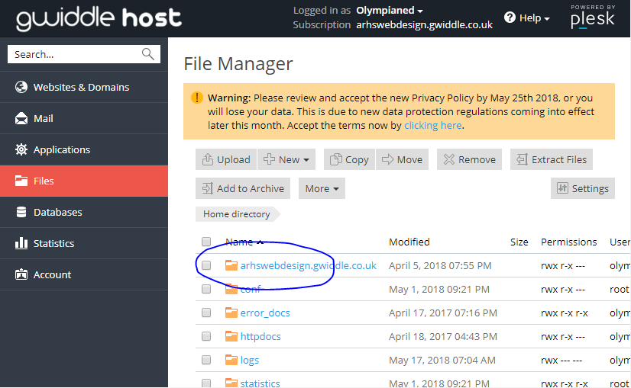

Slide 11
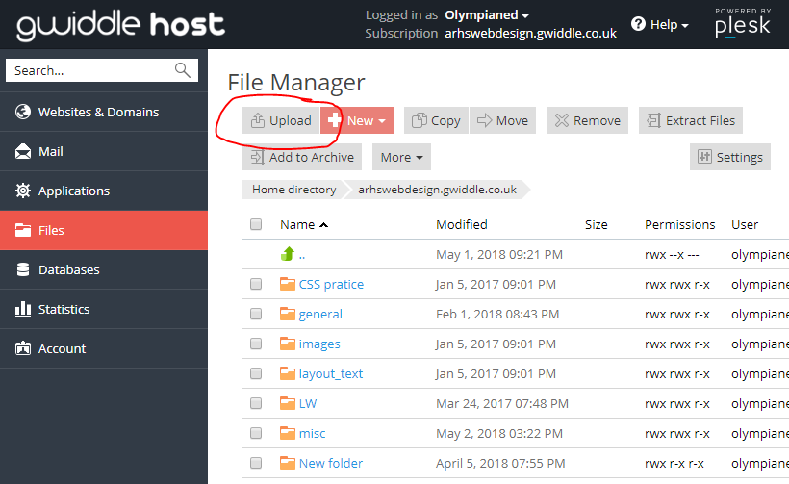

Slide 12
For the ftp approach, you need to install Filezilla 2 AND
Know your domain (website) name

Slide 13
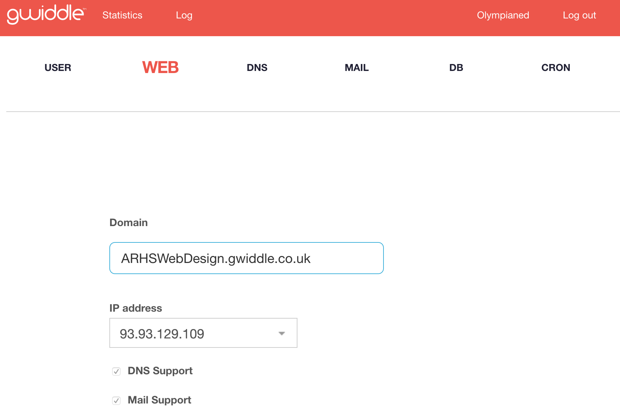

Slide 14
Using Filezilla 2
File -> Site Manager
Host: ftp.gwiddle.co.uk
Username: (yours)
pwd: (yours)
Protocol: FTP - File Transfer Protocol
Encryption: Require explicit FTP over TLS
Logon Type: Normal
Click “Connect”
Click (in left panel) on the folder you want to upload
Select all
Drag all of the files into the folder at right (on the gwiddle server)

Slide 15
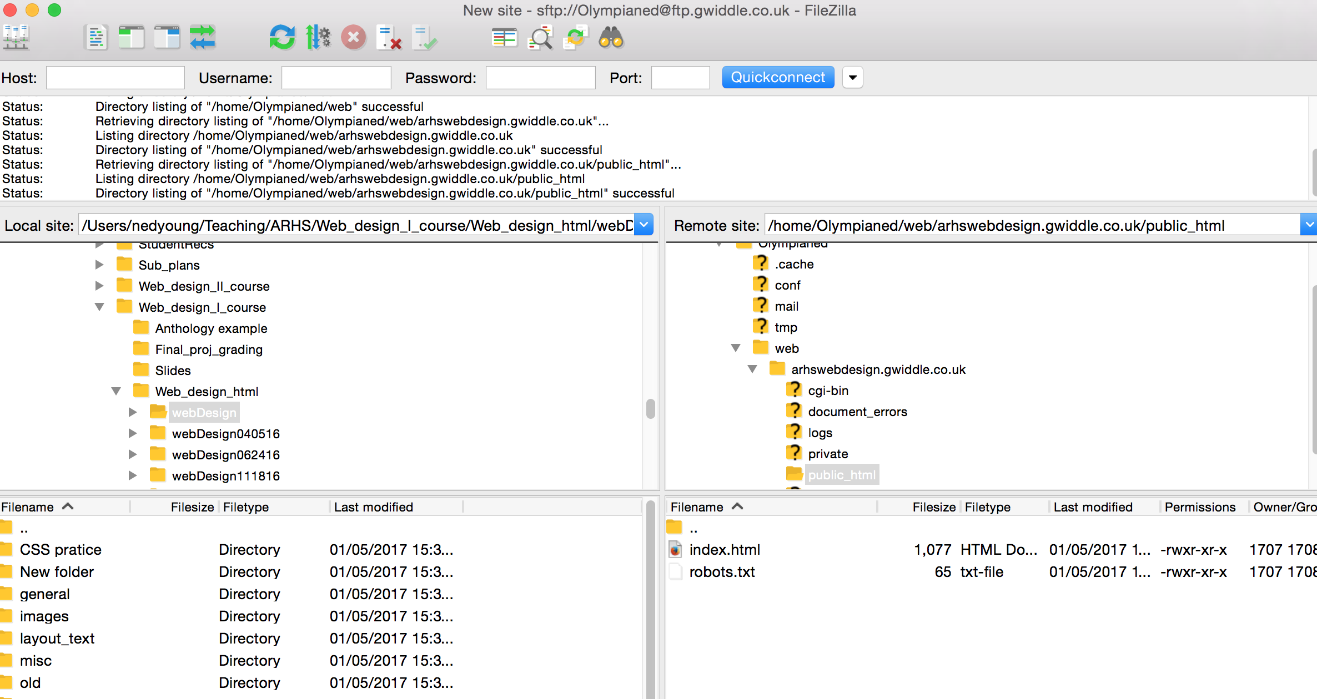

Slide 16
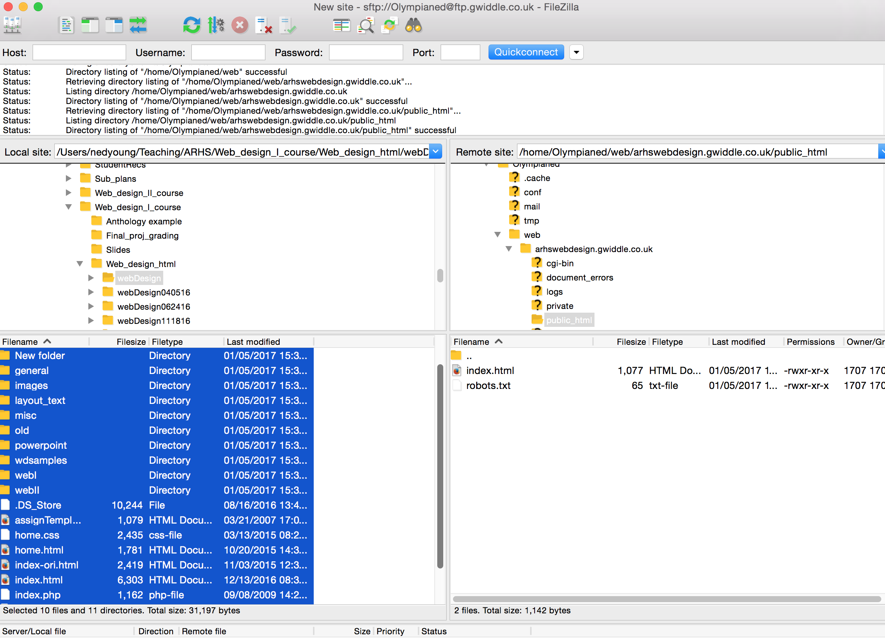

Slide 17
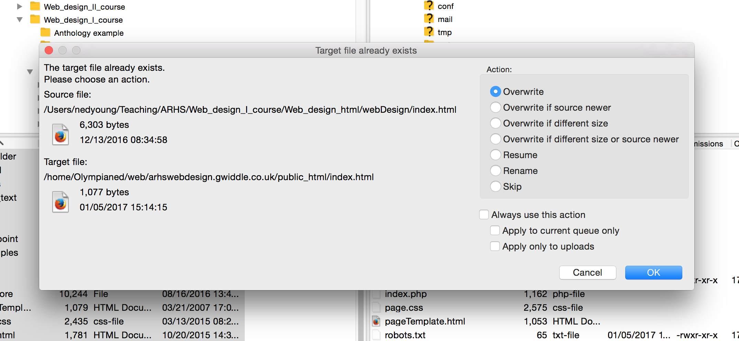

Slide 18
Wait 5 minutes

Slide 19


