Slide 1
Lung Cancer
Abigail Rhue
Danny Janani

Slide 2
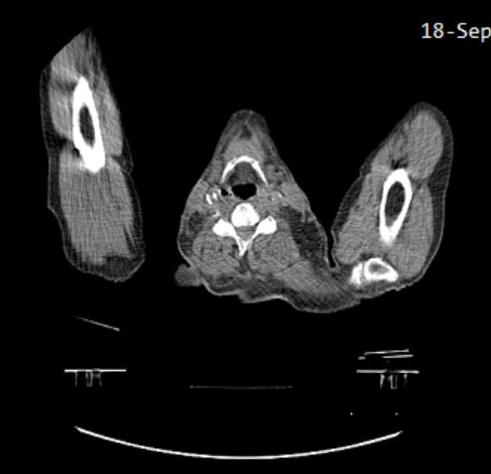
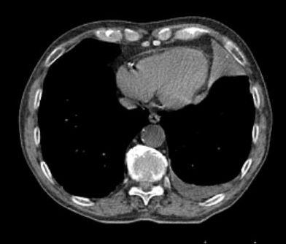
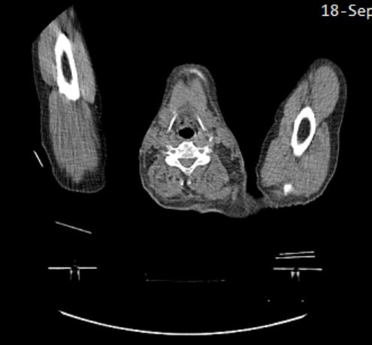
The Problem
Detect type of cancer based on images of cancerous lungs
NSCLC Radiomics Data

Slide 3
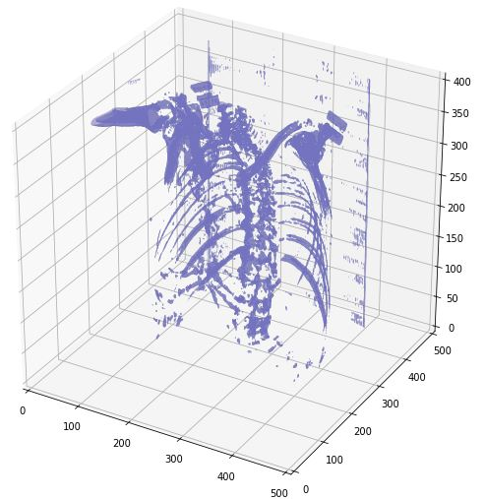
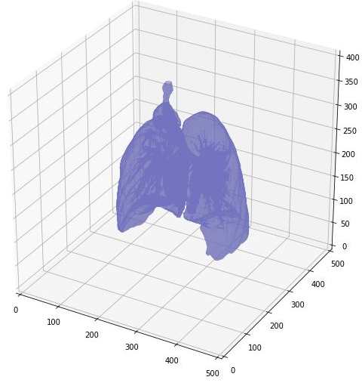
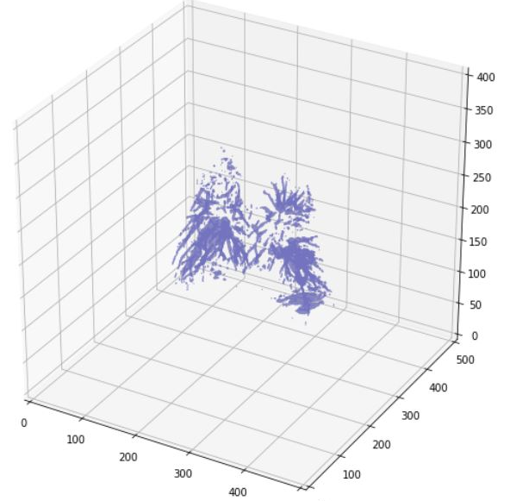
Data Visualization

Slide 4
3D Convolution

Slide 5
Results
Accuracy
Improvement
Need more data
Only had 422 patients, largest data set found had ~1000

