Slide 1
WebDev
by Nikola Baci

Slide 2
Webpage Composition
A webpage is made of 3 file types:
HTML – structure and content (skeleton)
CSS – layout and design (appearance)
JS – functionality and interactivity (brain)

Slide 3
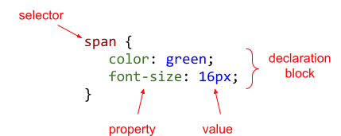
Intro to CSS
CSS – Cascading Style Sheets
Used to determine how a wabpage is rendered on screen or printed
A CSS rule example:

Slide 4
Applying CSS
3 ways to incorporate CSS into HTML
inline : using the style attribute of HTML elements
embedded style : using the <style> </style> element in the HTML head
external stylesheet : using <link> element to connect HTML to CSS file
Children elements inherit the parent’s style
Conflicts occur when:
Child element specifies a different style from parent element, in this case child’s style takes precedence
Element specifies a different inline style from external stylesheet, in this case the inline style takes precedence

Slide 5
CSS Basic Selectors
Each HTML element can be referred to by:
The tag name: header, footer, main, div, section, span, img
The class name (aka group)
The id
CSS can use any of those, or a combination to target any element
Tag name: span { … }
Classname: .myGroup { … }
ID: #specificId { … }
ID takes precedence over Class and Class takes precedence over tag

Slide 6
CSS Basic Selectors Con’t
Descendant selectors used to style elements wrapped by other elemente
main h1 { … } : means all h1 headers inside the main element
Pseudo-class selectors used to style elements based on user behavior or element metadata
element:disabled { … }
element:hover { … }
element:empty { … }
element:nth-child(n) { … }

Slide 7
CSS Selectors Con’t
Universal Selector : * { … }
Multiple Selectors: h1, h2 { … }
Direct Child Selector: p > h1 { … }
Attribute Selector:
=: attribute has exact value
~=: attribute contains while word
^=: attribute begins with value

Slide 8
Common CSS Properties
color: text color
background-color: background color of the HTML element
background-image
display: change the element display
Possible values: inline, block, none
Font property has several variations:
font-family, font-size, font-weight, font-style
Text property has several variations:
text-align, text-decoration, text-transform

Slide 9
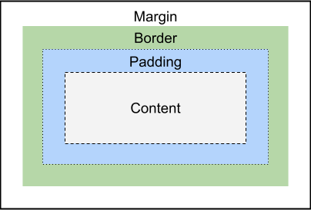
CSS Box Model

Slide 10
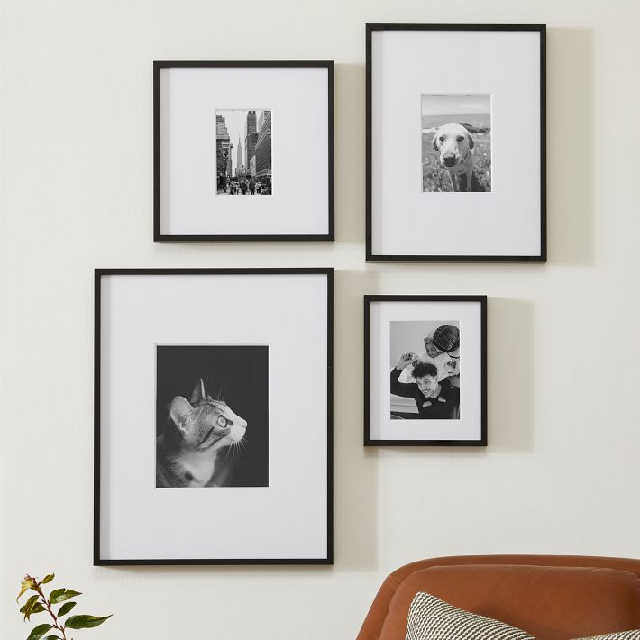
CSS Box Model Example

Slide 11
Flexbox Layout
Flexbox is a layout framework to control the position and behavior of the elements
Using flexbox you can manipulate the children elements of a container
The CSS property of the parent container should be set to flex
parnetContainer { display: flex; }
Properties of a flex container:
flex-direction, gap, justify-content, align-items, flex-wrap

Slide 12
flex-direction
flex-direction: row
flex-direction: column
Red arrow -> Main axis
Orange arrow -> Cross axis
flex-direction: row-reverse
flex-direction: column-reverse

Slide 13
flex-direction
flex-direction: row
flex-start
flex-start
flex-direction: column
align-items
justify-content
justify-content
align-items
flex-start
center
flex-end
flex-start
center
flex-end
flex-end
flex-end

Slide 14
Grid Layout
Just like Flexbox, Grid is a layout framework
The parent container becomes grid, and the children elements become grid items automatically
parentContainer { display: grid; }
To control the number/size of each column of the grid container:
parentContainer { grid-template-columns: 100px 200px 300px; }
3 columns with 3 different widths
To control the size of each row of the grid container:
parentContainer { grid-template-rows: auto 50px}
2 rows with 2 different heights

Slide 15
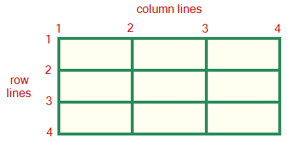
Grid Layout Properties
A grid container can control and set the following properties
grid-template-columns / grid-template-rows
gap
justify-content
align-content
A grid item can control how many rows and columns it span:
grid-row: 1 / 3
grid-column: 2 / 4
grid-area: 1 / 2 / 3 / 4

Slide 16
Responsive Web Design
Platforms we develop for:
Mobile
Table
Desktop
Methods to design a webpage:
Graceful degradation: desktop-first approach
Progressive enhancement: mobile-first approach

Slide 17
Media Queries
Developers use media queries to condition the design on the viewport size
Media types:
all
print
screen
Media features:
width
height
orientation ect.

Slide 18
Breakpoints
For responsive designs you can utilize the following breakpoints:
Up 480px for portrait mobile
481px – 780px for landscape mobile and portrait tables
781px – 1280px for landscape tables and laptops
1281px and up for big laptops and desktops

Slide 19
Project 1 Advice - CSS
Decide on the design/brand
https://looka.com/blog/graphic-design-styles/
https://blog.thenounproject.com/graphic-design-styles/
https://www.shopify.com/blog/graphic-design-styles
https://99designs.com/designer-resource-center/visual-design-styles
Use Flexbox for layout
Use Bootstrap for a natural-feel of components
Use media queries for mobile vs desktop layout

