Slide 1
WebDev
by Nikola Baci

Slide 2
Webpage Composition
A webpage is made of 3 file types:
HTML – structure and content (skeleton)
CSS – layout and design (appearance)
JS – functionality and interactivity (brain)

Slide 3
JavaScript Fundamentals
let x = 7.6;
const y = 9;
Variables are created with the keyword: let and const
Variables types:
Strings and string templates
Number
Boolean
Array
Object
Undefined
Null
let sName = "John Doe";
let s = `hi my name is ${sName}`;
let arrayEmpty = [];
let array = [1, 2, 3, 4, 5, ["hello", 1, 2]];
let student = {
id: "jodo1800",
name: "John Doe",
dob: "02/31/1800",
gpa: 2.1,
classes: ["cs355", "cs212", "cs313", "cs111"]
};

Slide 4
Conditions
let age = 54;
if(age < 13) console.log("You are a child");
else if (age >= 13 && age < 18) console.log("You are a teen");
else if (age < 65) console.log("You are an adult");
else console.log("You are an elderly");
const pi = 3.14;
if(pi === 3.14) console.log("PI is correct 1");
if(pi == 3.14) console.log("PI is correct 1");
if(pi == "3.14") console.log("PI is correct 2"); //true
if(pi === "3.14") console.log("PI is correct 3"); //false
if(pi !== 3) console.log("Yes we know that");

Slide 5
Loops
for(let i = 0 ; i < array.length; i++) {
console.log(array[i]);
}
let i = array.length-1;
while(i >= 0) {
console.log(array[i]);
i--;
}

Slide 6
Functions
function max(array) {
let max = array[0];
for(let x of array) { //for-each for loop
if(x > max) max = x;
}
return max;
}
let maximum = max;
let maxArrow = (array) => {
let max = array[0];
for(let x of array) { //for-each for loop
if(x > max) max = x;
}
return max;
}

Slide 7
JavaScript in Browser
JS can be embedded in HTML using <script> </script> element
Or linked to an external file using
<script src=“p/a/t/h”> </script>
Document Object Model (DOM)
Tree data structure that represents the HTML document

Slide 8
Window
Web browsers have a window object
Some properties:
window.document or document: represents the DOM
window.innerHeight and window.innerWidth
window.navigator
Some methods:
window.alert()
window.confirm()
window.open()

Slide 9
DOM
DOM structure is composed of nodes with:
Root node – the <html> </html>
Parent nodes
Children nodes
Searching DOM using JavaScript:
document.querySelector(): returns first occurrence of this element
document.querySelectorAll() : returns an array of elements
Arguments should be CSS selectors such as element tags, class names and id
DOM nodes have attributes with same name as HTML attributes:
Use attribute name to get and set a value
Use removeAttribute() method to delete an attribute

Slide 10
More on DOM attributes
innerText attribute changes the text of the node
innerHMTL attribute changes the HTML of the node
classList attribute array keeps track of CSS classes of the node
parentNode attribute refers to the node’s parent element
childNodes / children refers to the node’s nested children
nextElementSibiling refers to the bottom-next same-level node
previousElementSibiling refers to the top-next same-level node

Slide 11
Modifying DOM
appendChild(c) nests an HTML element inside the current node
inserBefore(item1, item2) moves item1 just before item2
removeChild(c) deletes a node
createElement(tag) creates a HTML element
createTextnode(text) creates HTML text
cloneNode(false) clones a given node
cloneNode(true) clones a given node and its children nodes

Slide 12
Event Driven JS
Event-driven programming is a style that is responsive on various events such as:
Change
Input
Load
DOMContentLoaded
Focus
Blur
Submit
Keyboard
Mouse
Developers write custom functions to handle events

Slide 13
Event Registering
For a function to “fire” when an event occurs, we need to register it
Three ways to register it:
In the HTML tag using on<Event> = functionHandlerName
In the script using a combination of querySelector and previous example
In the script using addEventListener(eventType, eventHandler)

Slide 14
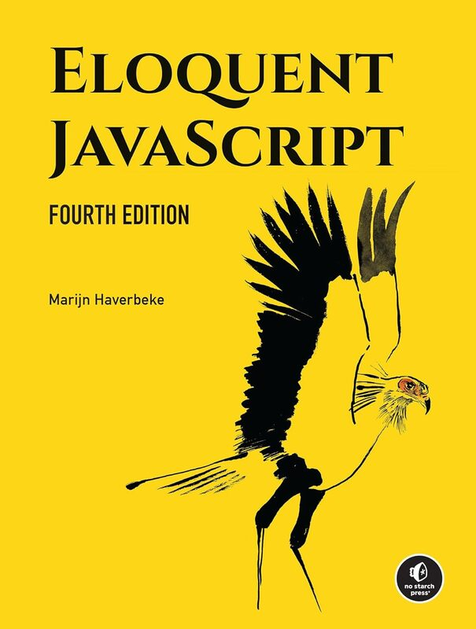
Reading
Eloquent JavaScript Book Link
Read Chapters
1-4 and 13-15

