Slide 1
WebDev
by Nikola Baci

Slide 2
ExpressJS
Express is a fast, unopinionated, minimalistic web framework for NodeJS and JavaScript applications and APIs
Unopinionated means that it does not matter how you structure your project
Minimalistic means that it only includes the necessary libraries and dependencies to make your project work
Express needs to be installed via npm
npm is a library that maintains and distributes modules created by other developers for different purposes
npm comes bundled with your NodeJS download
to install a package with npm you write: npm install package_name

Slide 3
ExpressJS Setup
2 ways to set up an ExpressJS server:
Simply install express via npm (see 01_why_express zip file)
Using express generator (see 02_express_generator zip file)
This creates a skeleton project outline with server setup and folders indented for special use cases (note you can change those folders if you want)
This is the setup we will use in class

Slide 4
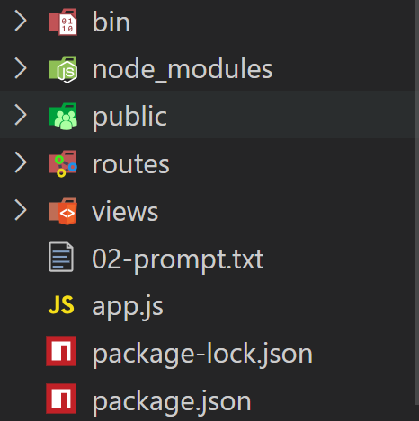
Express Generator
The bin folder contains only 1 file (www) which does the NodeJS server setup
The nodes_modules folder stores all the project dependencies code
The public folder has three subfolders intended to store images, frontend javascript and stylesheet.
Those are static files that need to be sent over for the website to be properly displayed

Slide 5
Express Generator
The routes folder stores javascript files that modularize the server responsibilities
By default there are 2 routers included:
user.js which is going to handle all urls that start with /user/…
index.js which is going to handle all urls that are not caught by user.js
This of index.js acting like else statements

Slide 6
Express Generator
The views folder stores all ejs files (dynamic html)
The app.js file further configures the express server
The package.json lists the project dependencies, scripts and metadata

Slide 7
Routers
Routers modularize the server's responsibilities.
Assume you are creating a Blog web server where
Users can create a profile (signup), login, logout, change profile info
All those actions could be handled by the User.js router as they relate to the user
All those urls have a common prefix:
domain.com/users/signup
domain.com/users/signup/submit-form
domain.com/users/signin
domain.com/users/signin/submit-form
domain.com/users/logout
domain.com/users/profile
domain.com/users/profile/save-changes
Used to get the page with the
form to fill
Used to submit the form data
for server to authenticate

Slide 8
Routers
Assume you are creating a Blog web server where
Users can create a posts, save drafts, publish and delete posts/drafts
All those actions could be handled by the Posts.js router as they relate to the user
All those urls have a common prefix:
domain.com/posts/user-id/draft
domain.com/posts/draft/save
domain.com/posts/draft/publish
domain.com/posts/post-id/delete
domain.com/posts/post-id/make-private

Slide 9
Routers
The router js files are tied to the prefix
Users.js is tied to /user
Posts.js is tied to /posts
Internally, routers don’t specify the prefix
Inside User.js
router.get(“/signup”, (req, res) => { … }); ← /user/signup
router.post(“/signup/submit”, (req, res) => { … }); ← /user/signup/submit
router.get(“/signin”, (req, res) => { … }); ← /user/signin
router.post(“/signin/submit”, (req, res) => { … }); ← /user/signin/submit

Slide 10
Routers
Routers work by writing: router.METHOD(“endpoint”, callback);
router is the object tied to the prefix
method is any HTTP method: get, post, put, delete
url is any url you have defined for your web app
callback is the function to handle the requests from the client

Slide 11
Responding to Clients
Express has several functions to respond and end connection with the client (web browser):
res.send() ← Send a Buffer, String, Boolean, Array
res.sendFile() ← Send a file
res.render() ← Render and send the dynamic HTML pages
res.redirect() ← Redirects to another portion of the server/web
res.download() ← Sends a file which is downloaded by the browser
res.cookie() ← Send a cookie to the browser
Read more here

Slide 12
EJS Template
Embedded JS is a HTML Templating package
Enables us to write JS logic code inside HTML files
Needs to be installed: npm install ejs
Tags used:
<% js code here %>
Allow the use of for/while loops, if-else statements
<%= variable name here %>
Substitutes the variable with its value
<%- include(relative/file/p/a/t/h) %>
Embedded other ejs files in the current file
Allows for component-based programming

Slide 13
Nodemon
Automatically restarts the server if code is changes
This streamlines the developments as you don’t have to restart the server every time you change/add/remove code
Nodemon is a package and need to be installed:
npm install –g nodemon
Once installed, instead of starting the server with node or npm, you start it with nodemon:
nodemon start

Slide 14
Git and GitHub
A friend creates the main repository: RepoX
Fork RepoX to your own GitHub account: RepoY
Forking is done on GitHub website
Clone RepoY to your local machine: RepoZ
Cloning is done on your terminal (MacOS) or PowerShell (Windows)
Command: git clone <url_repoy>
Then do the following to authenticate your RepoZ with RepoY:
git config credential.helper store
git push <url_repoy>
Enter your username: <user>
Enter your password: <pass>
The password is actually a Token (see next slide)

Slide 15
Git and GitHub
When asked for a password, a token is required
GitHub profile settings
Settings
Developer Settings
Personal access tokens
Generate new token (button)
Generate new token (classic)
Check the repo checkbox
Copy the token (only showed once)
Paste token in the password field

Slide 16
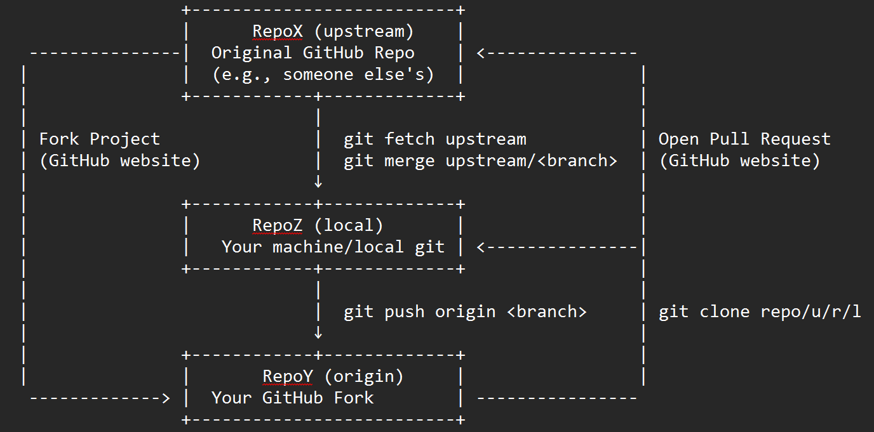
Git Collaboration Workflow

Slide 17
Workflow
Working Directory
Staging Area
Local Directory
Remote Repository
Original Repository
git stage
git commit
git push
Pull Request
git status
git status
git log

