Slide 1
Disclaimer
Open and friendly environment
Videos and recordings are not allowed for distribution or sharing
Content is mature, expected to be … not during work activities]
All characters presented today are fictional and not related to Jacob… that we know of…
All compliance matters will be alerted by Higashi san…. By whistle… protect your ears…
We all LOVE Jacob… or share love for him… or just want to keep their job. XD
Notes:
Make whistle counter for compliance and ref black/white stripe shirt. Ala soccer games

Slide 2
It’s all about Jacob Gordon
An appreciation roast
Jacob Gordon
Notes:
Play “Apache” with Will Smith video

Slide 3


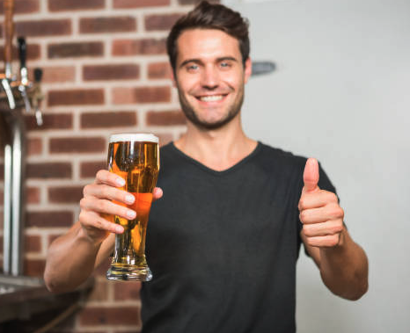

Timeline
Official approval
2nd Meeting
6/2
6/9
6/27c
Idea
1st meeting
Event

Slide 4
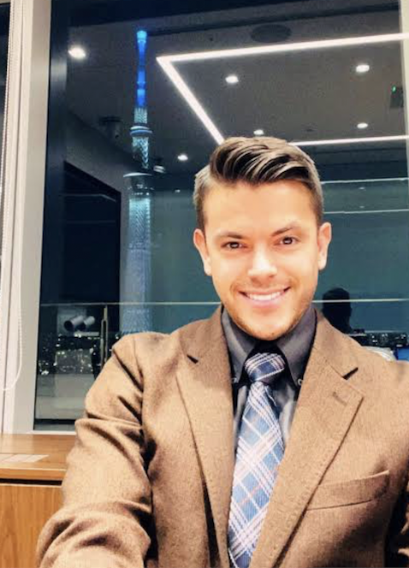
Biography and fun facts
Studied in university: Hawaii, Japan, Korea and various HUBs across the globe
Working in Japan since 09.2011 (not 911)
Working in major life insurance company since 06.2017
HUB gold card holder
Likes pretty shoes (much like his ladies)
Can play 4 chords on the guitar
Professional Elvis Presley impersonator (karaoke)
Top Gun enthusiast
Can pop or break dance?!
Notes:
Bruno Mars - Finesse

Slide 5
SLIDO HEARTBEAT 1
Notes:
Leo to make
Jeopardy song

Slide 6
IS Our boss smart enough..!? POP QUIZ CAN JG ANSWER???

Slide 7
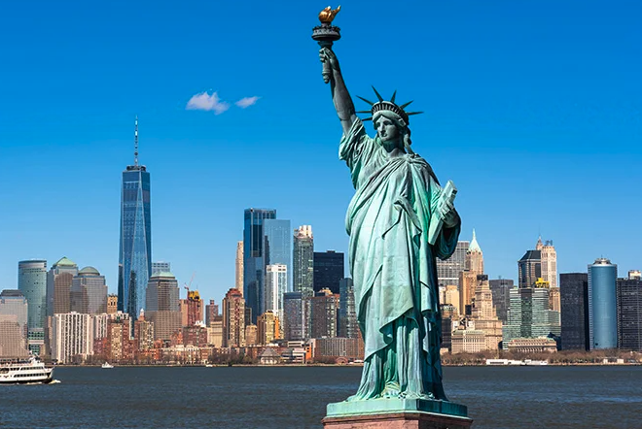
1.Which country gave the US the statue of liberty

Slide 8
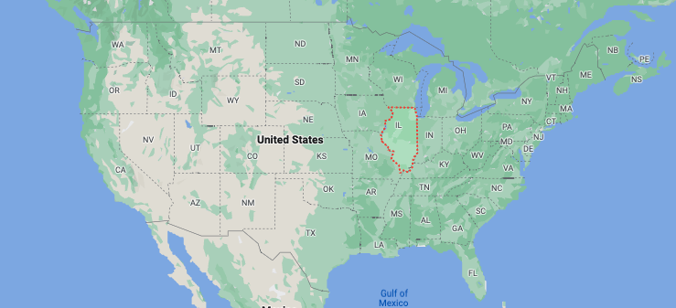
2.Capital of Illinois
SPRINGFIELD, INSERT HOMER SIMPSON GIF “DOH”

Slide 9
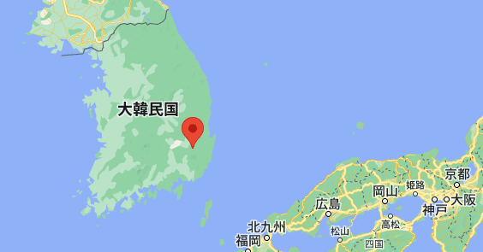
3.What’s meaning?
가 GA
가 GA
가 GA
가 GA

Slide 10
JAPAN QUESTIONS

Slide 11
SERIOUS OR STUPID QUESTION TBD

Slide 12
Who is Jacob’s GF

Slide 13
GENERAL CAHRACTERISTICS (EXCAMPLE SLIDES)13 14 END WITH AI EVERYONES THOUGHTS? SHORT, TALL, ESTHETICS END WITH AI SLIDO (PEBBLES BOULDERS EXAMPLE)

Slide 14

1. Cyber Japan Dancers

Slide 15

2. よーじや

Slide 16
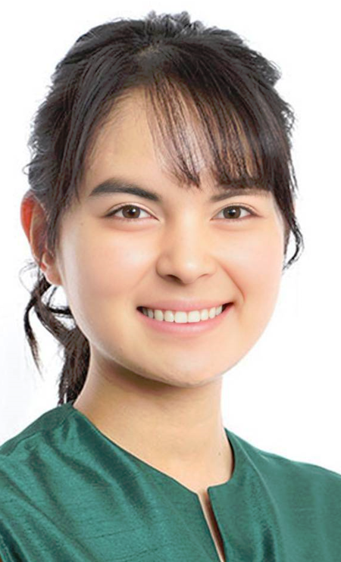
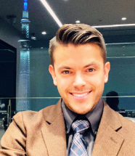
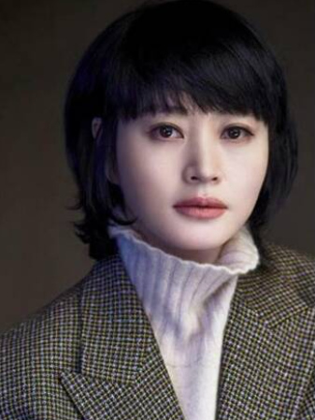
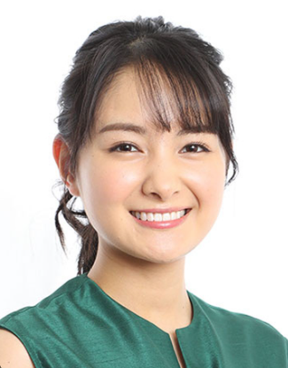
3. KANG-SAN

Slide 17
4. LEO

Slide 18
Venue: HUB, (KAWATSU-SAN)
Date: MID JULY(YAZAWA)
PPT slide: MUST
Who: FTE ONLY
Guest speaker: SANJEEVA-SAN
Music:

Slide 19
credits
Our special thanks and proof of our hard work and.. dedication
This is how much we planned for you
We forgot about this for… how long??? Back on track
We did it!!!!!
Sanjeeva-san doing his super presentation for you

