Slide 1
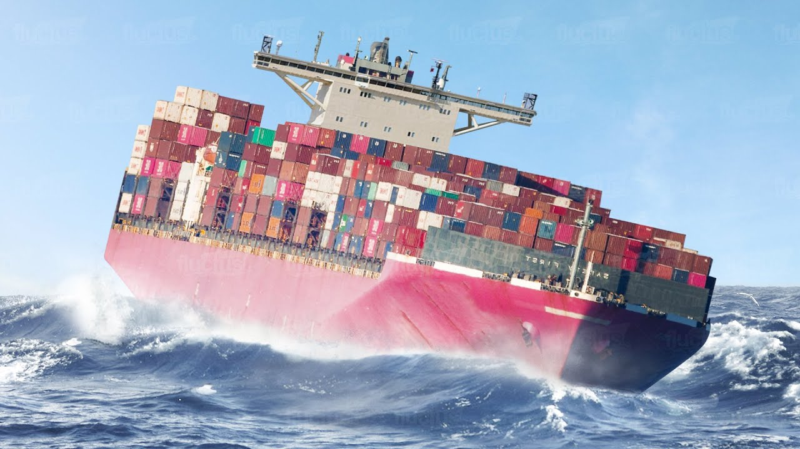
Shipping Company
Ariela Epstein | Shlomo Vovek | Tomer Karmazin

Slide 2
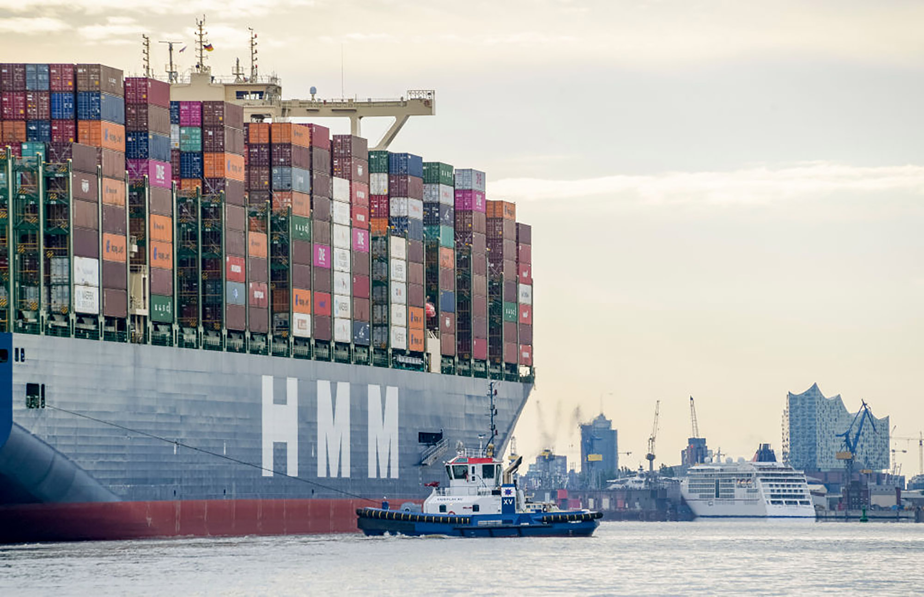
General Description
Our database management system allows its users to efficiently store, organize, manage, and retrieve data about our ships and deliveries. We can track your orders in every corner of the world, ensuring that your products will arrive quickly and safely to your homes. This system chooses the right ship, containers, and crew for your product’s journey.

Slide 3
The User Types Of Our Data-base System
Orders Manager
The orders manager has the responsibility of receiving shipping orders from customers and finding the right containers and ships for each order. His main goal is maximizing the number of orders shipped out on each boat. The orders manager traces each order by using a unique ID for every order, container, and good. Once the orders manager finishes loading each ship with filled containers, he creates a scheduled route for the ship to take.
Operatives Manager
The ops. manager’s job is to execute the scheduled routes as efficiently as possible. He is responsible for creating the actual routes taken between the scheduled routes. He plans out where the ship will actually dock and refuel. He oversees hiring the crew members for each ship’s schedule. As well as overall maintenance and repairs for the ships and provides the ships for use.

Slide 4
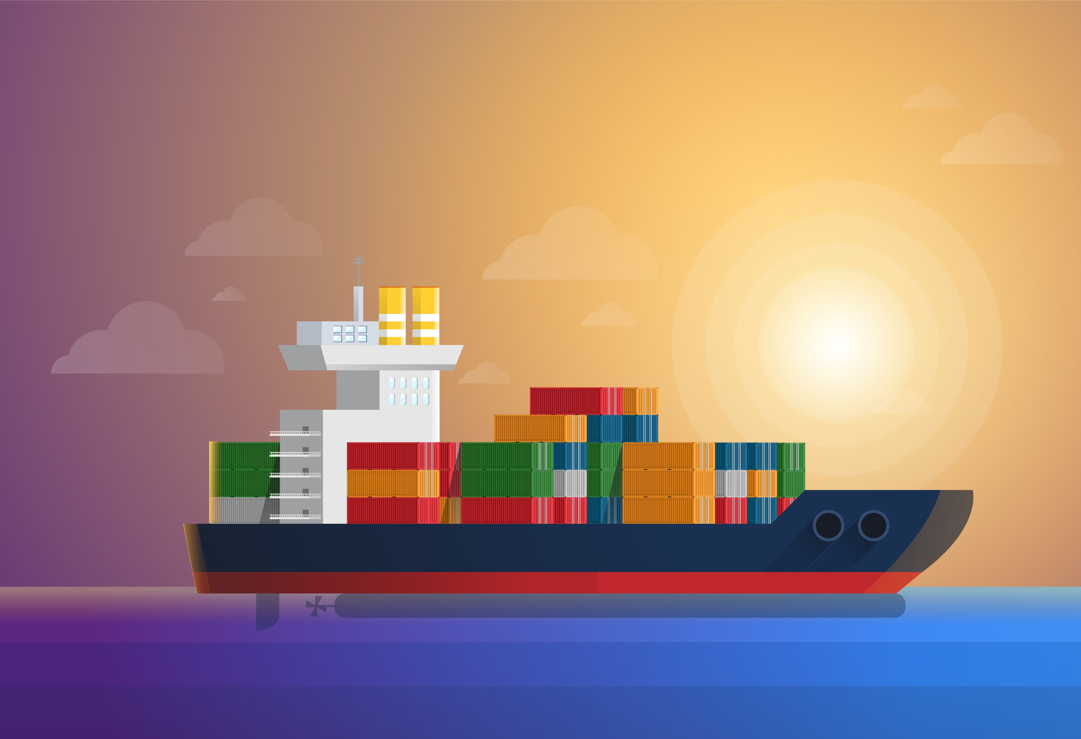
Entities
SHIPS – The core of our company. We use ships to deliver goods from port to port. Every ship has a name, id, status, crew capacity, weight capacity, source port, destination port. One ship houses multiple crew members and takes on many different schedules.
Crew – From the captain and the engineers, to the cooks and the deckhands. For each crew member we store a name, ID, role, and ship id they are currently working on.
Schedule – This stores the scheduled routes for each ship. It lists the ship id, source port, destination port, estimated departure date, and estimated arrival date.
Actual sailing – This is a weak entity. It stores the real departure dates and arrival dates of each scheduled route, and the stops that the ship will take on its way to fulfill the scheduled route. This represents the actual route that the ship will take.
Ports – These are the sources and destinations for every route. Each port has an ID and a name.

Slide 5
Entities
Delivery – This contains every order and its container that it’s in, and every ship it’s in, and every schedule it is in.
Containers – The containers store every order being shipped. Each container has an ID, size, weight capacity, current weight capacity, source, and destination. Each container is in a different size and can hold multiple orders.
Goods – This holds each goods id, its name, weight, unit, category, and supplier.
Orders – This stores each order between a customer and a supplier. It has a unique ID, customer’s id, supplier’s id, and the amount bought.
Customers – Each customer has a name, address, and ID. Customers can make multiple orders from different suppliers with different goods.
Suppliers – Each supplier has a name, address, and ID. Each supplier has one good that he produces and sells.

Slide 6
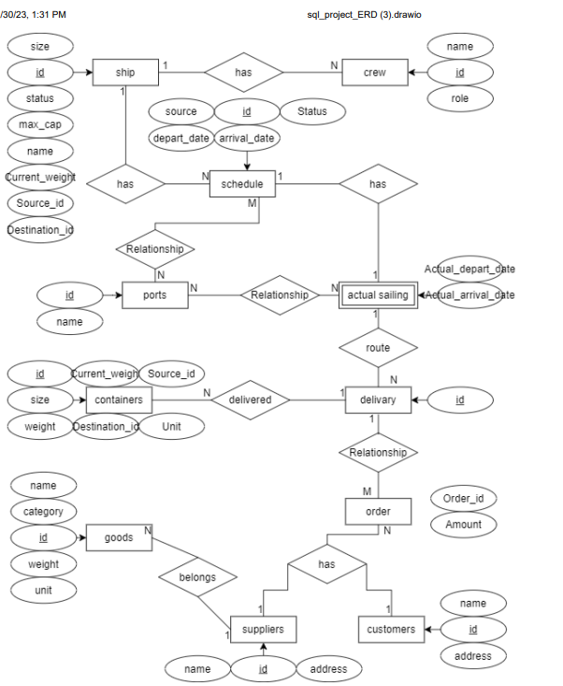
ERD

Slide 7
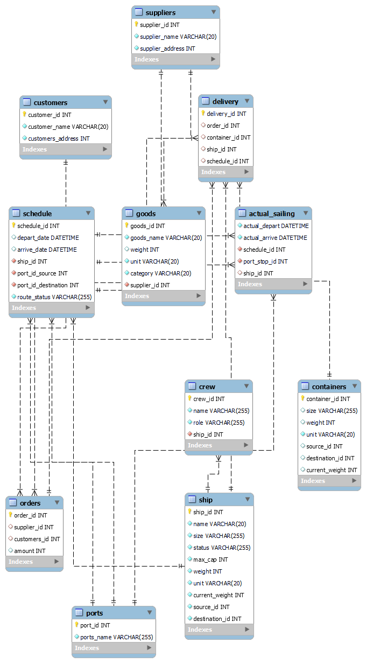
Physical ERD

Slide 8
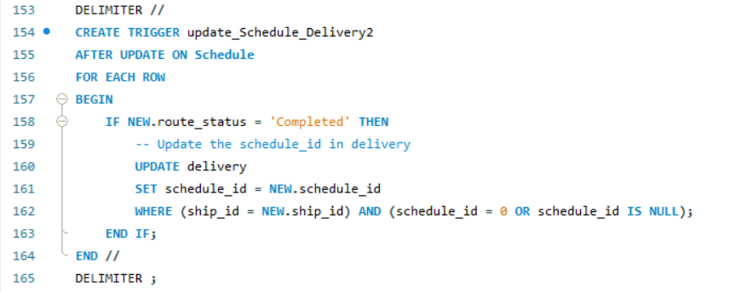
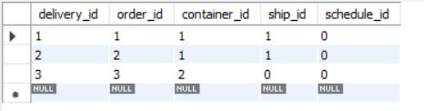
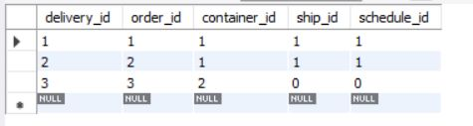
Triggers
before
after

Slide 9
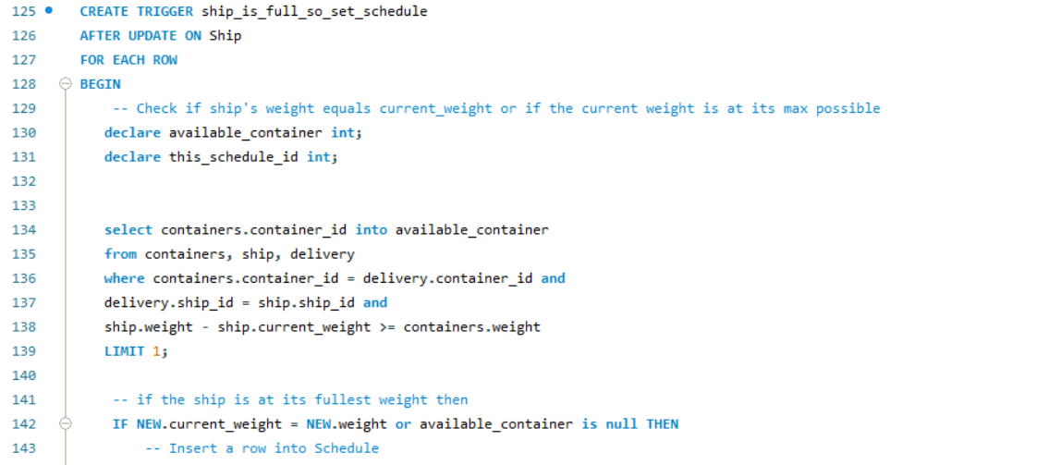
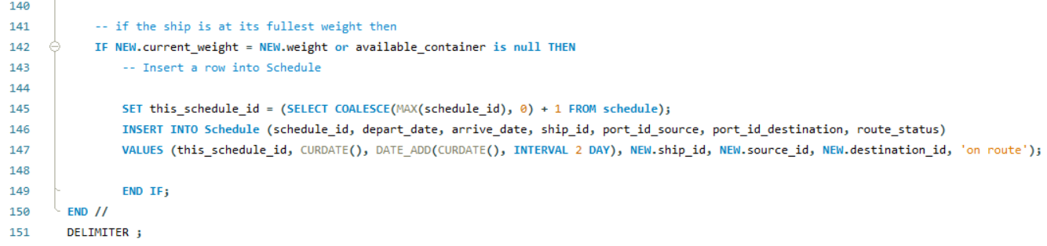
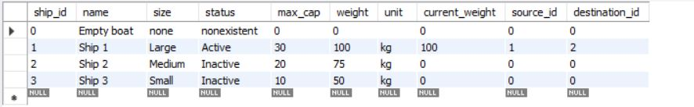
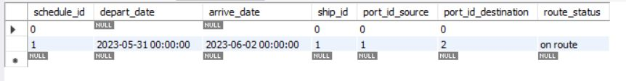
before
after

Slide 10
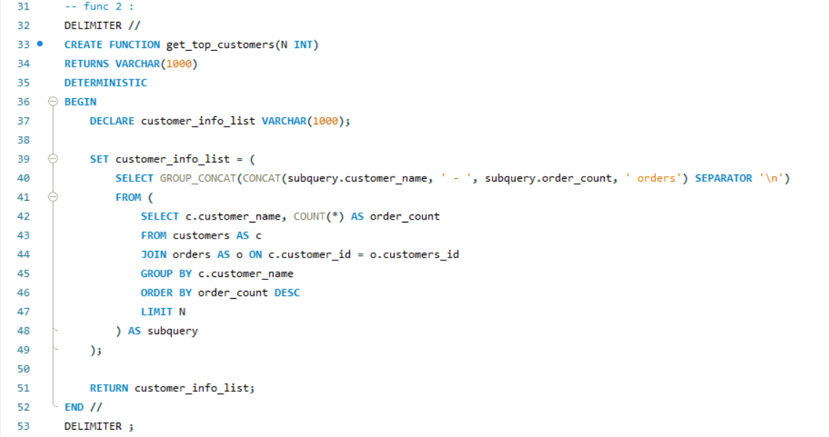
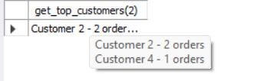
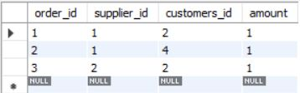
Functions

Slide 11
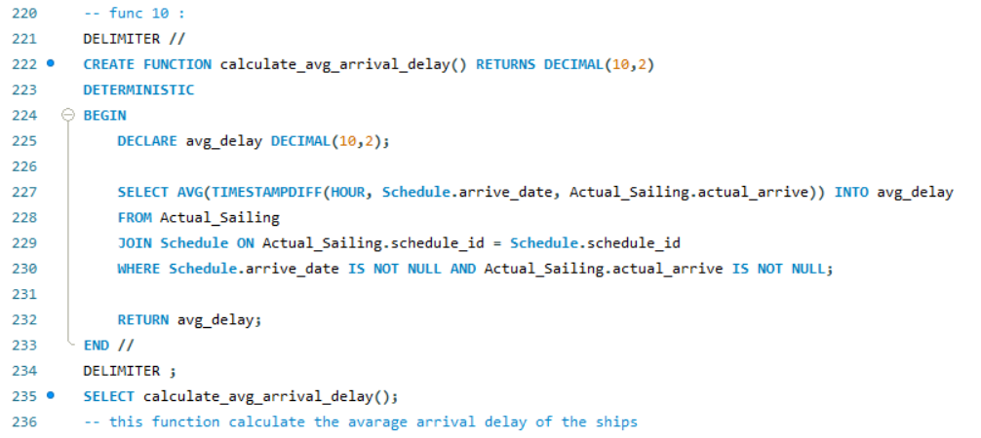

Functions

Slide 12
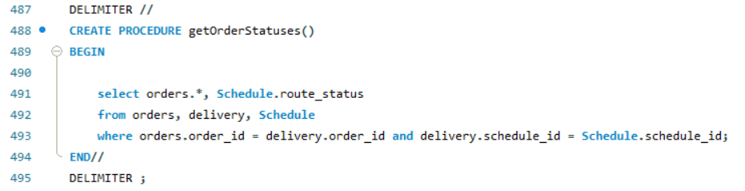
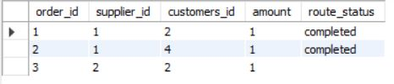
Procedures

Slide 13
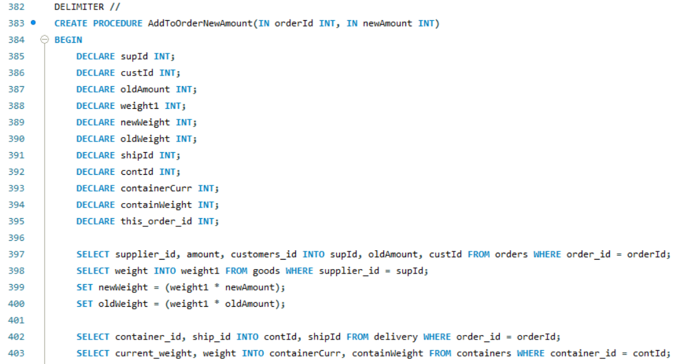
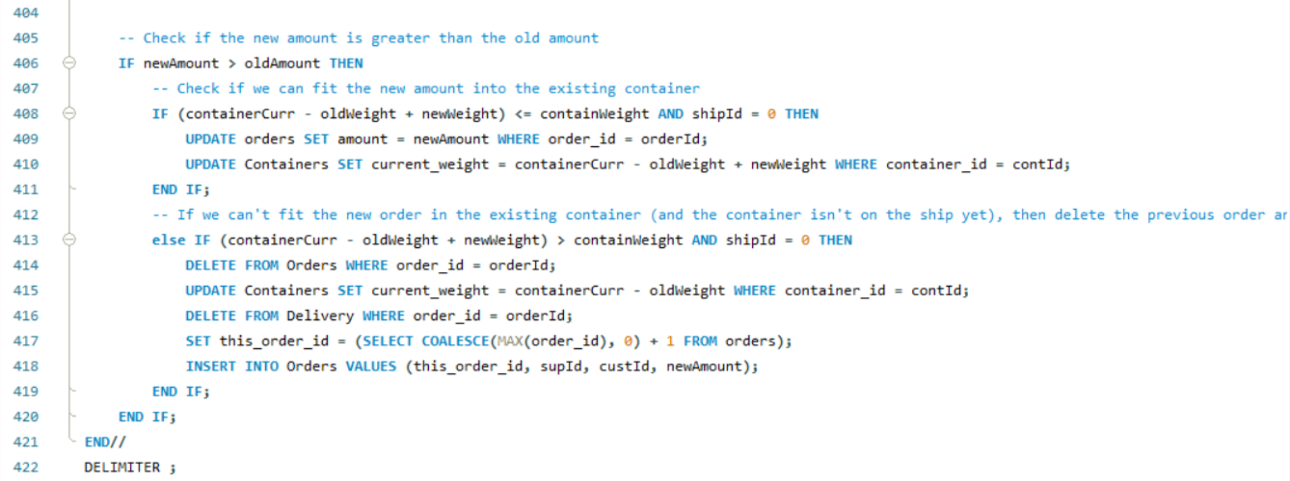


Slide 14
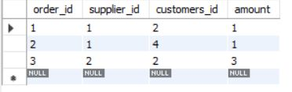
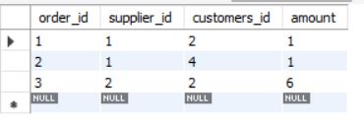
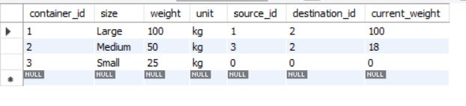
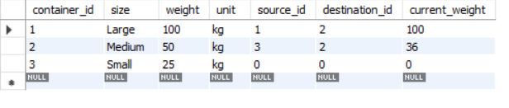
before
after
containers
before
after

Slide 15
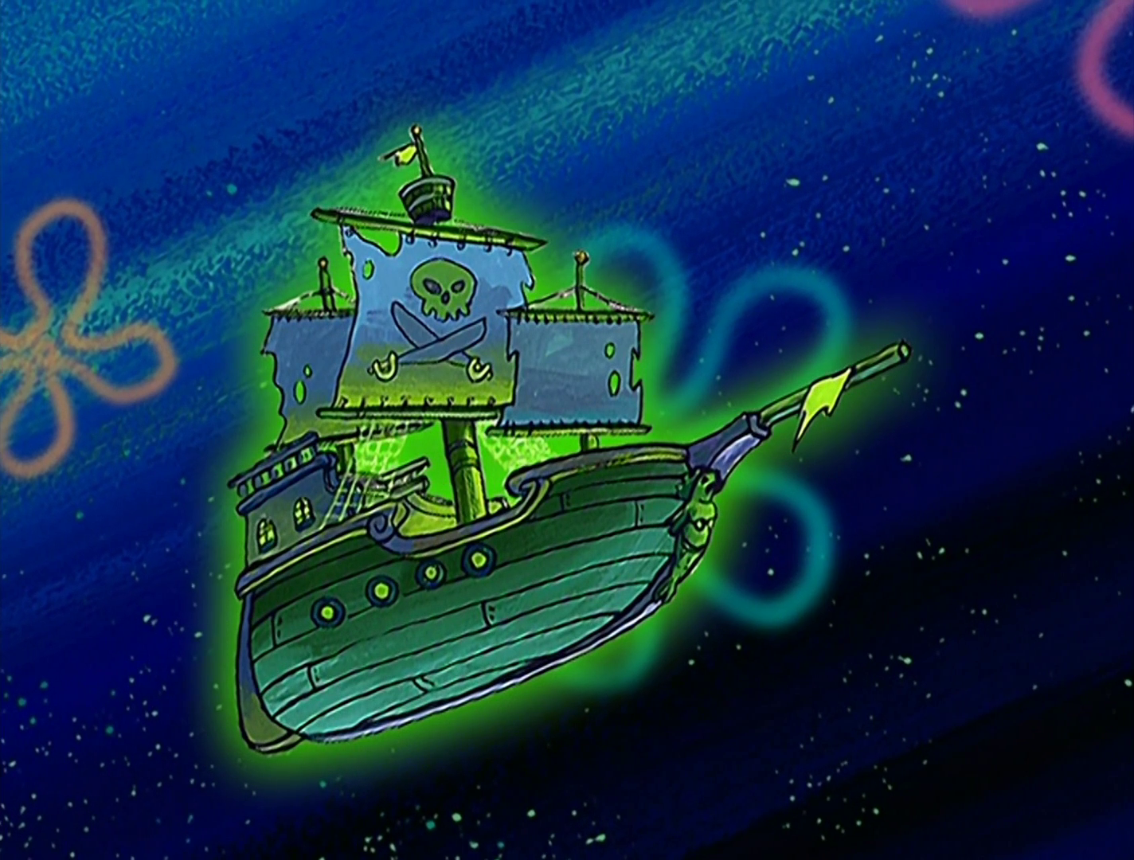
Thank You For Listening

