Slide 1
Learning Bilingual Lexicons from Monolingual Corpora
Aria Haghighi, Percy Liang,
Taylor Berg-Kirkpatrick and Dan Klein
Computer Science Division
University of California, Berkeley
TexPoint fonts used in EMF.
Read the TexPoint manual before you delete this box.: AAAAAAAAA

Slide 2

Standard MT Approach
Source
Text
Target
Text
Need (lots of) parallel sentences
May not always be available
Need (lots of) sentences
Notes:
Standard Approach: Need parallel sentences
The standard approach to machine translation requires a large amount of parallel sentence data.
While this approach is very effective, one shortcoming is that large parallel corpora may not be available for all language pairs or domains.

Slide 3
MT from Monotext
Source
Text
Target
Text
This talk: translation w/o parallel text?
Koehn and Knight (2002) & Fung (1995)
Need (lots of) sentences
Notes:
In this talk, we’ll be considering translation without parallel text. In particular, we’ll be assuming that we have access only to a source language corpora and a target language corpora. This setting has been considered before by blah.

Slide 4
Task: Lexicon Induction
Source Words
s
Target Words
t
Matching
m
state
estado
Source
Text
Target
Text
world
nombre
name
política
nation
mundo
Notes:
Our task will be bilingual lexicon induction. In this task we will consider a given a set of source words and set of target words and propose an at-most 1-1 matching between them. Today, we’ll present a generative model over matched lexicons and train it using EM.

Slide 5
Data Representation
Orthographic Features
state
#st
1.0
tat
1.0
te#
1.0
Source
Text
Context Features
world
20.0
politics
5.0
society
10.0
What are we generating?
Notes:
Our model will represent each word type as a feature vector derived only from the word-type and monotext. We’ll be using two types of features. Orthographic features which will consist of n-grams in the word as well as context fearture which represent counts words that occur near the word in text. Notice that although there are words in these ovals, there is no identity between the feature vector associated with the word and the word itself.

Slide 6
Data Representation
Orthographic Features
Orthographic Features
state
#st
1.0
estado
#es
1.0
tat
1.0
sta
1.0
te#
1.0
do#
1.0
Source
Text
Context Features
Target
Text
Context Features
world
20.0
mundo
17.0
politics
5.0
politica
10.0
society
10.0
sociedad
6.0
What are we generating?
Notes:
Of course we will extract features similarly for the target language. Now we have features vectors for words which lie in different vector space and we will need a way to be able to compare which can come from different languages.

Slide 7
Canonical Correlation Analysis
PCA
PCA
Source Space
Target Space
Notes:
A key technique of our model is Canoncial Correlation Analysis or (CCA), which is probably new to many of you. I’ll illustrate what it does with a brief example. Imagine, we have dataset of three paired points, 1, 2, and 3 and we want to have a low dimensional representation which

Slide 8
Canonical Correlation Analysis
2
1
3
3
2
1
2
1
PCA
PCA
1
2
3
3
Source Space
Target Space
Notes:
A key technique of our model is Canoncial Correlation Analysis or (CCA), which is probably new to many of you. I’ll illustrate what it does with a brief example. Imagine, we have dataset of three paired points, 1, 2, and 3 and we want to have a low dimensional representation which

Slide 9
Canonical Correlation Analysis
1
2
3
1
2
3
CCA
2
1
1
2
3
3
CCA
Source Space
Target Space
Notes:
A key technique of our model is Canoncial Correlation Analysis or (CCA), which is probably new to many of you. I’ll illustrate what it does with a brief example. Imagine, we have dataset of three paired points, 1, 2, and 3 and we want to have a low dimensional representation which

Slide 10
Canonical Correlation Analysis
Canonical Space
1
2
3
2
1
1
2
3
3
Source Space
Target Space
Notes:
A key technique of our model is Canoncial Correlation Analysis or (CCA), which is probably new to many of you. I’ll illustrate what it does with a brief example. Imagine, we have dataset of three paired points, 1, 2, and 3 and we want to have a low dimensional representation which

Slide 11
Canonical Correlation Analysis
Canonical Space
2
2
2
2
Source Space
Target Space
Notes:
A key technique of our model is Canoncial Correlation Analysis or (CCA), which is probably new to many of you. I’ll illustrate what it does with a brief example. Imagine, we have dataset of three paired points, 1, 2, and 3 and we want to have a low dimensional representation which

Slide 12
Generative Model
Source Words
s
Target Words
t
Matching
m
Notes:
I will no walk through the steps of our model…..
First, we generate a number of source and target word-types.

Slide 13
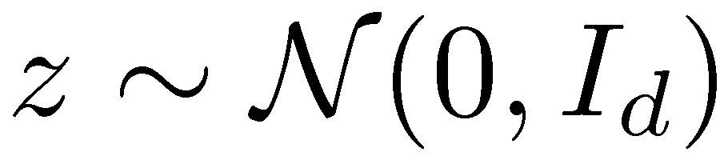





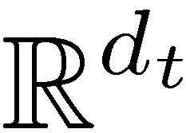
Generative Model
Canonical Space
state
estado
Source Space
Target Space
Notes:
Now we’re going to generate matched words. These words will be generated from a canonical space by a vector, let’s call it z. We have to choose z in some way, so welll draw it from a unit-normal multivariate gaussian. Then, we will generate source and target word vectors from z using matrices W_s and W_t, which each encode how to transform between canonical space and source and target space respectively. This process corresponds to the probabilstic version of cca.

Slide 14
Generative Model
Source Words
s
Target Words
t
Matching
m
state
estado
world
nombre
name
politica
nation
mundo
Notes:
I will no walk through the steps of our model…..
First, we generate a number of source and target word-types.

Slide 15

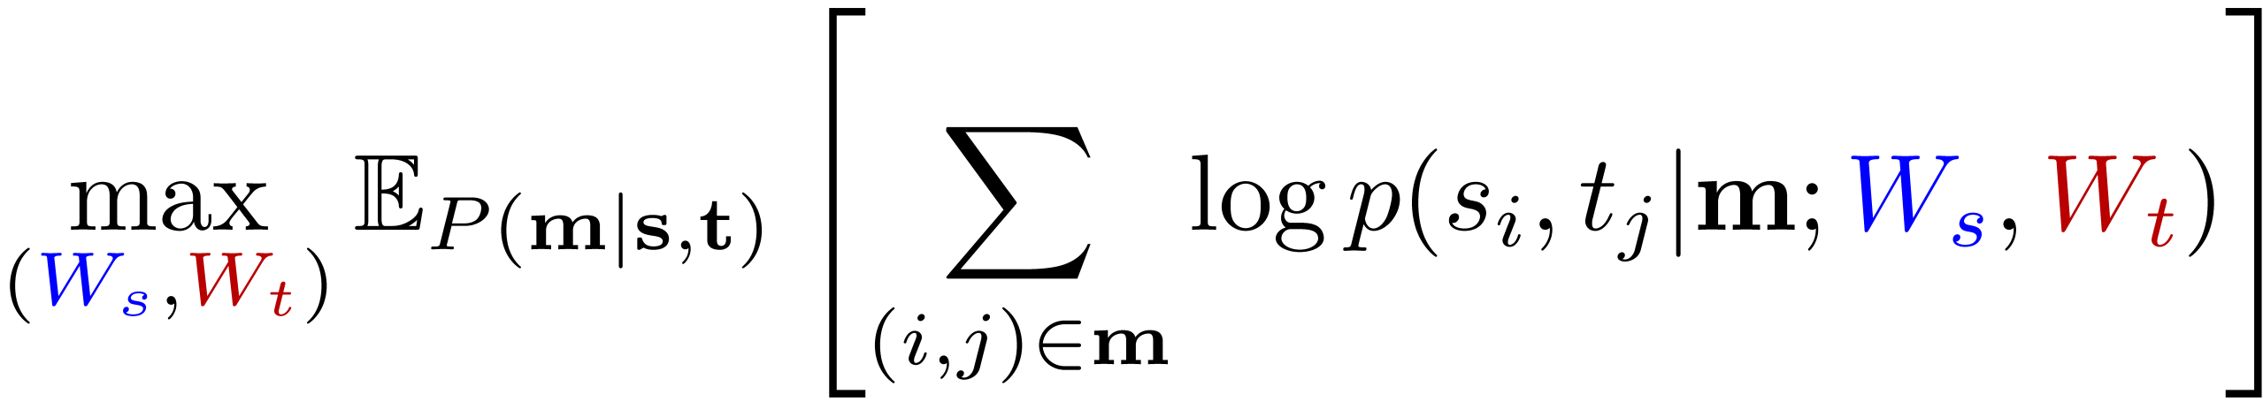
Learning: EM?
E-Step: Obtain posterior over matching
M-Step: Maximize CCA Parameters

Slide 16

Learning: EM?
Getting expectations over matchings
is #P-hard! See John DeNero’s paper
“The Complexity of Phrase Alignment Problems”
0.2
..
0.30
0.30
..
0.15
0.10

Slide 17
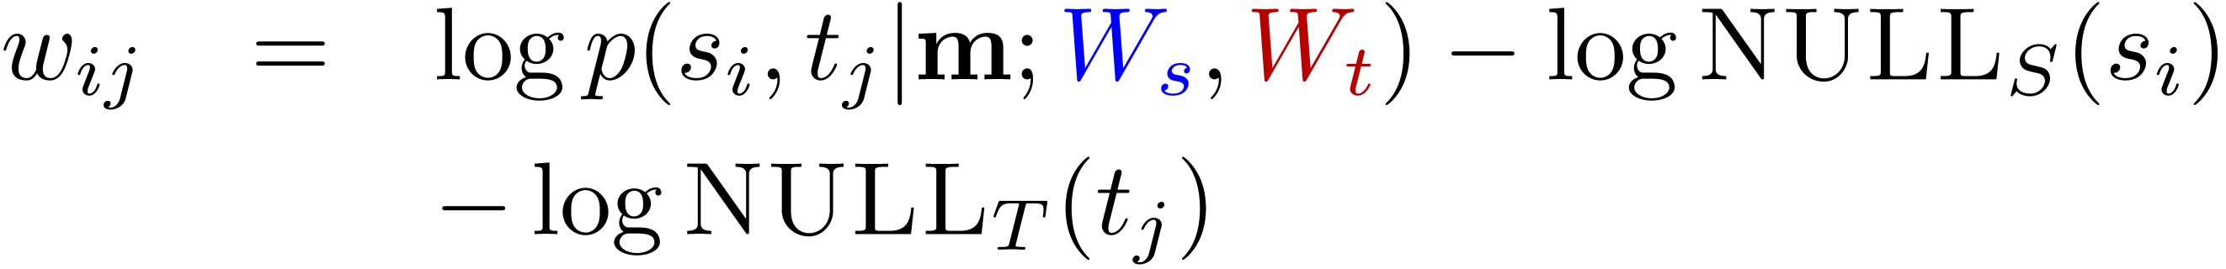
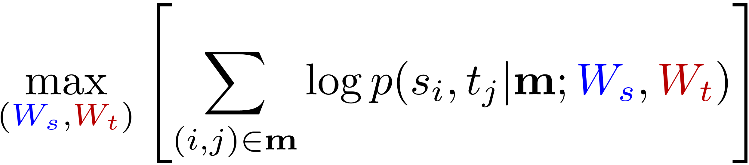
Inference: Hard EM
Hard E-Step: Find bipartite matching
M-Step: Solve CCA

Slide 18
Experimental Setup
Nouns only (for now)
Seed lexicon – 100 translation pairs
Induce lexicon between top 2k source and target word-types
Evaluation: Precision and Recall against lexicon obtained from Wiktionary
Report p_{0.33}, precision at recall 0.33
Notes:
Transition.

Slide 19
Feature Experiments
Baseline: Edit Distance
Precision
4k EN-ES Wikipedia Articles

Slide 20
Feature Experiments
MCCA: Only orthographic features
Precision
4k EN-ES Wikipedia Articles

Slide 21
Feature Experiments
MCCA: Only Context features
Precision
4k EN-ES Wikipedia Articles

Slide 22
Feature Experiments
MCCA: Orthographic and context features
Precision
4k EN-ES Wikipedia Articles

Slide 23
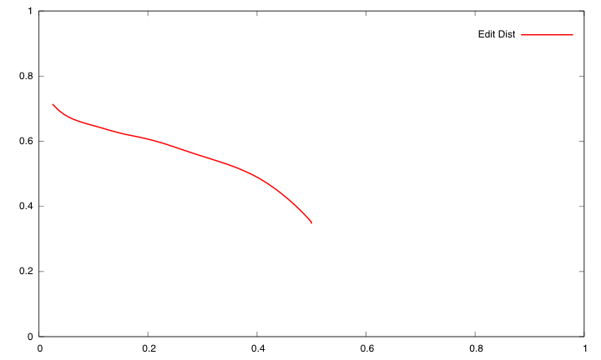
Feature Experiments
Precision
Recall

Slide 24
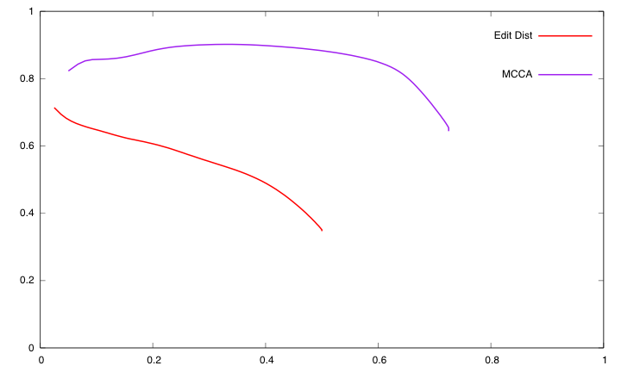
Feature Experiments
Precision
Recall

Slide 25
Corpus Variation
Identical Corpora
93.8
Precision
100k EN-ES Europarl Sentences

Slide 26
Corpus Variation
Comparable Corpora
¼
Precision
4k EN-ES Wikipedia Articles

Slide 27
Corpus Variation
Unrelated Corpora
?
92
89
Precision
68
100k English and Spanish Gigaword

Slide 28
Seed Lexicon Source
Automatic Seed
Use edit distance to induce seed lexicon as in
Koehn & Knight (2002)
92
Precision
4k EN-ES Wikipedia Articles

Slide 29
Analysis
Notes:
Replace tables with inplace ppt

Slide 30
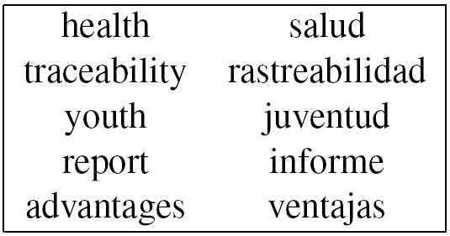
Analysis
Top Non-Cognates

Slide 31
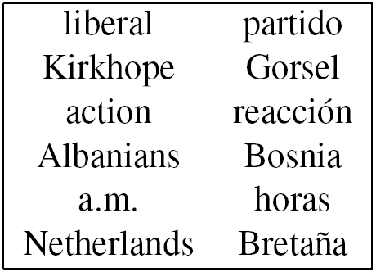
Analysis
Interesting Mistakes

Slide 32
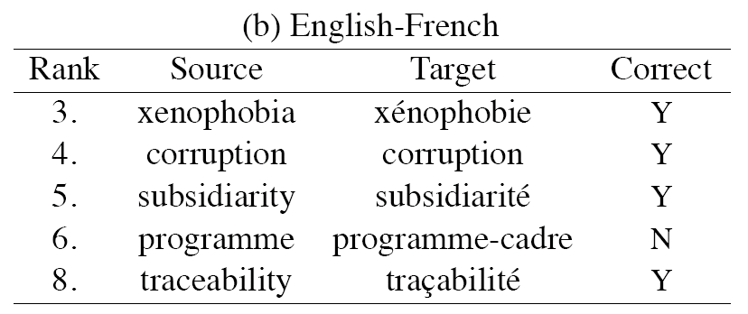
Language Variation

Slide 33
Language Variation

Slide 34
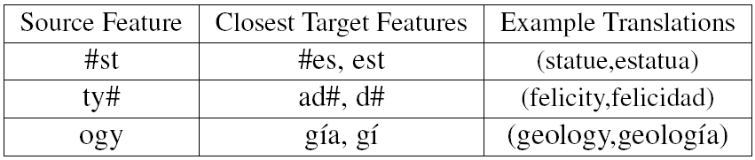
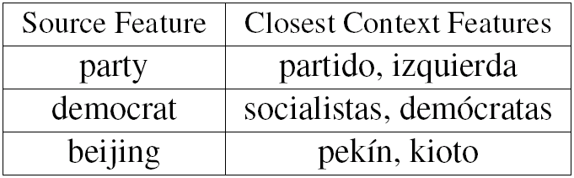
Analysis
Orthography Features
Context Features

Slide 35
Summary
Learned bilingual lexicon from monotext
Matching + CCA model
Possible even from unaligned corpora
Possible for non-related languages
High-precision, but much left to do!

Slide 36
Thank you!
http://nlp.cs.berkeley.edu

Slide 38
Error Analysis
Top 100 errors
21 correct translations not in gold
30 were semantically related
15 were orthographically related (coast,costas)
30 were seemingly random

Slide 39
Bleu Experiment
On English-French only 1k parallel sentences
Without lexicon BLEU: 13.61
With lexicon BLEU: 15.22

Slide 40
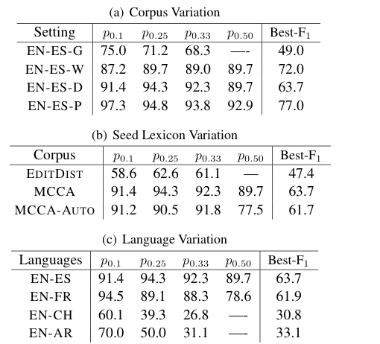
More Numbers

Slide 42
Conclusion
Three cases of unsupervised learning in NLP
Unsupervised systems can be competitive with supervised systems
Future problems
Document summarization
Building MindNet-like resources
Discourse Analysis

Slide 43
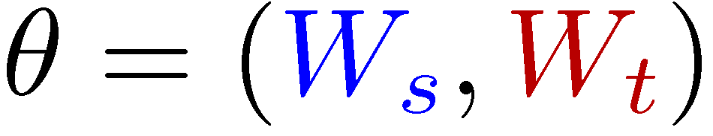
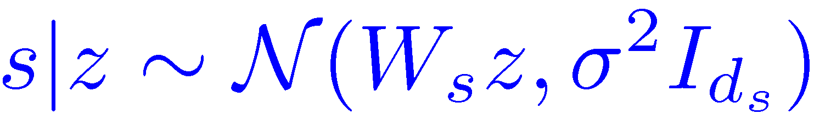
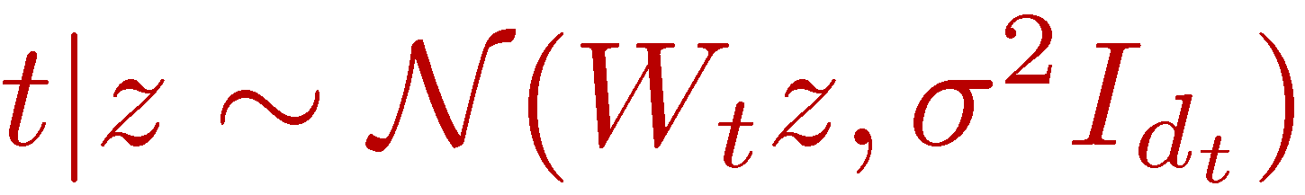
Generative Model
Orthographic Features
#st
1.0
tat
1.0
te#
1.0
Latent Space
Context Features
world
20.0
politics
5.0
society
10.0
state
estado
Source Space
Target Space
Generate Matched Words

Slide 44
Generative Model
Orthographic Features
#st
1.0
tat
1.0
te#
1.0
Latent Space
Context Features
world
20.0
politics
5.0
society
10.0
state
state
estado
Source Space
Target Space
Generate Matched Words

Slide 45
Translation Lexicon Induction
Source Words
s
Target Words
t
Matching
m
Source
Text
state
estado
Target
Text
world
nombre
name
mundo

Slide 46
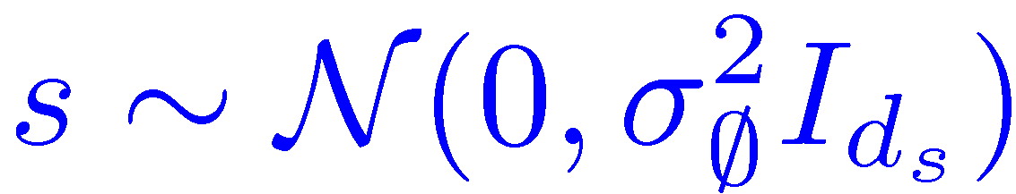
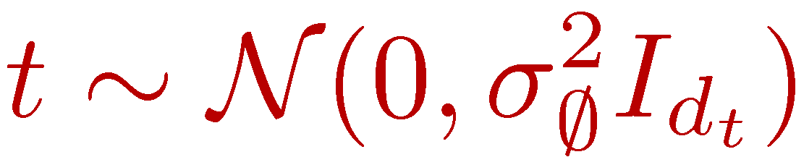
Generative Model
For each matched word pair:
For each unmatched source word:
For each unmatched target word:

Slide 47
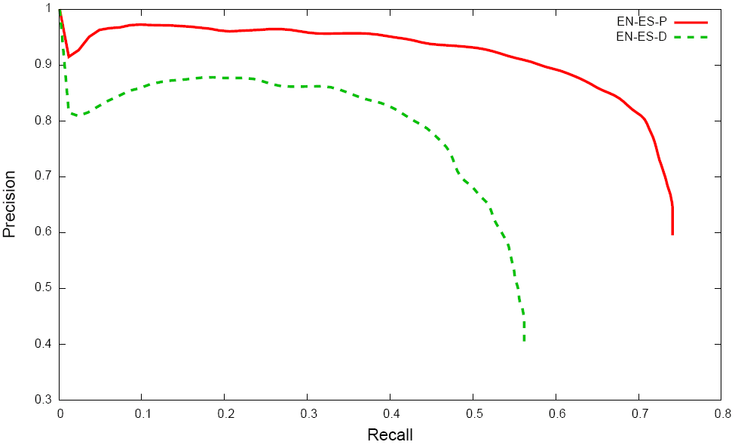
Results: Accuracy

Slide 48
Corpus Variation
Disjoint Sentences

Slide 49
Corpus Variation
Unrelated
?

Slide 50
Machine Translation
Source
Text
Target
Text

Slide 51
Machine Translation
Source
Text
Target
Text

Slide 52
Machine Translation
Source
Text
Target
Text
Source Word | Target Word | P(T | S)
state | estado | 0.98
world | mundo | 0.97
name | nombre | 0.99
What are we generating?

Slide 53
Canonical Correlation Analysis
Canonical Space
1
2
3
1
2
PCA
PCA
3
2
1
3
CCA
CCA
Source Space
Target Space

Slide 54
Corpus Variation
Unrelated Corpora

Slide 55
Inference: EM?
E-Step: Compute matching posteriors
M-Step: Estimate

Slide 56
Data Representation
Orthographic Features
Orthographic Features
state
#st
1.0
estado
#es
1.0
tat
1.0
sta
1.0
te#
1.0
do#
1.0
What are we generating?
Source
Text
Context Features
Target
Text
Context Features
world
20.0
mundo
17.0
politics
5.0
politica
10.0
society
10.0
sociedad
6.0
Notes:
Now, I’m going to walk you through gen. model

Slide 57
Language Variation

Slide 58
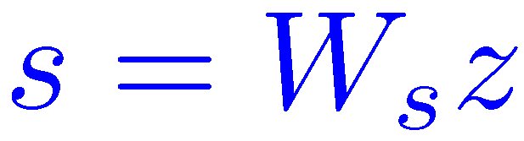
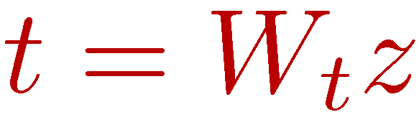
Generative Model
Latent Space
Generate matched word vectors
state
estado
Source Space
Target Space

Slide 59
Generative Model
Source Words
s
Target Words
t
Matching
m
state
estado
Generate unmatched word vectors
world
nombre
name
política
nation
mundo

Slide 60
Results: Example Matches

Slide 61
Results: Examples
Top Non-Cognates
Interesting Mistakes

Slide 62
Canonical Correlation Analysis
Canonical Space
1
2
3
1
2
PCA
PCA
PCA
PCA
2
3
1
3
CCA
CCA
Source Space
Target Space
Notes:
A key technique of our model is Canoncial Correlation Analysis or (CCA), which is probably new to many of you. I’ll illustrate what it does with a brief example. Imagine, we have dataset of three paired points, 1, 2, and 3 and we want to have a low dimensional representation which

Slide 63
Generative Model
Source Words
s
Target Words
t
Matching
m
state
estado
world
nombre
name
política
nation
mundo
Notes:
Not that there are no parameters used to generate null words.

Slide 64
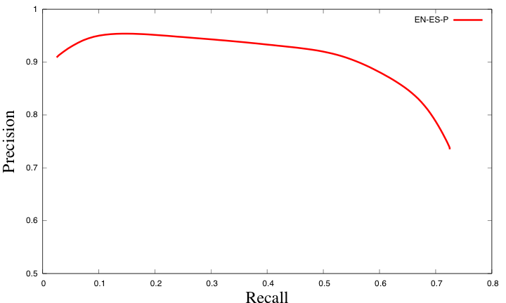
Corpus Variation
Identical Corpora
p_{0.33}
89.0
Precision
Recall
100k EN-ES Europarl Sentences

