Slide 1


Slide 2
Dart Variables
Variable is used to store the value and refer the memory location
in computer memory.
The variable cannot contain special characters such as whitespace, mathematical symbol, runes, Unicode character, and keywords.
The first character of the variable should be an alphabet([A to Z],[a to z]). Digits are not allowed as the first character.
Variables are case sensitive. For example, - variable age and AGE are treated differently.
The special character such as #, @, ^, &, * are not allowed expect the underscore(_) and the dollar sign($).
The variable name should be retable to the program and readable.

Slide 3
Dart Data Types
Number
Strings
Boolean
Lists
Maps

Slide 4
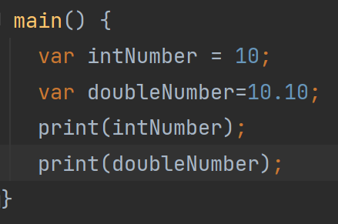
Dart Number
Integer - Integer values represent the whole number or non-fractional values.
Double - Double value represents the floating number or number with the large decimal points.

Slide 5
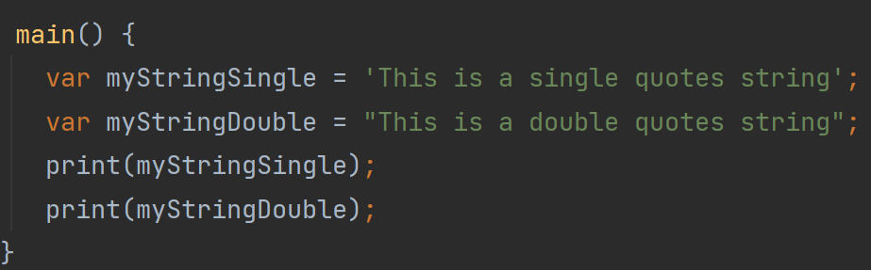
Dart String
String - A string is the sequence of the character. If we store the data like – name,
address, special character, etc. It is signified by using either single quotes or double quotes.

Slide 6
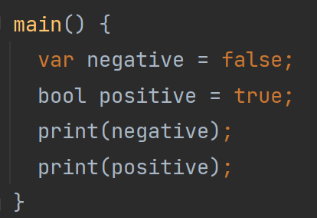
Dart Boolean
The Boolean type represents the two values - true and false.
The bool keyword uses to denote Boolean Type.
The numeric values 1 and 0 cannot be used to represent the true or false value.

Slide 7
Dart Boolean
The Boolean type represents the two values - true and false.
The bool keyword uses to denote Boolean Type.
The numeric values 1 and 0 cannot be used to represent the true or false value.

Slide 8
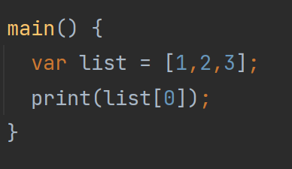
Dart Lists
The list is a collection of the ordered objects (value). The concept of list is similar to an array.
An array is defined as a collection of the multiple elements in a single variable.
The elements in the list are separated by the comma enclosed in the square bracket[].

Slide 9
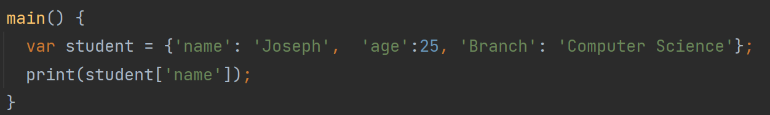
Dart Maps
The maps type is used to store values in key-value pairs. Each key is associated with its value.
The key and value can be any type. In Map, the key must be unique, but a value can occur multiple times.
The Map is defined by using curly braces ({}), and comma separates each pair.

Slide 10
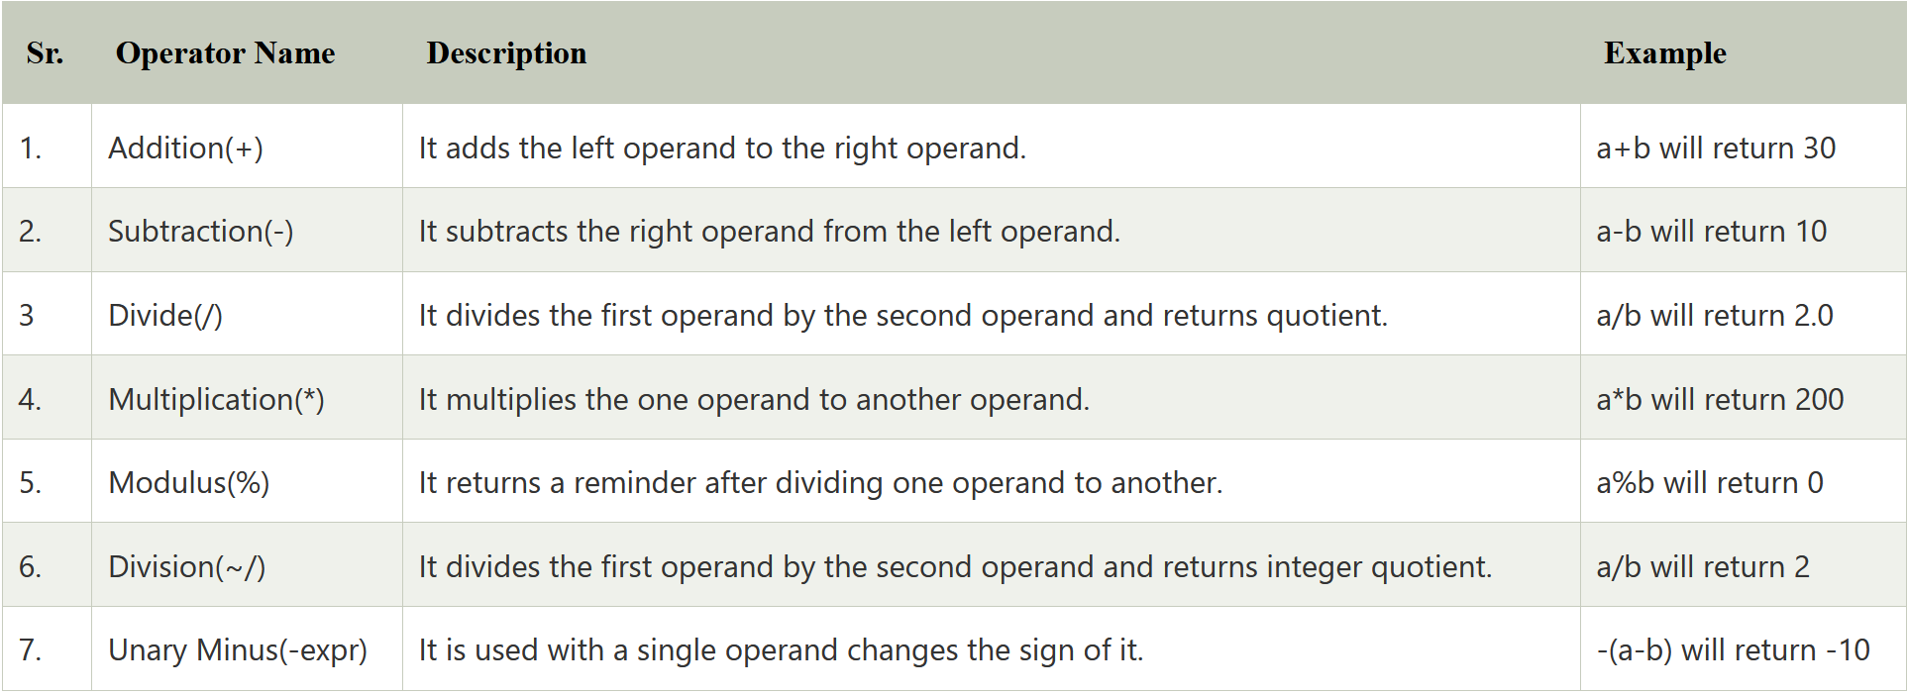
Dart Operators (Arithmetic Operators)

Slide 11
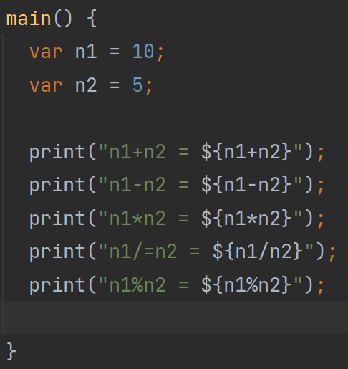
Dart Operators (Arithmetic Operators)

Slide 12
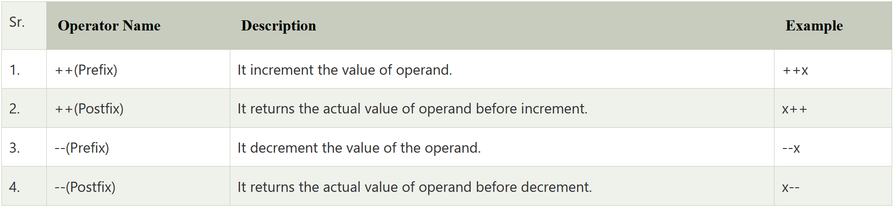
Dart Operators (Unary Operators)

Slide 13
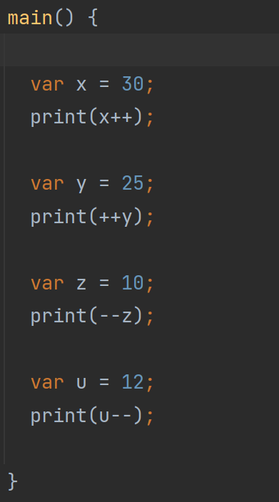
Dart Operators (Unary Operators)

Slide 14
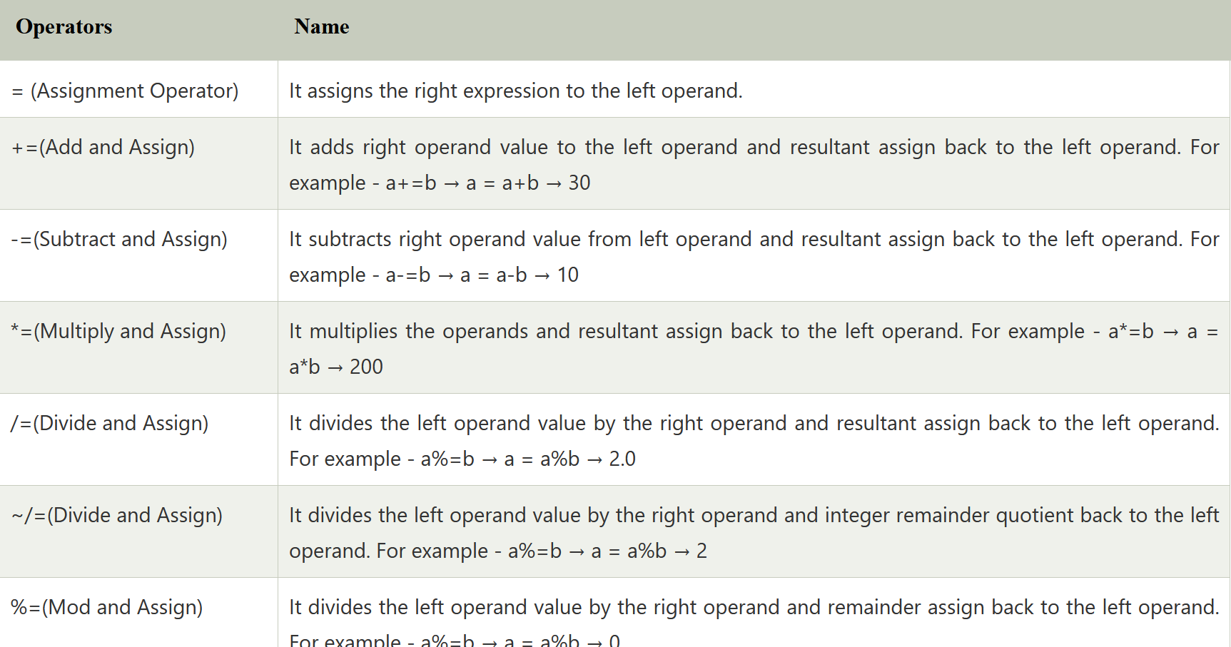
Dart Operators (Assignment Operator)

Slide 15
Dart Operators (Assignment Operator)

Slide 16
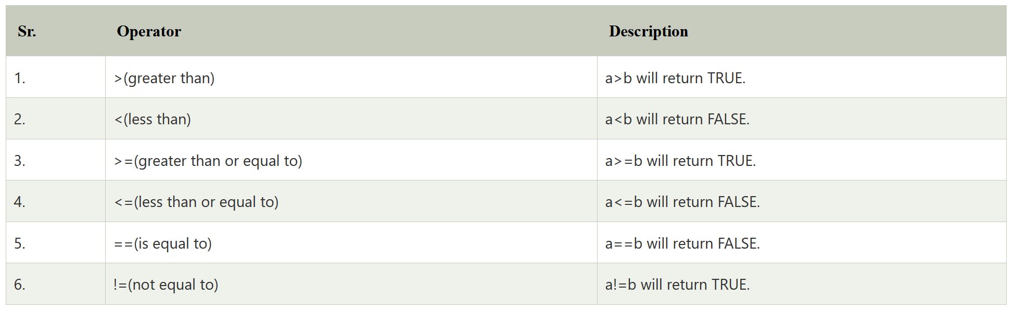
Dart Operators (Relational Operator)

Slide 17
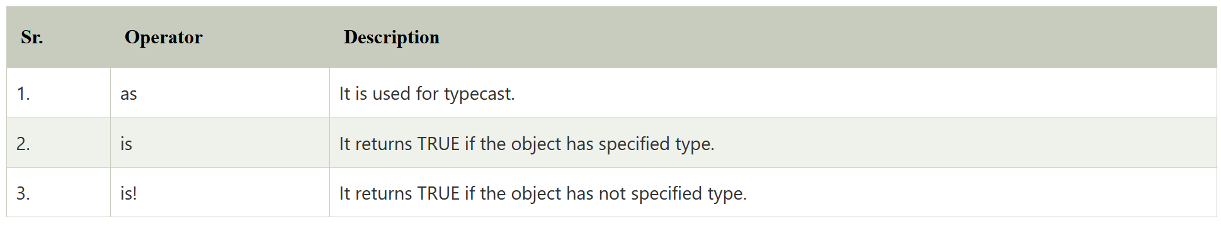
Dart Operators (Type Test Operators)

Slide 18
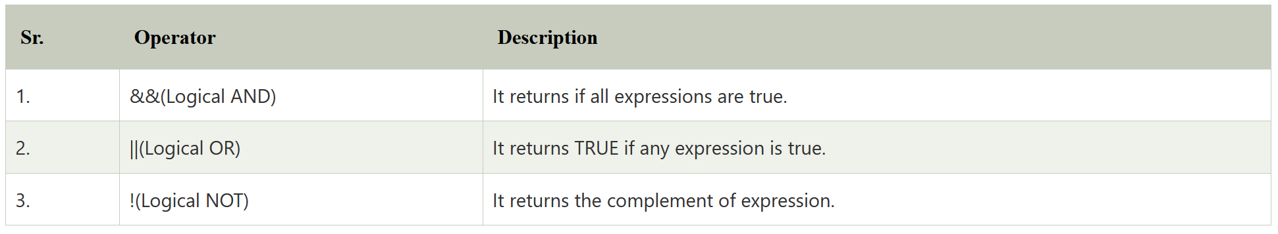
Dart Operators (Logical Operators)

Slide 19
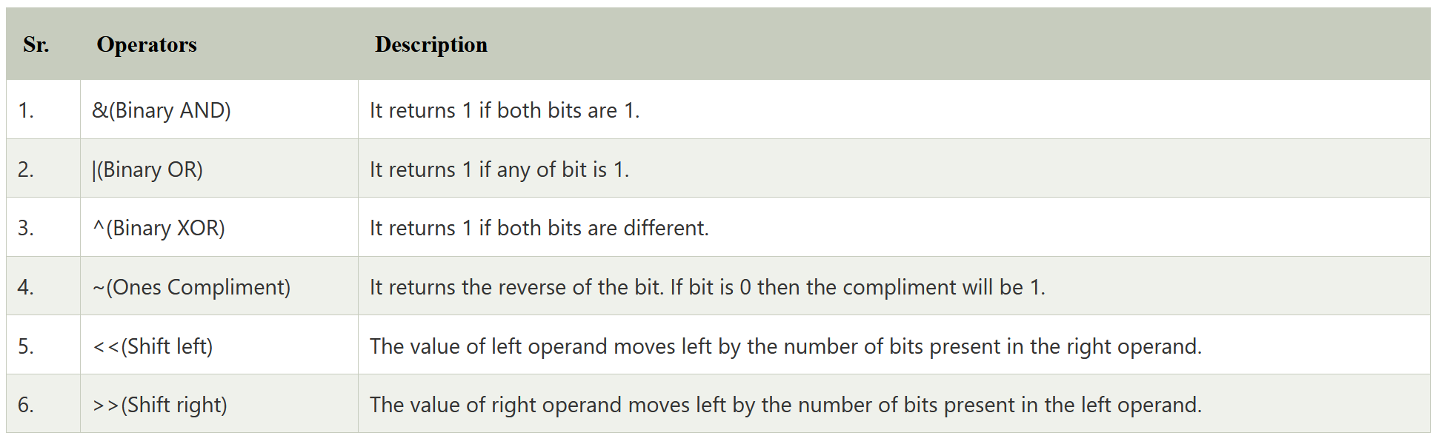
Dart Operators (Bitwise Operators)

Slide 20
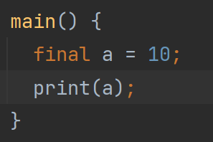
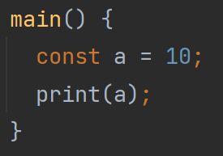
Dart Constants
Dart Constant is defined as an immutable object
Which means it can't be changed or modified during the execution of the program.
Once we initialize the value to the constant variable, it cannot be reassigned later.
The Dart constant can be defined in the following two ways.
Using the final keyword
Using the const keyword

