Slide 1


Slide 2
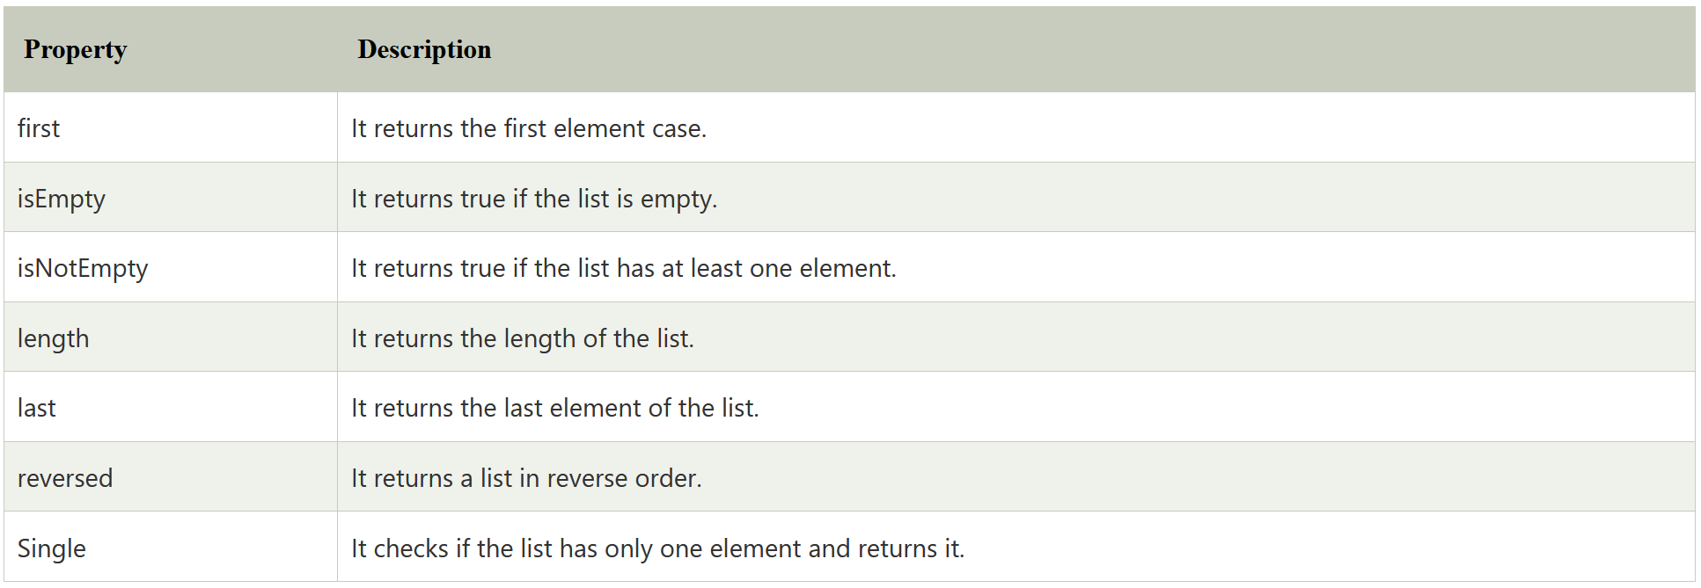
List Properties

Slide 3
Types of Lists
List can be categorized into two types -
Fixed Length List
Grow able List

Slide 4
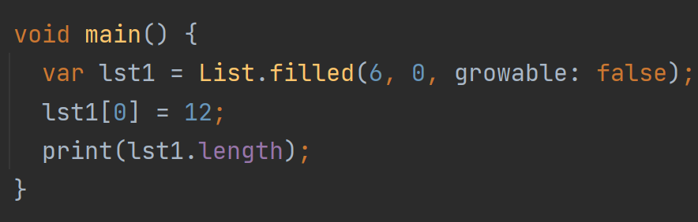
Fixed Length List
The fixed-length lists are defined with the specified length.
We cannot change the size at runtime.

Slide 5
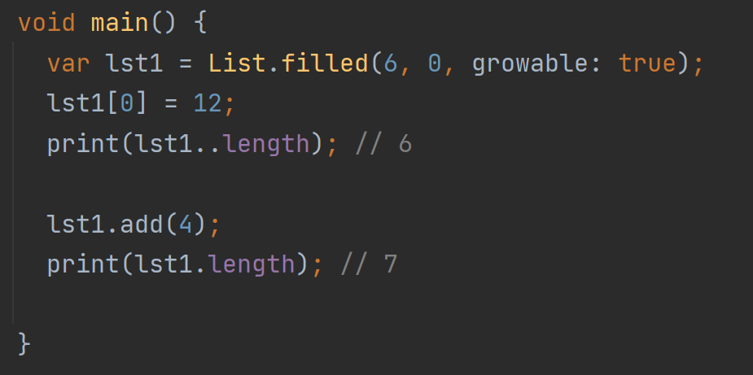
Grow able List
The list is declared without specifying size is known as a Grow able list.
The size of the Grow able list can be modified at the runtime.

Slide 6
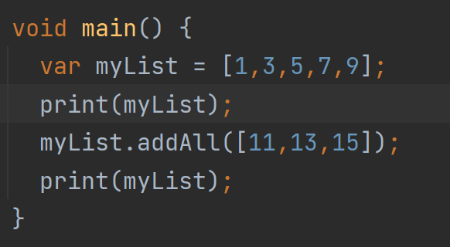
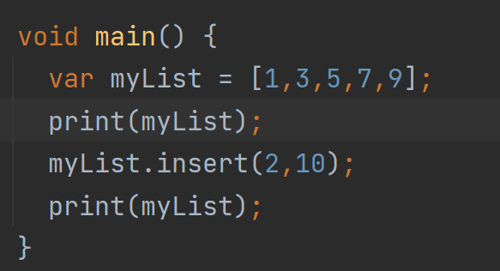
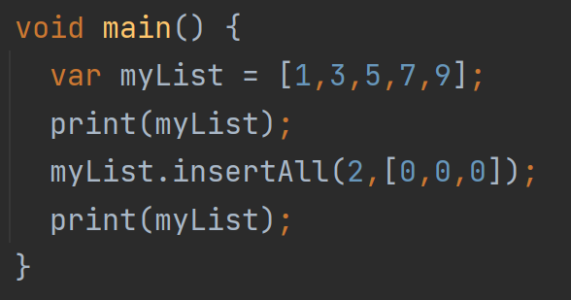
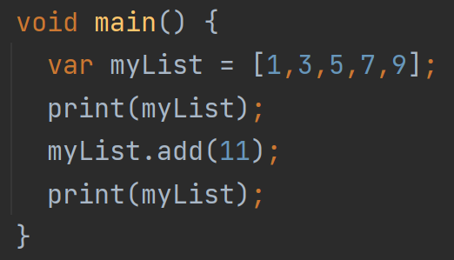
List Insert
Dart provides four methods which are used to insert the elements into the lists. These methods are given below.
add()
addAll()
insert()
insertAll()

Slide 7
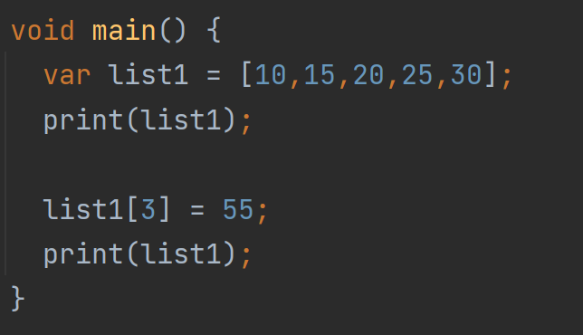
Updating List
list_name[index] = new_value;

Slide 8
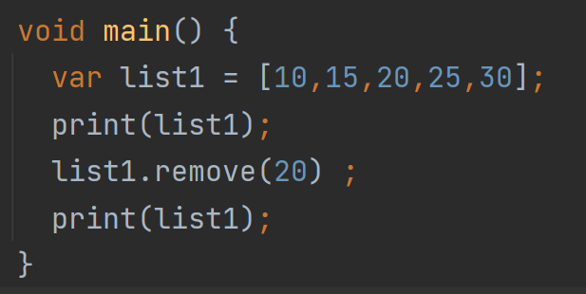
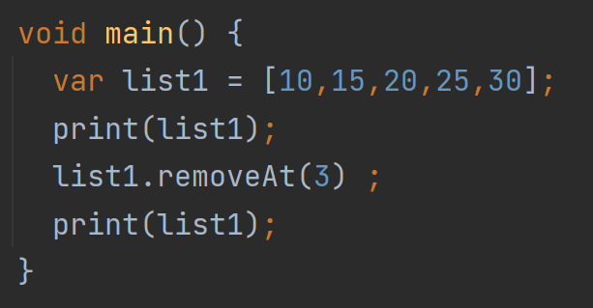
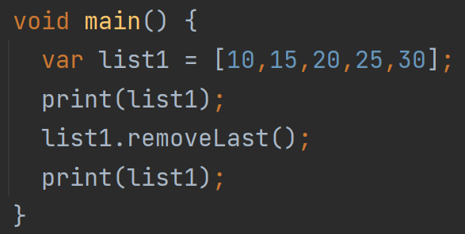
Removing List Elements
The Dart provides following functions to remove the list elements.
remove()
removeAt()
removeLast()
removeRange()

