Slide 1


Slide 2
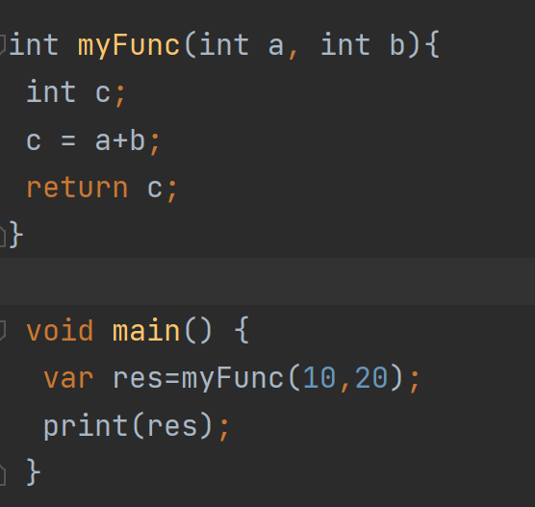
Function parts
Let's understand the general syntax of the defining function
return_type - It can be any data type such as void, integer, float, etc. The return type must be matched with the returned value of the function.
func_name - It should be an appropriate and valid identifier.
parameter_list - It denotes the list of the parameters, which is necessary when we called a function.
return value - A function returns a value after complete its execution.

Slide 3
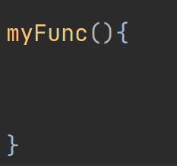
Defining a Function
A function can be defined by providing the name of the function with the appropriate parameter and return type. A function contains a set of statements which are called function body.

Slide 4
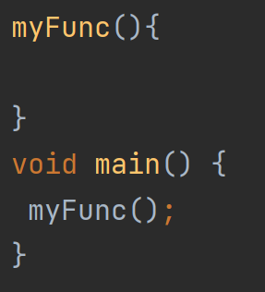
Calling a Function
After creating a function, we can call or invoke the defined function inside the main() function body

Slide 5
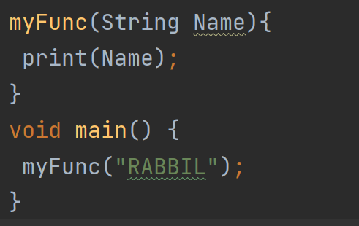
Passing Arguments to Function
When a function is called, it may have some information as per the function prototype is known as a parameter (argument).

Slide 6
Function Return & Return Type
It can be any data type such as void, integer, float, etc. The return type must be matched with the returned value of the function.
A function returns a value after complete its execution.

Slide 7
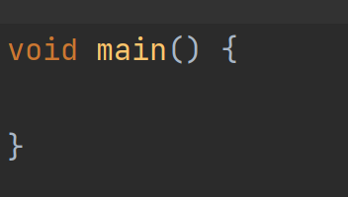
The main() function
The main() function is the top-level function of the Dart.
It is the most important and vital function of the Dart programming language.
The execution of the programming starts with the main() function.
The main() function can be used only once in a program.

Slide 8
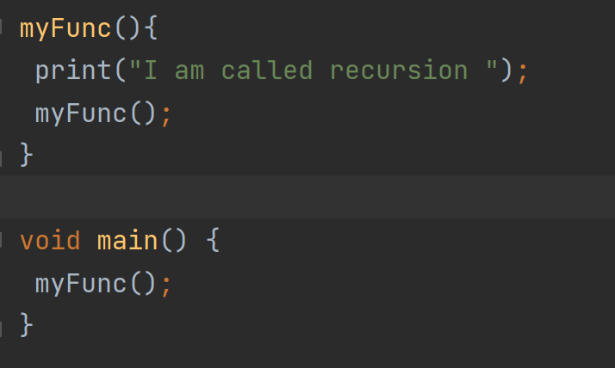
Function Recursion
Dart Recursion is the method where a function calls itself as its subroutine.
It is used to solve the complex problem by dividing it into sub-part.
A function which is called itself again and again or recursively, then this process is called recursion.

