Slide 1


Slide 2
Dart Object-Oriented Concepts
Dart is an object-oriented programming language, and it supports all the concepts of object-oriented programming such as classes, object, inheritance, mixin, and abstract classes.
Class
Object
Inheritance
Polymorphism
Interfaces
Abstract class

Slide 3
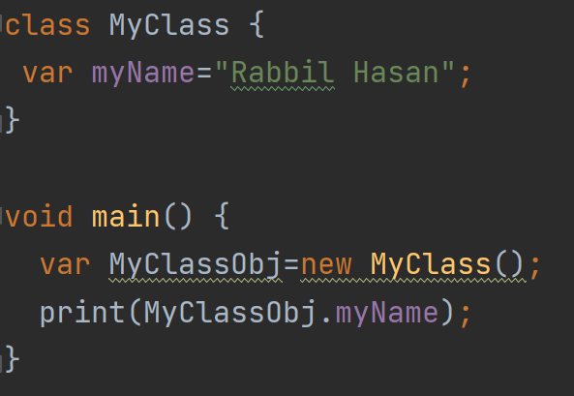
Dart Class
Dart classes are defined as the blueprint of the associated objects. A Class is a user-defined data type that describes the characteristics and behavior of it. To get all properties of the class, we must create an object of that class.

Slide 4
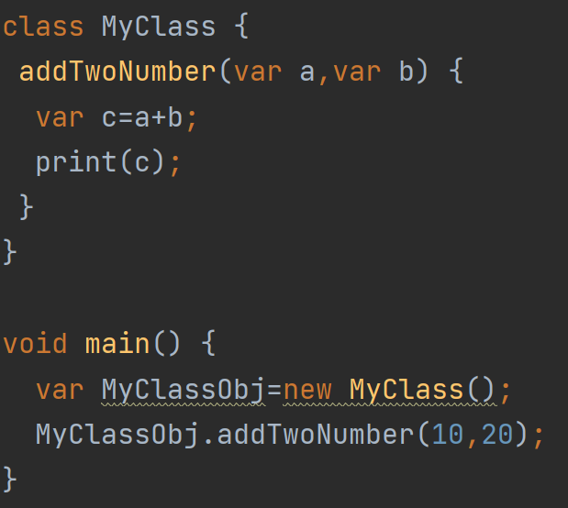
Accessing Variable & Function From Class
Accessing Variable
Accessing Function

Slide 5
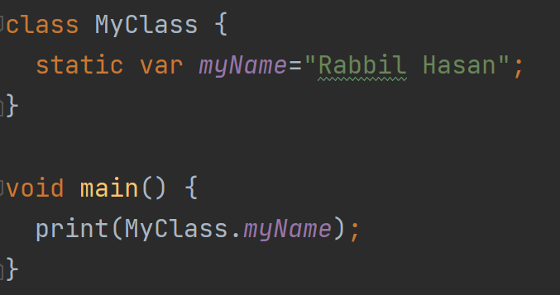
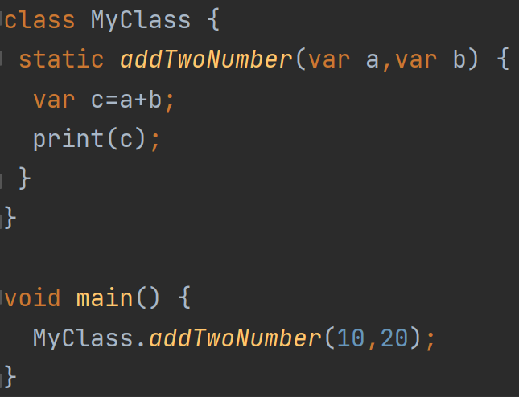
Accessing Static Variable & Function From Class
Accessing Static Variable
Accessing Static Function

Slide 6
Accessing Static Variable & Function From Class
Accessing Static Variable
Accessing Static Function

Slide 7
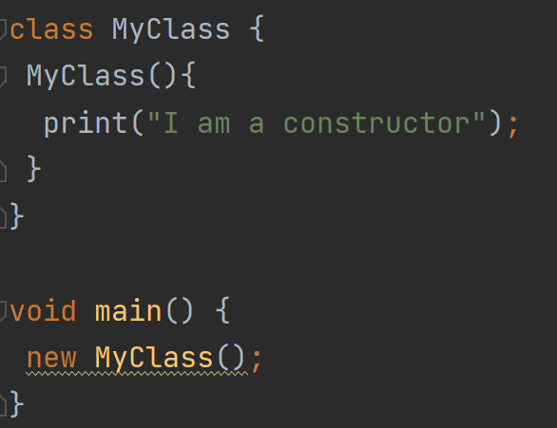
Class Constructor
A constructor is a different type of function which is created with same name as its class name. The constructor is used to initialize an object when it is created.
Constructor has no return type
Constructor can have parameter
Constructor execute automatically

